Slide 1
FAMILY TREE FUN TIME
Introducing Kids to Genealogy
Cate Nicholls
Barrie Public Library
Prepared for OLA Genealogy Boot Camp for Librarians
OGS Conference 2016

Slide 2
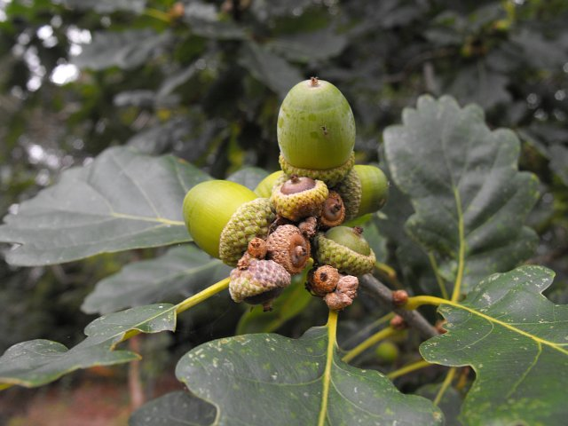
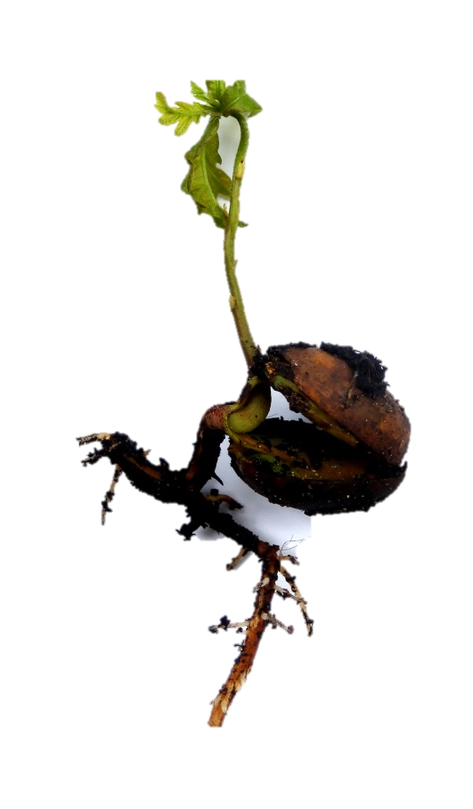
Planting the seed.
Nourishing the seed.
Growing the seed.
Pruning the tree.
Enjoy the fruit of the tree, all from a little seed.
Notes:
For our discussion today we are going to use the analogy of planting a seed for an oak tree. The word “tree” is widely used in genealogical circles.

Slide 3
Planting the seed.
What do we want to have happen?
Why?
Introduce children/teens to genealogy
Define genealogy?
How are we going to accomplish this goal?
Notes:
Using the analogy of planting a tree from a seed, we can look at programming aimed at introducing children and teens to genealogy at the library. Planting (idea) is the first step, so start with the questions—What do we want to have happen? Why? How are we going to accomplish this? For our purposes, we want an introduction to genealogy. What do we mean by this term genealogy?

Slide 4
Nourishing the seed.
Program Planning-When? How?
Outreach
Ages?
Series? One-off?
Special events?
Holidays?
Drop-in? Registered?
Advertising
Existing programs?
Resources?
Community?
Notes:
Once the seed is planted, it will need water to soften the shell to sprout. Questions are the water to help develop the program.

Slide 5
Growing the seed.
Tilling and preparation
Wrap it up
Special Events
Themes
Holidays/Celebrations
TD Summer Reading
Clubs
Notes:
Once some of the basic questions are answered and program planning begins with when and how, we need to narrow down specifics. Resources provide structure and may help determine the when and how of program planning. What resources are available? Community partnerships? Existing programs? Of course, the program needs to have appeal and be fun.

Slide 6
Pruning the tree
cost
space
who
time
advertising
handouts
training

Slide 7
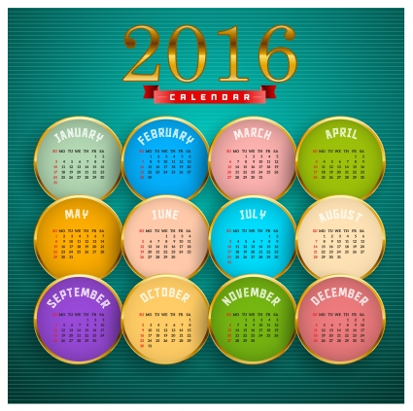
By the Month
Notes:
What events/holidays are celebrated/recognized monthly that you may be able to use to introduce genealogy?

Slide 8
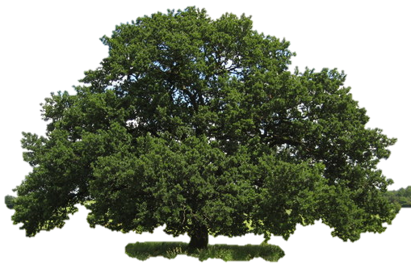
Tips and Templates
Genealogy begins with__________?
Ask yourself-What do we want to have happen?
Begin simply and make use of available resources.
Have Fun!
Notes:
Remember: Genealogy begins with ME!
What will you take away?
Questions?

Slide 9
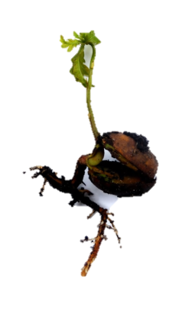
Enjoy the fruit of the tree, all from a little seed.
Notes:
Questions?

Slide 10
Ideas

Slide 11
Ideas
Book club discussion/activity suggestions:
historical fiction --create a timeline with a significant event in your life
--identification exercise (compare and contrast)
--response journal to feelings experienced while reading
--invite guests/parents with knowledge of the event or
time period
--interview and record memories
--“Flashback Diner”
contemporary read --identify issues
--debate teams
January (Literacy) –provide self-directed activity sheets for all ages
February (Family Day) –organize family game program (Who Do You Think You Are?)
-Celebrate Your Heritage
October – Thanksgiving
December –Year Wrap Up Party
Self-Esteem Club
Tween/Teen drop-in
Art for Children Program
Photography workshop/club
Coffee House meetings
Storytime after activity
Stuffie Sleep-over

