Slide 1
Doors Open at the Archives of Ontario
Jay Young, Outreach Officer, Archives of Ontario
OLA Genealogy Bootcamp
June 2, 2016
ontario.ca/archives

Slide 2
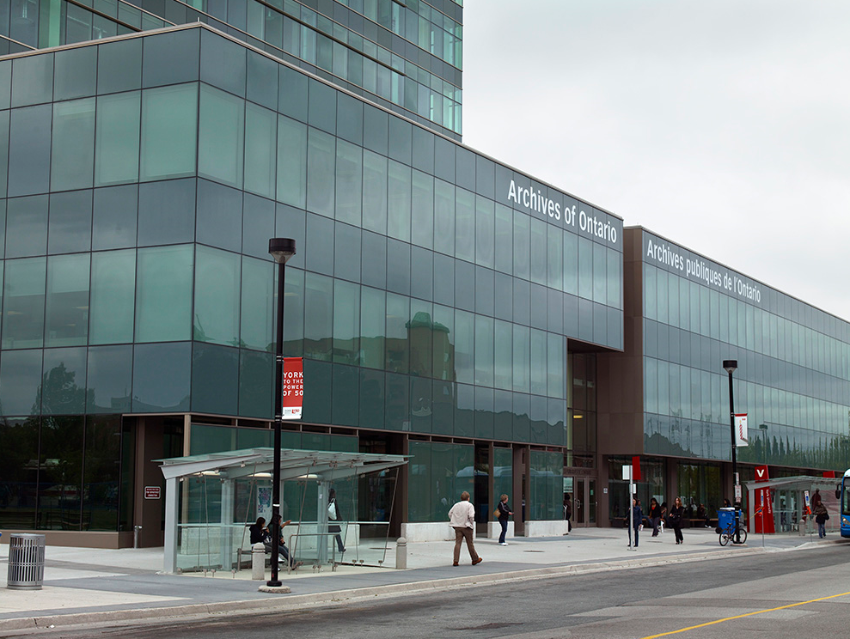
About the Archives of Ontario
Second largest archive in Canada
Modern public facility located at York University
Collect, preserve, promote and facilitate access to the province’s documentary memory

Slide 3
Why Doors Open?
Engage stakeholders
Leverage community excitement generated by Doors Open
Showcase new initiatives
Connect with Doors Open theme

Slide 4
Doors Open at the Archives of Ontario
Public tours
Thematic programming
Education programming
Exhibit promotion
Social media

Slide 5
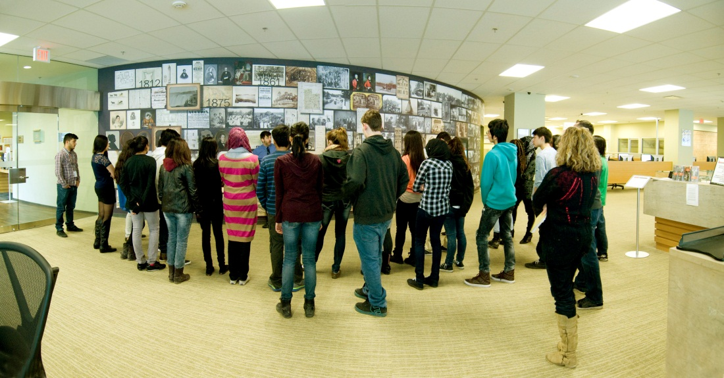
Public Tours
Engage visitors by showing public and staff-only areas of the Archives of Ontario

Slide 6
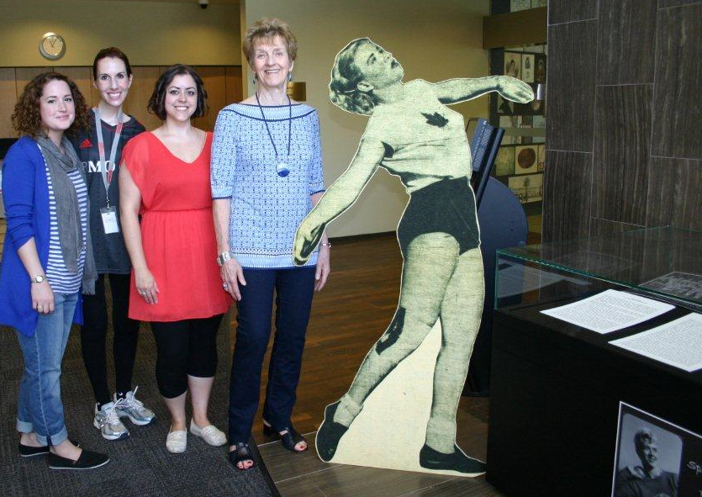
Thematic Programming
Effective to link special initiatives to Doors Open theme
Example: Doors Open Toronto 2015 theme: “Sports, Recreation and Leisure”

Slide 7
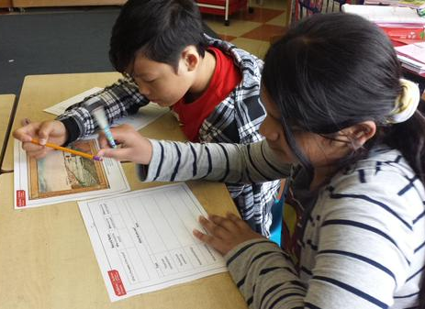
Education Programming
Doors Open: Interactive children’s activities in our classroom
Links with curriculum-based education programming aimed at students from grades 3 to 12
2015-2016: more than 3,600 students and 180 educators learned about the importance of archival records

Slide 8
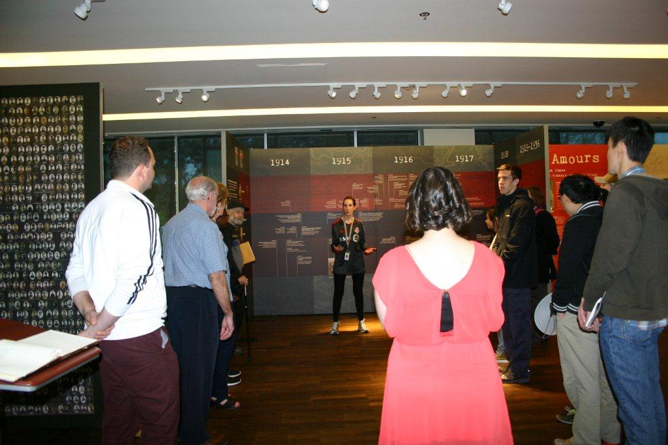
Exhibit Promotion
Helen McClung Exhibit Area
Current exhibit: Dear Sadie – Love, Lives and Remembrance from Ontario’s First World War
Next exhibit: Family Ties: Ontario Turns 150

Slide 9
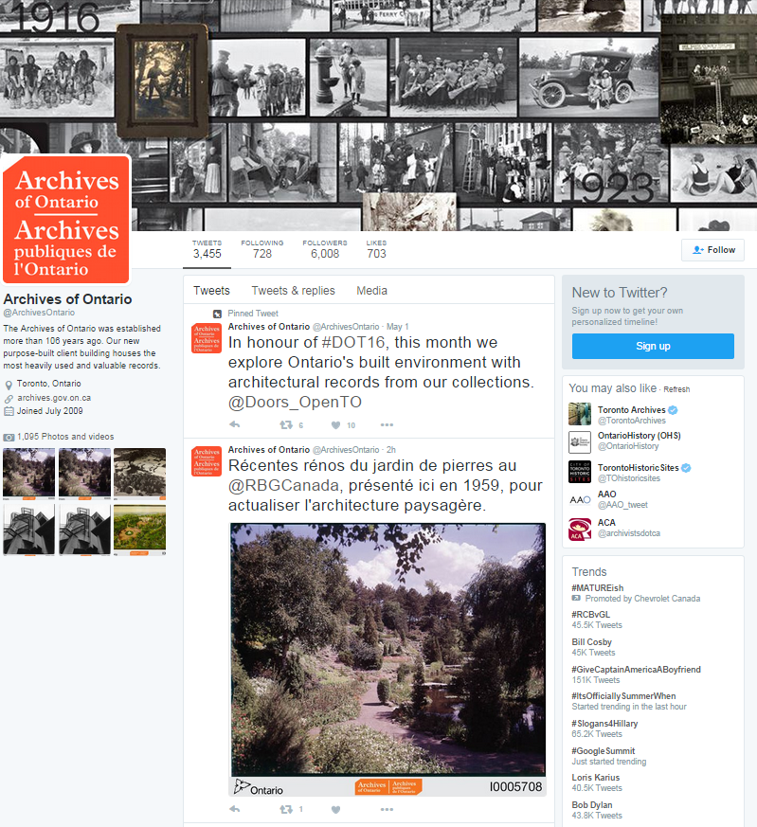
Social Media
Promotional value
Encourage use of social media use by visitors
Doors Open tie-in with Archives of Ontario channels

Slide 10
Doors Open ideas for libraries
What exciting things are happening at your library?
How does your library connect to the annual theme?
What do you want the public to know about?
Heritage buildings
New facilities
Special collections
Special events

Slide 11
Thank you!
More information:
Doors Open Ontario website
www.doorsopenontario.on.ca
Jay Young
Outreach Officer
Archives of Ontario
Jay.Young@ontario.ca

