Slide 1
THERE IS A GENEALOGIST IN MY LIBRARY: WHAT DO I DO?
Marian Press
OLA Preconference 2016 marian.press@utoronto.ca

Slide 2
There is a Genealogist in My Library: What Do I Do?
You may have been assigned to help with little or no training
Are genealogists different than other patrons?
What does your library have immediately to hand to help?
How do you provide yourself with the necessary training?
How do you organize/disseminate what you learn to help other staff/users?

Slide 3
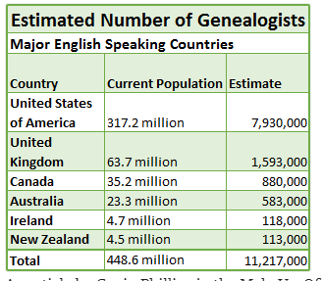
2016 figures – doesn’t give his source
http://www.makeuseof.com/tag/cousins-dna-make-suspect/

Slide 4
What Do I Do?
Genealogy questions are legitimate questions and worth staff time!

Slide 5
Range of Needs
Genealogists come in many shapes and sizes
Beginners will be “name collecting”
Can use BMDs, censuses
More experienced:
Looking for social context, local history
May have chosen your library specifically for this
May be extremely knowledgeable on your area

Slide 6
Genealogy Reference Interview
“Why can’t you give me my complete family tree, like they do on TV?”
Researchers may not have a clear idea of what resources your library can offer
Often have difficulty articulating what they are really looking for
You want to avoid hearing user’s complete family history

Slide 7
Genealogy Reference Interview
You have to determine how much they know/have done already
Do they just need names and dates or detailed local history and social context?
Beginners may need your instruction in basic methodology as well as resources
Especially on how to evaluate sources!
Interview may need to take much longer than normal (may need to be 20 minutes or longer)

Slide 8
Genealogy Reference Interview
Need clear policies on what help you will provide
In person and by email, as these will differ
What can you easily develop as resource material can use themselves or take away?
Need to know where to refer them when they have exhausted your resources

Slide 9
Two Useful Resources

Slide 11
Helping Your Clients and Yourself to Learn
Core “how-to” texts
Free courses and webinars available
FamilySearch Learning Center
Legacy Family Tree Webinars
Two good example of many
Also use the genealogy gateway sites
Usually have a “how-to” category
Once you have learned, share with others

Slide 12
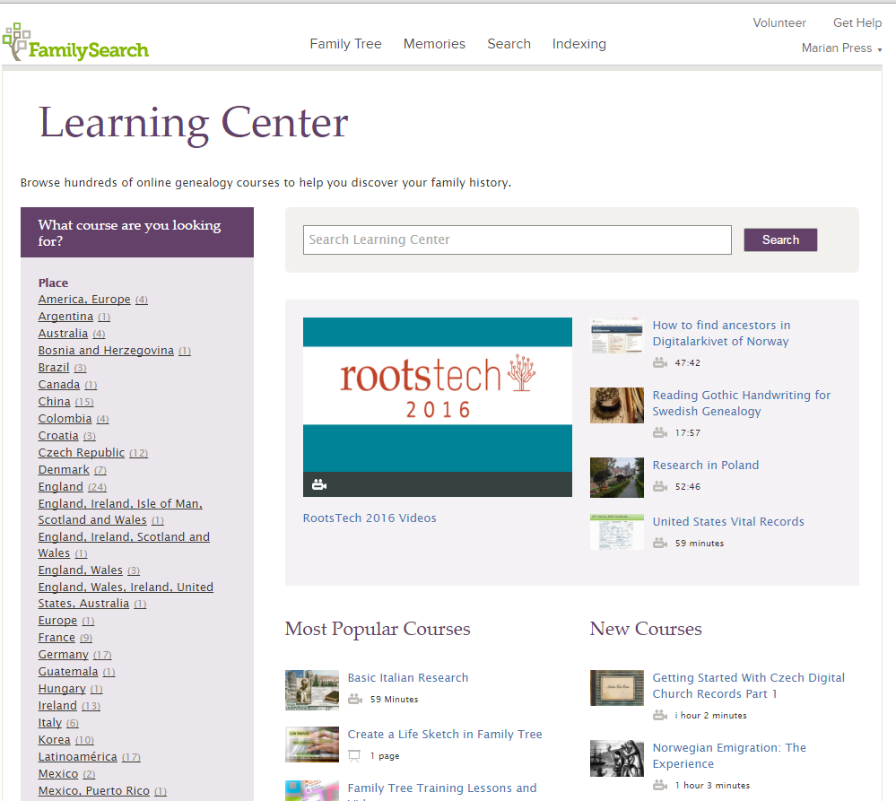

Slide 13
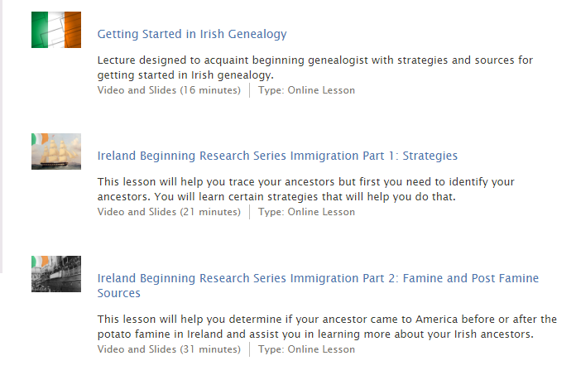

Slide 14
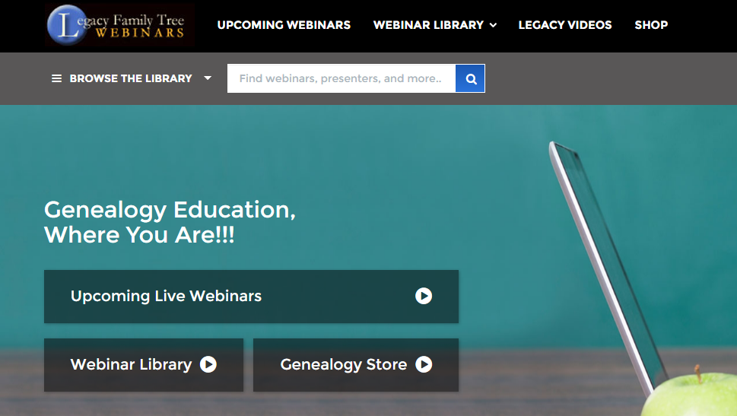

Slide 15
What Resources Do You Have Readily Available?
Need to be aware of what you have at hand already in paper
It isn’t all online!
May be surprised at what is relevant to a genealogist
Available: archive.org

Slide 16
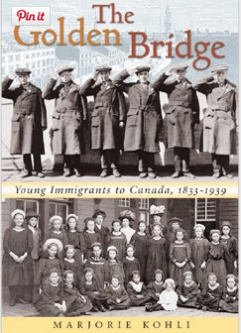
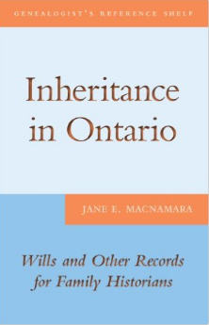
Core Texts for Users
Need collection of core “how-to” texts for beginner patrons
Have given list of some Canadian texts in handout

Slide 17
What Resources Do You Have Readily Available?
The Obvious:
Local directories
Local histories
Local newspapers
Obituary files
Local Books of Remembrance
Photograph collections
County Atlases [McGill]
Less Obvious:
Locally-published recipe collections
Local diaries
Local maps
Current & historical
Business histories
Fraternal organizations
Periodical databases

Slide 18
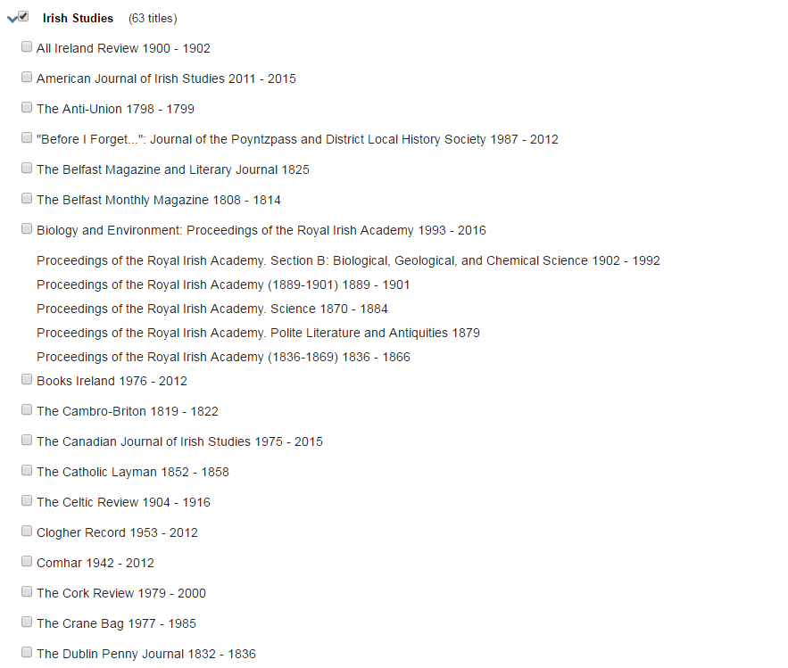

Slide 19
It’s Not All Online
Will have to convince users of this!
But my emphasis is on online sources:
Beginners can make a tremendous start with online sources available to you
Impossible to advise on paper sources for individual libraries
Many resources libraries cannot acquire easily are available online

Slide 20
Databases: The Big Three
Resources to get anyone started and well on their way are all free:
Ancestry – free at libraries
FamilySearch.org - free
Library and Archives Canada - free

Slide 21
Ancestry Library Edition
For Canada, for example: censuses, immigration records, city and area directories, Ontario BMDs, Ontario voters’ lists, school yearbooks, Drouin (for Quebec)
For some provinces almost nothing
User-submitted family trees (quality???)
Help Boards for patrons

Slide 22
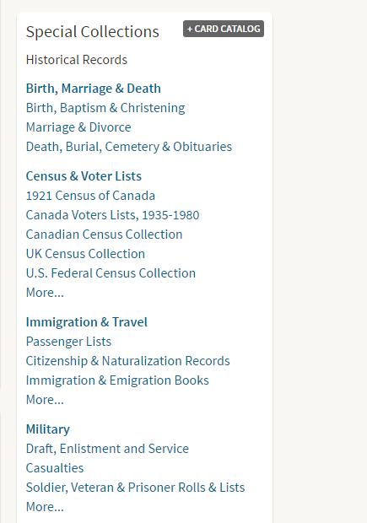

Slide 23
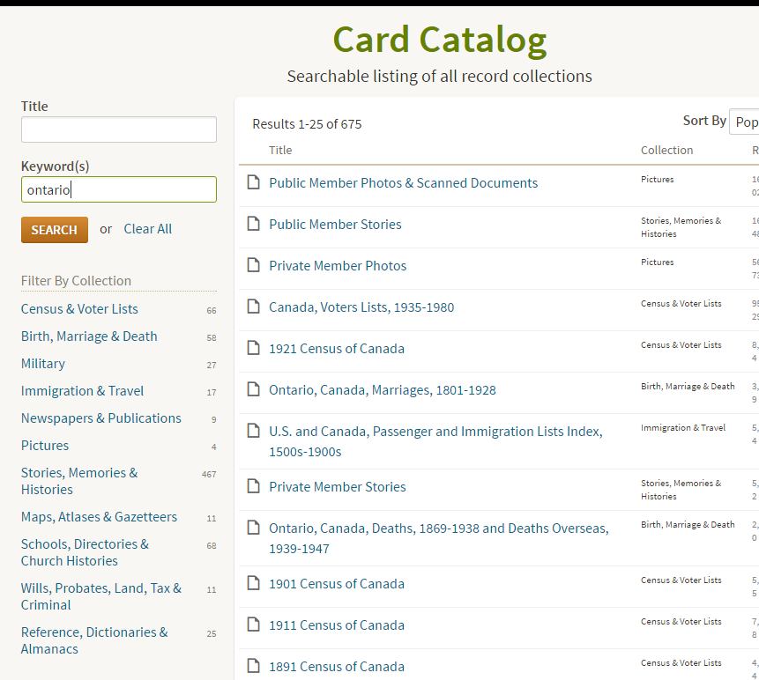

Slide 24
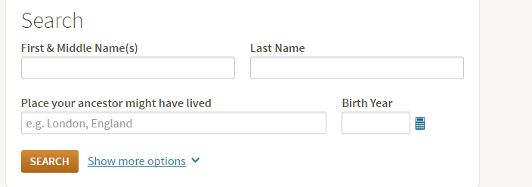
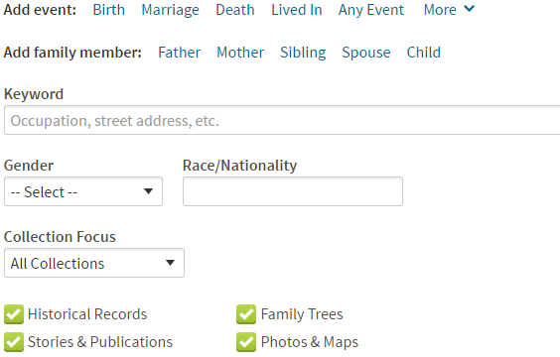

Slide 25
FamilySearch.org
All resources free (although some indexes link to commercial sites)
More and more indexes link to images or digital microfilm
Can search for people by name in “Records”
Can search for resources on places and surnames under “Catalog”
Need to be able to tell users how to get resources found

Slide 26
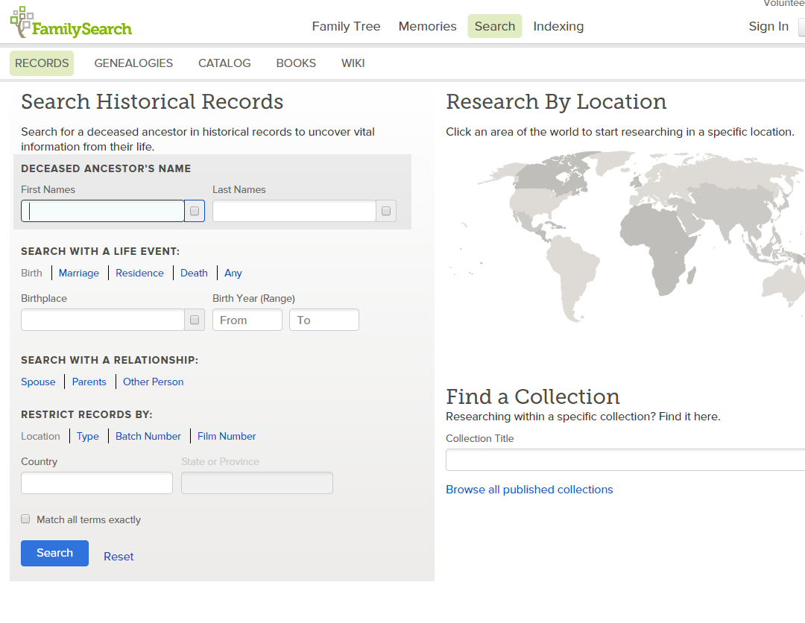

Slide 27
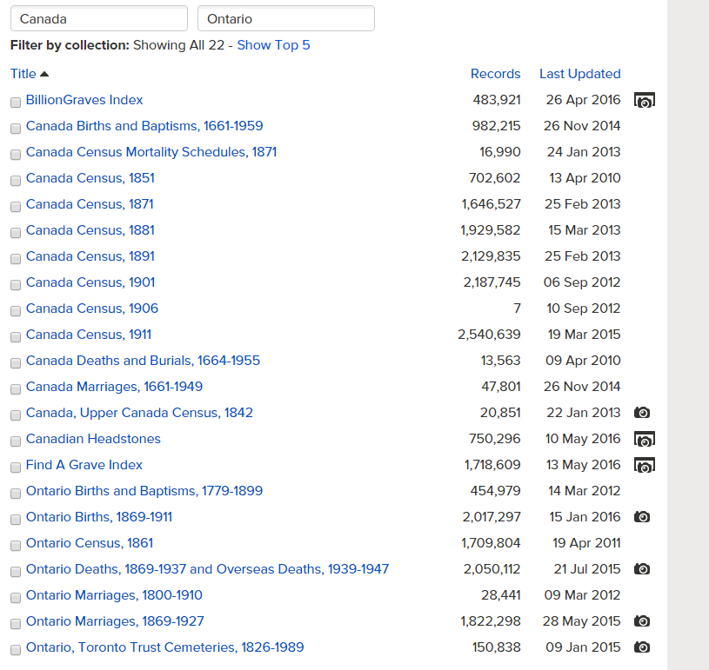
Partner site
On FamilySearch

Slide 28
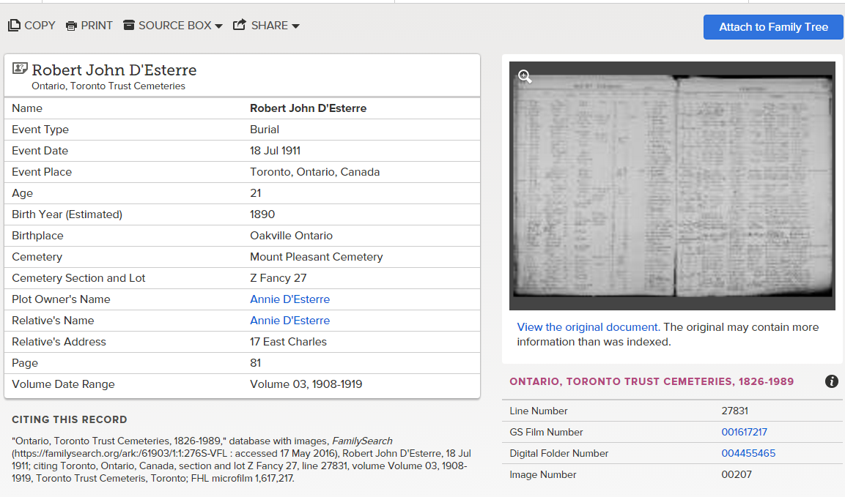
TORONTO TRUST CEMETERIES

Slide 29
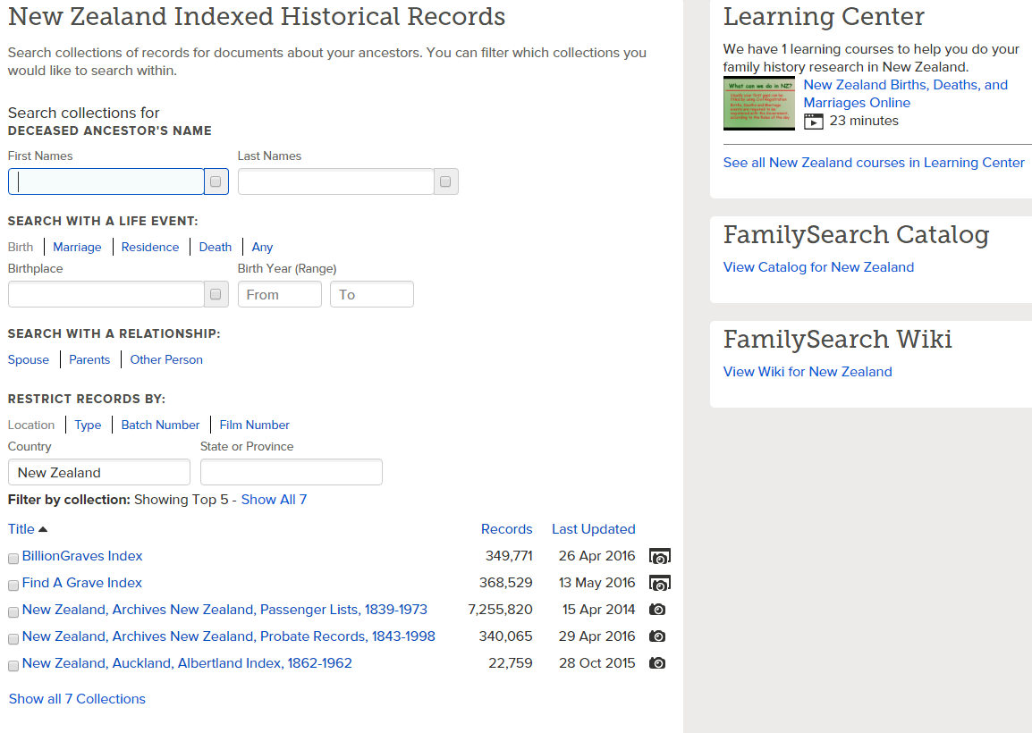
Image at a partner site
Image on FamilySearch

Slide 30
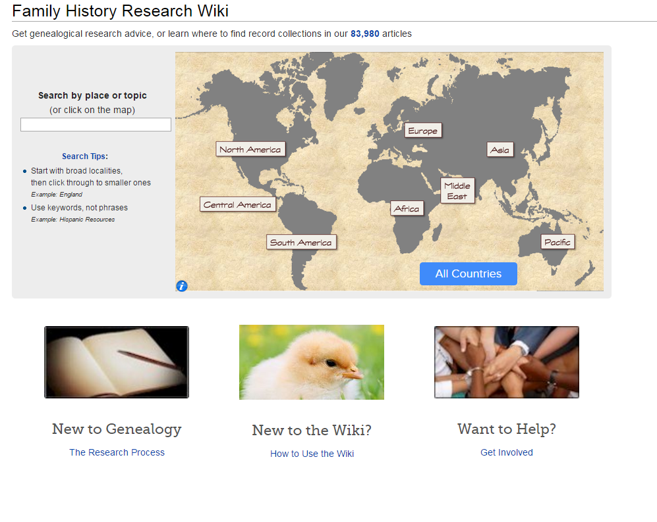
FamilySearch Wiki

Slide 31
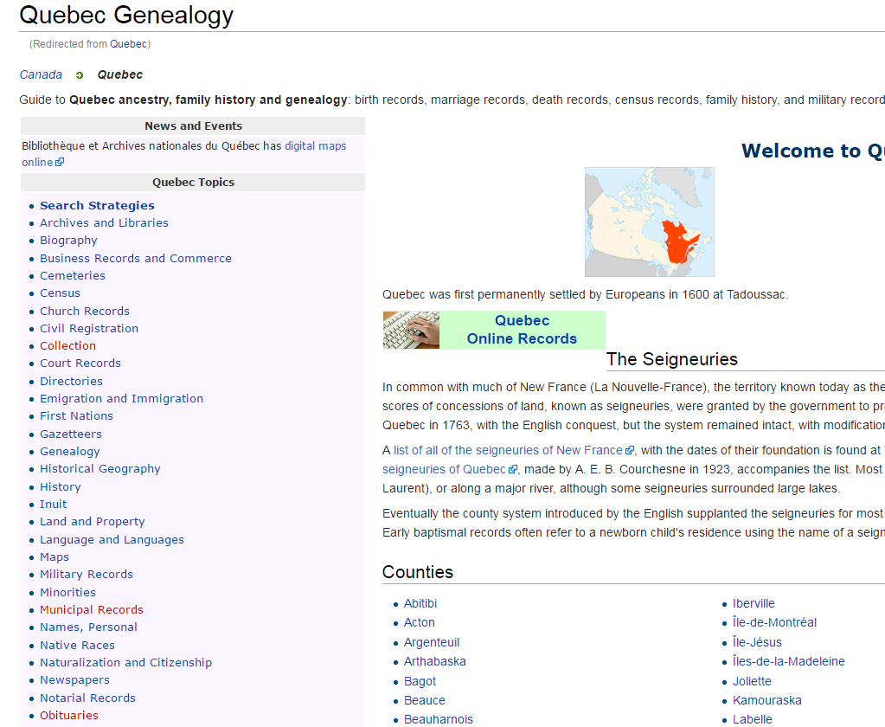

Slide 32
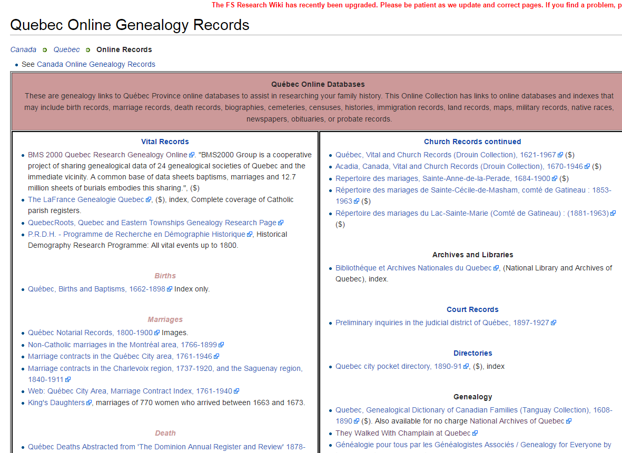

Slide 33
Contribute to the Wiki for Your Area

Slide 34
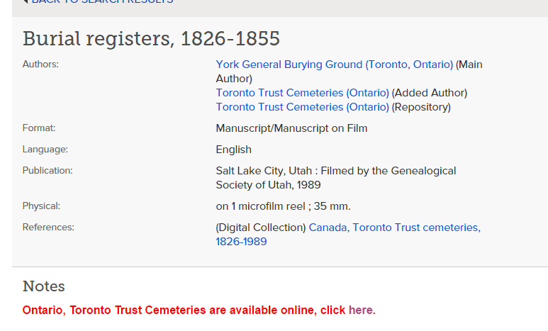
Getting Hold of the Records

Slide 35
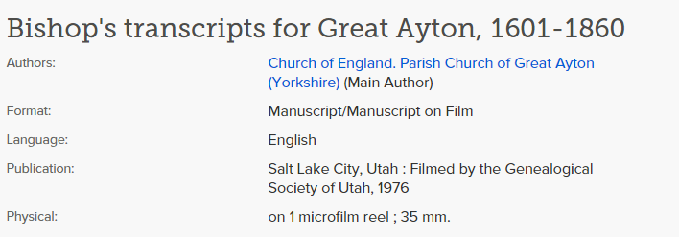
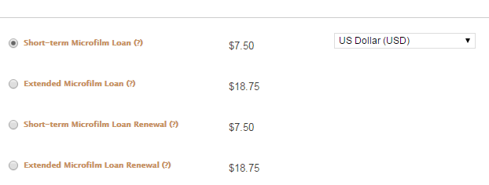

Slide 36
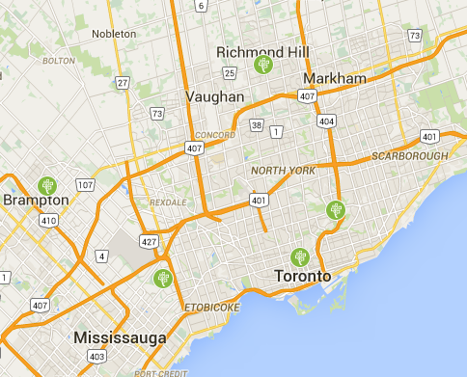
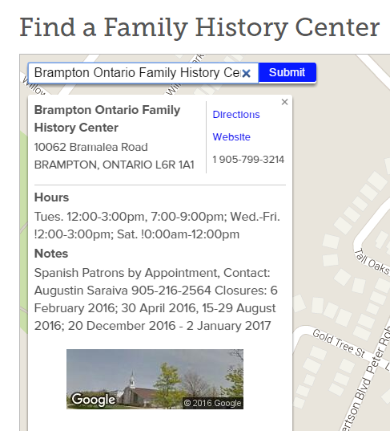

Slide 37
Library and Archives Canada
“Genealogy and Family History” landing page
Lots of good “how to” pages
Often the records are traditional microfilm, not online
Except for “how to,” not a place to start for beginners
Particularly good for land, military and immigration records

Slide 39
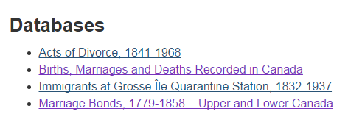
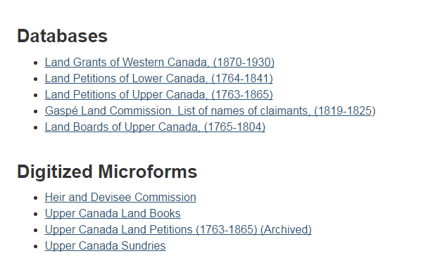

Slide 40
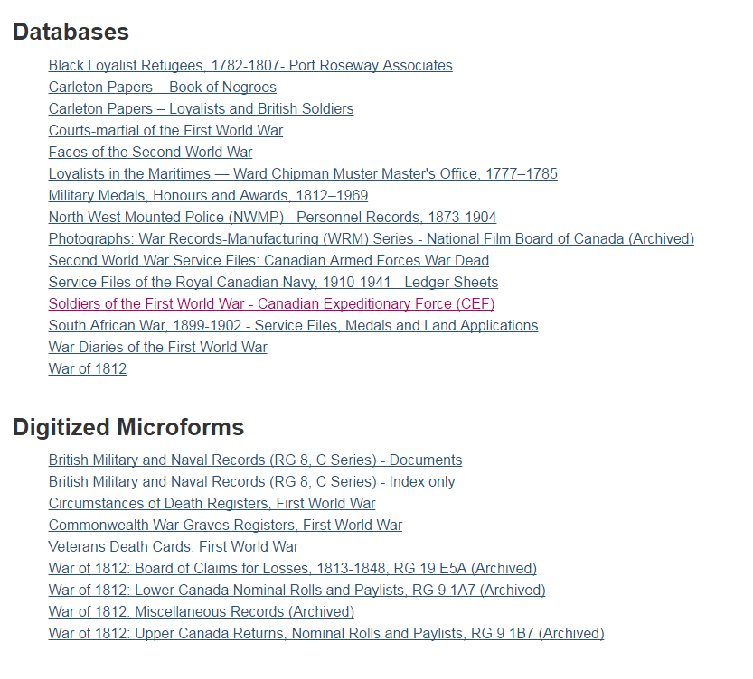

Slide 41
Beyond the Big Three: Quickly Finding Other (Online) Sources
Genealogy Gateway Sites:
Sites that list and provide links to relevant genealogy sites
Can be worldwide, national, local in scope
A good place to start for more specialized resources
The biggest ,“Cyndi’s List,” can lead you to other gateway sites for other geographic areas
Alphabetic listing, not evaluative

Slide 42
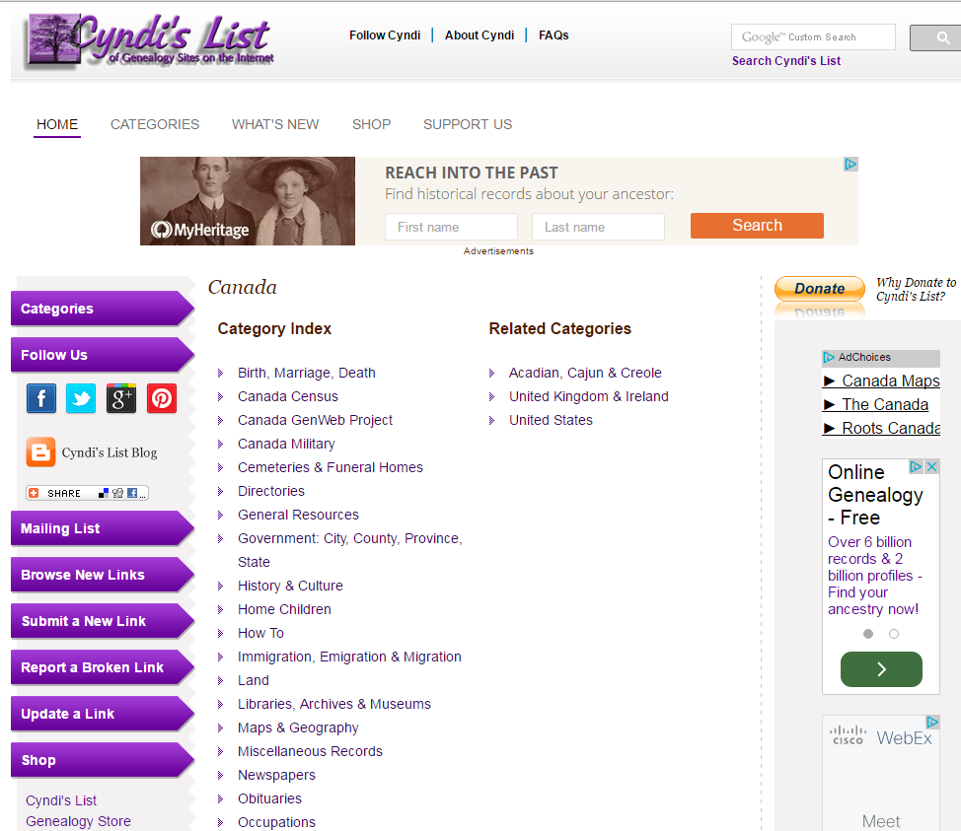

Slide 43
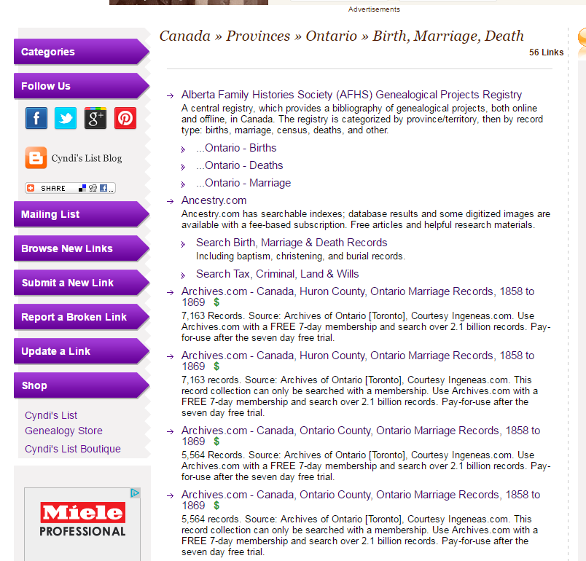

Slide 44
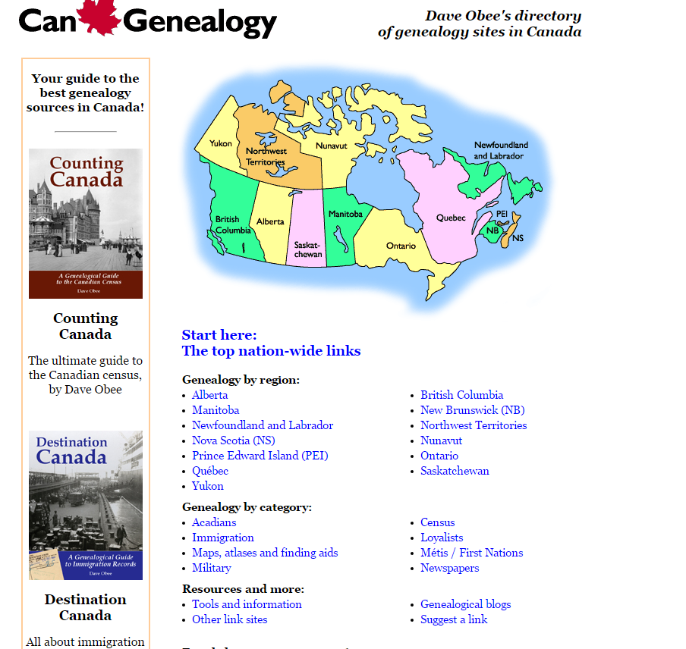

Slide 45
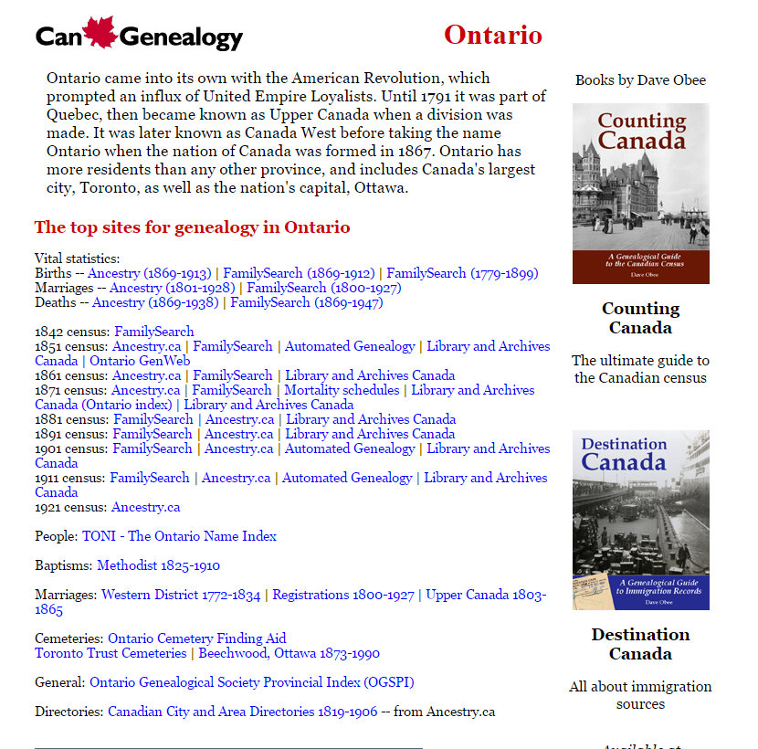

Slide 46
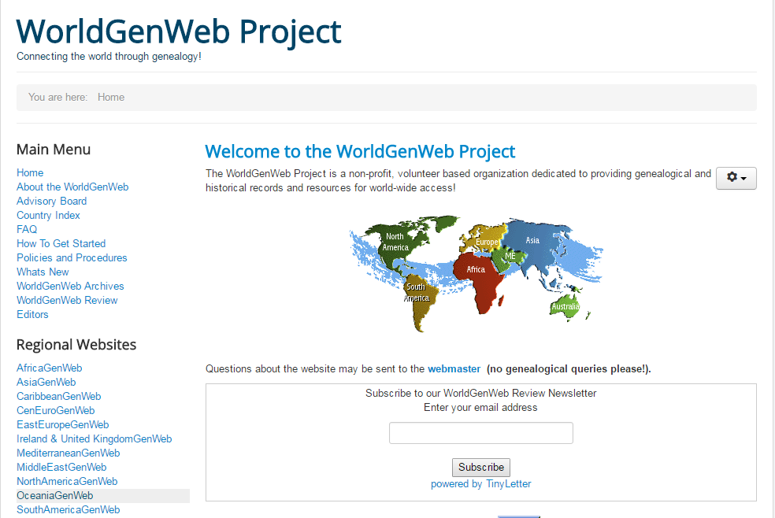

Slide 48
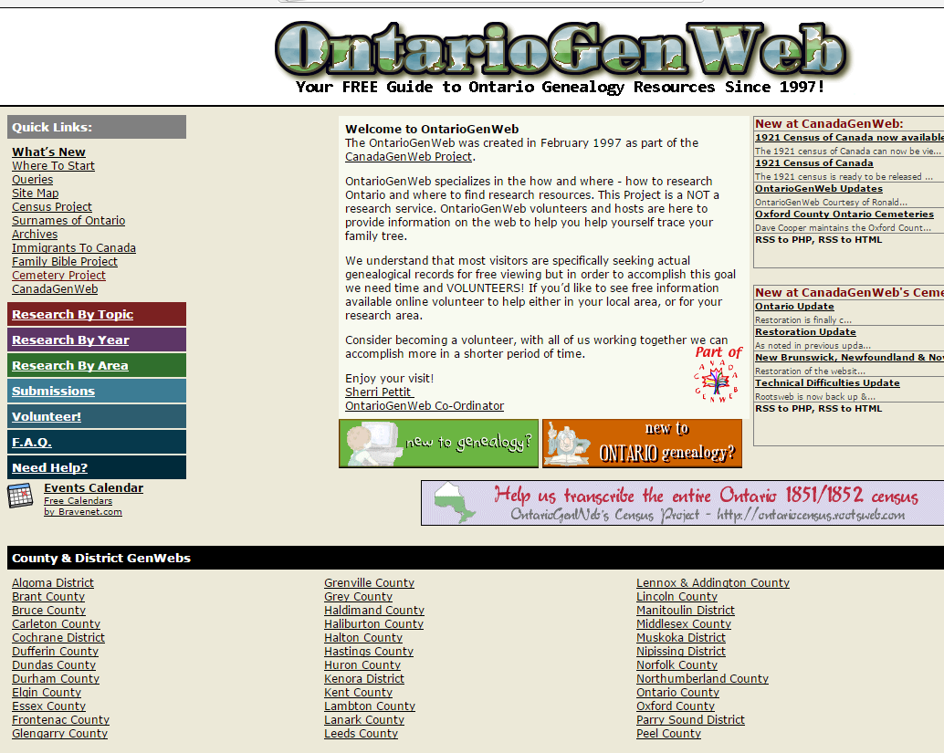

Slide 49
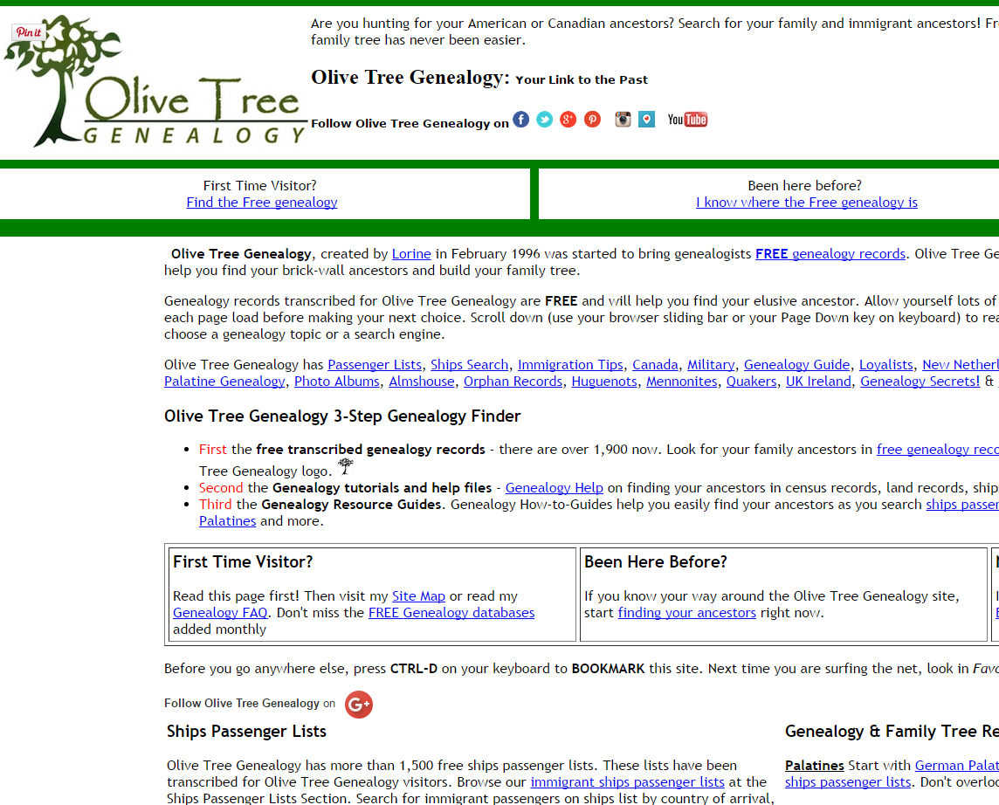

Slide 50
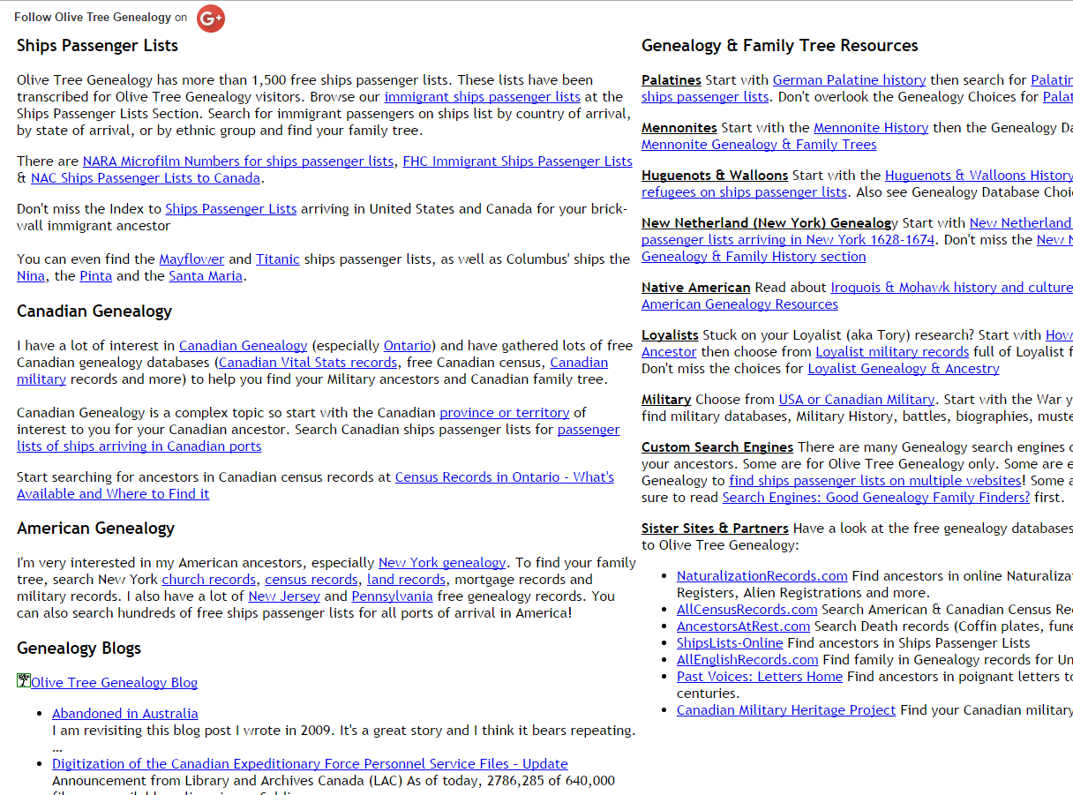

Slide 51
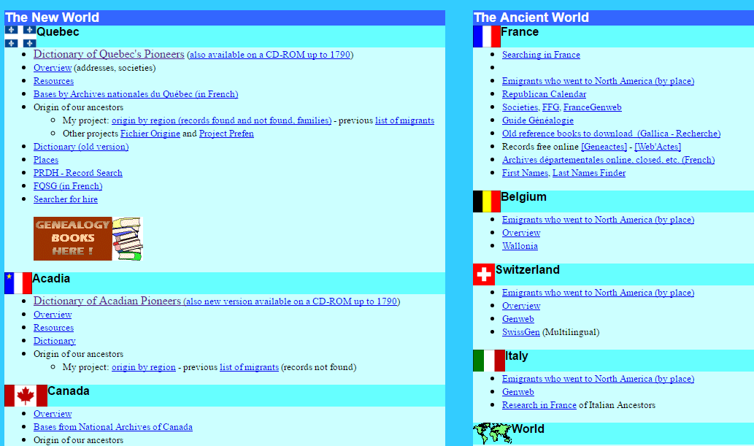

Slide 52
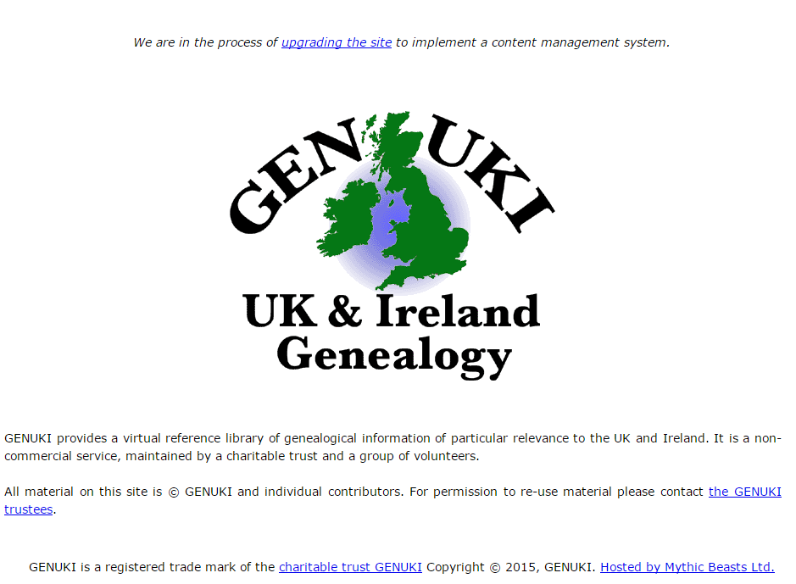

Slide 53
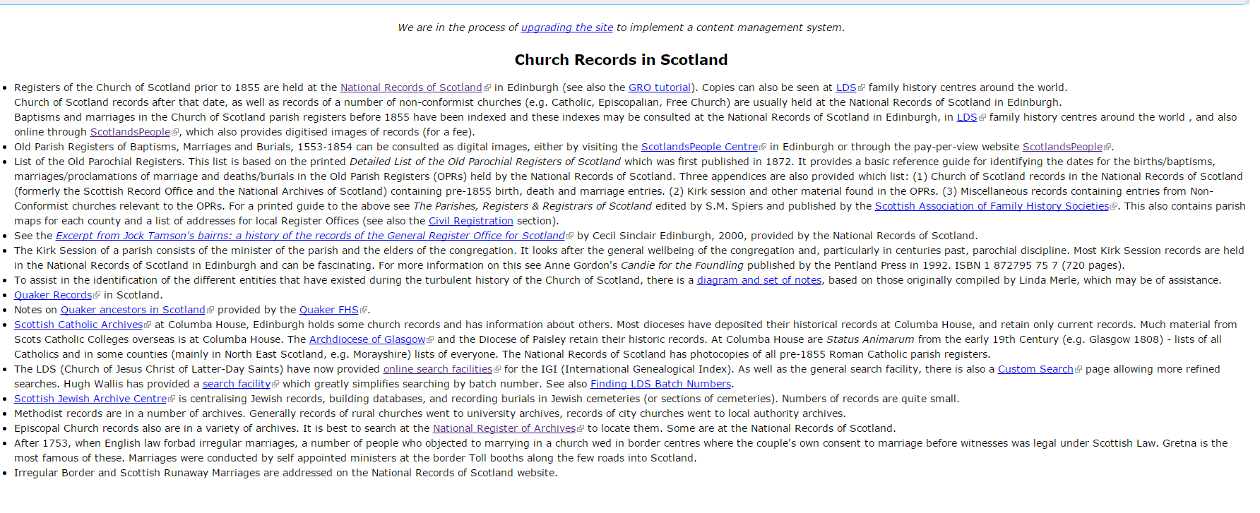

Slide 54
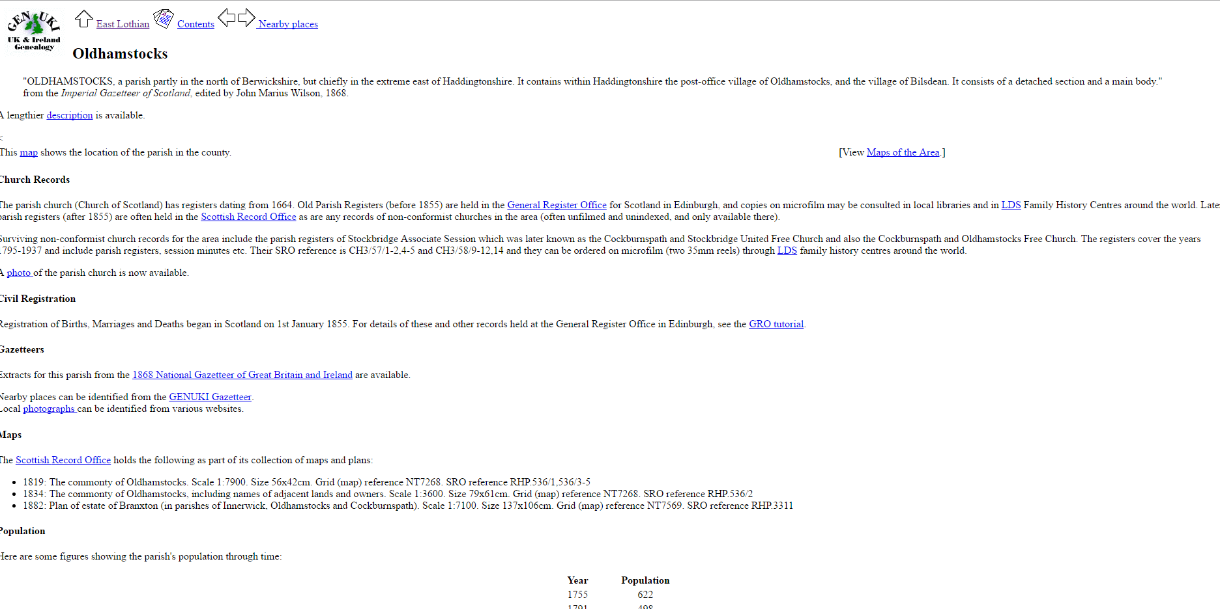

Slide 55
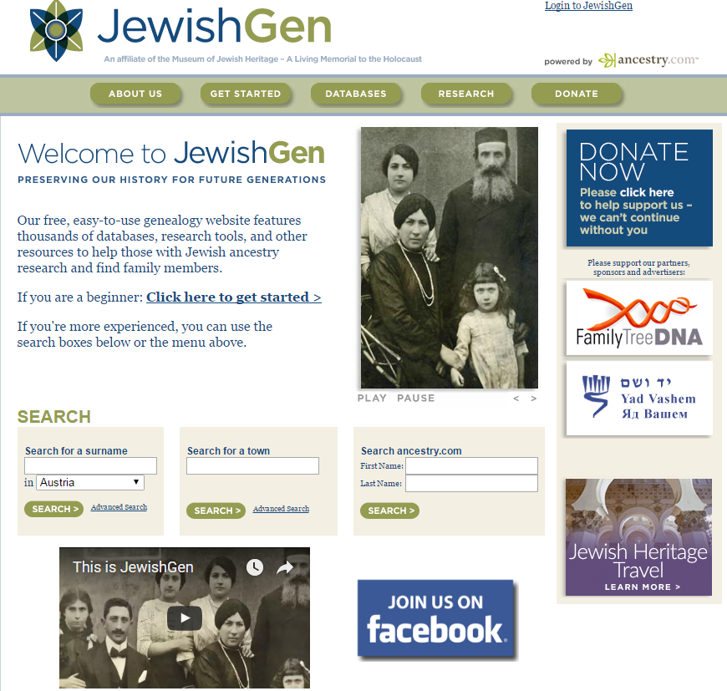

Slide 56
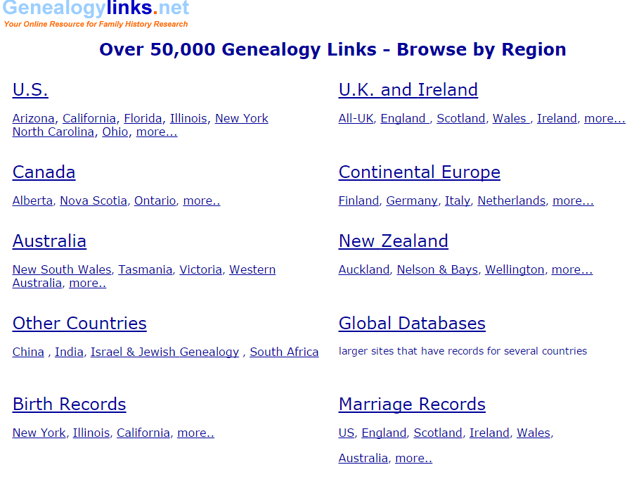

Slide 57
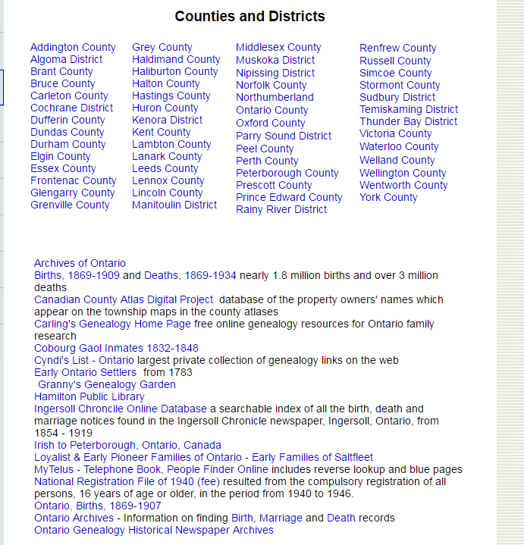

Slide 58
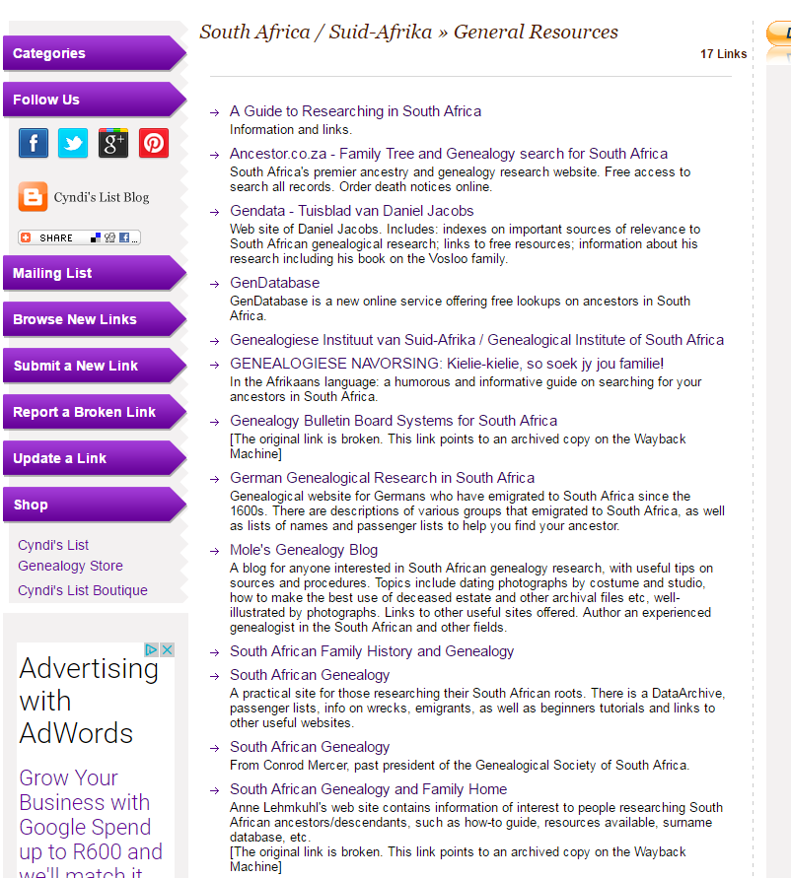

Slide 59
Other Important and Accessible Sources
Newspapers
Paper, microfilm and online
There are some good gateway sites online
Not just BMDs, but social events, exam results, etc.
Online books
To supplement what you already own
Online family trees
A somewhat dangerous source (very?)

Slide 60
Ontario Newspapers
Not particularly well served
Some provinces are, e.g., British Columbia
Globe and Mail and Toronto Star available (ProQuest)
OurOntario and other small sources available

Slide 63
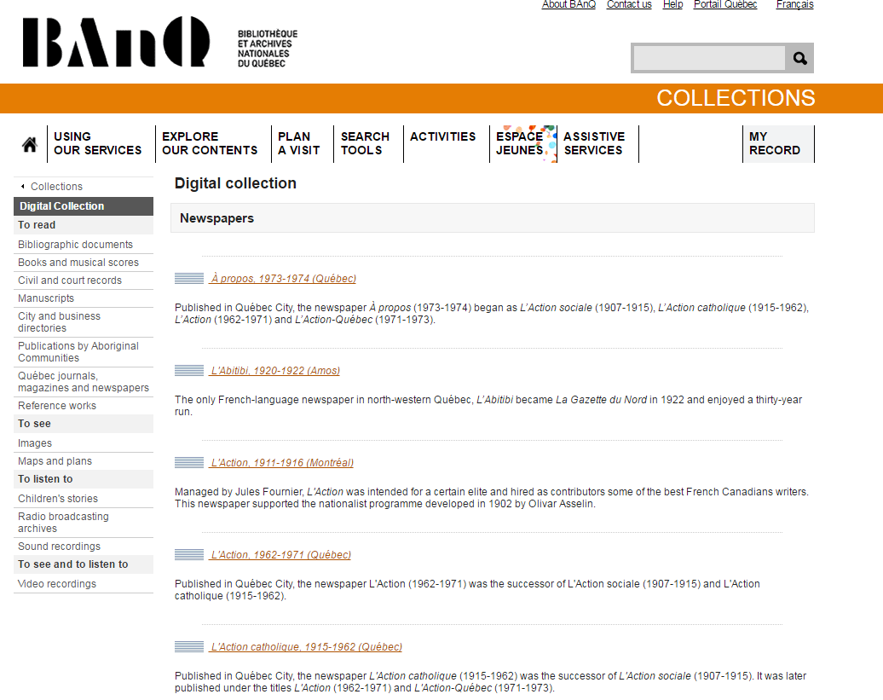

Slide 64
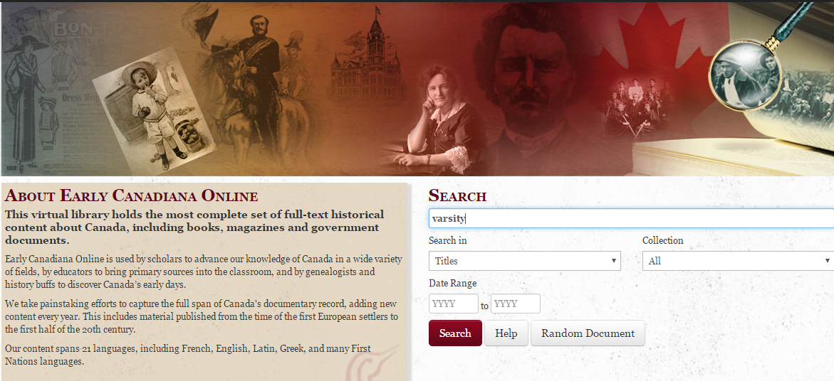
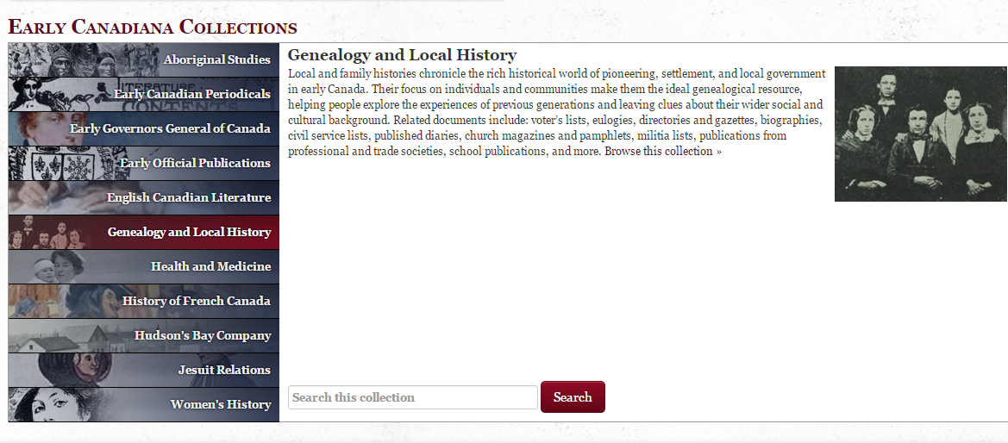

Slide 65
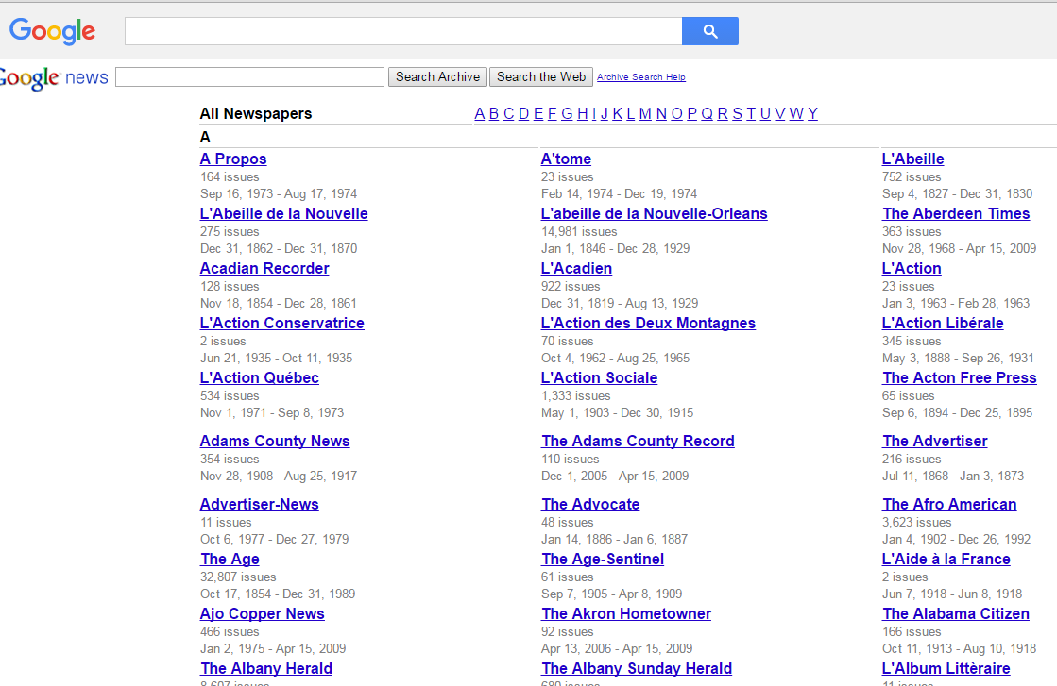
Google News Site Search: site:google.com/newspapers "humphrey ewing"

Slide 66
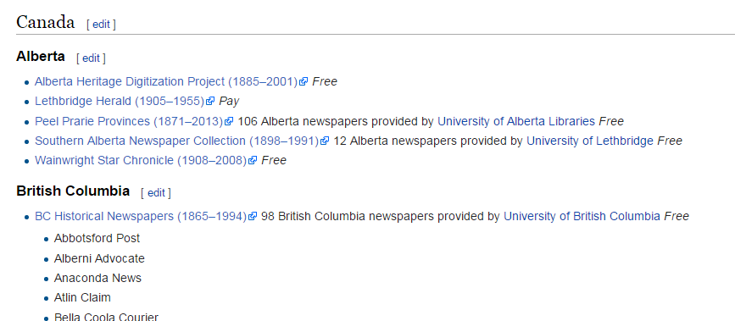

Slide 67
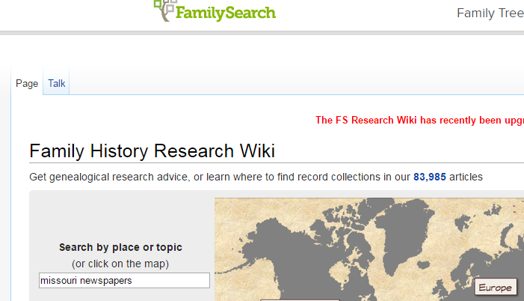

Slide 69
Online Books
You will know what you have in paper in your library, but in addition…
A major source for early local histories
More and more published genealogies
Emphasizing here Ontario collections and large-scale digitization projects

Slide 70
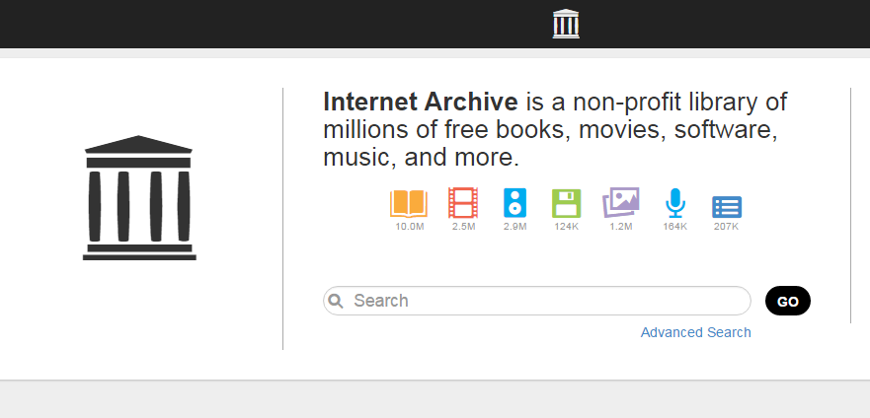
Search is a catalogue search, not a keyword content search

Slide 71
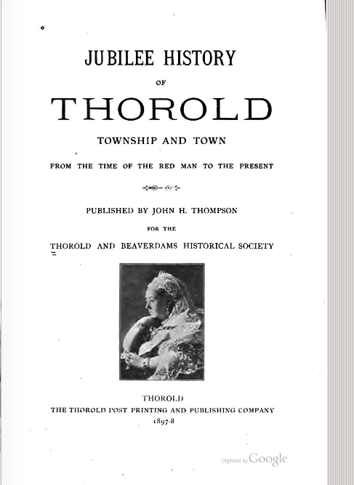

Slide 72
This is a keyword content search

Slide 73
Not all results can be seen in full text. Copyright restrictions. All available in FHCs.

Slide 82
Online Family Trees
Good way to get people started past the basic BMDs and censuses
Need to teach them about sources and evaluation of information presented
Three good sources:
Ancestry
FamilySearch
MyHeritage
Then there is Google!

Slide 85
Contributed family tree results found at end of record search results

Slide 89
Helping Clients to Record What They Find
Downloadable paper forms
FamilySearch
Ancestry
Legacy Family Tree
Very good free genealogy database program
Can upgrade for better charting, etc.
GEDCOM download capability at your library? For Ancestry especially.

Slide 97
Offer Patrons Organized Help
Partner with genealogy societies
Create genealogy events

Slide 98
Be Creative!

Slide 99
Networking With Others for Help
Your own colleagues
Other genealogy librarians
Canadian Local History and Genealogy Network (CLA)
Other public libraries
Relevant local archives
Especially Archives of Ontario
Church archives
Maintain links with local genealogy societies

Slide 107
Share What You Have
Have a dedicated web page for family and local history
Available from top level of web site
Explanation of local resources and where they are
“How-to” “handouts” for local resources
Helps with not repeating basics constantly
Digital resources of your own available
Links to relevant external digital resources
Link to email reference for genealogy
Clear statement of what and will not be provided
A section on Commissioned Research Services? – Ontario Chapter of APG
Establish a genealogy/family history blog

Slide 111
A Knowledge Base for Your Library
“a database of related information about a particular subject”
Can choose to share with public, or not. (But why not, if collecting for yourself already)
Can start with paper and simple handouts
May have internal content management systems or intranet that could be used
Plus your web site

Slide 113
Keeping Up-To-Date With New Developments
Always new developments in genealogy world
Genealogy news blogs best way to keep up
Clear stand-out leaders in most interest categories
Also best way to keep up with database developments – e.g., Ancestry and FamilySearch

Slide 121
marian.press@utoronto.ca

