Slide 1
Genealogy Boot Camp for Librarians
OLA Pre-Conference, OGS Conference 2016
Shannon Bryan, Coordinator of Information and Web Services
Belleville Public Library

Slide 2
Agenda
Belleville Public Library and John M. Parrott Art Gallery
Local History – Building our collection
Programming – Getting people through the doors
Marketing – How do we do it?
Research Services – How and what do we provide?

Slide 3
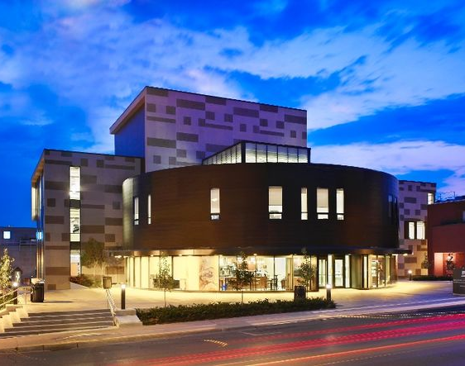
Belleville Public Library
Belleville, Ontario
Population of 49,000
One branch – downtown
Library – first two floors
John M. Parrott Art Gallery – third floor
Community Archives of Belleville and Hastings County – April 2016

Slide 4
Local History – Building our Collection
Canadiana Room – weeded about 50% of our Local History Collection
Local History Collection Policy
Non-Circulating material
Circulating material
Farley Mowat
City-issued documents
Belleville Newspapers
Genealogy Collection

Slide 5
Programming – Getting people through the doors
Culture Days - September 26-27, 2014
Genealogy 101 Workshop – Jan 2015
Genealogy 102 Workshop – Fall 2016/Winter 2017
Timing and Audience
Future Partnerships

Slide 6
Marketing – how do we do it?
Community Event Announcements
CJBQ Radio – Mary Thomas, Newsmaker Sunday
In-house advertising
Social Media and www.bellevillelibrary.ca
Posters delivered
Digitized Collections – Belleville History Alive

Slide 7
Research Services – How and what do we provide?
Ask a Librarian
Free Research vs. Fee-Based Research
Complex questions
Managing Staff time
“Out-of-Towners”

Slide 8
Questions?
Belleville Public Library and John M. Parrott Art Gallery
254 Pinnacle Street
Belleville, Ontario
K8N 3B1
www.bellevillelibrary.ca

