Slide 1

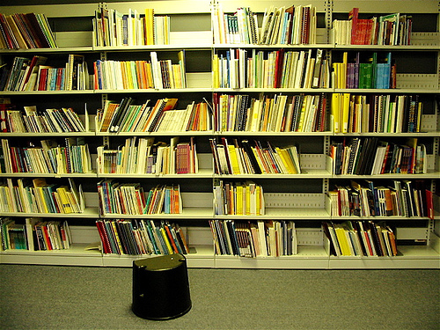
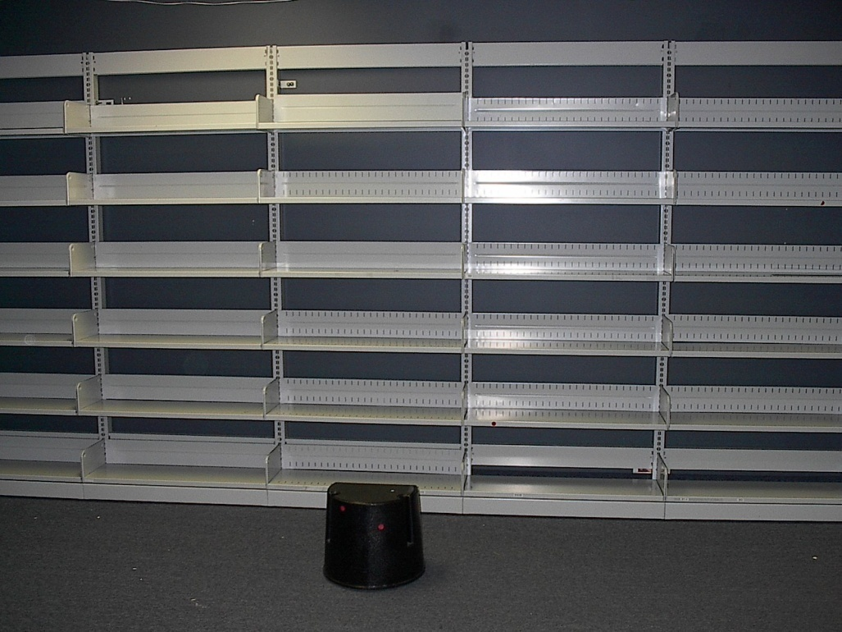
Library Closure and Continued Collection Access: the AlphaPlus Experience
Learners’ Collection,
Summer 2007
Learners’ Collection,
November 23, 2007
Presenters: Mary Reynolds and Lisa Gayhart, AlphaPlus Centre

Slide 2
Abstract
As a service agency for adult basic education, the AlphaPlus Library has supported instructors and researchers in the Anglophone, Francophone, Deaf and First Nations Literacy streams in Ontario for over 15 years. A significant cut in funding in the fall of 2006 necessitated the closure of the Library on September 4th, 2007. Our goal and challenge was to find ways to provide continued access to as many of the 49,000+ volumes in our resource collections as possible, and to do so before November 30th, when AlphaPlus was slated to move to a new office space. Strong connections in the provincial literacy and library communities enabled AlphaPlus to successfully decentralize approximately 75% of its resource collections to libraries and literacy organizations across Ontario, and beyond.

Slide 3
Why Decentralize?
Fall 2006 - Federal cuts to provincial literacy initiatives resulted in the loss of operating budget for the AlphaPlus Library
Summer 2007 – Library closed for a review of its collections and services
Fall 2007 – Decision made to close the Library effective September 4
AlphaPlus’ challenge - How to provide continued access to literacy resources for instruction and research

Slide 4

Step One – Decentralization Preparation
Identify, negotiate, and consolidate new partnerships
Develop and distribute paperwork
    Contracts
    Collection content preferences
Develop and implement in-house tracking system for literacy collection recipients
Identify and implement Horizon Circulation database adjustments

Slide 5
Step Two - Collection Analysis
Instructional / Program Resources
Research / Funded Projects
Cultural Collections
Learner Resources and Learner Produced Writings
Each resource in the AlphaPlus Library was examined for quality and relevance within four unique collection areas.

Slide 6
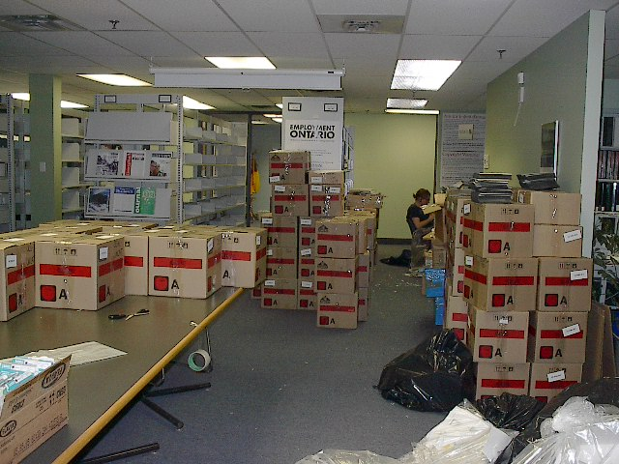
Step Three - Collection Distribution
AlphaPlus collections matched with library or literacy partners’ expressed needs
Collections created, boxed and shipped
MARC records and Excel lists created and distributed for each collection created

Slide 7
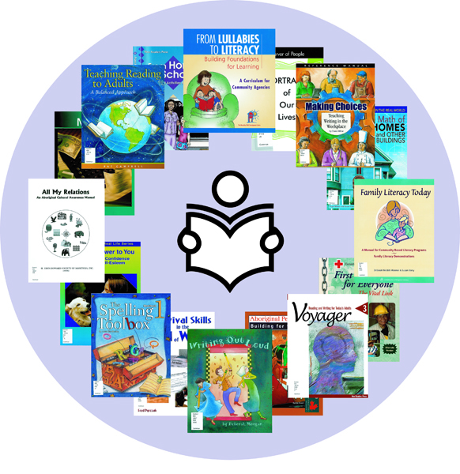
CLC Program Partners
2003-2007: 22 public library participants in the Community Literacy Collection (CLC) program
September 2007: Current and former CLC partners contacted and asked to permanently house literacy collections from the AlphaPlus library
    100% response rate
September – November 2007: collections created and shipped
    6126 volumes redistributed

Slide 8
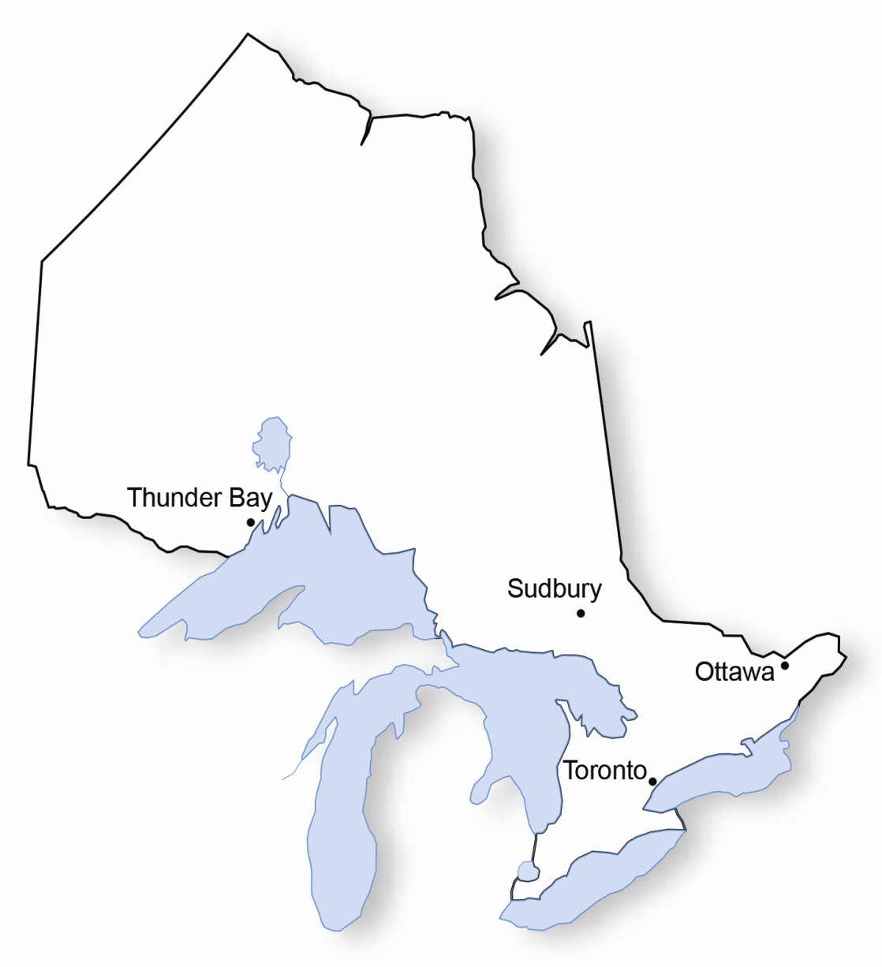
Literacy Collections in Ontario Public Libraries, December 2007
Barrie
Chapleau
Cobourg
Cochrane
Cornwall
Dunnville
Georgina
Grey Highlands
Haileybury
Ignace
Iroquois Falls
Kenora
Kirkland Lake
Lambton
Markham
New Liskeard
Sault Ste. Marie
Simcoe
St. Catharines
Thunder Bay
Timmins

Slide 9

POOLs Development
September – October 2007
OLS-N offered to create rotating POOLs of literacy resources, culled from the AlphaPlus instructional, program, and learner collections
SOLS offered van service and promotional support
Sample collections developed and sent
POOLs topic areas and content identified and tracked
MARC output files and collection spreadsheets created
November 2007 – present
10,500+ resources shipped to OLS-N
On-going communication surrounding POOLs creation and promotion

Slide 10
POOLs Topic Areas

Slide 11

Libraries and Archives Canada (LAC)
Canadian Book Exchange Centre (CBEC)
Remaining AlphaPlus library resources evaluated for donation to LAC and CBEC
Single copy of each English Canadian resource donated to LAC for review / preservation
          3700 volumes
Any remaining trade publications donated to CBEC for re-distribution / recycling
          1400 volumes

Slide 12
Final Destinations
Instructional / Program Resources
Research / Funded Projects
Cultural Collections
Learner Resources and Learner Produced Writings
Deaf – Deaf Literacy Initiative
Francophone – CLCP Libraries ; Centre de documentation sur l’éducation des adultes et la condition féminine (QC)
Native – POOLs, Ontario Native Literacy Coalition, First Nation Public Libraries
National Adult Literacy Database for digitization
Regional Literacy Networks and Umbrella organizations
LAC/CBEC
Primo Literacy and Clear Language Collection
CLCP Libraries and POOLs
National Adult Literacy Database for digitization
LAC
CLCP Libraries and POOLs
Regional Literacy Networks and Umbrella organizations
LAC/CBEC

Slide 13
In the End…
Redistribution of 36,874 of 49,000 resources: over 75%!

Slide 14
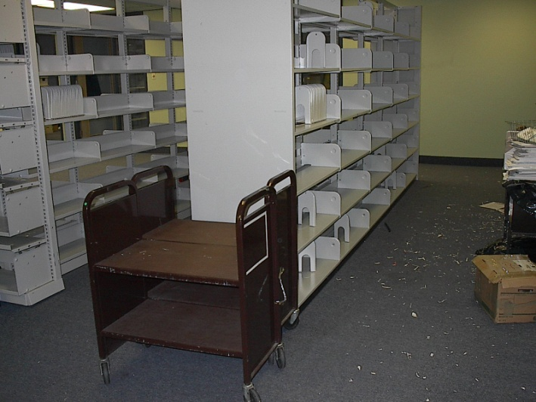
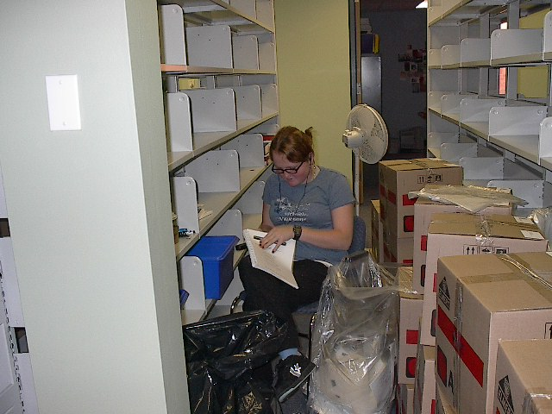
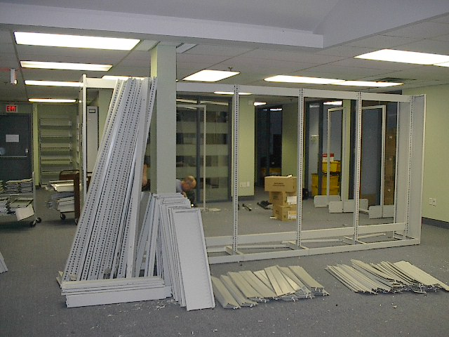
Decentralizing is More Than Books
Surplus furniture sold through free, online classified ads or donated to libraries and literacy organizations
Systematic recycling of library resources for which no new home could be found
Shelving donated or sold to partners and other libraries

Slide 15





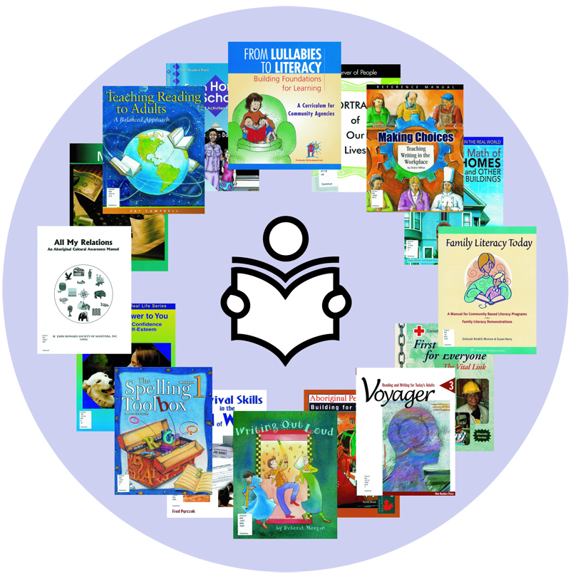
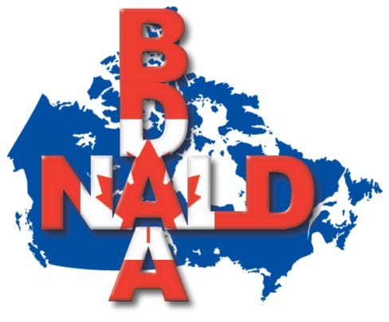




AlphaPlus Library Decentralization Participants

