Slide 1
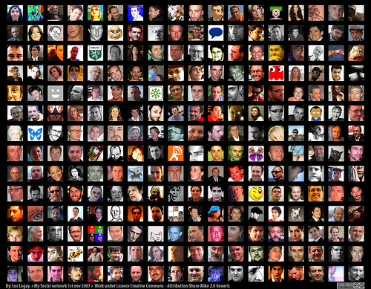
New Academic Librarians:
Networking to success
Jim Brett, University of Guelph
Debbie Chaves, Wilfrid Laurier University
Caroline Stewart, University of Guelph-Humber
OLA Super Conference Session # 331 January 29, 2009

Slide 2
Our agenda
Introductions – who we are
What’s networking?
Why do it?
Where to do it?
Developing the skills
  Thinking professionally
  Developing a 30 second commercial

Slide 3
Networking Video
Learn about various academic librarians perspectives on networking
http://www.vimeo.com/2965898

Slide 4
Networking - what is it?
It's about establishing relationships with others, typically people with shared interests.
You all have networks ...
- family
- friends
- classmates
- organizations / clubs
It's an essential life skill ....

Slide 5

Networking – everyone can do it

Slide 6
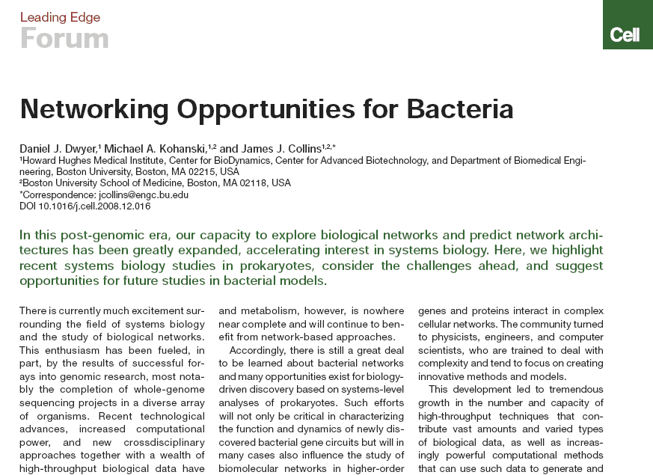
….. Even Bacteria

Slide 7
Networking as a professional / career skill
Networking is talking to strangers to increase your contacts
Networking is about building relationships
Networking is about teaching and giving/sharing
It helps you:
- find a job
- be informed about career choices / directions
- find collaborators
- develop a support network
- creates opportunities

Slide 8
The Where and How of Networking
Where? Everywhere and anywhere

Slide 9


Slide 10


Slide 11
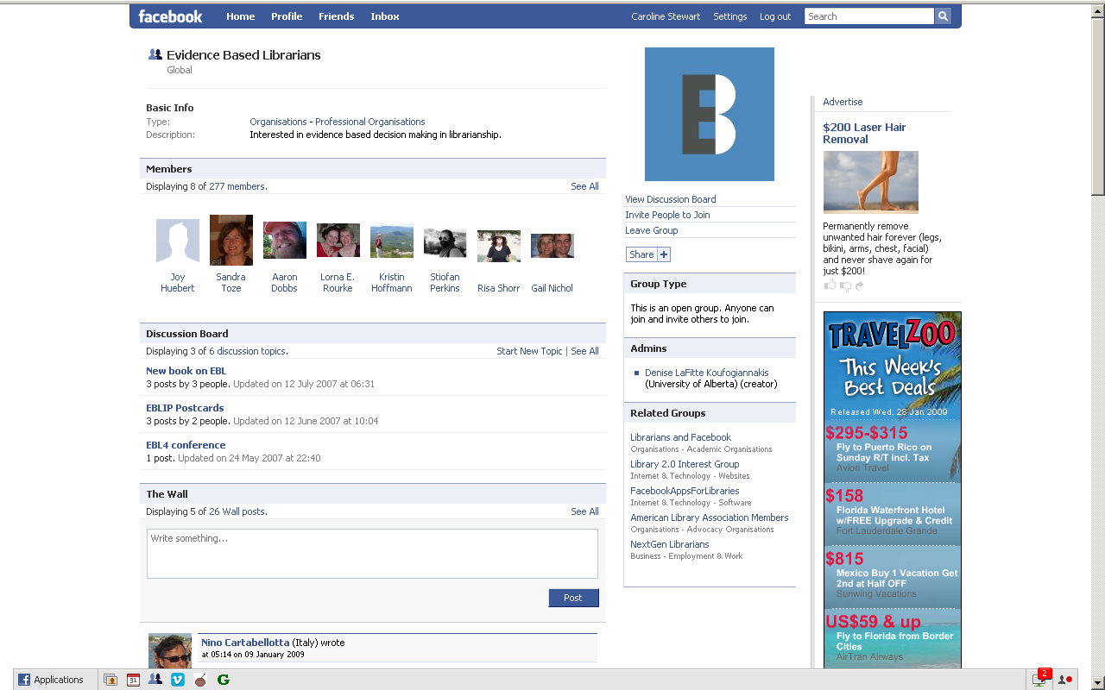

Slide 12
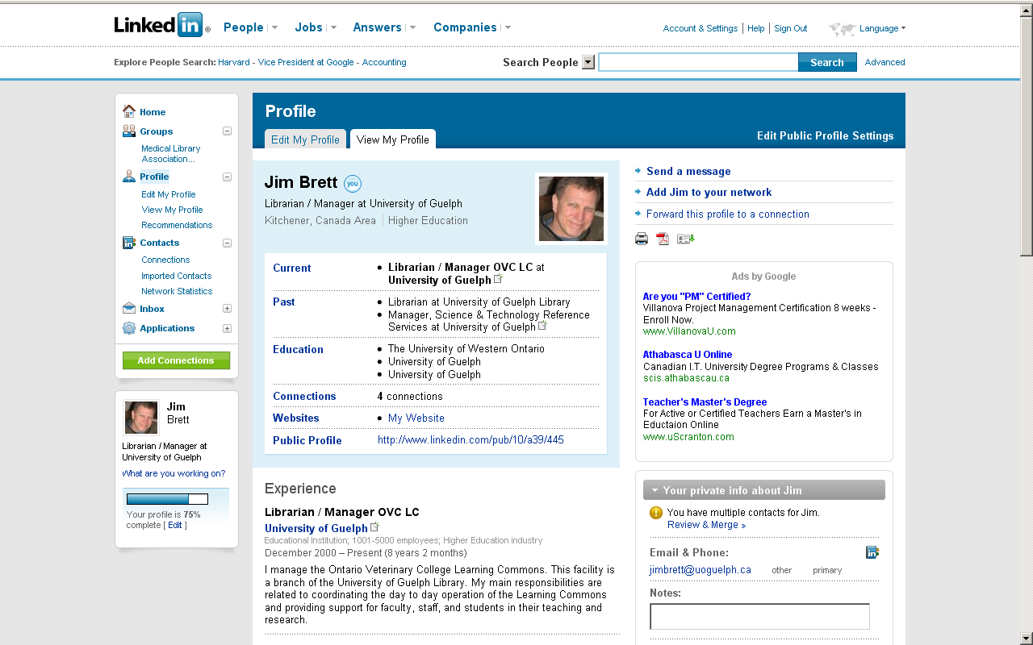

Slide 13
How? Start a conversation / make contact
Introduce yourself to strangers
Call people
Email
Here’s something to make things easier …

Slide 14
The 30 Second Commercial
This is a common exercise to get you thinking about how you portray yourself when meeting people.
Your personal marketing moment.
Think about what you would say to strangers in an elevator.
Its about what you can give to another person. Its about sharing.
Ask how they got to the position that they are at? What are you passionate about. You may need to think about these ideas before you begin your networking experience.

Slide 15
Debbie's 30 second commercial
I am Science Librarian at Wilfrid Laurier University. I have a doctorate in science and this has allowed me to create new and exciting changes in my job. I have only been a librarian for just over a year. I am passionate about teaching and research. I think more librarians should actively engage in research. Do you have any thoughts about how to create more research opportunities for new librarians?

Slide 16
Caroline's 30 second commercial
I am a liaison librarian at the University of Guelph-Humber. I have been a librarian for two and a half years. I am involved in the Ontario College and University Division of the Ontario Librarian Association as the incoming vice-president/president elect. I also was involved in planning Super Conference 2008 and 2009. Being involved in professional organizations has really benefitted my career. How important do you think professional involvement is for librarians?

Slide 17
Anatomy of a 30 second commercial
The Intro
Name and current situation
The Message
What you do and what your passions are
The Ask
Send the message outwards
The Hook
How you can help and what your strengths are

Slide 18
Let's Build Your Commercial
Take five minutes and create a 30 second commercial that’s reflective of your current situation that you can use at this conference.

Slide 19
Changing Nature of Your Commercial
Who you are professionally, what you’re interested in and involved in change over your career.
Your conversation starter can change as often as you need it to …
- looking for a job
- beginning professional
- new involvement or responsibilities

Slide 20
1983 (as a student at UWO)
Hello, my name is Jim Brett and I'm a student in the MLS program at the University of Western Ontario.
Prior to enrolling at Western I completed an Masters degree in science at the University of Guelph and
spent a year working as a researcher in plant science. I noticed that you are a science librarian - that's the field I'd like to work in. I wondered if I could talk to you about science librarianship and what it's like to work in an academic library?

Slide 21
1986 (as a gov docs librarian at Guelph with two years experience)
Hello, my name is Jim Brett. I’m a government documents librarian at the University of Guelph. My main responsibility is collection development for Canadian federal and foreign national documents. I’m interested in speaking with other gov docs librarians about the tools they use for collection development and assessment.

Slide 22
1995 (as the Chair of the Canadian Association of University Teachers' Librarians Committee)
Hi, my name is Jim Brett a librarian at the University of Guelph. I'm also the current Chair of the CAUT Librarians' Committee. I've read about your institution's new collective agreement and wondered if I could spend a bit of time with you discussing how the language for the librarian members was incorporated
into the faculty document.

Slide 23
2009 (as a member of the Liaison Librarian Review Committee of the UoG Library)
Hi there, I'm Jim Brett. I work as a liaison librarian at the UoG and I'm the manager of the Veterinary College learning commons. We're going through a review of the structure of our liaison group and the services we provide. I see you work at XXXX and I understand that you have organized functional teams that deal
with a broad range of service delivery issues. Could I take some of your time to talk to you about how you defined and created the functional teams.

Slide 24
Socializing vs. Networking
Networking is not about getting a date
Be professional
Be sincere
We all have something in common
Smile - use open body language and make eye-contact
Have a business card - even if it just reciprocity
Don't be overly aggressive
Don't sit with your friends
Show up to events early to meet new people
Networking is less about you and how you can help others
Networking is not disingenuous

Slide 25
Contact Us
Jim Brett jimbrett@uoguelph.ca
Debbie Chaves dchaves@wlu.ca
Caroline Stewart caroline.stewart@guelphhumber.ca

