Slide 1

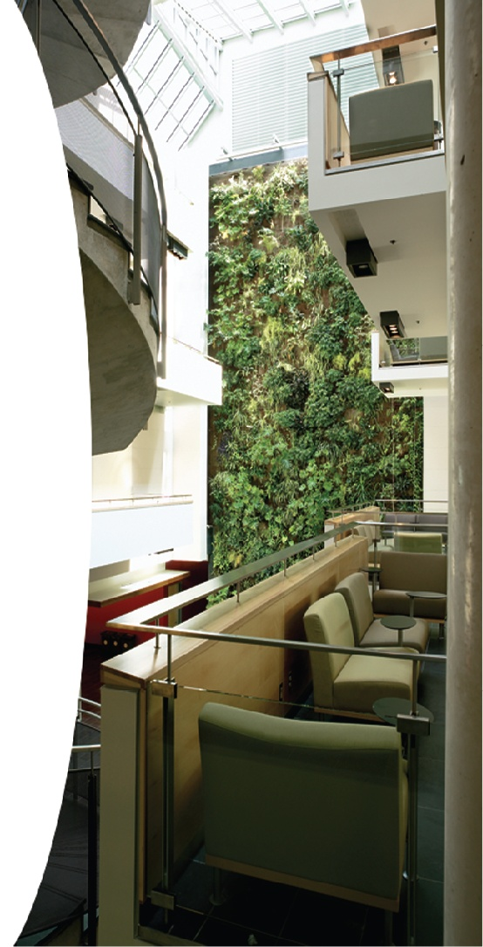
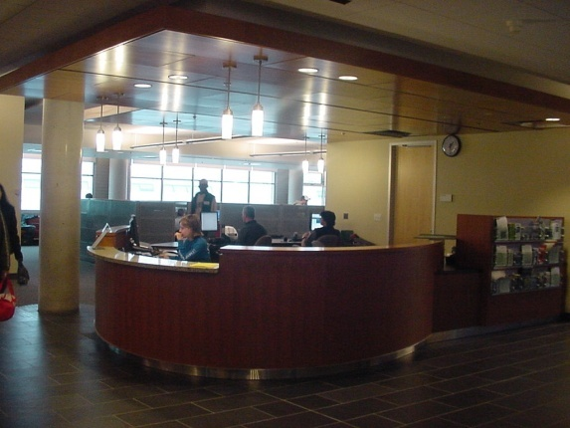
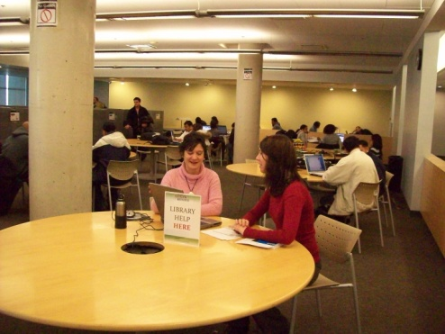
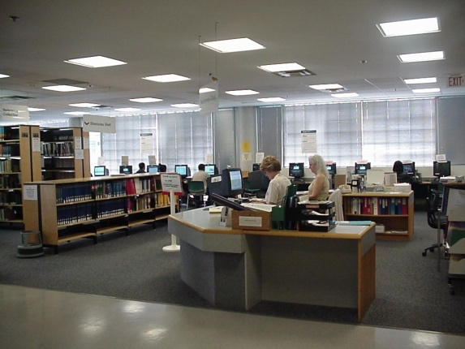
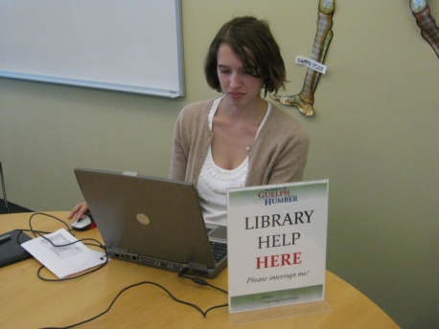
Making Reference Work!

Slide 2
Decline
in numbers of reference transactions
Between 1991 and 2002,
the number of reference
transactions dropped by
26.27%
*ARL stats 2002, Landesman (2005)
Notes:
We are all aware of the constant decline in reference questions’ numbers. In the article 'Getting It Right-The Evolution of Reference Collections' Margaret Landesman points on the ARL stats, showing that the numbers of reference and circulation transactions dropped below 1991 levels. Between 1991 and 2002, the number of reference transactions dropped by 26%.27.

Slide 3
Decline
ARL statistics, Librarians at the Desk: Yes or No?, Lake & Millard (2007)
Notes:
Following trends few years ago our colleagues from McMaster had presentation on to have or not to have librarians at the reference desk.

Slide 4
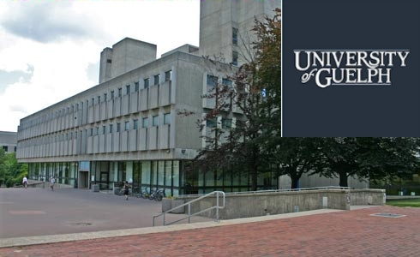
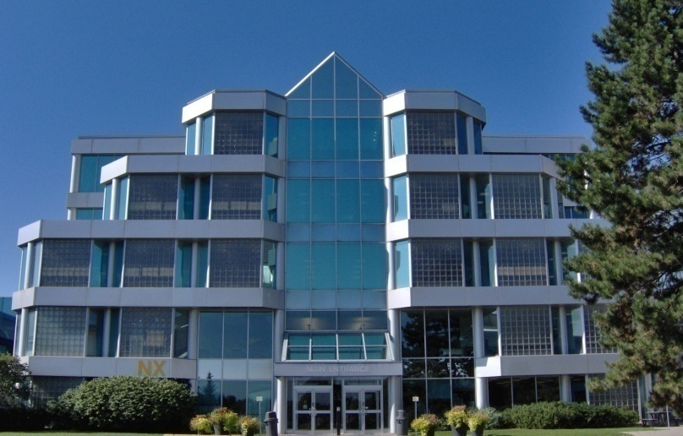

“Best of both worlds”
– a degree and a diploma
Notes:
University of Guelph Humber is a very unique institution. It started in 2002 as a collaborative project between University of Guelph and Humber College. Students get the theoretical aspects of their field of study from U of Guelph. They get the practical application of their research from Humber College. In essence they have “Best of both worlds” – a degree and a diploma. This unique educational setting has, of course, unique requirements for the University’s library services.

Slide 5
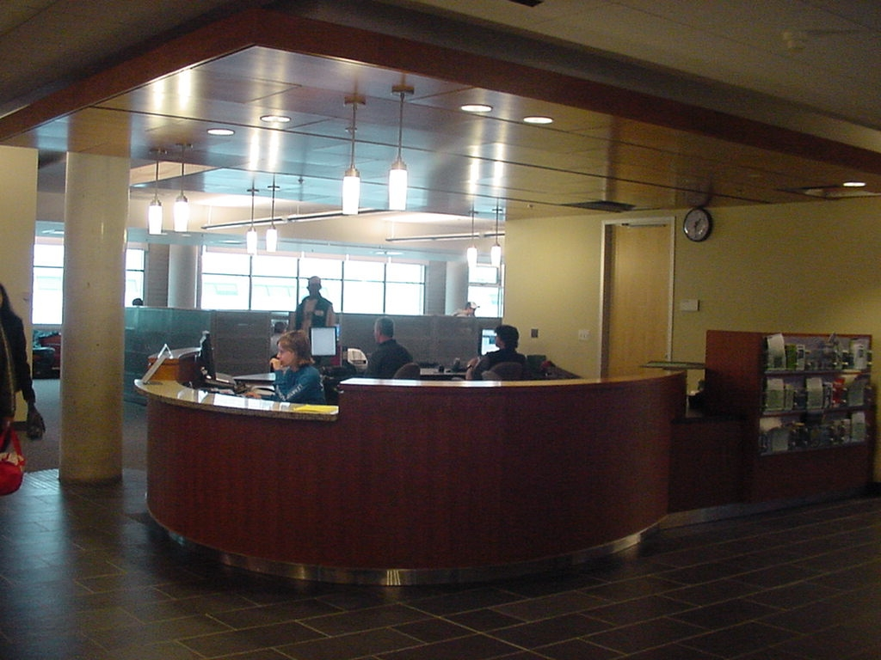
Learning Commons Desk
Notes:
At the end of 2002 UofGH building had been finished, Learning Commons had been open and information desk built. Library staff constituted from UofGH and Humber staff shared desk with LSPs (Learning Support Peers) and CSAs (Computer Supports Assistants); student support peers.

Slide 6
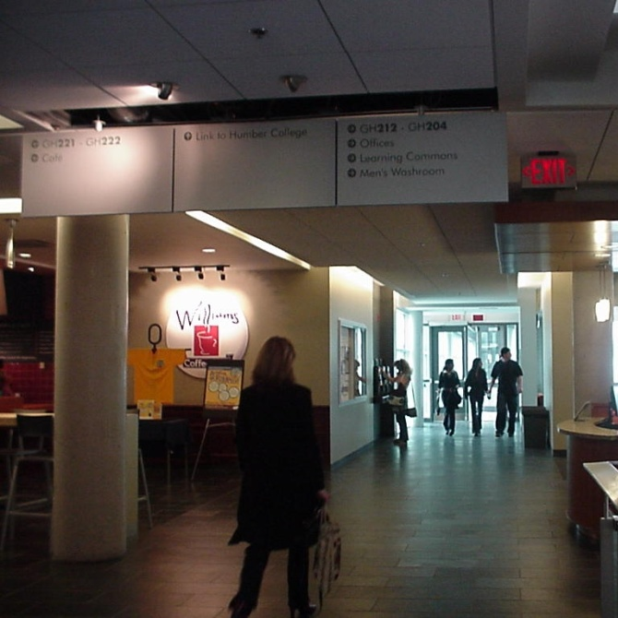
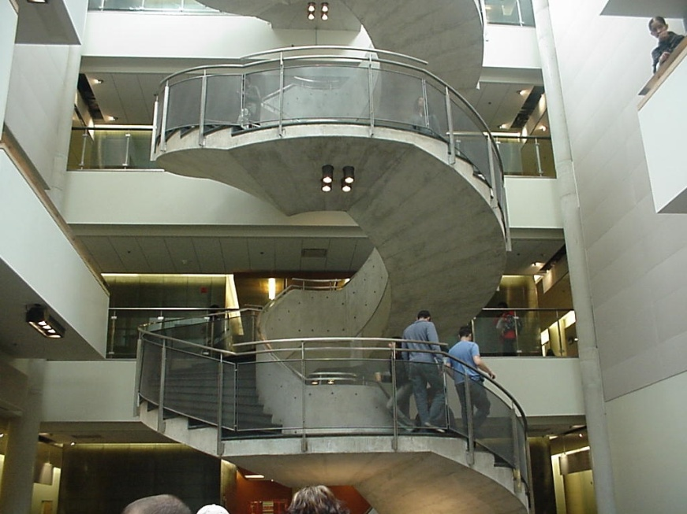
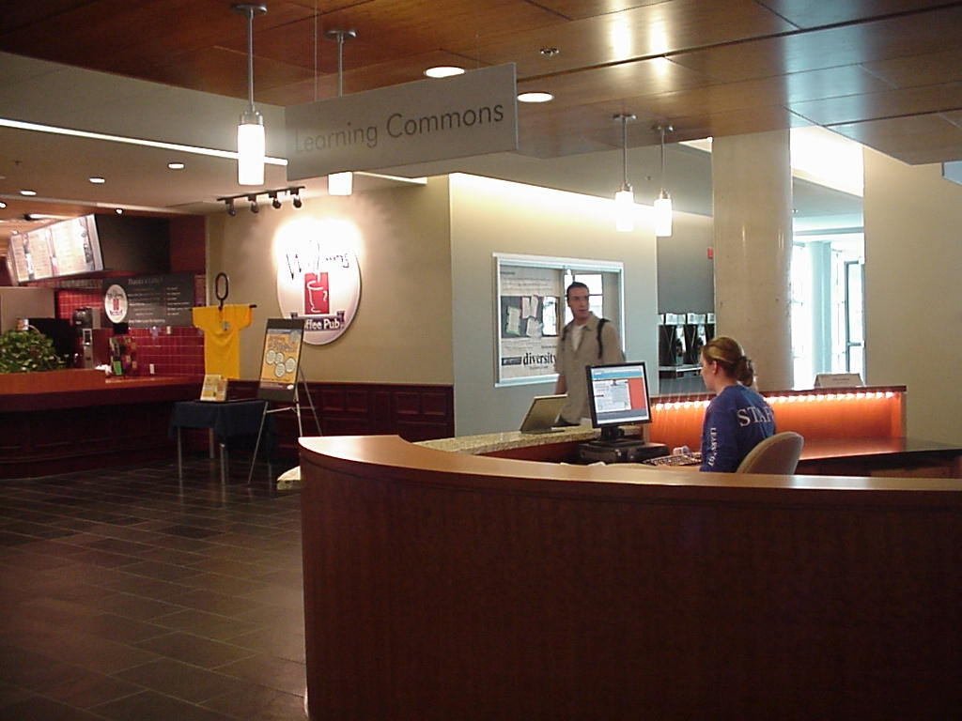
Research and William’s
57.5 hours per week
2003
Notes:
LC desk is the center of the second floor, right between the stairs that lead to classrooms and bridge that connects GH with Humber, facing the Williams and Internet cafe.
We started offering 57.5 hours per week of reference services at the new location, including weekend hours.

Slide 7
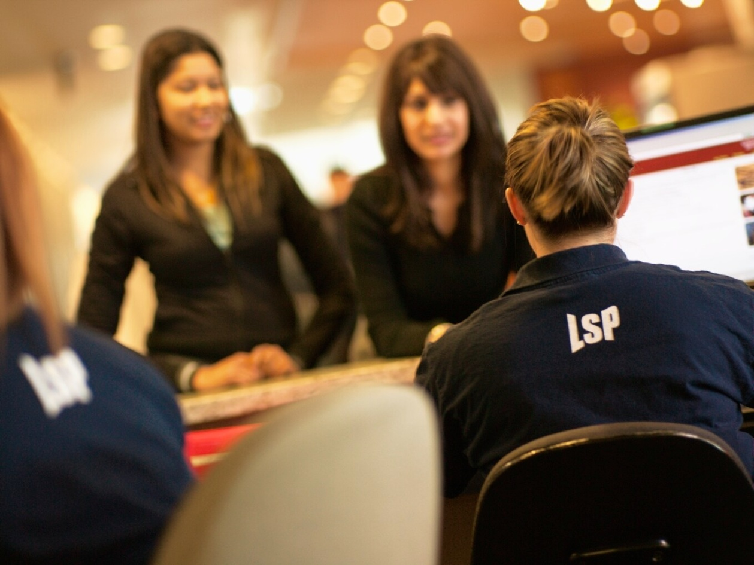
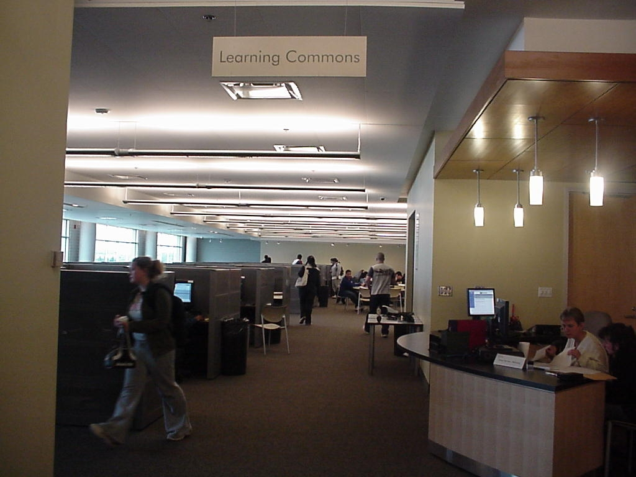

Social hub
43.5 hours per week
2005
Notes:
The position of the desk itself has created the desk into the centre of the social hub. It was hard to connect the same desk with the possibility to start research, or explore library catalog and databases. The hours decreased.

Slide 8

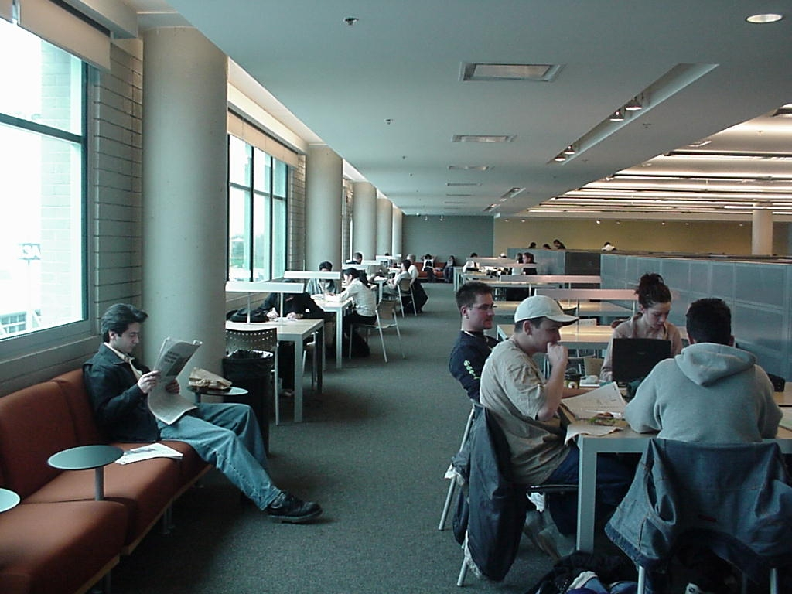
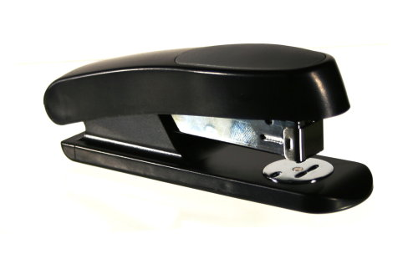

Stapler!!!
31.5 hours per week
2009
Notes:
In 2008 hours were further reduced to 39.5. Library staff working at LC desk, were overwhelmed with social atmosphere of the commons and with the lack of library related questions (stapler became the synonym for the desk service).

Slide 9
Hours Decrease
Notes:
The number of students approaching LC desk was constantly declining. Further reduction of hours was expected and staff even started to advocate total abundance, leaving desk to student peer supporters only.

Slide 10
It was time for a new approach!

Slide 11
Library Services Strategic Plan
Fall 2009
  New vision, mission and goals
    The University of Guelph-Humber Library is the recognized information service provider of choice for the University of Guelph-Humber academic community.
Notes:
In the fall of 2008 GH hired a new library manager, Norma Palomino who listened to our concerns and she wanted to add a fresh approach for the direction of our library, which we welcomed. Our entire library team under Norma’s guidance began developing a new strategic plan, with a new vision, mission and goals.
VISION
What this new vision meant for the library was we had the challenge of instilling in the students and faculty that the University of Guelph-Humber is the information service provider of choice for the GH community. We realized early on in the process that we were competing for our user’s attention because they were so reliant and comfortable using the internet rather than utilizing our vast resources. As a result, part of our strategic plan was based on redesigning our reference approach and educating the user.

Slide 12
Library Services Strategic Plan
Promotion and outreach a priority
Accessibility
Access to two libraries… therefore:
2 catalogues
2 library accounts
2 logins to access to electronic resources
Notes:
Our strategic plan set 7 goals: and the ones we developed relating to reference services were faculty develop library services promotion strategies, create a culture of assessment of library services and reinforce our partnership with our LC partners.
Promotion and outreach become a priority. We realized that we have a wealth of resources available to our users but they were not aware of them. During the focus groups and other consultations, we showed stakeholders different sections of our website or explained the collections accessible to them, and they showed surprise, excitement, and regretted not knowing about the services before.
Related to the lack of awareness issue comes accessibility. Our students are lucky enough to have access to two library collections, but that also involves access challenges. Having two libraries encompasses having 2 catalogues, 2 library accounts, and 2 logins for electronic resources. This complexity of resources often deters students away from our services.

Slide 13
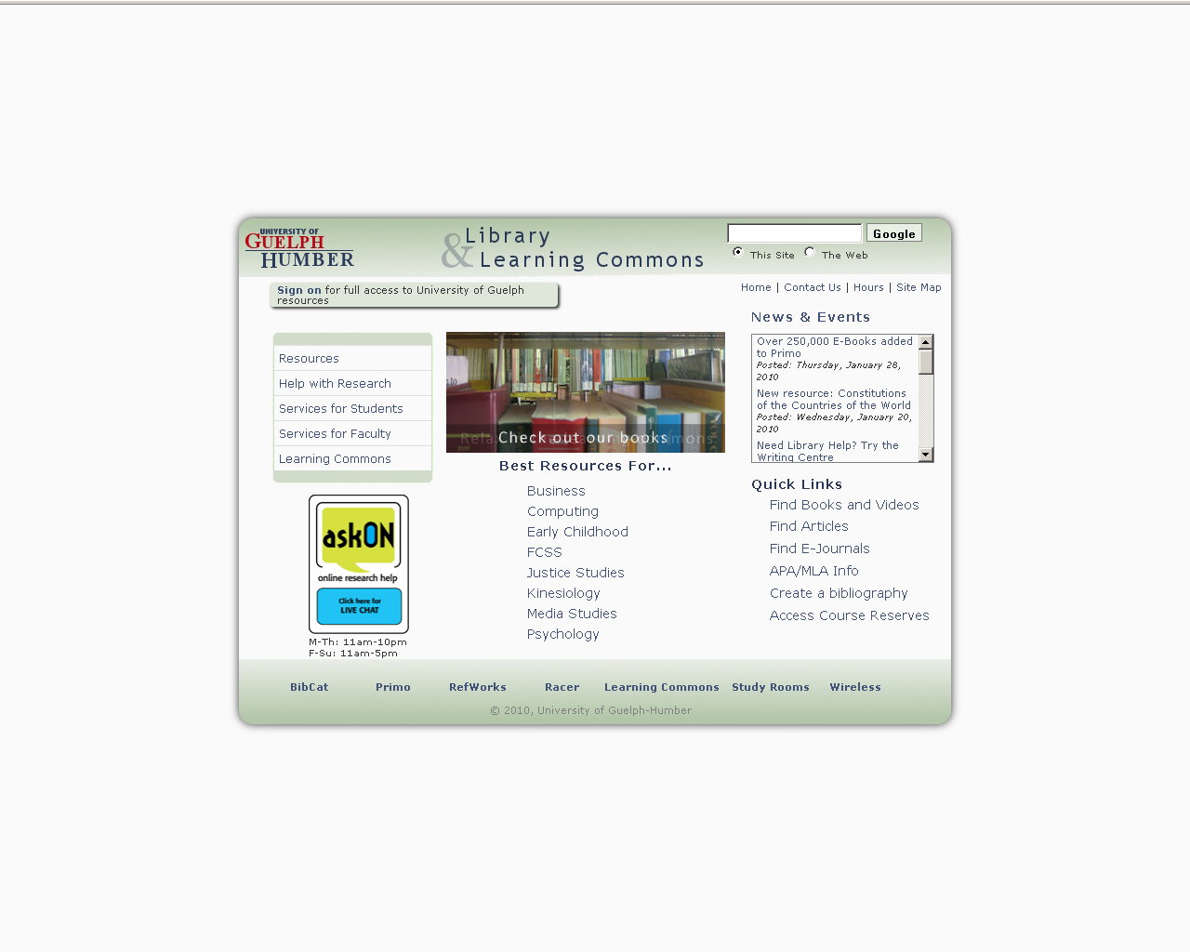
Library Services Strategic Plan
Notes:
This is our library webpage. At the botton, you’ll the two links for our student to access both the BibCat (Humber College) and Primo (the UofGuelph)catalogues

Slide 14
Library Services Strategic Plan
Culture of Continuous Assessment
Notes:
During the strategic planning process, the library team reinforced the commitment to a culture of continuous assessment. After we identified the need for change in the Learning Commons reference position, we stated a process of data gathering to support our decision-making

Slide 15
Library Services Strategic Plan
Learning Commons survey
  52% students call the LC something else
Focus groups
  More one-to-one interaction
LibQual survey
  Physical space
  Lost in Humber
Notes:
Among other tools of assessment to make a decision about our reference position situation, we conducted a survey to find out how our students envisioned the Learning Commons as a place and what they called the space.
Surprisingly enough, we’ve found out that 52% of the students called the LC not “Learning Commons”, but rather something else. All these names made sense, representing different functions for the students and how they used the space.
Some examples that were given,
Names given by students:
* Williams area: the Williams coffee pub is the only place in the GH building where students can have a meal and socialize.
* GH, Guelph-Humber: 40% of the students who populate the Learning Commons are Humber College Students. We found that the Humber students would call the LC simply “GH” because they are actually going in the UGH building.
* Computer area/place, Lab, GH Lab: Almost half of the study area at the LC is populated by computers for student access. Students take great advantage of these computers for working on their assignments, printing, or just checking out their friends in Facebook.
* The Commons: this is the closest name to the real name that students give to the place. However, it emphasize the social aspect of it rather than the “Learning” piece of it. One of the students even name it: “the social library”
* 2nd Floor, Guelph-Humber 2nd floor: this name simply refers to its location in the GH building
We also conducted several focus groups to gather feedback from our users. Contrary of what we expected following trends in technology, our users demanded more personal, face to face interactions with library staff members. We took this piece of advise as a key element to reshape the reference service position
Finally, UofGH Library Services participated in the 2009 Winter edition of LibQual and users identified the Library as the area that required urgent change. This includes all learning areas that GH students use daily, including of course the learning commons.
The survey has 664 responses from which 230 had written comments. Amoung those comments, GH students expressed feeling overwhelmed by the number of Humber students populating the place. We have to think that the Humber student population rounds 17,000 students, while the GH student body gathers. 3,000 students. GH students are a minority, and they feel it. Library services at GH has a commitment to student services and provides help to all students regardless their affiliation. However, the fast-growing GH student population loudly demanded more customized attention. This was taken into account as well when redefining the new position.

Slide 16
Library Services Strategic Plan
Interviews with Learning Commons partners
  Writing Centre
    Students “I need to write a paper”
    Writing tutors providing research help to students
Notes:
As part of the assessment process, we interviewed our Learning Commons partners, the Math and Writing Centre and asked them for feedback and ideas to better understand their place and our place in the LC. Also, our idea was to research and understand our students behavior rather than seek what “was working wrong”. We decided whatever pattern of conduct our students displayed, Library Services should re-arrange and accommodate the way we delivered our services to accommodate to the student body’s behavior.
A key element in this research was meeting with the Writing Centre Manager, Franc Jamierson. Franc provided valuable feedback regarding the students research process at the WC. Students most often go to the Writing Centre to get help writing a paper, this could range from how to write a thesis statement, to grammar usage, to correct citation styles and very often research based questions. Franc and the tutors find that many students do not follow standard steps in research, such as first searching for information, reading the literature, brainstorming ideas, and finally writing.... they rather do all these steps at once. Saying this, there are more seasoned students that have begun writing their papers and are just looking for some fine tuning.
As I just mentioned the much of the help that the writing tutors were providing was helping students find research. While the tutors did an excellent job, they were not trained or necessarily familiar with our databases.
This fact made us aware of a service opportunity for the library, since the writing tutors were performing a typical library-related task: searching for information.
Writing and researching are inter-vowed processes. As such, having a writing centre detached to the library gave us an opportunity to go the other way around, and bring a library service to the writing centre.

Slide 17
Library Services Strategic Plan
Redefine the position
  Winter 2009: two pilot projects:
  Librarian with(out) a Latte
  Reference assistance at the Writing Centre
  RSPs
Notes:
With this information from Franc, talking with students and our survey we thought we should redefine our reference position in the LC and move to a different service model. After brainstorming our options, the team decided to try 2 different models: “librarian with a latte” (although we didn’t’ actually have a latte, we could of since Williams was right across the way!) As well, have a position in the Writing Centre.
In the winter semester of 2009 we split the position between the two locations. In the morning we situated ourselves with a laptop and sign at a table that students use to study and gather in the LC. In the afternoon we provided assistance at the WC.
The experience for us as staff was quite interesting and very different at each location. At first when we moved to the LC “librarian with a latte or laptop” we had a few curious students asking us the odd question here and their, but at least they weren’t stapler related questions. Then not to far into our experiment we started to sense an indifference and even a little hostility that we were taking up space in a place where space is very limited. Although we were trying to make library access even easier for the students, they just seemed not to get their head around us being in their space.
On the contrary, the Reference assistance at the Writing Center was gradually increasing the number of consultations, reaching to 40 at the end of the semester. Franc, the writing center director, was instrumental for this success. He is an enthusiastic supporter of this writing center/library joint venture, and make sure every writing tutor knew of the availability of the research support point there. We noticed that the quiet environment provided by the Writing Centre helped students identify an area of study with concentration. You may think that 40 questions for our first semester is not much, however the questions we were getting were lengthy research questions lasting more than 1 hour, using several resources, exploring not only University of Guelph databases and library collection, but also utilizing our physical collection in the Humber library. Although I must mention that of the success we had supporting students was using our electronic resources. Part of our goal of course was to educate our users on how to perform successful searches so they would be able to do them on their own, and especially at midnight when they are at home.

Slide 18
Library Services Strategic Plan
Fall 2009
Research Help at the Writing Center
RSP
Notes:
So based on our little experiment in the Winter 09 semester we decided to move our postion to the Writing Centre and not keep the “librarian with a latte/laptop” position. However we did see a need for the students to have peers that could help them with library related questions.
The University of Guelph-Humber largely supports its recruitment efforts and student success goals using a support peer model. This model states that students learn better from their peers because they identify with someone from the student body, someone who can easily be on their shoes and have insight into their learning experience. Since the model is so successful in other GH areas ( particularly the Departments of Registrar and Student Support), we decided to give it a try and replace the “Librarian who has invaded their space” with this new model. In that way we are being responsive to a student demand and at the same time accommodate student preferences avoiding filling the learning commons desk position with a staff member. The program is called Research Support Peers and it´s still on a testing period.
This past semester The Writing Center position, has even become more successful with 155 questions in the fall semester. We are even getting a lot of repeat users now because they know they can get specialized attention and help. Along with the promotion that the Writing Centre has provided with the new service we have done a lot of outreach to students in our information literacy classes.

Slide 19
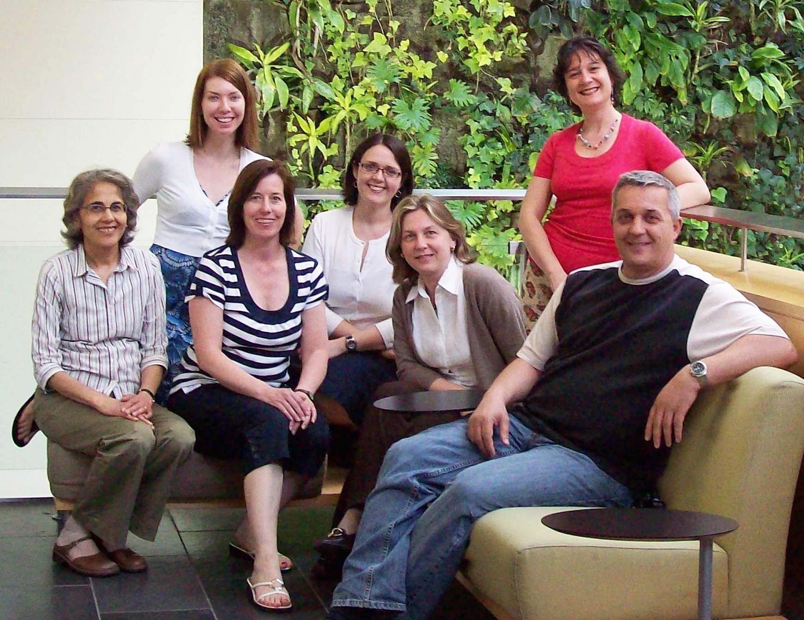
Library Services Strategic Plan
Notes:
Finally, all of this creative and energetic work couldn´t had been done without this amazing group of people at the UofGH library team. Thank you!

Slide 20
Library Services Strategic Plan
Questions?

Slide 21
Thank you !!!
Questions?
Feel free to contact us:
Denise Rooney denise.rooney@guelphhumber.ca
Dijana Kladnjakovic dijana.kladnjakovic@guelphhumber.ca
Our slides will be posted on the Conference site.

