Slide 1
Government information: Bridging the print/electronic divide
OLA Super Conference 2010
Session: 1805
Carol Perry, University of Guelph
David Burke, Queen's University

Slide 2
Outline
Web-based, born-digital, electronic government publications
Legislation, Policies, Directives
Access Strategies

Slide 3
Government Publications
Government Publications are "Ontario Government documents in any form, including print and electronic, intended to be distributed to the general public." They include, for example, statutes, regulations, annual reports of ministries and agencies, public documents on programs and services provided by ministries and agencies and statutory reports.

Slide 4
Legislation: Federal
Publishing & Depository Services
  Order-in-Council (1927)
  Department of Public Works and Government Services Act (1996)
  Communications Policy (2006)
  Common Services Policy (2006)
  Information Management Policy (2007)
Library & Archives Canada
  Library and Archives Canada Act (2004)
  Legal Deposit of Publications Regulation (2007)

Slide 5
Legislation: Provincial
Ministry of Government Services Act (2006)
Management Board Minute (1970)
Management Board of Cabinet Directive (1975)
Corporate Management Directive: Government Publications (1997)

Slide 6
Legislation: Municipal
Legal deposit does not appear to apply to publications of Municipal Governments
No co-ordinated municipal preservation projects
Muniscope (Intergovernmental Committee on Urban and Regional Research) has been collecting since the the 1960s but this appears more of a resource for municipalities themselves

Slide 7
Legislation: Summary
 | Collecting | Capture | Authority | Electronic | Publicly Accessible | Repository
Canada | Yes | 40%, 60%-80% | Legislative | Yes (M, S) | Yes | LAC, DSP(*)
Ontario | Yes | 75% | Policy | Yes (M, S) | Yes | OLL, Ozone, KO
Alberta | Yes | 25% | No | Yes (M?) | Yes | ALL
British Columbia | Yes | 75% | Yes | Yes (M?) | Yes | BCPL, BCLL
Manitoba | Yes | 50%-60% | No | Yes (M?) | No | MLL
New Brunswick | Yes | Unknown | Legislative | Yes (M?) | Yes | NBLL
Newfoundland and Labrador | n/a | n/a | n/a | n/a | n/a | n/a
Nova Scotia | Yes | Full (all PDFs) | Legislative | Yes (M?) | Yes | NSLL
Nunavut | Yes | 20% | No | Yes (M?) | No | NLL
Prince Edward Island | n/a | n/a | n/a | n/a | n/a | n/a
Quebec | Yes | Full | Legislative | Yes (M, S) | Yes | BAnQ (PGQ)
Saskatchewan | Yes | “Fair” | Legislative | Yes (M?) | Yes | SLL
Yukon | n/a | n/a | n/a | n/a | n/a | n/a

Slide 8
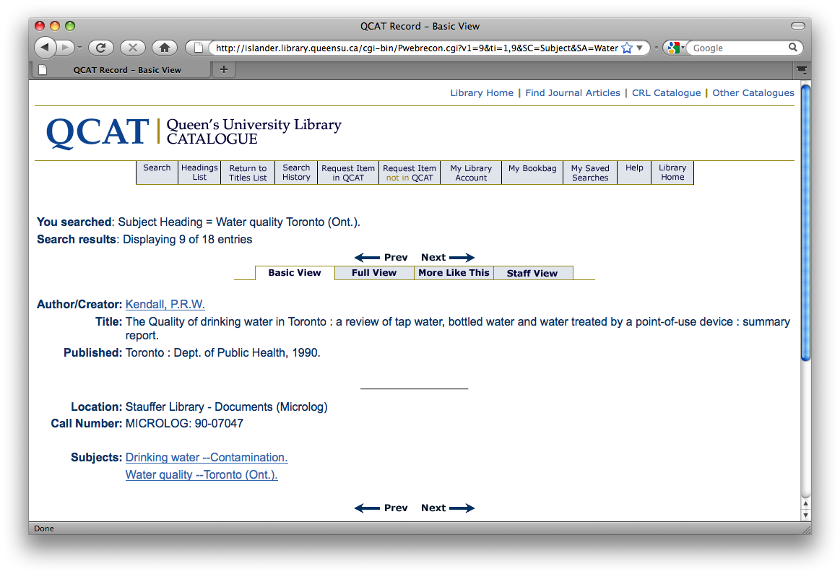
Access: CRI / Microlog

Slide 9
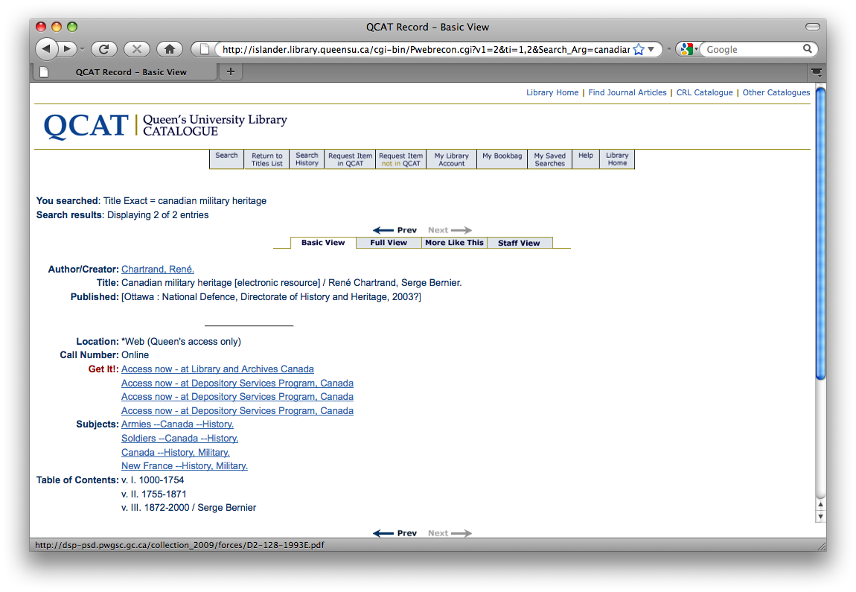
Access: QCAT to DSP

Slide 10

Access: QCAT to LAC

Slide 11
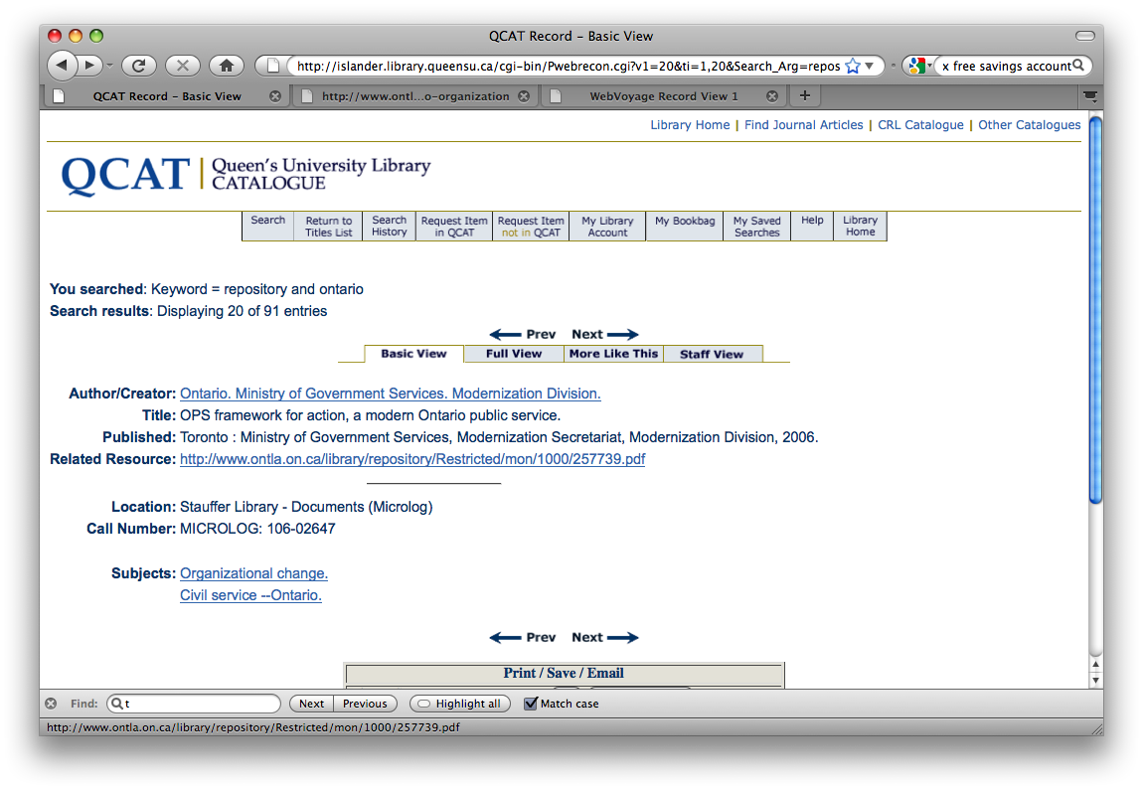
Access: QCAT to OLL

Slide 12
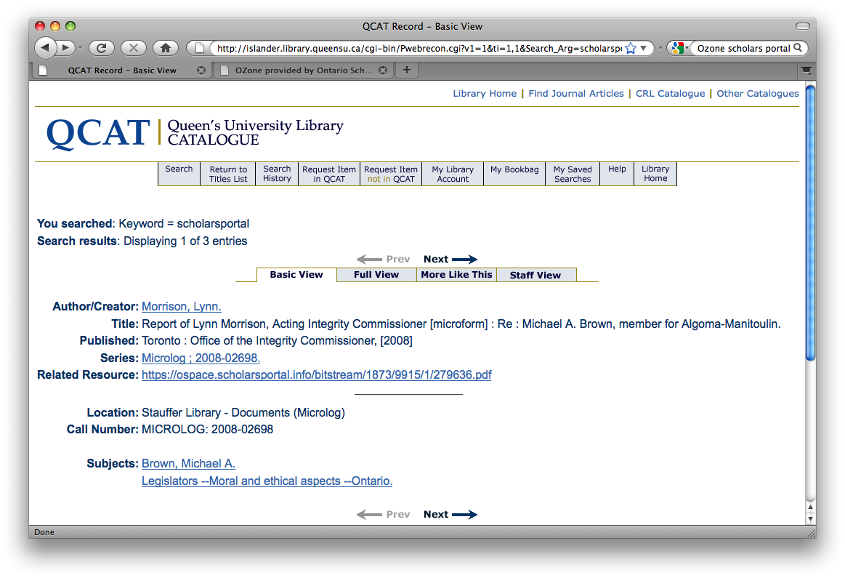
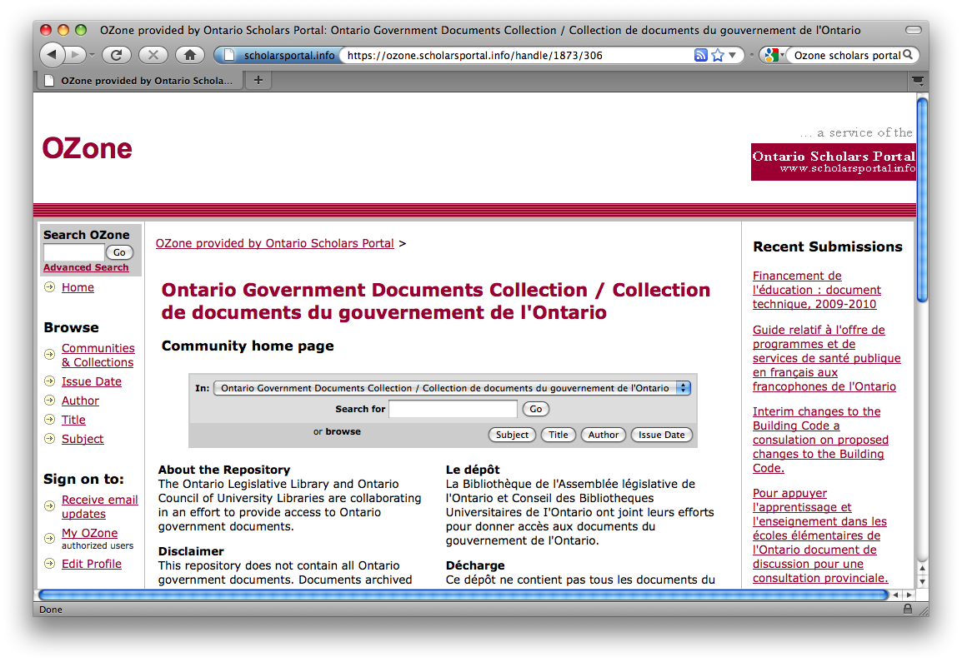
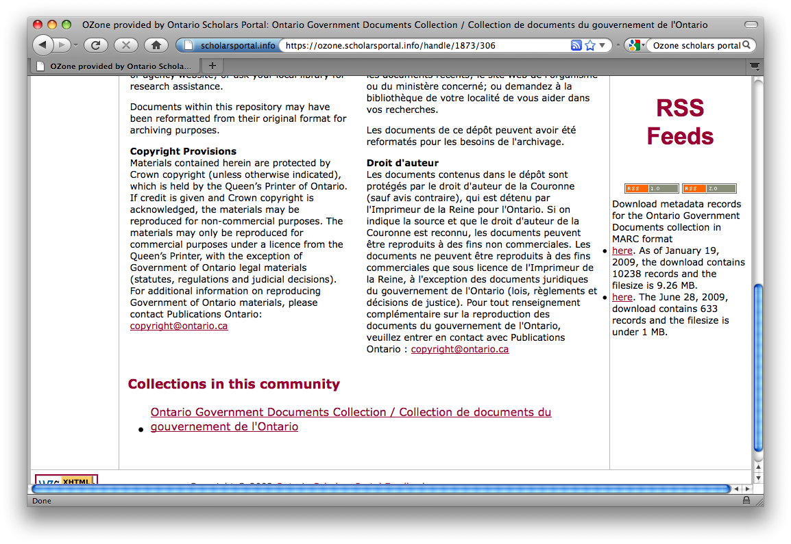
Access: QCAT to Ozone

Slide 13
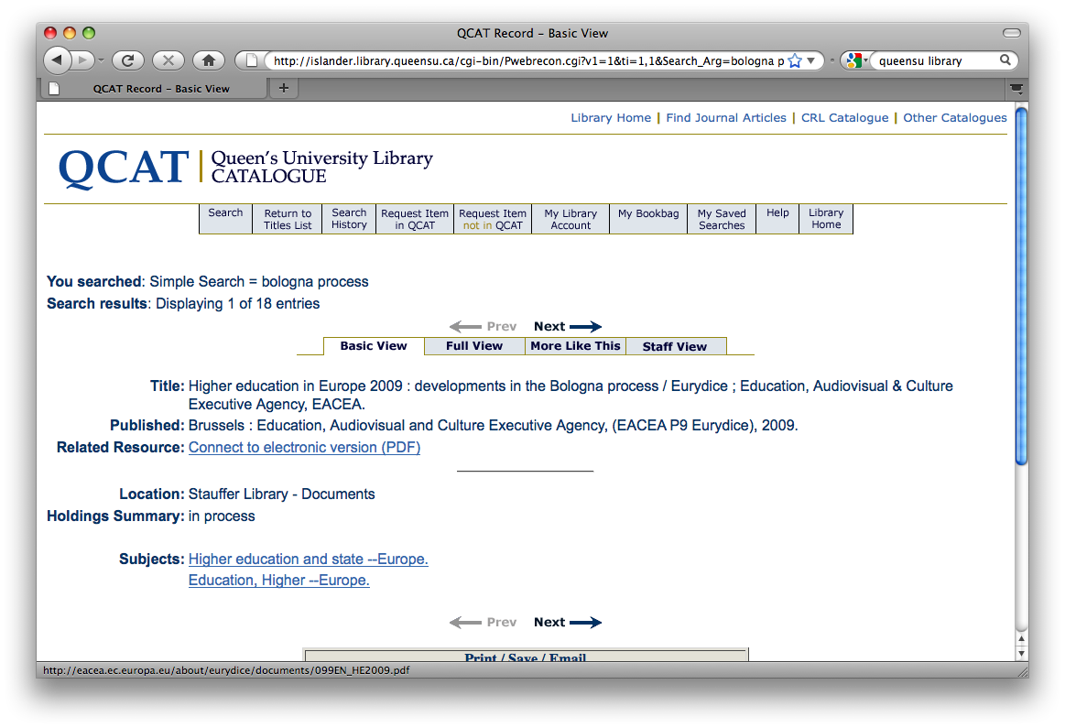
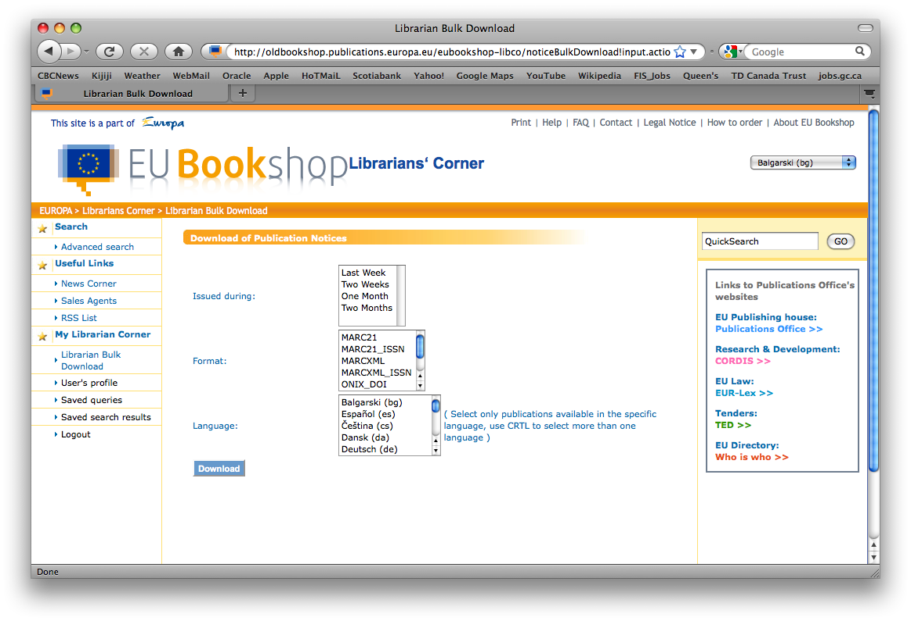
Access: QCAT to EUi

Slide 14
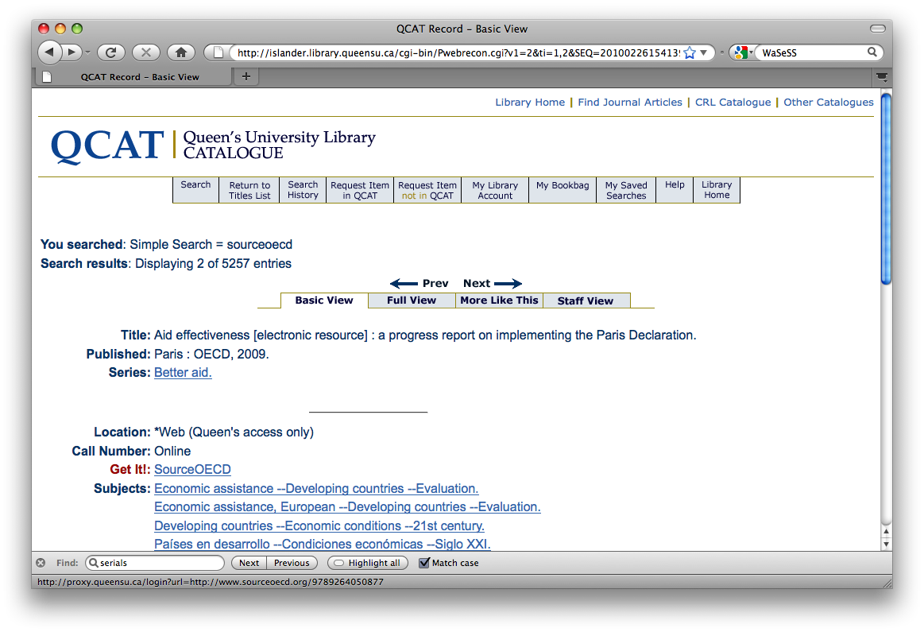
Access: QCAT to OECD

Slide 15
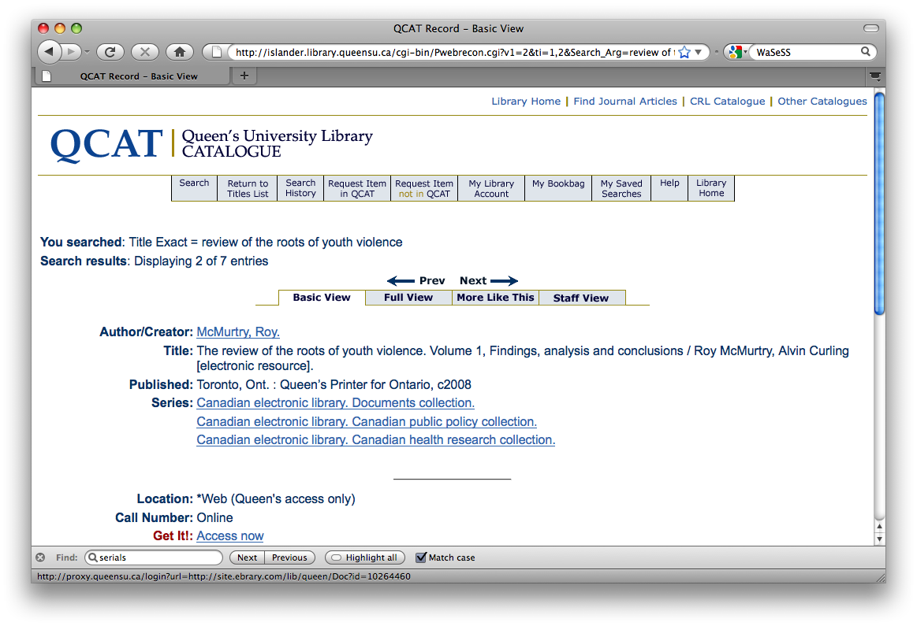
Access: CEL

Slide 16
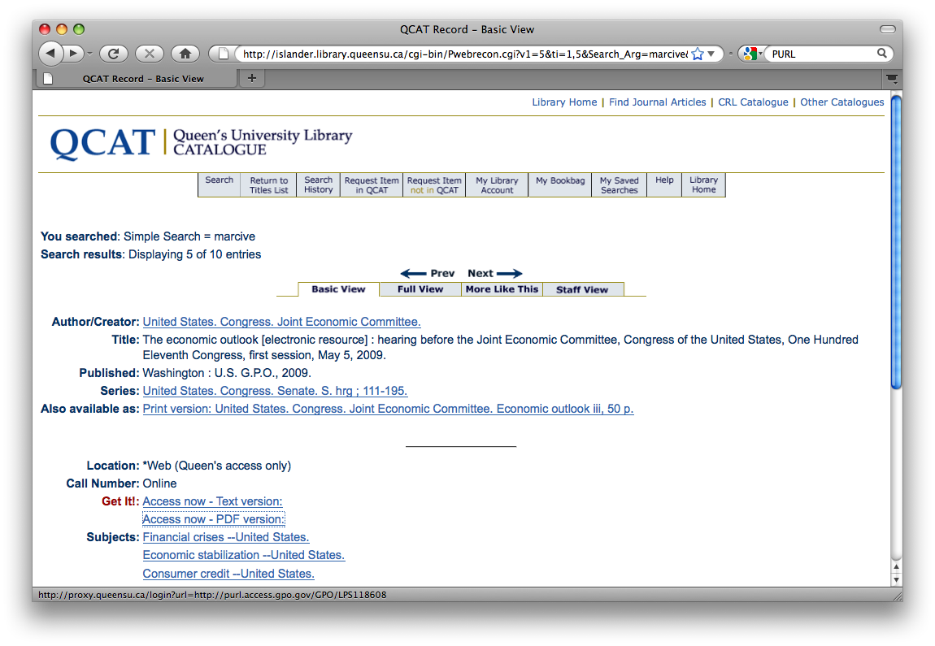
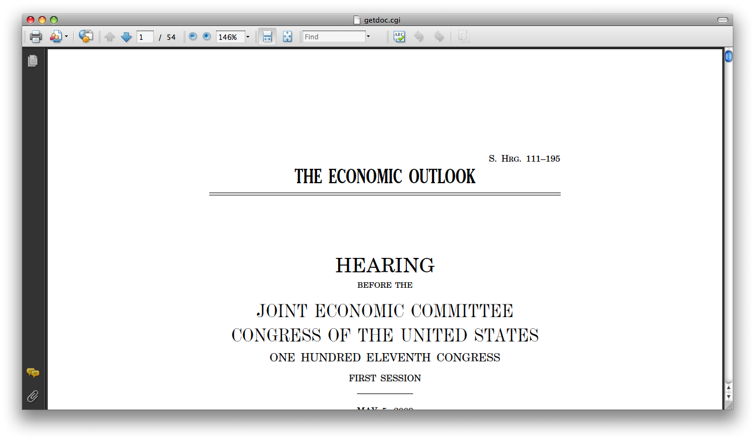
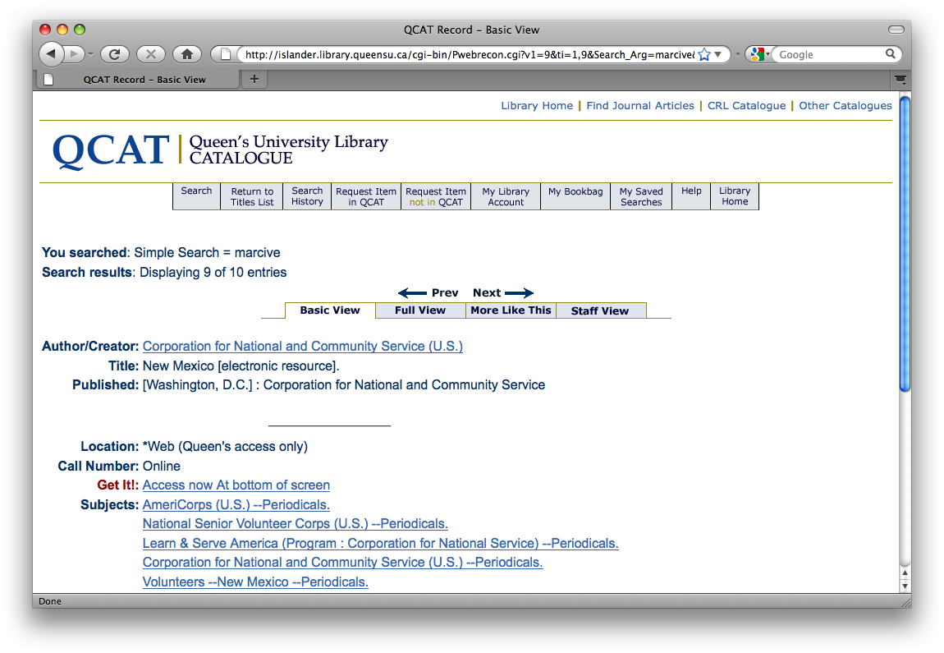
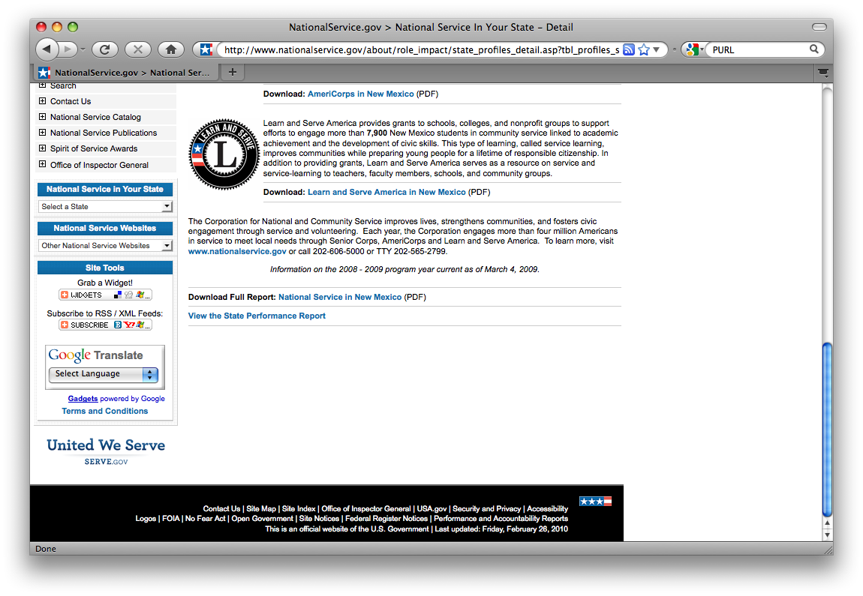
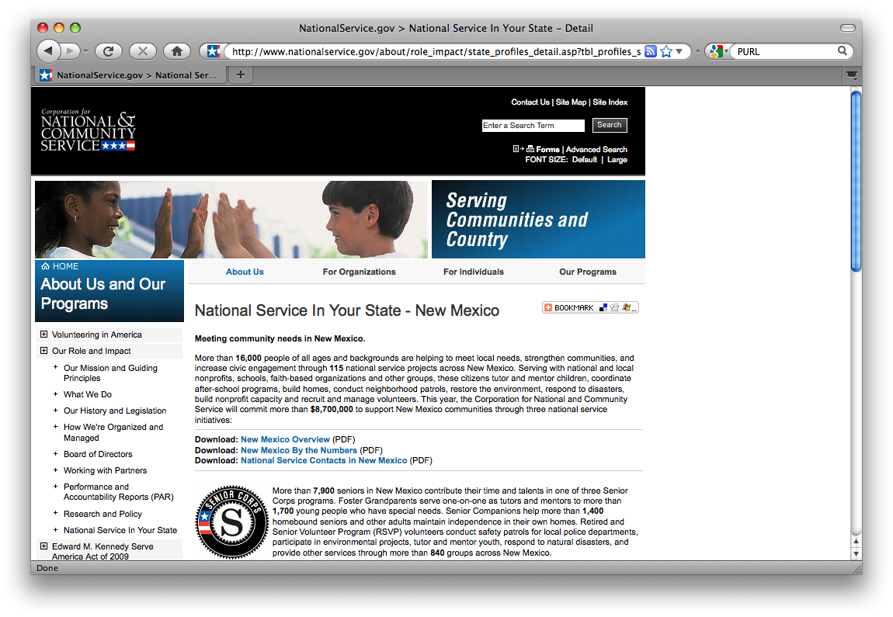
Access: QCAT to Marcive

Slide 17
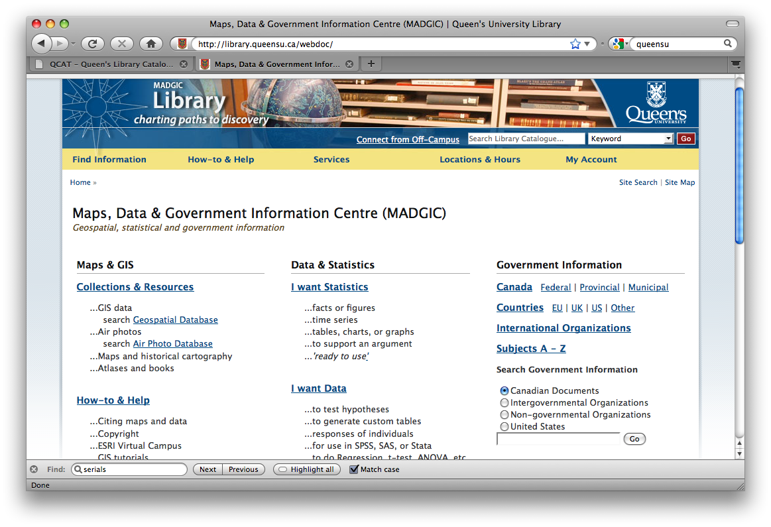
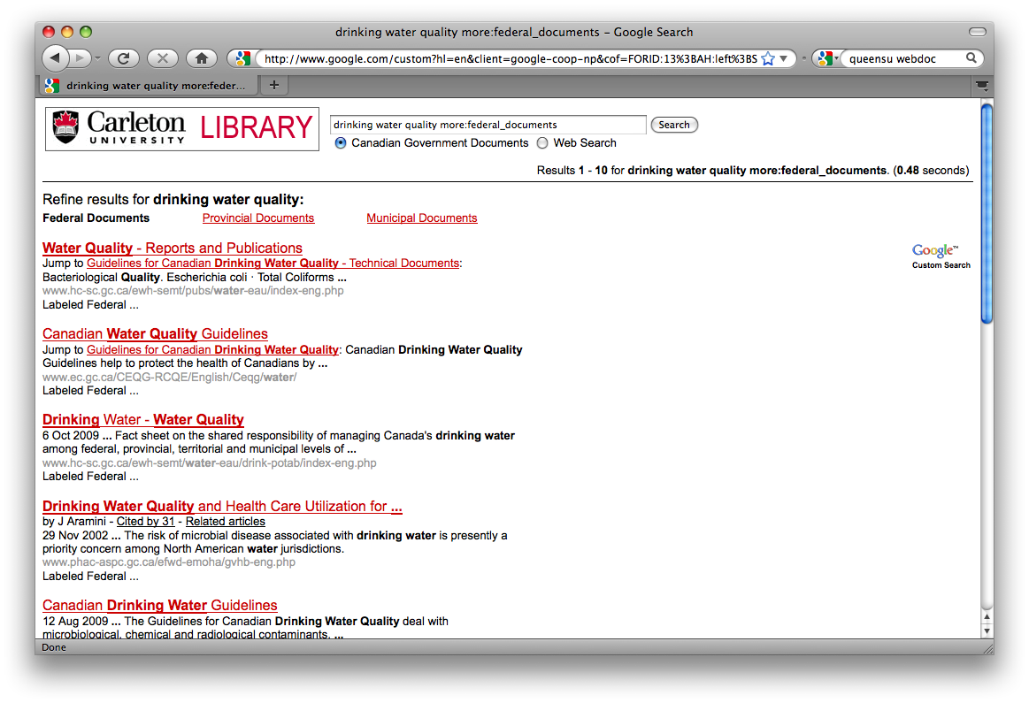
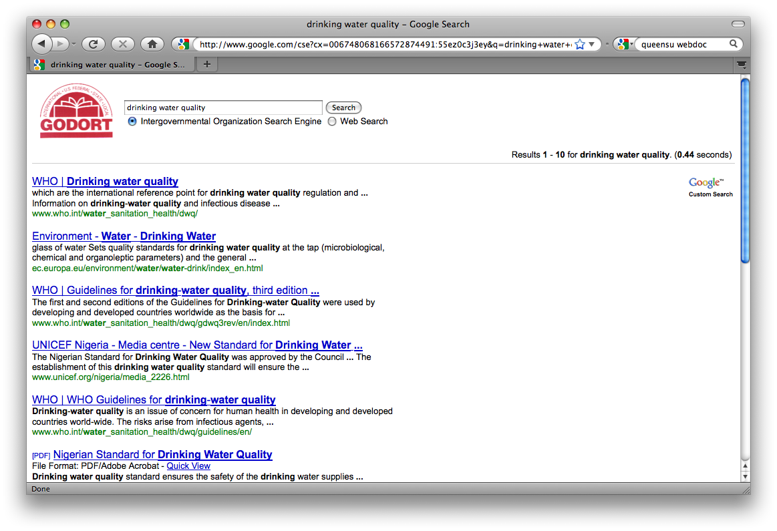
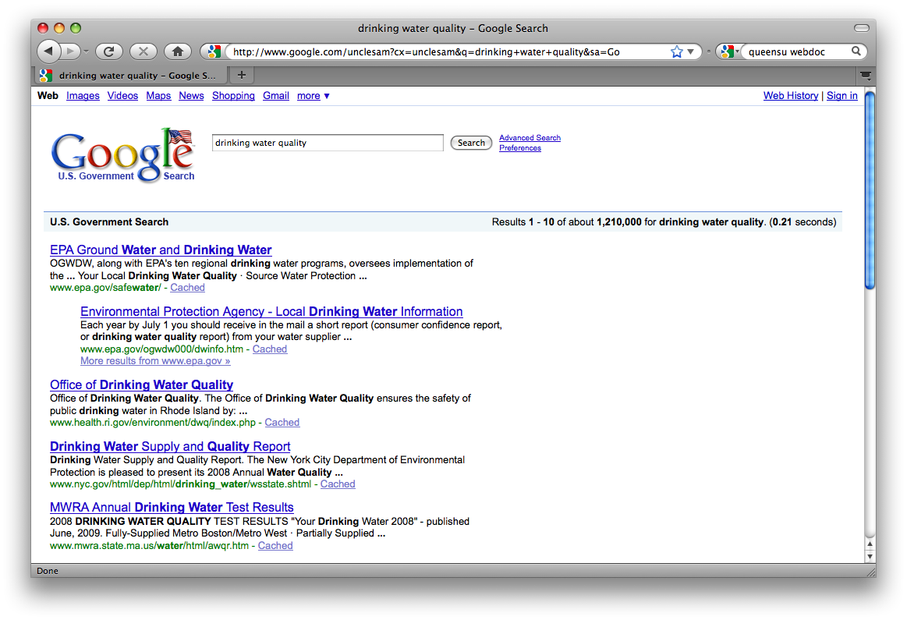
Access: CSE & Widgets

Slide 18
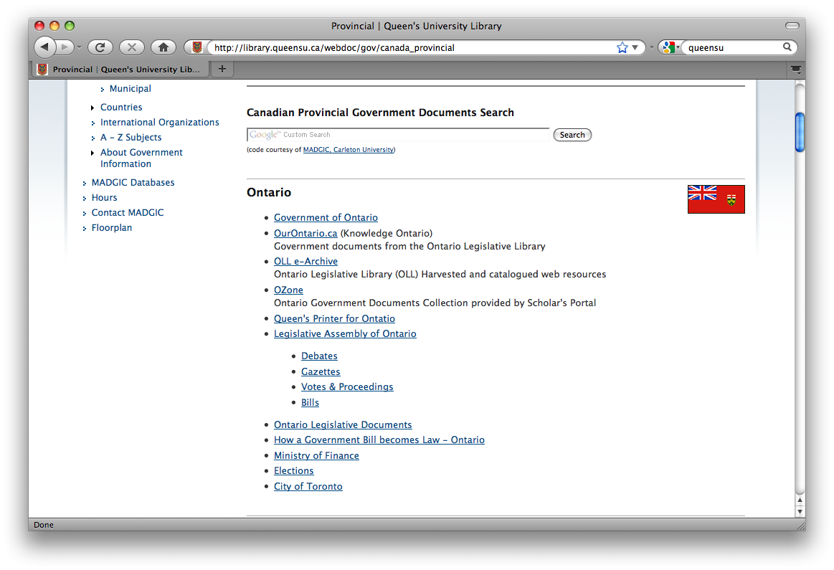
Access: Guides

Slide 19
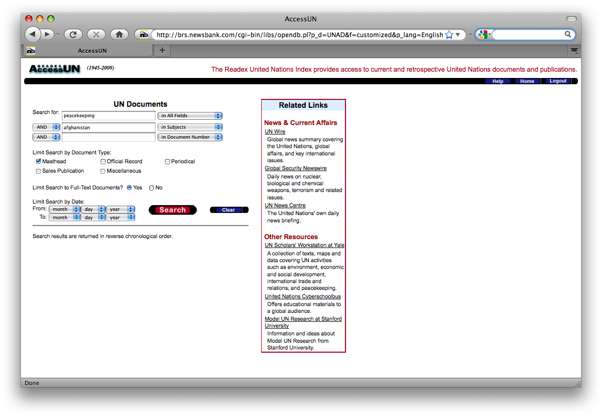
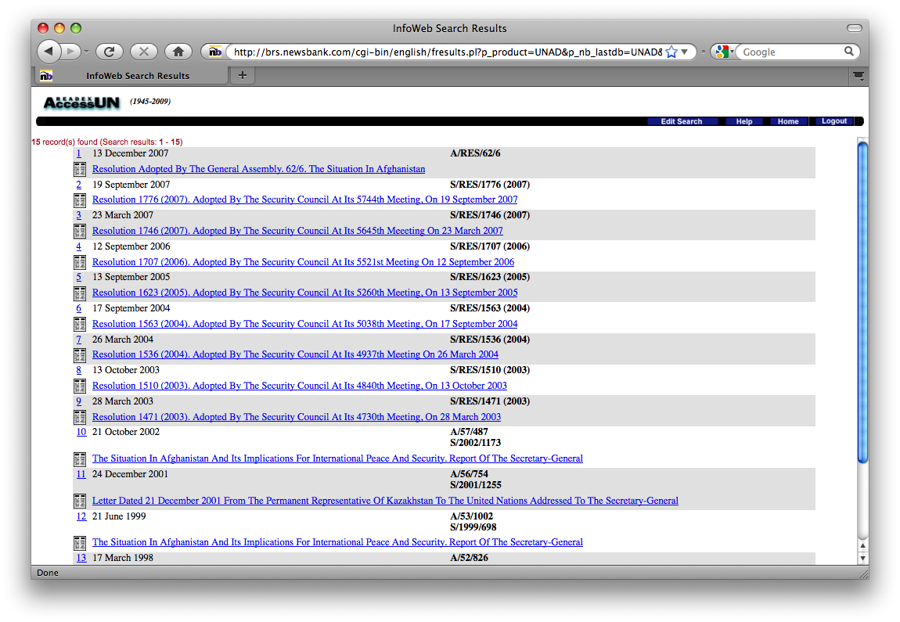
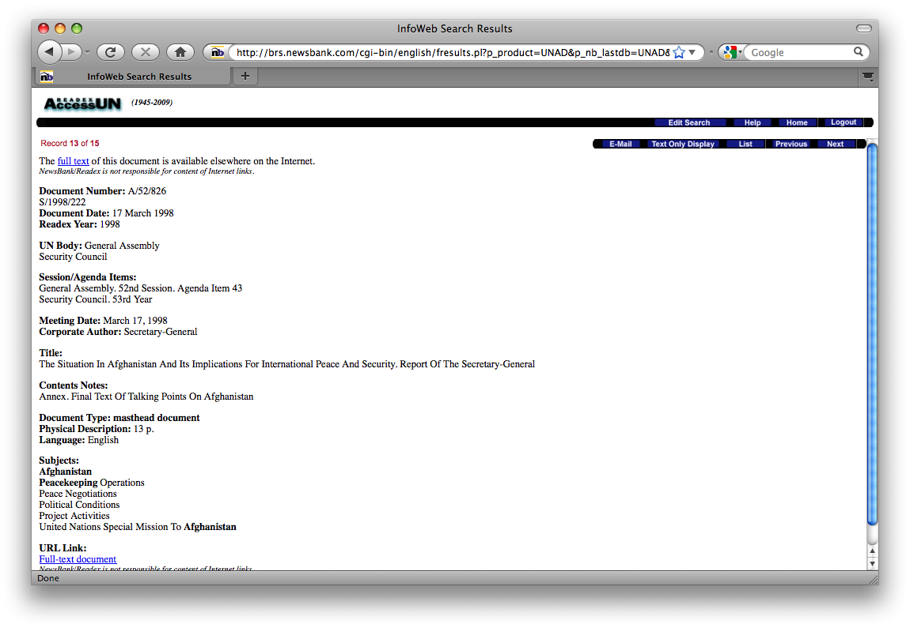
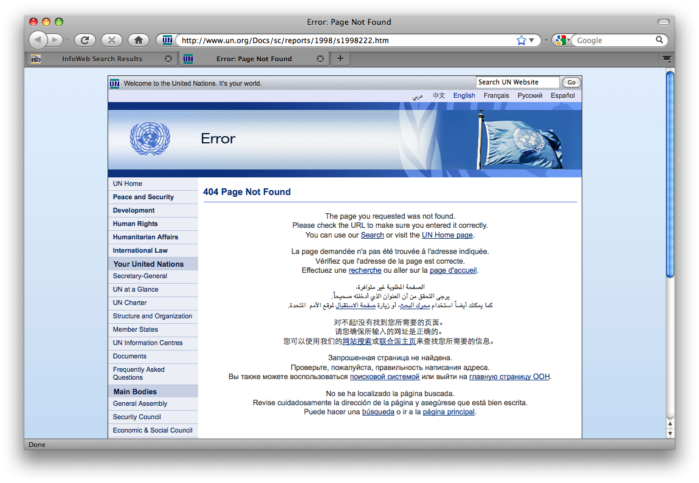
Access: AccessUN

Slide 20
Access: Networking
Listservs
Roots of Youth Violence Secretariat
Canada Mortgage and Housing Library
Heritage Canada Knowledge Centre

Slide 21
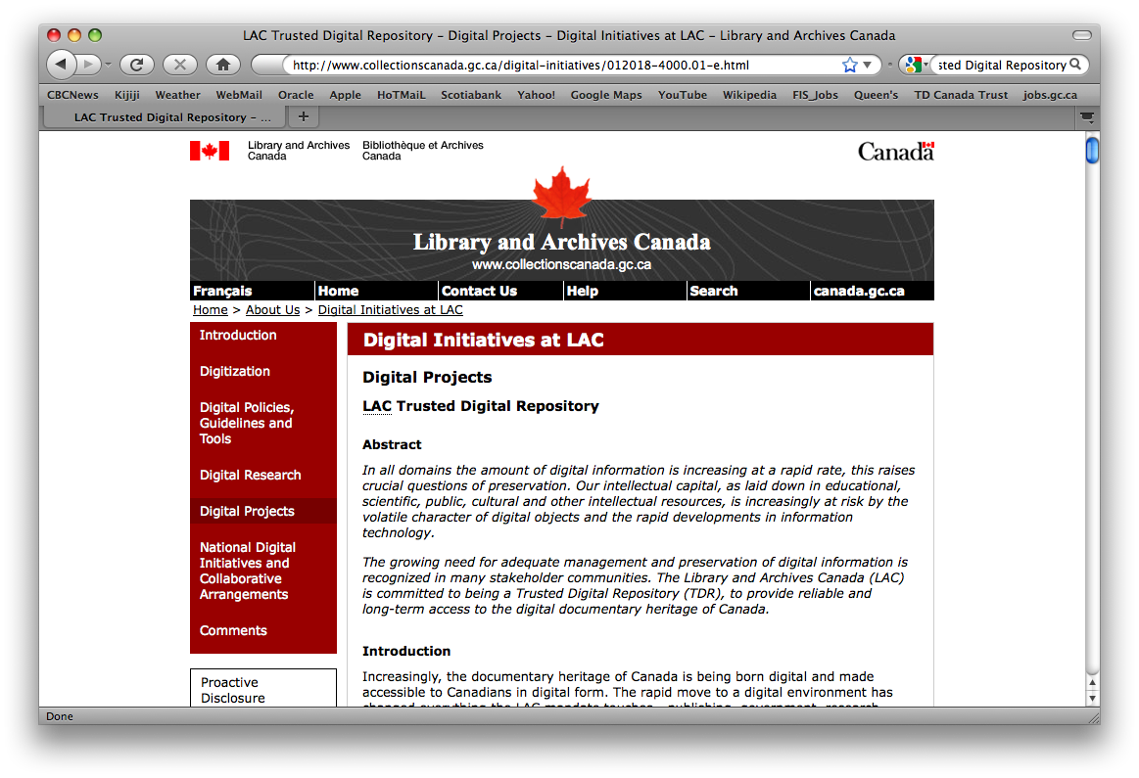
LAC’s E-Collection, Web Archive and TDR

Slide 22
Government information: Bridging the print/electronic divide
OLA Super Conference 2010
Session: 1805 continued
Carol Perry, University of Guelph
David Burke, Queen's University

Slide 23
Outline
Canadian Academic Libraries Survey preliminary results
Reference challenges
Collaborative solutions

Slide 24
Canadian Academic Libraries Government Publications Survey
Survey of the current state of government publications collections & services in academic libraries in Canada
January 10-February 10, 2010
119 respondents
Preliminary results available

Slide 25
Collection Policy

Slide 26
Location of service unit

Slide 27
Integration of service unit

Slide 28
Collection location

Slide 29
Catalogue links

Slide 30
User support

Slide 31
Collaborative projects

Slide 32
Survey comparisons
Question | CARL 2005 | U.S. FDLP 2005 | U.S. FDLP 2007 | Our Survey 2010
Collection policy | 63% | 90% | 94% | 53%
Separate ref desk | n/a | 19% | 17% | 19%
Digitization projects | n/a | 10% | 4% FDLP materials | 45%
Amalgamation of dept | n/a | 26% | n/a | 25%

Slide 33
Collection arrangement
Where are government materials housed? | U.S. FDLP 2005 | U.S. FDLP 2007 | Our Survey 2010
Separate collection | 9 % | 9% | 37%
Partially integrated into main stacks | 79% | 79% | 39%
Fully integrated into main stacks | 12% | 11% | 24%

Slide 34
Reference challenges
Changing websites, URLS
Multiple sites containing gov’t information – no single portal
Split collections – historical print material & digital-only current materials.
Split collections – coded material & current LC material
Limited resources
Decreasing staff numbers

Slide 35
Reference challenges cont’d
Dark web (material stored in databases)
Preservation of ephemera
Missing compliance documents
Changing governments
No co-ordinated municipal preservation projects

Slide 36
United Nations – Terms of Use
“The United Nations reserves its exclusive right in its sole discretion to alter, limit or discontinue the Site or any Materials in any respect. The United Nations shall have no obligation to take the needs of any User into consideration in connection herewith.”

Slide 37
Preservation Policies
Site | Policy statement | Caveats/disclaimers
Gov’t of Canada Website Archive | Yes | None
Parliament of Canada | No | Will discuss removal with interested parties
UN Official Document System (ODS) | No | Right to alter,limit, discontinue
UN – Human Development Reports | No | Right to add, change, improve or update. Use at own risk
FAO | No | Use at own risk
World Bank | ‘as is’ | Right to alter, limit, or discontinue
IMF | No | Right to modify or terminate site and/or contents
EU | No –but commitment to enhance public access | No guarantee re: accuracy/completeness
WHO | No | Does not warrant site as complete or accurate

Slide 38
Solutions : Change focus
Meet users at point of need
Embed gov’t information into IL programs
Langer’s theory of sideways learning – let users find information then instruct them in processes of gov’t for context
Build reliable easy to use tools otherwise users will gravitate away from difficult to use resources. (Hennig et al 2006, Griffiths & Brophy 2005)

Slide 39
Needs assessment
Audit of user needs
Audit of user knowledge of services
Audit of how current services are used
Audit of how users find gov’t information on their own
Work with faculty to embed material into curriculum
  How have changes in curriculum affected usefulness of current services offered by libraries?

Slide 40
User preferences – Burroughs, 2009
Users prefer
Using general search engines to begin research (77% )
Receiving gov’t information in digital format (75%)
Notification of newly available govt information
Website alerting to any other format (26%)
To use online guides & tutorials (35%) most common service used
Survey conducted at:
University of Montana-Missoula Library, 2006

Slide 41
Solutions : Regional
OurOntario
  Quarterly updates
OCUL – Ontario Digitization Initiative
OCUL – ODESI project – data & GIS
Scholar’s Portal E-Books platform
Ozone – on Scholar’s Portal
  Ontario Legislative Library & OCUL
Provincial preservation projects
  Alberta’s ‘Our Future, Our Past’

Slide 42
Solutions : National
Canada Gazette (Library & Archives Canada) 1841-1997
Canada Gazette (Canada Gazette Directorate) 1998-2008
Hansard digitization 1900-1994 (Library & Archives Canada)
Canadiana.org
CANLII
Government of Canada Website Archive

Slide 43
Gov’t of Canada Website Archive
Mandate – to serve as the continuing memory of the government & its institutions
Web Archive – under “Politics & Gov’t” on L&A site
Website crawl – 2x/year
  May miss material on websites for <6 months
Stores websites separately from publications found on the Internet
Allows downloading of pdf documents

Slide 44
Web Archive cont’d
Does not archive
  Databases
  Forms within website
  Drop-down menus
  Sites blocking crawler access by robts.txt file
  Info behind login pages
Web crawlers blocked by archive
  Does not allow Google past index page
Harvest provincial & territorial websites annually (deep archived – no access)

Slide 45
Solutions : U. S.
GPO Access - Federal Digital System (FDsys)
  Provides public access to Government information submitted by Congress and Federal agencies and preserved as technology changes.
  Currently being migrated from GPO Access. (Coverage ranges from 1981, 1981, 1991, 1994 >).
  Emphasis on version control as a way of indexing and managing changes to a digital document

Slide 46
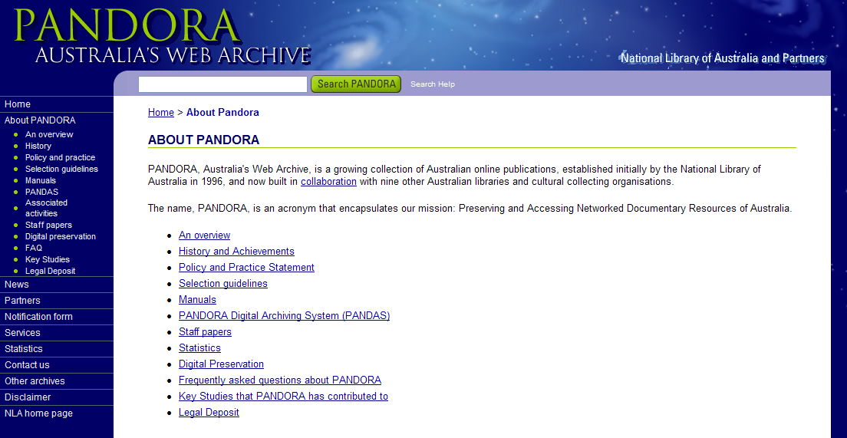
Solutions: Web archive portals

Slide 47
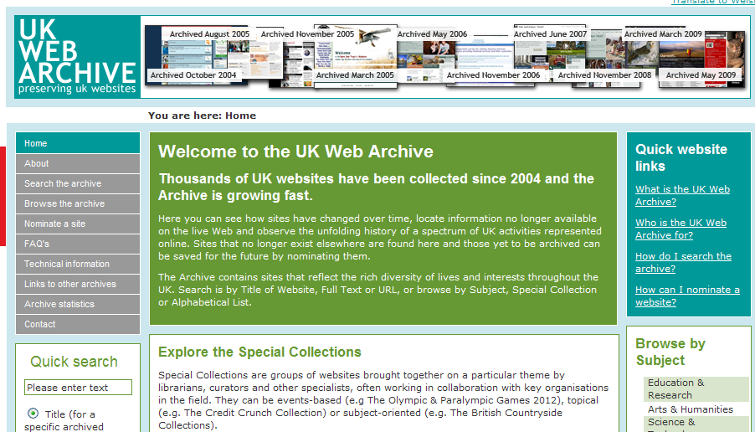
Solutions: Archive indexes

Slide 48
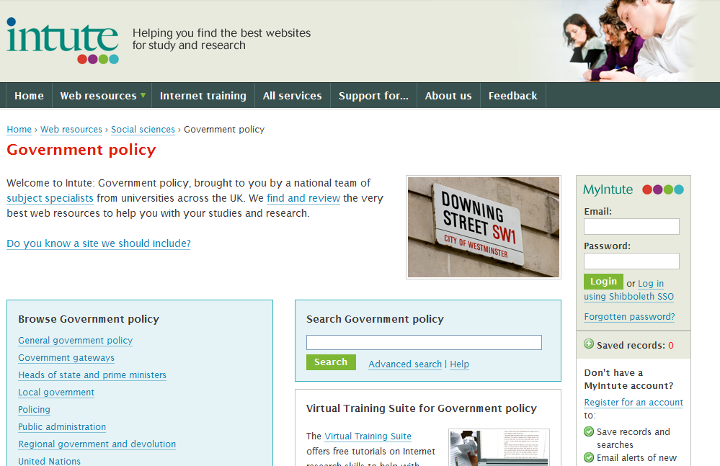
Solutions: Collaborative guides

Slide 49
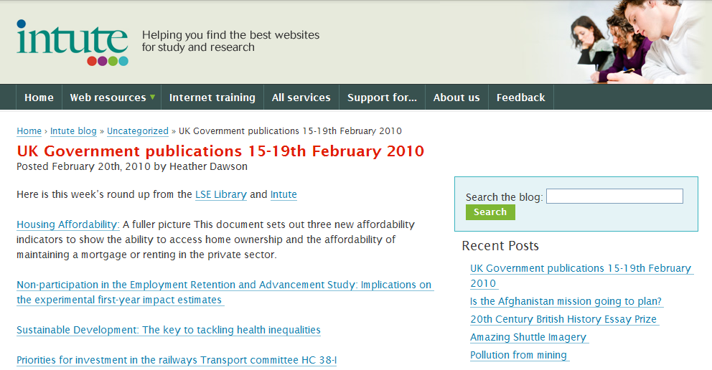
Solutions : Current events feeds

Slide 50
Acknowledgements
FIMS Co-op Librarians Winter 2009
  Kaori (Kay) Sato
  Danielle Robichaud

Slide 51
Contacts
David Burke
Stauffer Library
Queen’s University, Kingston
david.burke@queensu.ca
Carol Perry
McLaughlin Library
University of Guelph, Guelph
carolp@uoguelph.ca

Slide 52
References
Bertot, J. C., Jaeger, P., Simmon, S., Grimes J. Reconciling government documents and e-government: Government information in policy, librarianship and education. Editorial. Government Information Quarterly 26 (2009) 433-436
Burroughs, J.M. What users want: Assessing government information preferences to drive information services. Government Information Quarterly 26 (2009) 203-218.
Cheney, D. Government Information collections and services in the social sciences: the subject specialist integration model. Journal of Academic Librarianship 32:3, p. 303-312. 2006.
Cuillier, D. Piotrowski, S. Internet information-seeking and its relation to support for access to government records. Government Information Quarterly. 26 (2009). 441-449
Federal Depository Library Program. Biennial Survey of Depository Libraries 2007 Results. U.S. Government Printing Office.2008.
Federal Depository Library Program. Biennial Survey of Depository Libraries 2005 Results. U.S. Government Printing Office. 2006.
Freund, L. , Nilsen, C. Assessing a genre-based approach to online government information. Proceedings of the 36th annual conference of the Canadian Association for Information Science (CAIS) . University of British Columbia, Vancouver, 2008.

Slide 53
References cont’d
Hubbertz, A. Update 2007: Collection and preservation of web-based provincial/territorial government publications. CARL ABRC. 2007.
Hubbertz, A. Collection and preservation of web-based provincial/territorial government publications: Report on a survey of CARL and APLIC libraries. Ottawa. Canadian Association of Research Libraries. 2005.
Library and Archives Canada. Canadian Digital Information Strategy: Draft Consultation version. 2007.
Murray, K. R. Hsieh, I.K. Archiving Web-published materials: A needs assessment of librarians, researchers, and content providers. Government Information Quarterly 25 (2008) 66-89.
Nicholson, Andrew, Stave, Tom and Zhang, Kaiping(2006) 'Mapping New Horizons in Government
Documents Reference Service', The Reference Librarian, 45: 94, 95 — 108.
Tomic, D. & Craig, S. Poster. Ontario Legislative Library: Ontario 2007 Election Campaign: political party website archiving. OLA Superconferece, January 31.2008.
West, Amy. Coming soon to a location near you. Government Information Quarterly. 25. 2008 p. 61-65
Yelinek, K., Hinchcliff, M. Accidental government documents librarian: A review of experiences and training needs of interim documents librariansThe Journal of Academic Librarianship, Volume 35, Number 1, pages 46–56. Check date

