Slide 1
USING PICTURE BOOKS
TO TEACH WRITING
By Rachel Seigel

Slide 2
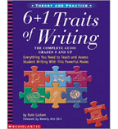
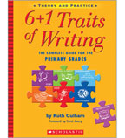
6+1 Traits of Writing
By Ruth Cullum

Slide 3
6+1 Traits
Ideas
Organization
Sentence Fluency
Word Choice
Voice
Convention
+ Presentation

Slide 4
Text Forms
Narrative
Recount
Persuasive
Exposition,
Report
Explanation
Procedural writing.

Slide 5
IDEAS
The Heart of the Piece (or the content)

Slide 6
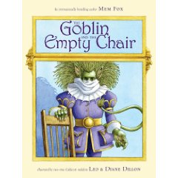
The Goblin and the Empty Chair by Mem Fox

Slide 7


Slide 8
Well laid out Organization)
Beautiful Book (Presentation)
Strong Narration (Text Forms)
Clear ideas/theme

Slide 9

Jack the Bear- Christina Leist

Slide 10
Clear message/idea
Well organized
Use of Dialogue-Conventions

Slide 11

Duck ! Rabbit! By Amy Kraus Rosenthal

Slide 12
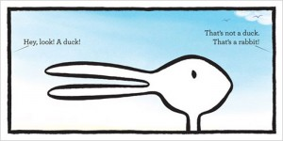

Slide 13
Clear idea
Interesting Presentation
Clear Pattern/structure (Organization)

Slide 14
Organization
The internal structure of the piece.

Slide 15

The Wrong Book- Nick Bland

Slide 16
Repeating Phrase or pattern
Clear ideas

Slide 17
SENTENCE FLUENCY
Is it a good read-aloud?

Slide 18

All the World- by Liz Scanlon

Slide 19


Slide 20
Clear Idea/Message
(Ideas)
Good Rhythm for Read Aloud (Sentence Fluency)
Beautiful
Illustrations (Presentation)

Slide 21

While the World is Sleeping by Pamela Duncan Edwards

Slide 22
Repeating Pattern or Phrase-
(Organization)
Lyrical, Rhyming Verse (Sentence Fluency)
Beautiful Illustration
(Presentation)

Slide 23
WORD CHOICE
The Use of Vivid and Descriptive Language to Create Pictures in the Reader’s Mind

Slide 24
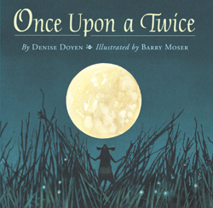
Once Upon a Twice by Denise Doyen

Slide 25
Poetic language (Word Choice)
Reads Aloud well. (Sentence Fluency)
Illustrations fit the text (Presentation)

Slide 26

Lion’s Lunch by Fiona Tierney

Slide 27
Vivid, Descriptive Language (Word Choice)
Clear message (idea)
Narrative form (Text Forms)

Slide 28
Voice
The Individuality or the flavour of the Writing

Slide 29

Purple Kangaroo- Michael Ian Black

Slide 30
Voice is earnest and unique
Use of Speech Bubbles (Convention)
Persuasive Writing- narrator trying to convince the reader to take some action

Slide 31

Smile by Leigh Hodgkinson

Slide 32
Vivid,distinctive Voice
Use of different fonts within the text (Convention)
Clear idea

Slide 33
CONVENTION
The Mechanics of the Piece (Grammar, Spelling, Punctuation)

Slide 34
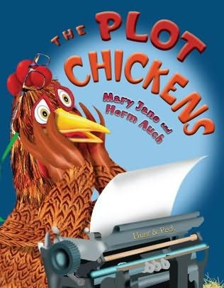
The Plot Chickens by Mary Jane Auch

Slide 35
Ilustrates a components of a story (Convention)
Interesting Format (Presentation)
Rules for Writing a Story- (Procedural)

Slide 36

Chester’s Masterpiece- Melanie Watt

Slide 37
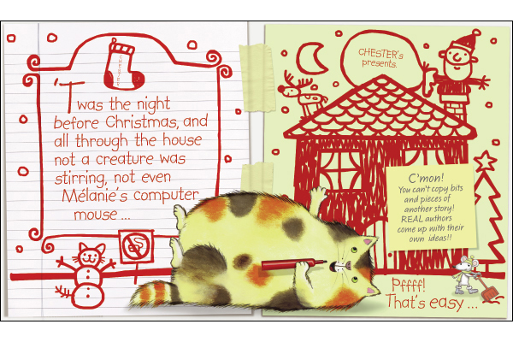

Slide 38
Distinct Voice
Components of writing a story
Fun presentation

Slide 39
+1= Presentation
How It looks on paper- Overall attractiveness and appearance.

Slide 40
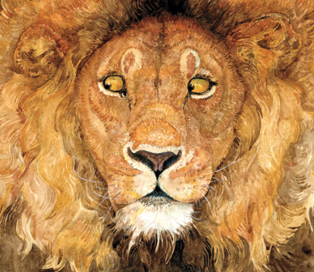
The Lion and the Mouse by Jerry Pinkney

Slide 41
Book is a Visual Treat (Presentation)
Clear Narrative (Text Forms)
Clear Organisation

Slide 42

Looking Like Me- Walter Dean Myers

Slide 43
Visually Appealing (Presentation)
Clear Message (Ideas)
Descriptive Language (Word Choice)

Slide 44
Text Forms

Slide 45
NARRATIVE
A story that is often imaginary, but may be based on fact, relays events sequentially, using descriptive language, and usually told in past tense.

Slide 46
Recount
A first person account of something that has already happened, told in the past tense in time order.

Slide 47

Nasreen’s Secret School by Jeanette Winterson

Slide 48
Recounts something that is happened in the past
Distinct Voice in writing (Voice-6+1)
Clear sequence of events-Organization (6+1)

Slide 49
Persuasive Writing/Exposition
Persuading the reader to take some action/accept a point of view

Slide 50

The Book that Eats People by John Perry

Slide 51
Narrator wants the reader to accept his point of view
Procedural Writing-Rules for surviving the book)

Slide 52

Have I Got a Book For You by Melanie Watt

Slide 53
Narrator is trying to convince the reader to take action
Distinctive Voice (6+1)

Slide 54
PROCEDURAL
How to Do Something

Slide 55
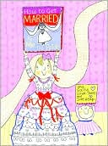
How to Get Married...By Me the Bride
by Sally Lloyd-Jones & Sue Heap

Slide 56
A clear explanation of how to do something
Unique point of view (Voice 6+1 Traits)

Slide 57
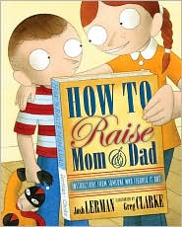
How to Raise Mom & Dad by Josh Lerman

Slide 58
Explains how to do something
Clear Point of View (Voice 6+1 Traits)

Slide 59

Never Ask a Bear by Louise Bonnetti-Rampersaud

Slide 60
Takes the form of a guide book
Fun rhyming text to read aloud(Sentence Fluency)

Slide 61
Explanation
What something is/Why it is

Slide 62

The Zoo I Drew by Todd H. Doodler

Slide 63
Explains something about each animal
Illustrations work perfectly with book + Unique Fluted Cover (6+1 Presentation)

Slide 64
Report
Conveys information about a particular event or situation (ie. Newspapers, journals, letters, magazines)

Slide 65
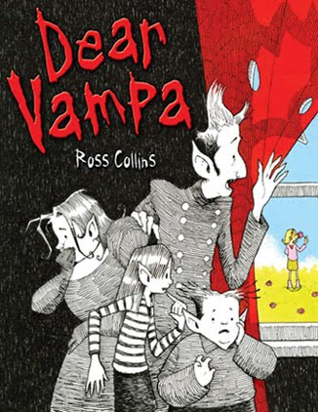
Dear Vampa-by Ross Collins

Slide 66
Uses letters to report on particular events
Clever Illustrations compliment the text (Presentation 6+1))
Convention- Twist Ending

