Slide 1

The Good, the Bad & the Ugly: do students use quality sources?
Kathy West
Janet Williamson
University of Alberta Libraries

Slide 2
Definition
Credibility: capable of being believed or believable
Veracity: agreement with actual facts; accordance with the truth
Authoritative: proceeding from a competent authority
Objectivity: the ability to consider, information, without being influenced by personal feelings or opinions; impartiality
(Oxford English Dictionary )

Slide 3
Publication
Matrix
Academic
Research Institutes
Professional Publishers
Government
Think Tanks
Trade Associations
Corporations
Lobby Groups
Personal

Slide 4
TGB&U: plan
Literature review
Research study
Methodology
Findings
Conclusions
Implications

Slide 5
Literature review
“….my first step used to be the library, but it was too much information, now I just go to the Web.”
(Student quote, Head and Eisenberg, 2009)

Slide 6
Literature review
“…most participants believed that they, themselves, had the ability to discern the credibility of a … source, based on their ‘gut level’ interpretation….”
(Head and Eisenberg, 2009)

Slide 7
Literature review
“I found one that had a purple background and blue writing and it was … a fun font, so I didn’t feel it was too good… a website to use as a reference.”
(Student quote, McClure and Clink, 2009)

Slide 8
Literature review
Want convenience of access
Want fast information
Image of an hamburger

Slide 9
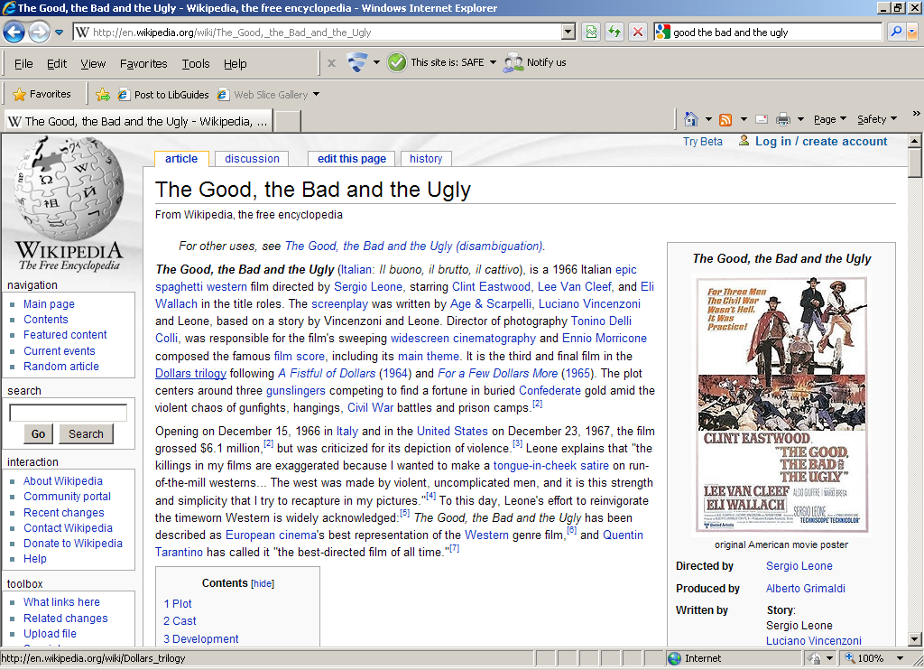
Wikipedia Research
MIS faculty initiated project
randomly selected 100+ Wikipedia articles

Slide 10
Wikipedia Research
MIS faculty initiated project
randomly selected 100+ Wikipedia articles
Assigned 2 Wikipedia articles/student: errors, omissions, corroborations
Located & categorized 4-7 independent sources per Wikipedia article
Librarian assessment
Assesed100+ Wikipedia articles & student research:
errors, omissions, corroborations
Student assessment
Arrived at assessment of Wikipedia; (accuracy, completeness, objectivity, presentation, quality)
Submitted evaluation & sources for grading by instructors
Assessed student selected sources

Slide 11
Wikipedia Research
MIS faculty initiated project
randomly selected 100+ Wikipedia articles
Assigned 2 Wikipedia articles/student: errors, omissions, corroborations
Located & categorized 4-7 independent sources per Wikipedia article
Librarian assessment
Assesed100+ Wikipedia articles & student research:
errors, omissions, corroborations
Student assessment
Arrived at assessment of Wikipedia; (accuracy, completeness, objectivity, presentation, quality)
Submitted evaluation & sources for grading by instructors
Assessed student selected sources

Slide 12
Wikipedia Research
MIS faculty initiated project
randomly selected 100+ Wikipedia articles
Assigned 2 Wikipedia articles/student: errors, omissions, corroborations
Located & categorized 4-7 independent sources per Wikipedia article
Librarian assessment
Assesed100+ Wikipedia articles & student research:
errors, omissions, corroborations
Student assessment
Arrived at assessment of Wikipedia; (accuracy, completeness, objectivity, presentation, quality)
Submitted evaluation & sources for grading by instructors
Assessed student selected sources

Slide 13
Methodology
Dataset
  References utilized and categorized by students for 100+ Wikipedia articles
  Random sample– 50 Wikipedia articles
    Yielded 1258 student sources

Slide 14
Methodology
9 topics:
  geography,
  technology,
  science,
  popular culture,
  person,
  history,
  arts,
  politics,
  entity

Slide 15
Methodology
Sources categorized:
  Academic
  Government/ public institution:
  Professional book or journal publisher
  Corporate
  Personal
  Unknown

Slide 16
Methodology
1258 sources
of which 1189 were findable and categorized them .
Image of a man with
magnifying glass

Slide 17
Methodology
Student categorized vs. Librarian categorized
  (academic, government, professional publisher, corporate, personal, unknown)
Coded for print vs. online
Coded for library resources vs. web

Slide 18
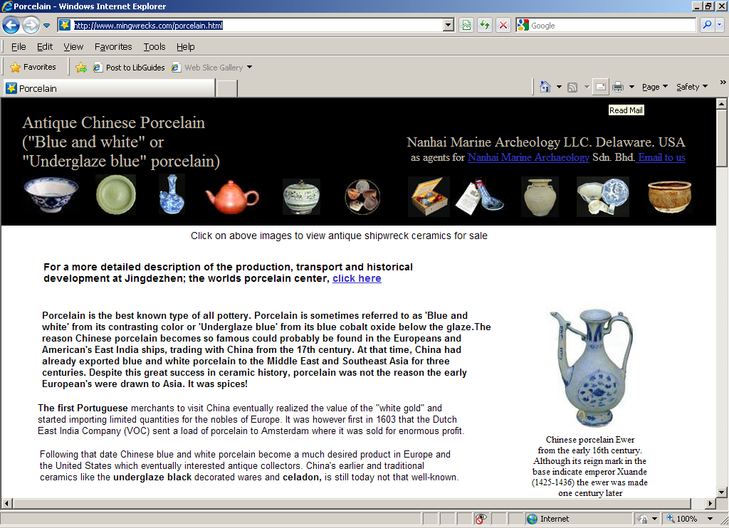
Methodology: example
Source: http://www.mingwrecks.com/porcelain.html

Slide 19
Methodology: example
Source: http://www.mingwrecks.com/porcelain.html
Blue and white porcelain
Student classified - Academic
Librarian classified - Corporate

Slide 20
Findings: format

Slide 21
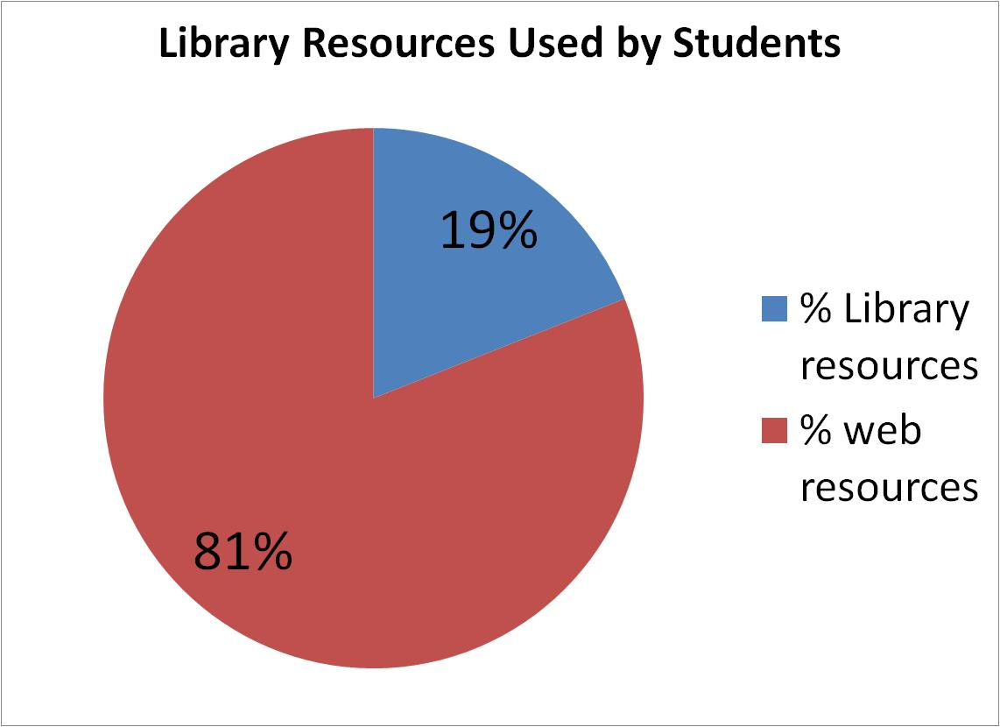
Findings: library vs. web

Slide 22
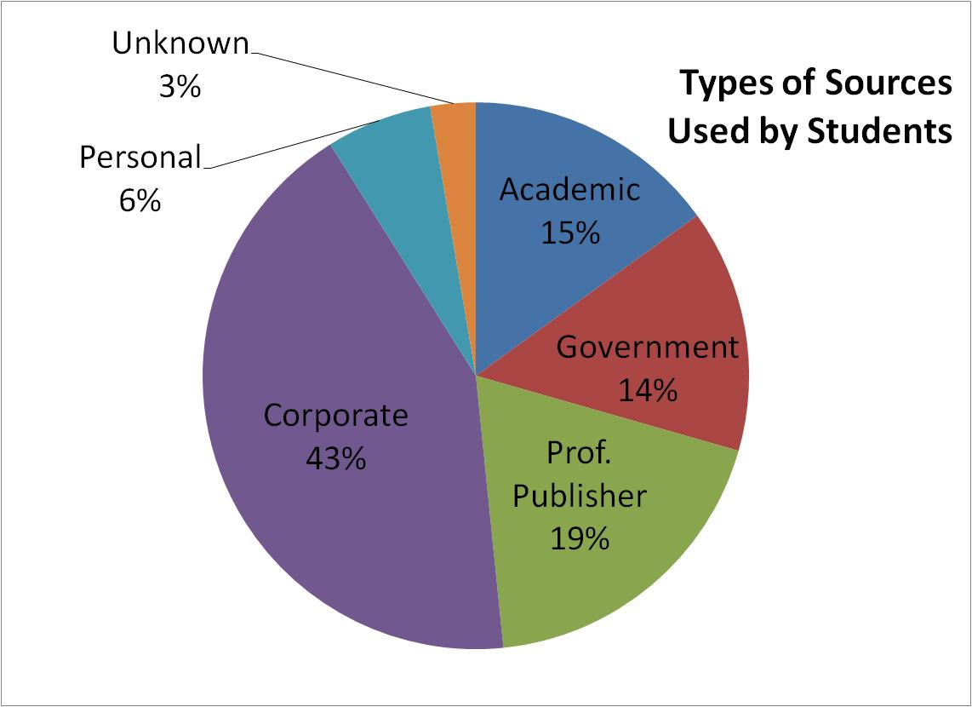
Findings: types of sources

Slide 23
Findings: The Good
64% of student assessment accurate
% correctly categorized

Slide 24
Findings: The Bad
36% of student assessment inaccurate
% incorrectly categorized

Slide 25
The Bad

Slide 26
The Bad (sort of)
8% of academic sources incorrectly categorized as government
  Cornell University Law School
  UBC- Library
  Harvard Kennedy School
  British History Online
  Holbourne Museum of Art, University of Bath

Slide 27
The Bad (sort of)
20% of corporate sources incorrectly categorized as professional publishers
  ABC
  CBC
  About.com
  NBC
  AllExperts

Slide 28

Findings: The Ugly
academic vs professional
corporate vs government & professional

Slide 29
The Ugly
10% of corporate sources incorrectly categorized as government
  National Duckpin Bowling Congress
  Academy of Motion Picture Arts and Science
  Belle Glade Chamber of Commerce
  British Columbia Construction Association
  National Tertiary Education Union

Slide 30
The Ugly
20% of corporate sources incorrectly categorized as professional publisher
  Special Operations. Com
  Amazon
  Gamesspot
  Howstuffworks
  Googlemaps
  MTV

Slide 31
The Ugly
14 % of professional publisher sources incorrectly categorized as academic
  Encyclopedia Britannica
  Encarta
  Canadian Writer’s Pocket Guide

Slide 32
The Ugly
4 % academic sources incorrectly categorized as professional publisher
  Sage Journals Online
  Kings University College
  Science Magazine, AAAS
  Journal of Pure and Applied Algebra

Slide 33
The Ugly: issue
Some students have difficulties differentiating between refereed content and higher education content produced professional publishers.

Slide 34
The Ugly

Slide 35
TGB&U conclusions
Students recognized the types of sources they used -- 64% of the time
Students did not recognize the types of sources they used--36% of the time
In spite of incentives, students chose non-academic/corporate sources–- 81% sources identified with Google
Accessibility is more critical to the students than quality information–- 91% sources were online

Slide 36
TGB&U implication
Academic library websites and databases– still too confusing; not easy or convenient

Slide 37
TGB&U conclusions
Student confusion:
  did not recognize the difference between sites that used government info. vs. a actual government site
  terminology in organizations name interpreted incorrectly
  did not recognize distinction between professional publisher (are corporate entities) vs. commercial website
  did not recognize the distinction between refereed content vs. higher education content

Slide 38
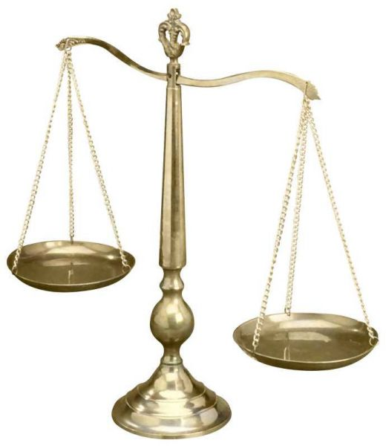
“The information literate student identifies a variety of types of sources… identifies the purpose and audience of potential resources in a variety of formats (e.g. popular, scholarly)…”
  (ACRL Standards 1.2.4)

Slide 39
TGB&U implication
Info lit– instruction
  What is a government site?
    Differentiating government from other organizations
    Differentiating sites that use government data
  What is the distinction between commercial website and professional publisher?
  What is the distinction between a refereed content vs. higher education content?

Slide 40
TGB&U
Next steps:
  Despite the fact that the students did not always use quality sources were they able to recognize credible Wikipedia articles?

Slide 41
Further reading
West, K. and Williamson, J. “Wikipedia: Friend or Foe?”, Reference Services Review , Vol. 37 No.3, pp.260-271.

Slide 42
Contact:
Kathy West kathy.west@ualberta.ca
Janet Williamson janet.williamson@ualberta.ca
Address:
  Winspear Business Library
  1-18 Business Building
  University of Alberta Libraries
  Edmonton, AB, T6G 2R6

