Slide 1
Millennials Among You
How young librarians are here to help

Slide 2
    “Millennials have alternative resources at their fingertips which are forcing libraries to prove, more than ever, that their research needs can be better met through the library, whether online or in-person.” (Ursin Cummings 286)

Slide 3
Baby Boomers (1946-1965)
9 536 480* Canadians
Millennial Generation (1980-2000)
8 575 175* Canadians
* Numbers provided by Statscan’s 2006 census
Generation X (1966-1979)
5 886 290* Canadians

Slide 4
Tapscott’s Eight Net Gen Norms from Grown Up Digital: How the Net Generation is Changing your World
Freedom
Customization
Scrutiny
Integrity
Collaboration
Entertainment
Speed
Innovation

Slide 5
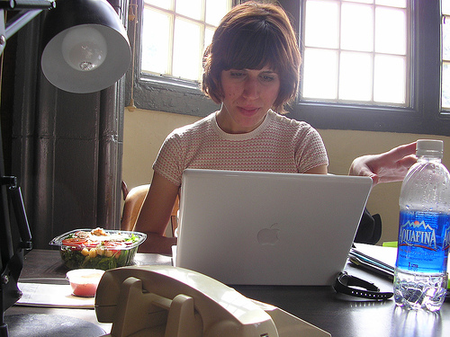
Innovation
Ooh, shiny!
joguldi

Slide 6
Customization
You are a beautiful and unique snowflake.
Respect for preferences
Happiness
Engagement

Slide 7
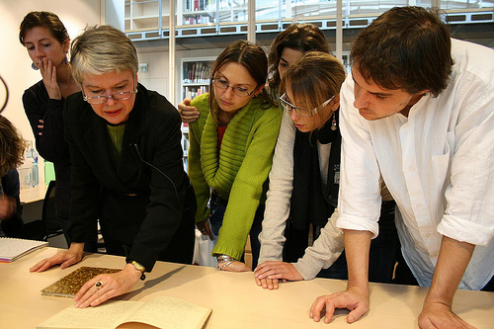
Collaboration
It takes many snowflakes to snow.
smannion

Slide 8
“We cannot simply rest on our knowledge that the students [and young librarians], members of the rising Net Generation, are different. We must understand how and why and embrace those differences—not ignore, reject, or dismiss them.” (Gibbons 11)

Slide 9
Hire us!

Slide 10
Thank you!
jlogan6@uwo.ca

Slide 11
Works Cited
Franke, Nikolaus, Peter Keinz, and Christoph J. Steger. "Testing the Value of Customization: When Do Customers Really Prefer Products Tailored to Their Preferences?." Journal of Marketing 73.5 (2009): 103-121. Business Source Complete. EBSCO. Web. 8 Feb. 2010.
Gibbons, Susan. The Academic Library and the Net Gen Student: Making the Connections. Chicago: American Library Association, 2007. Print.
Sujansky, Joanne G., and Jan Ferri-Reed. Keeping the Millennials: Why Companies are Losing Billions in Turnover to this Generation--and what to do about it. Hoboken, NJ: John Wiley & Sons, 2009. Print.
Tapscott, Don. Grown Up Digital: How the Net Generation is Changing Your World. New York: McGraw-Hill, 2009. Print.
Ursin Cummings, Lara. "Bursting Out of the Box: Outreach to the Millennial Generation through Student Services Programs." Reference Services Review 35.2 (2007): 285-95. Library and Information Science and Technology Abstracts. Web. 10 Oct. 2009.

