Slide 1
Breaking Down Barriers:
From Assumptions to Understanding
Peter Maguire, Community Librarian – Castle Downs Branch
Edmonton Public Library
Notes:
,

Slide 2
Outline
WHAT WAS THE EPL BARRIERS STUDY?
WHAT DID WE LEARN ABOUT BARRIERS?
HOW HAVE WE ADDRESSED BARRIERS?

Slide 3
WHAT WAS EPL’S BARRIERS STUDY?

Slide 4
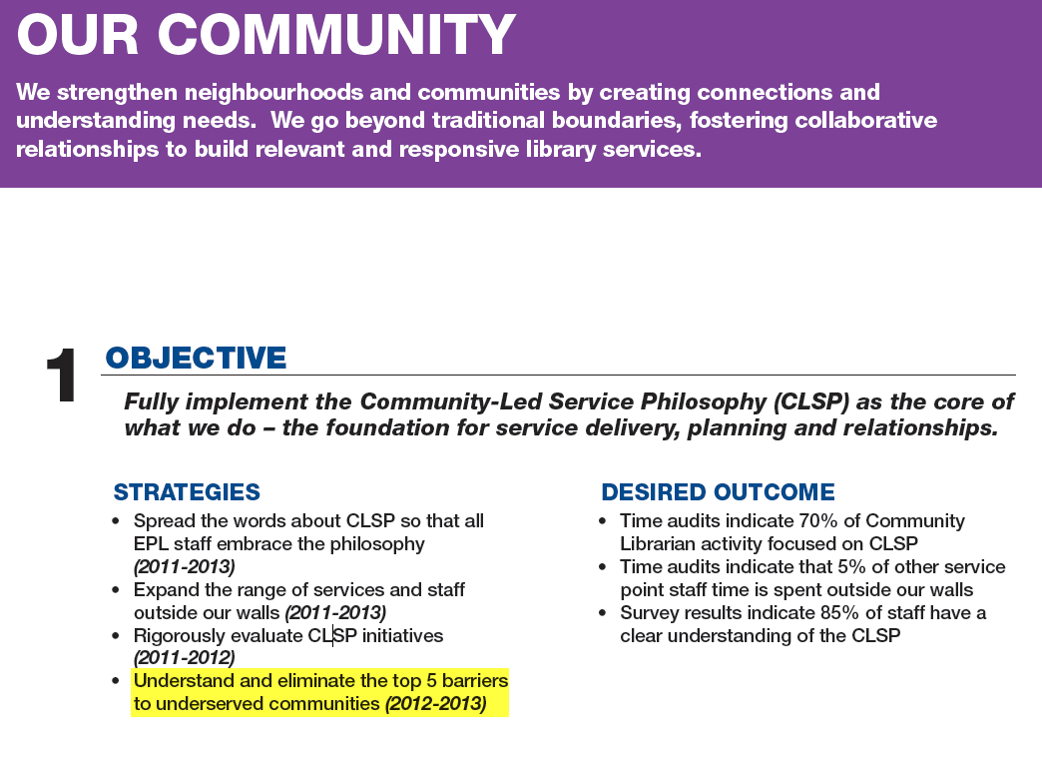

Slide 5
Project Goals
1. To identify the populations most underserved by EPL services.
2. To identify the barriers potential users face when accessing EPL services.
3. To develop evidence-based recommendations for mitigating or eliminating those barriers.

Slide 6






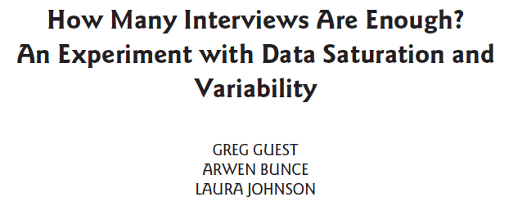

Review Literature

Slide 7
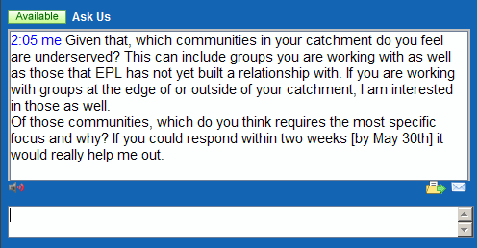
Ask Community Librarians

Slide 8
Re-Review Literature

Slide 9
Re-Ask Outreach Staff

Slide 10
Eleven Targeted Populations
Adults, Aboriginal | Students, University of Alberta
Adults, Homeless | Teens, at-risk and Group Home
Families, Low income | Teens, Parents
Adults, Low literacy | Far away from libraries
Adults, low-income | Seniors
Newcomers

Slide 11
Findings?

Slide 12
Findings?

Slide 14
WHAT DID WE LEARN ABOUT BARRIERS?

Slide 15
What are Library Services?
Notes:
exercise

Slide 16
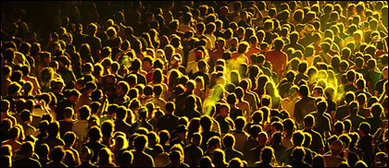

Slide 17
|

Slide 18
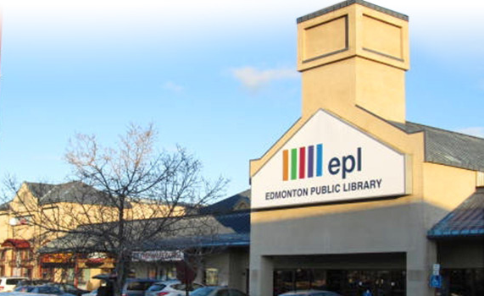
|

Slide 19
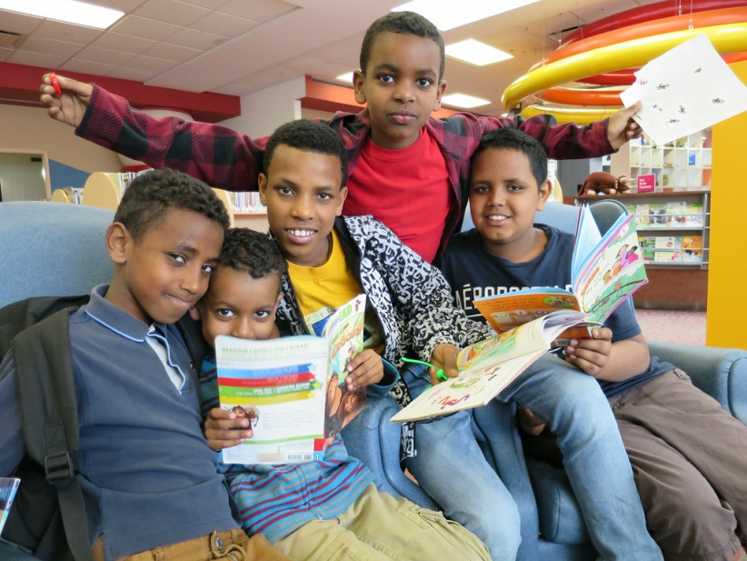
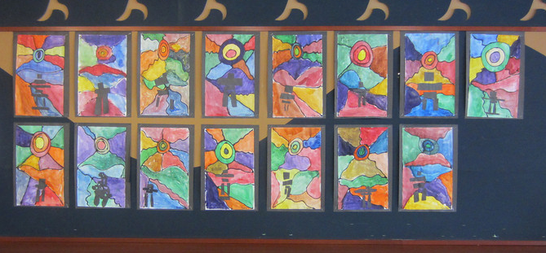
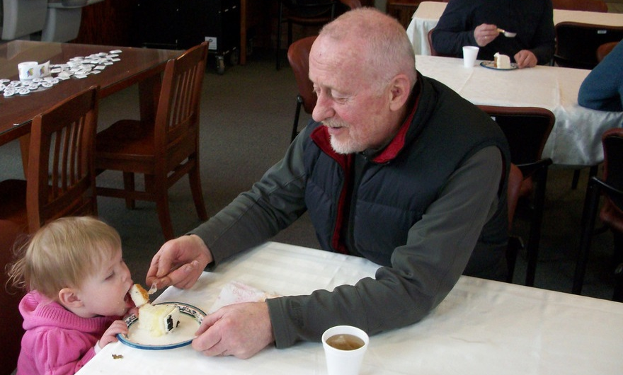
|

Slide 20
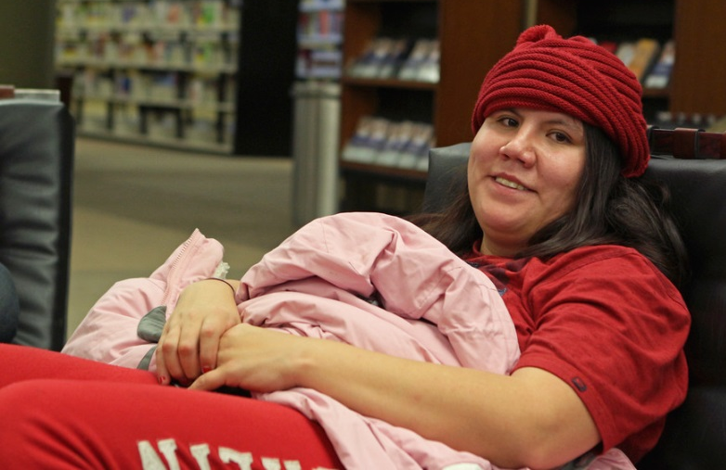


|

Slide 21
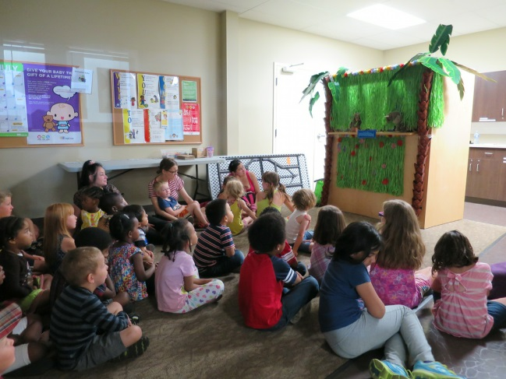

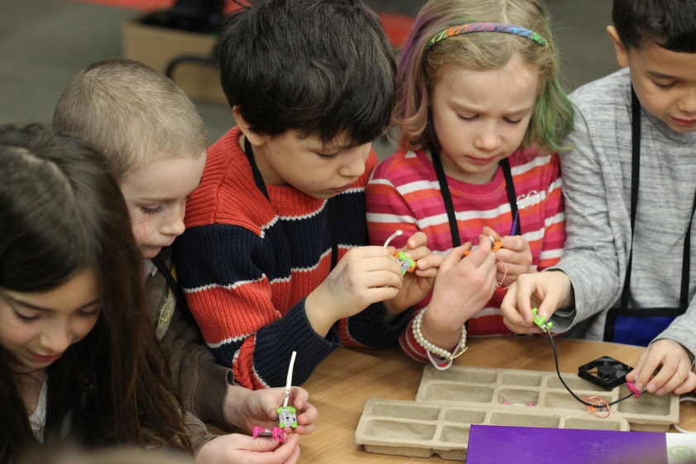
|

Slide 22
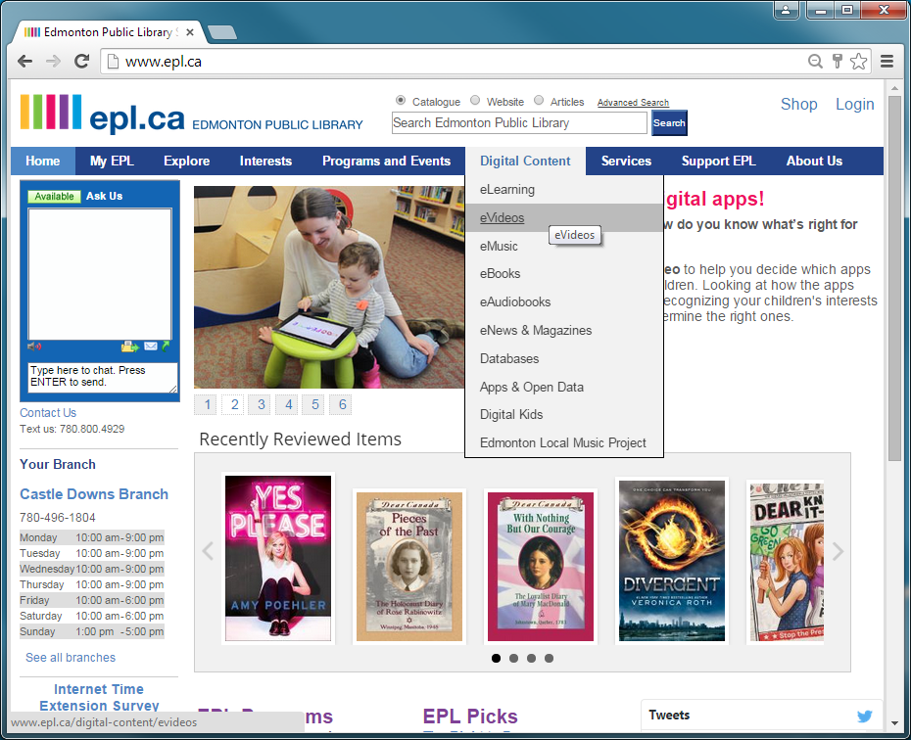


|

Slide 23
WE SHARE

Slide 24
PURPOSE
Notes:
exercise

Slide 25
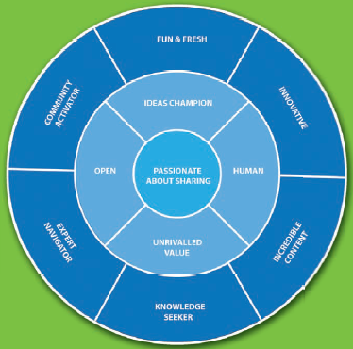

Slide 26
SERVICES
Notes:
exercise

Slide 27
Borrow Stuff
Use Bathroom
Use a Computer
Play With Kids
Find Answers
Escape

Slide 28
Services
Materials
Discovery Service (Reference)
3. Space
4. Digital access
5. Programming

Slide 29
So,
WHAT DID WE LEARN ABOUT BARRIERS?

Slide 30
Top Five Barriers
Transportation
Awareness of Services
Library Policies
Fines and Fees
Literacies

Slide 31
Transportation

Slide 32
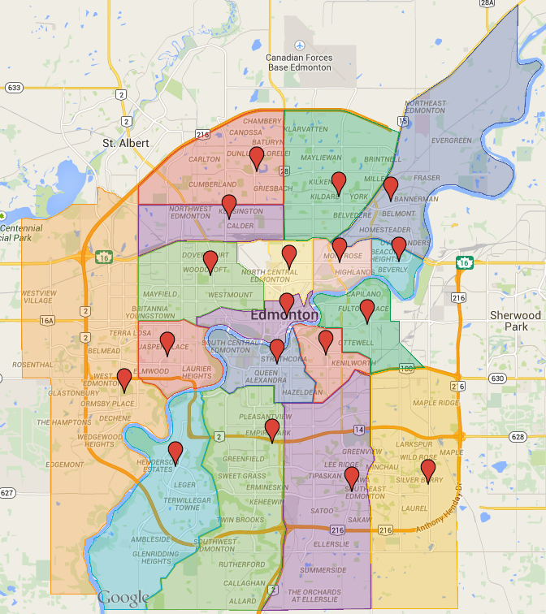
Distance to Library

Slide 33
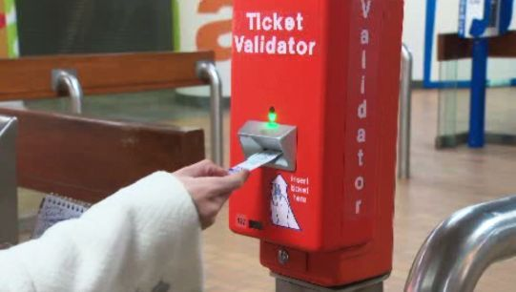
Getting to Library
http://www.globaltvedmonton.com/uploadedImages/Global_Edmonton/News/etsvalidator.jpg

Slide 34
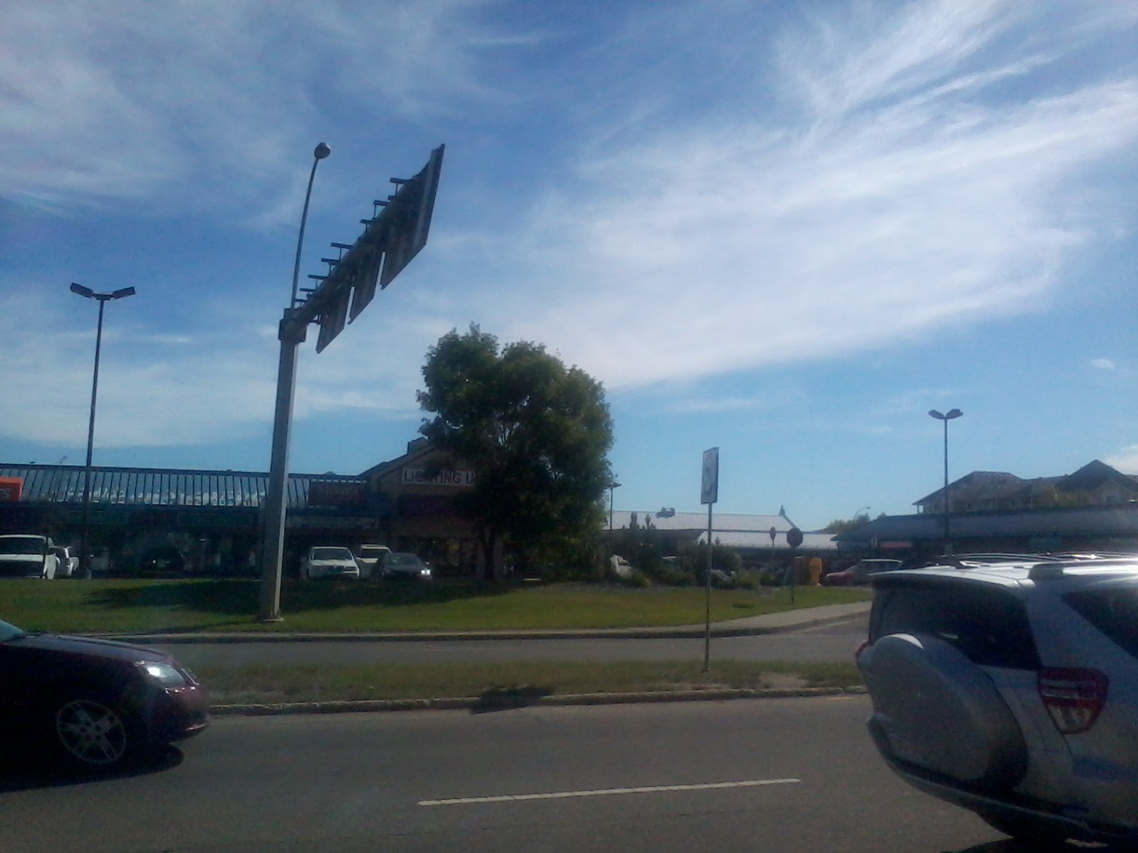
Getting Into Library

Slide 35
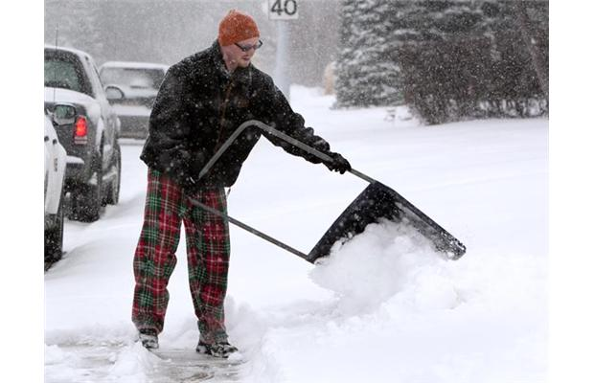
Seasonal Conditions
http://www.edmontonjournal.com/cms/binary/6348059.jpg?size=620x400s

Slide 36
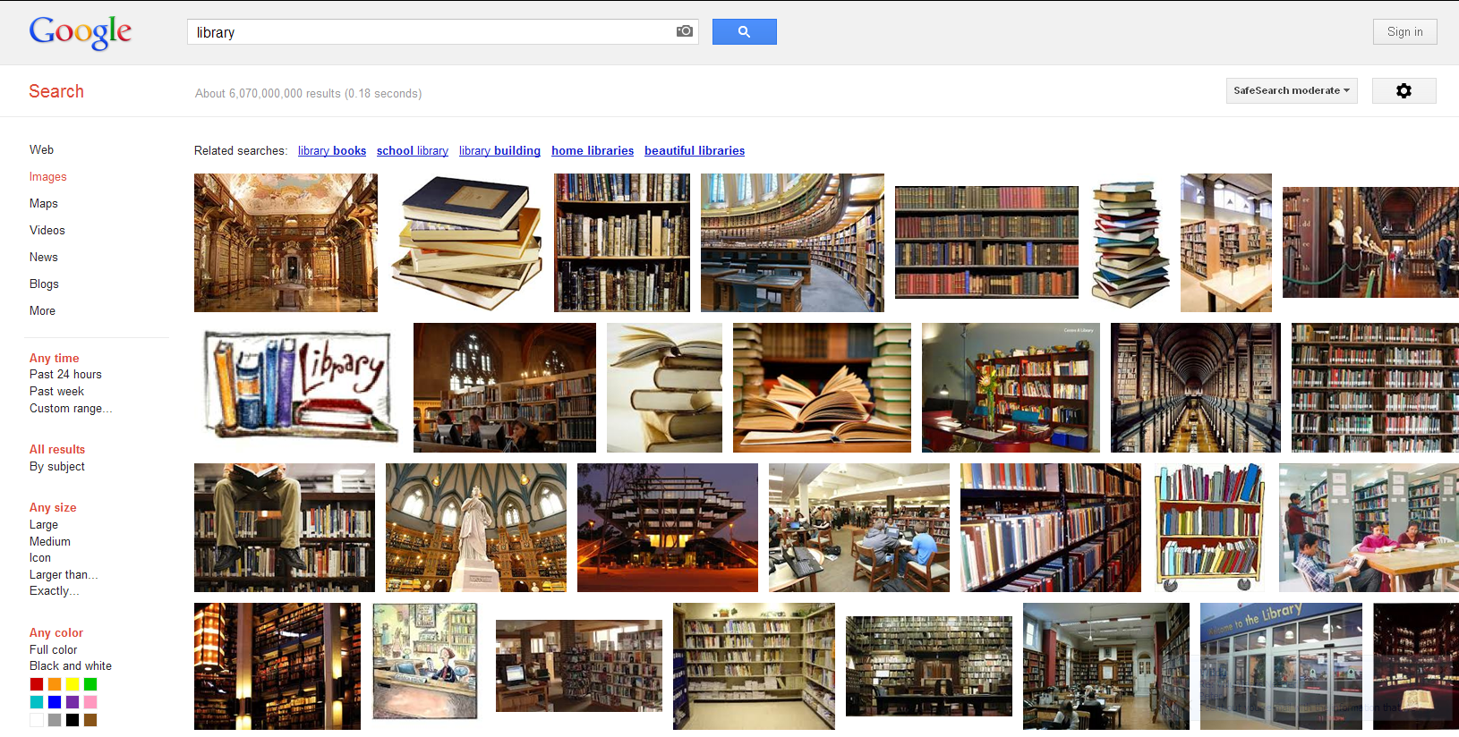
Awareness – Mental Models

Slide 37

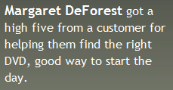
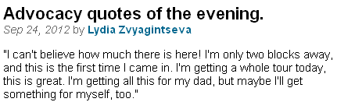
Awareness – Expectations

Slide 38
Awareness - Location

Slide 39
Location

Slide 40
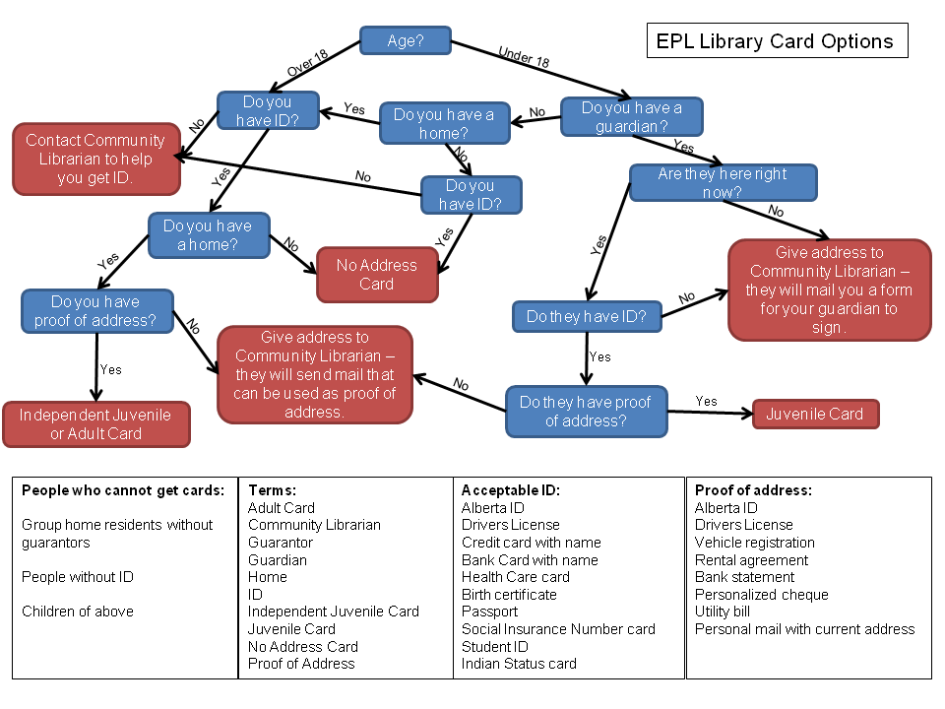
Library Policies – Written

Slide 41
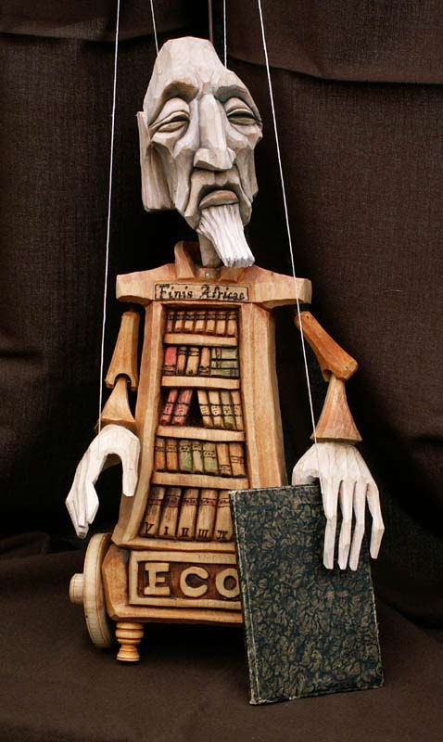
Library Policies
http://3.bp.blogspot.com/_2thMM_fEjdE/S70aMYXO9II/AAAAAAAAAno/qZT_TpxFyO0/s1600/librarian.jpg

Slide 42

Policies
Enforced
http://monsterlibrarian.com/monster_librarian_2.jpg

Slide 43
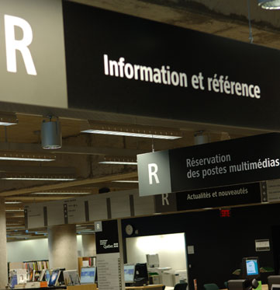
Literacies - Written
http://www.oclc.org/ca/en/about/cooperation/images/grandebil-lg.jpg

Slide 44
Literacies – Digital

Slide 45
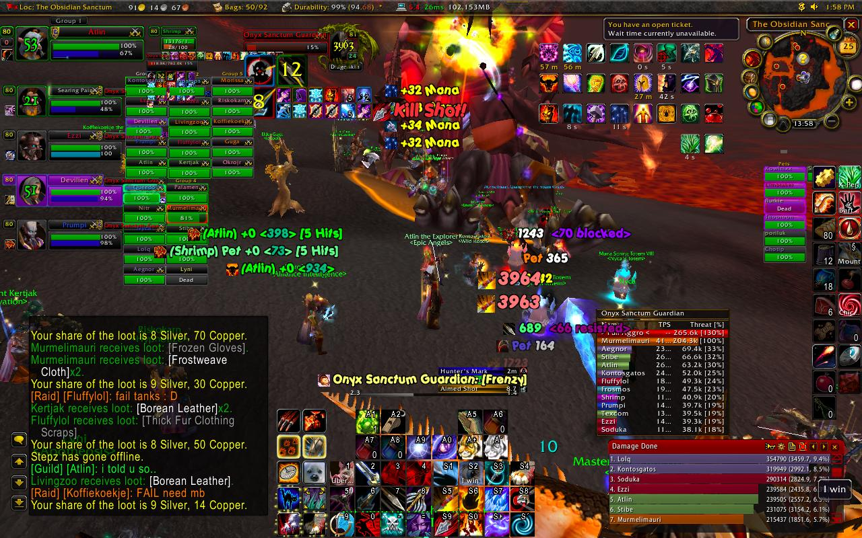
What Digital Mediation can Feel like:
http://i.imgur.com/bcL7k.jpg

Slide 46
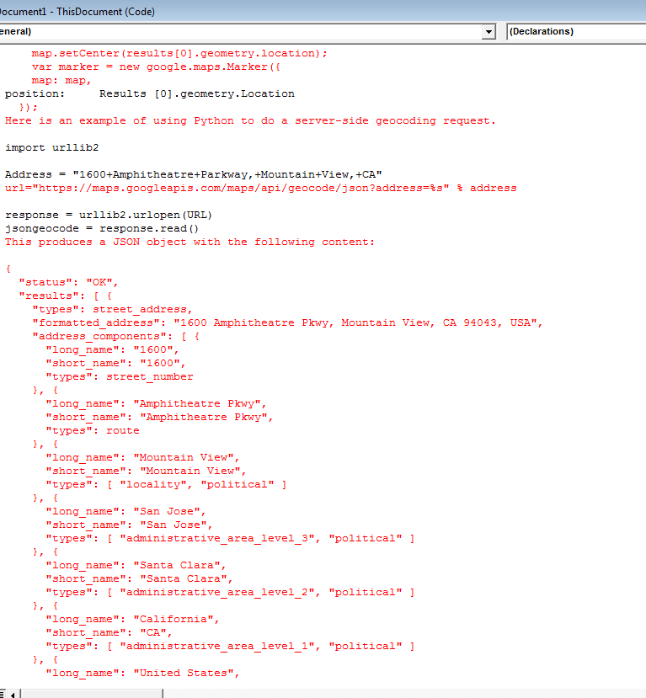

Slide 47
FINES AND FEES – do not want to pay
"The highest fine that I owed was $60, and I didn't want to borrow after that. "
Olivia, Aboriginal Adult

Slide 48
FINES AND FEES – Cannot pay
"The highest fine that I owed was $60, and I didn't want to borrow after that. "
Olivia, Aboriginal Adult
Yeah, uh.. my fine is kind of a little outrageous I, you know the money situation because of my situation. It's hard to pay, I wouldn't be able to pay it right?
Anne, Homeless Adult

Slide 49
FINES AND FEES – Bothered but will pay
"The highest fine that I owed was $60, and I didn't want to borrow after that. "
Olivia, Aboriginal Adult
Yeah, uh.. my fine is kind of a little outrageous I, you know the money situation because of my situation. It's hard to pay, I wouldn't be able to pay it right, so I'm hoping they'll be able to wipe it.
Anne, Homeless Adult
I love it. I love all the qualities, and all the services they provide, I just hate the overdue fines. And I get stuck with them all the time.
Sarah, Isolated Community Member

Slide 50
FINES AND FEES - Disconnected
"The highest fine that I owed was $60, and I didn't want to borrow after that. "
Olivia, Aboriginal Adult
Yeah, uh.. my fine is kind of a little outrageous I, you know the money situation because of my situation. It's hard to pay, I wouldn't be able to pay it right, so I'm hoping they'll be able to wipe it.
Anne, Homeless Adult
I love it. I love all the qualities, and all the services they provide, I just hate the overdue fines. And I get stuck with them all the time.
Sarah, Isolated Community Member
Yeah. Stupid.
Jack, At-Risk Teen

Slide 51
Assumptions

Slide 52
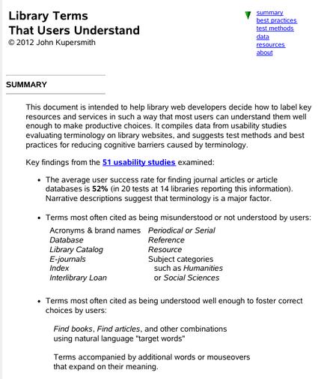
People Understand What Librarians Say
Notes:
- Keeping in mind that Kupersmith was looking at University students and

Slide 53

People Understand What Librarians Say

Slide 54
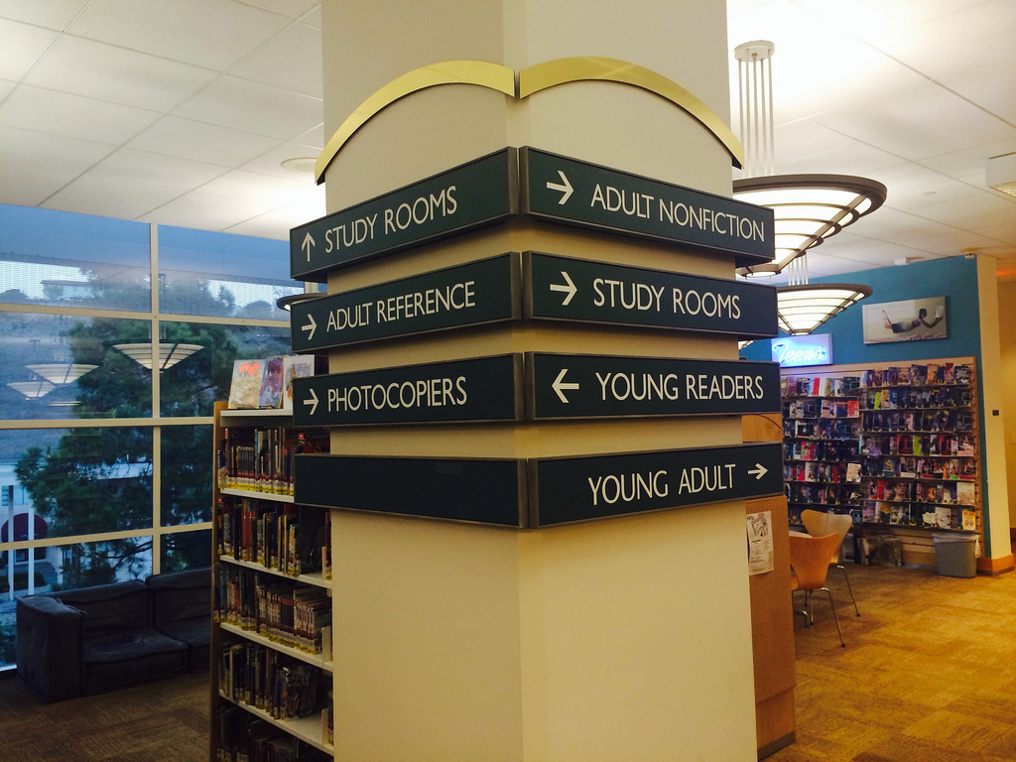
We Understand What People Need
https://farm3.staticflickr.com/2872/10875380243_a4d2224528_b.jpg

Slide 55


People Will Tell Us What They Need
http://upload.wikimedia.org/wikipedia/commons/4/4d/%27A_Basket_of_Peaches%27_painting_by_Edward_Edmondson%2C_Jr.jpg
http://upload.wikimedia.org/wikipedia/commons/4/43/Ambersweet_oranges.jpg
Notes:
Oranges and Peaches reference question story -

Slide 56
People Understand What Libraries Do
Notes:
- These quotes were recontextualized by the study – now when I have these interactions I think about how it represents

Slide 57
WHAT HAS EPL DONE TO ADDRESS THOSE BARRIERS

Slide 58
Assumptions ==== > Understanding

Slide 59
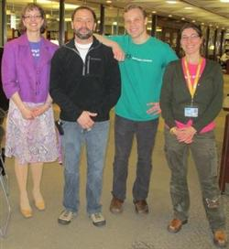
What Has Been Working?

Slide 60
Top Five Barriers
Library Policies
Transportation
Awareness of Services
Fines and Fees
Literacies

Slide 61
Policies
http://3.bp.blogspot.com/_2thMM_fEjdE/S70aMYXO9II/AAAAAAAAAno/qZT_TpxFyO0/s1600/librarian.jpg

Slide 62
Policies – Recommendations
Staff Orientation and training
Simplify Borrowing Policies and Procedures
Simplify Membership Policies and Procedures

Slide 63
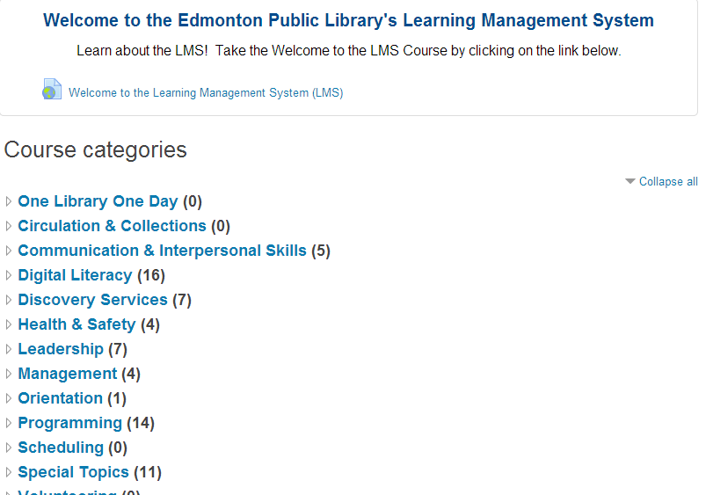
Orientation and Training

Slide 64

What is Discovery Service?
Notes:
In-house developed customer service training based on our own experiences and building on what we have learned from outside consultants

Slide 65
Customer Service @ EPL:
It’s Personal.
Presented by:
Notes:
The training being expanded from a service philosophy to specific courses

Slide 66
Customer Service @ EPL II:
It’s still personal!
Notes:
…and that continues to be built on and expanded

Slide 67
Borrowing Policies
3 borrowing periods
    1 week: Flicks, Hits and Bestsellers to Go(Rapid Reads)
    2 week: Pedometers (Provincial partnership)
    3 week: Everything Else
2 Limited Borrowing Item Types
    1 Flick/Hit/Bestseller
    5 Video Games
2 renewal schedules
    No renewals: Magazines & Flick/Hit/Bestsellers
    2 renewals: Everything else (if no requests)
Notes:
I feel like this looks more complicated than it actually is for users to use. Books, CDs, and DVDs all have the same rules attached to them and account for most of the circulation within the library.

Slide 68
Membership Policies
[Context for Non-Albertan Libraries]
Membership fees are a common practice in Alberta

Slide 69
Membership Policies
EPL eliminated its membership fee
Almost everyone in Edmonton is eligible for a card.

Slide 70
Policies

Slide 71
Policies
No Card
No Card
No Card

Slide 72
Age?
EPL Library Card Options
Over 18
Under 18
Yes
Do you have ID?
No
Do you have a guardian?
Yes
Do you have a home?
No
Are they here right now?
No
Yes
No
Yes
EPL Access Card
Do they have ID?
Register for JUV-01 card. Give address to Staff – they will mail you a form for your guardian to sign.
No
Do you have proof of address?
No
Register for Access/JUV-01 card, give address to Staff – they will send mail that can be used as proof of address.
Do they have ID at home?
Yes
Yes
Yes
No
No
Do they have proof of address?
JUV-01 Card
Independent Juvenile or Adult Card
Yes
Juvenile Card
People who cannot get cards: Group home residents without guarantors

Slide 73
Fees – Recommendations
Institute a Regular Fine Cleanup
Explore simplification of fees
Create other options for payment

Slide 74
Fee Simplification
Eliminated Membership Fee
Investigated options and kept Fee Structure
Did not add any new penalty charges

Slide 75


Slide 76
Transportation - Recommendations
Increase Access Points
Increase Promotion of Off-site Services

Slide 77
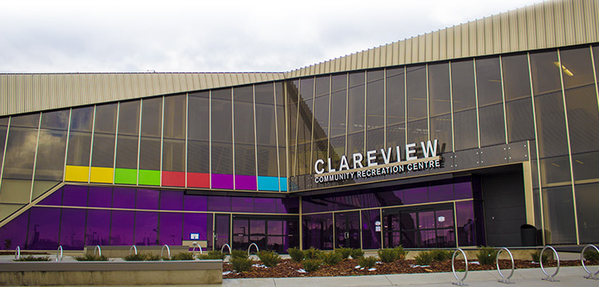
Access Points

Slide 78
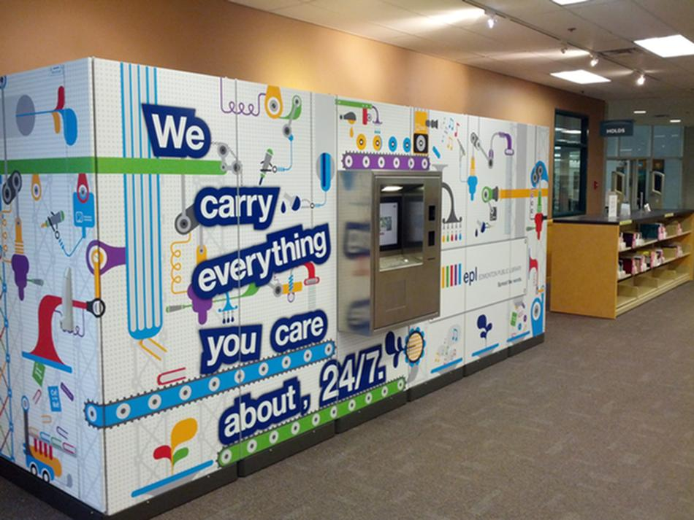
Access Points

Slide 79
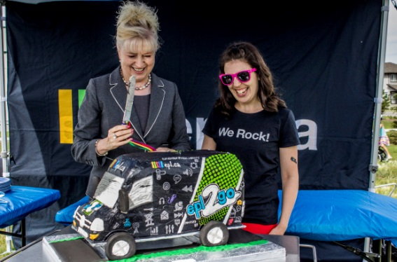
Access Points
http://i2.wp.com/metronewsca.files.wordpress.com/2014/07/mg_3587_modded_by_james.jpg?crop=0px%2C15px%2C5184px%2C3422px&resize=618%2C408

Slide 80
Service Awareness
Categorize services from a customer-centered perspective

Slide 81
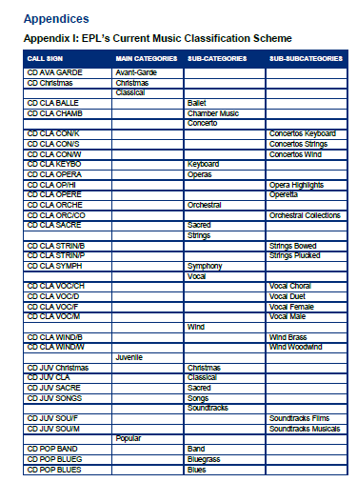
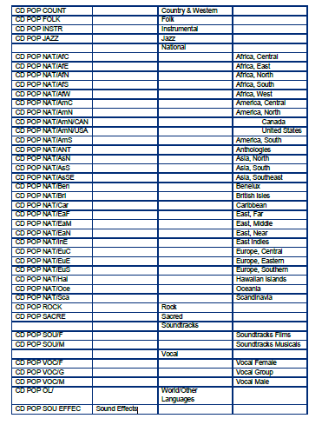
Service Awareness

Slide 82
Service Awareness
Updated Classification (bold = new) | Call sign | Interfile with (old category)
Non-classical
Blues/R&B/Soul | CD BLUES | CD POP BLUES
Christmas | CD Christmas | CD Christmas
Country & Bluegrass | CD COUNT | CD POP COUNT
Dance & Electronic | CD DANCE | Display (or shelve at the front of CD POP VOC)
Faith-based music | CD FAITH | CD POP SACRE
Folk | CD FOLK | CD POP FOLK
Instrumental | CD INSTR | CD POP INSTR
Jazz | CD JAZZ | CD POP JAZZ
Pop music | CD POP | Display (or shelve at the front of CD POP VOC)
Rap & Hip hop | CD RAP | Display (or shelve at the front of CD POP ROCK)
Rock | CD ROCK | CD POP ROCK
Sound Effects | CD SOU EFFEC | CD SOU EFFEC
Soundtracks | CD SNDTRK | Shelve at the front of CD POP SOU/F
World music | CD WORLD | Display (or shelve at the front of CD POP NAT)
Classical
Chamber | CD CLA CHAMB | CD CLA CHAMB
Keyboard | CD CLA KEYBO | CD CLA KEYBO
Operas | CD CLA OPERA | CD CLA OPERA
Orchestral | CD CLA ORCHE | CD CLA ORCH
Sacred | CD CLA SACRE | CD CLA SACRE
Strings | CD CLA STRIN | Shelve at the front of CD CLA STRIN/B
Winds | CD CLA WIND | Shelve at the front of CD CLA WIND/B
Vocal | CD CLA VOCAL | Shelve at the front of CD CLA VOC/CH
Children's
Children's Christmas | CD J Christmas | CD JUV Christmas
Children's Classical | CD J CLA | CD JUV CLA
Children's Faith | CD J FAITH | CD JUV SACRE
Children's Songs | CD J SONGS | CD JUV SONGS
Children's Soundtracks | CD J SNDTRK | CD JUV SOU

Slide 83
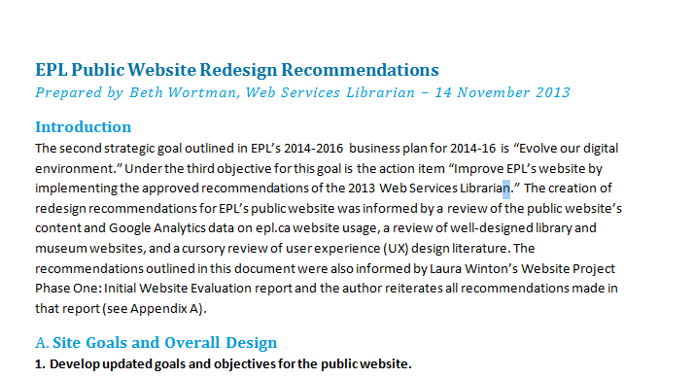

Slide 84


Service Awareness

Slide 85
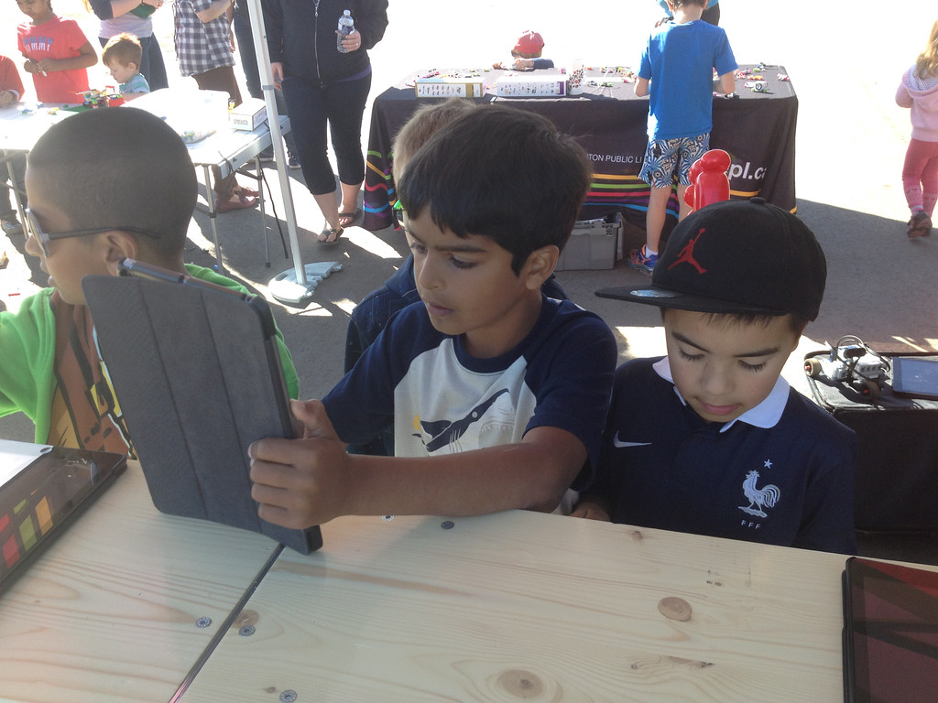

Slide 86
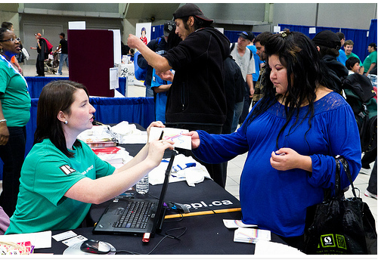
http://www.homewardtrust.ca/homelessconnect/gallery/photos.php?id=5

Slide 87
Literacies
Increase provision of Flexible Digital Literacy Instruction
Encourage Literacy Instruction Programs from Partner Agencies

Slide 88
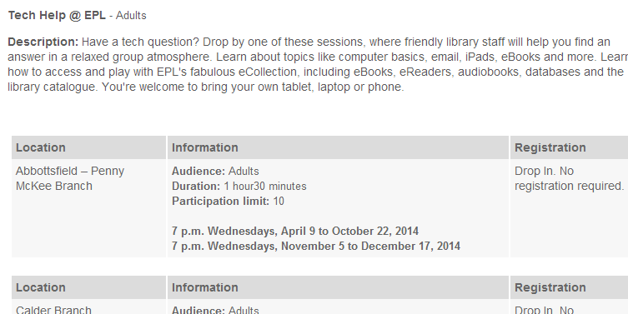
Digital Literacy
Available at All Branches

Slide 89
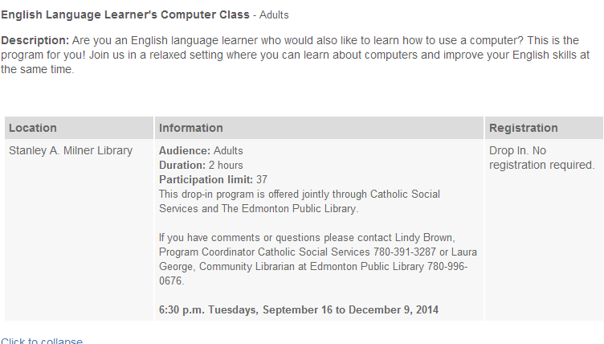
Digital Literacy

Slide 90
Assumptions ==== > Understanding

Slide 91
Assumptions = > Understanding

Slide 92
Questions?
http://www.homewardtrust.ca/homelessconnect/gallery/photos.php?id=5
Contact:
Peter Maguire
T: 780.495.9876
pmaguire@epl.ca

