Slide 1
You Can Do That Here!
Library Patrons as Open Source Maker Community

Slide 2
Government of Ontario
Culture Development Fund
Community Media Centre Project
Mobile App, eLearning Channel, Download/Research Stations

Slide 3
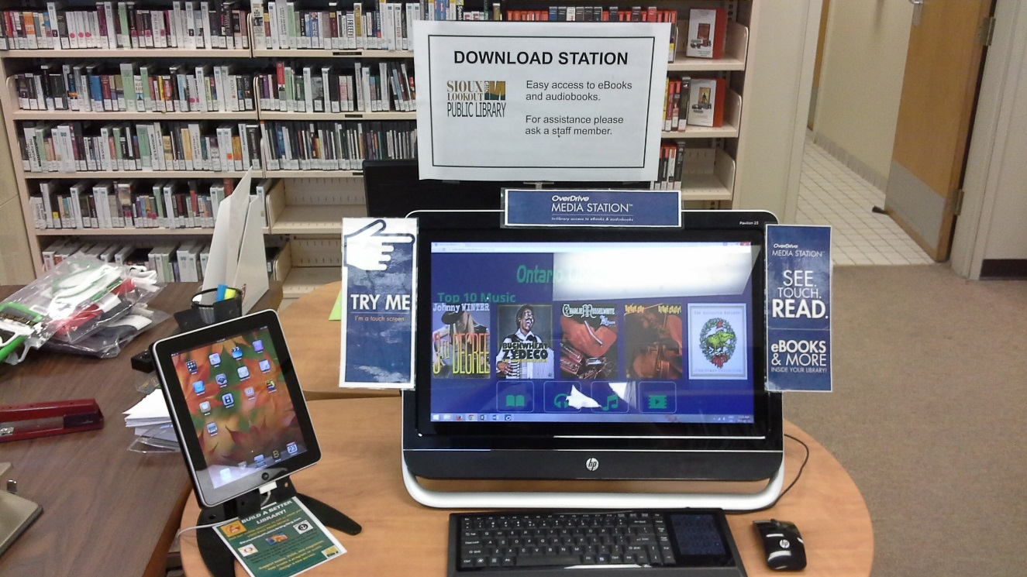
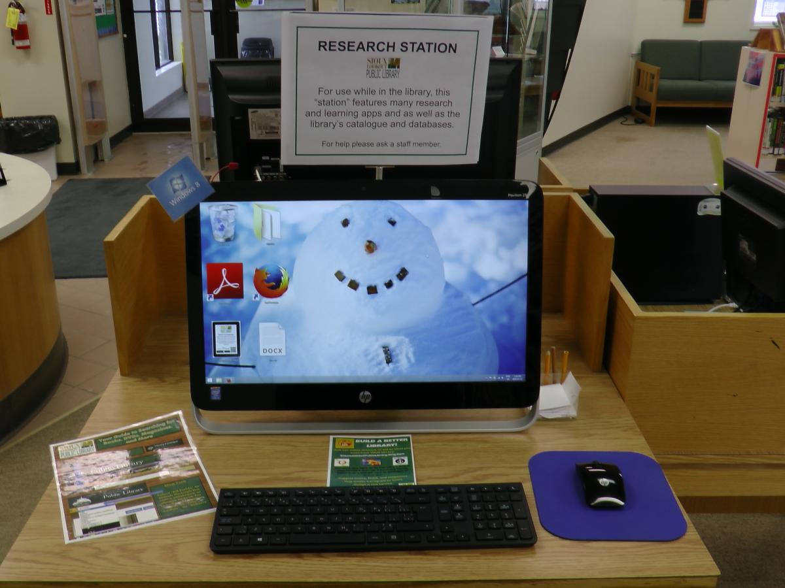

Slide 4
Ontario Trillium Foundation
Community Grant
Community Media Room Project New computers/furniture, projector, live streaming

Slide 5
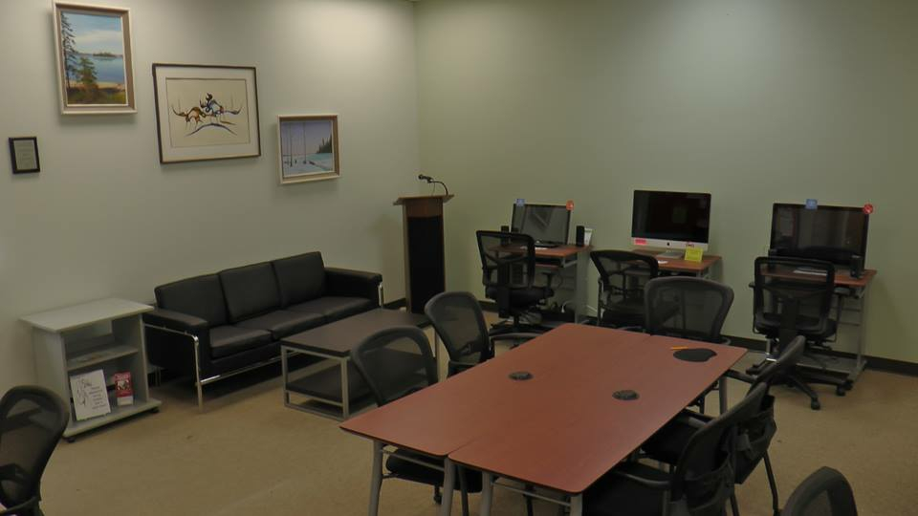

Slide 7
“The library should be an expression of its community’s vision and creativity; this can only happen if we involve them actively in decision-making and planning.”
Community-Led Libraries Tool-Kit

Slide 8
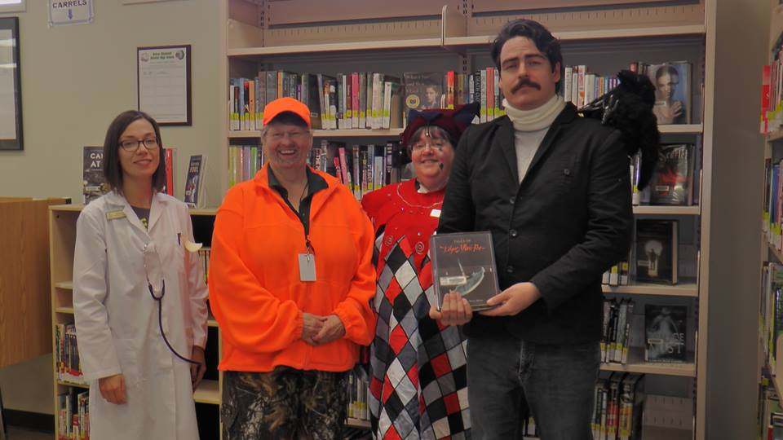

Slide 9
“When you are growing up there are two institutional places that affect you most powerfully: the church, which belongs to God, and the public library, which belongs to you.”

Slide 10
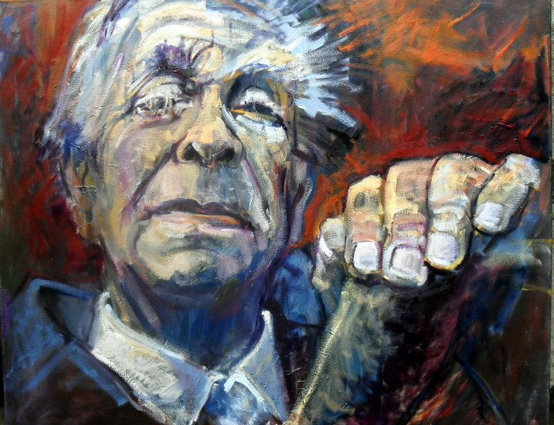
Jorges Luis Borges

Slide 11
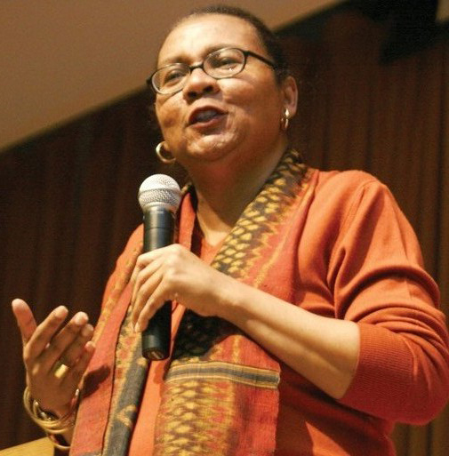
bell hooks

Slide 12
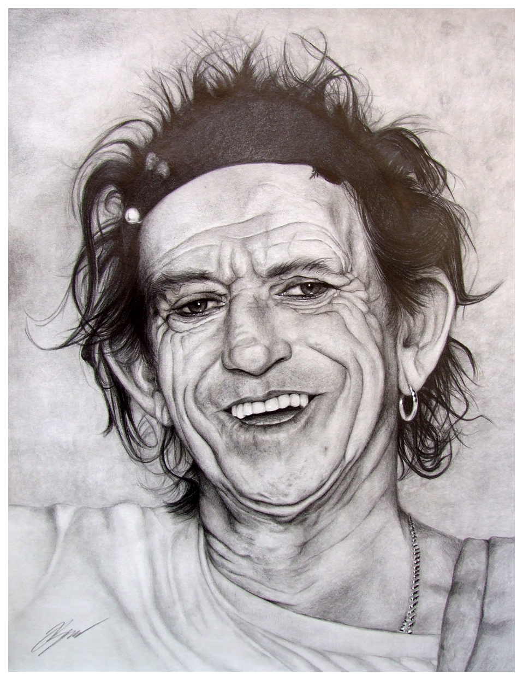
Keith Richards

Slide 13
You Can Do That Here!

Slide 14
Library Patrons as Open Source Maker Community

Slide 15
A User:
a person or thing that uses.
one who uses drugs, especially as an abuser or addict.
Computers. a person who uses a computer.

Slide 16
A patron:
a person who gives money and support to an artist, organization, etc.
a person who buys the goods or uses the services of a business, library, etc.

Slide 17
Library Patrons as Open Source Maker Community

Slide 18
“Open source code is typically created as a collaborative effort in which programmers improve upon the code and share the changes within the community…

Slide 19
Open source sprouted in the technological community as a response to proprietary software owned by corporations.”
http://www.webopedia.com/TERM/O/open_source.html

Slide 20
What is the source code for your library?
Strategic Plans
Policies/Procedures
Programming
Collection Guidelines
Service Delivery

Slide 21
The source code for your library is always under revision…but who has control over how it is written and put into use?

Slide 22
Public Libraries Act
Powers and duties of board
20. A board,
(a) shall seek to provide, in co-operation with other boards, a comprehensive and efficient public library service that reflects the community’s unique needs;

Slide 23
Library Patrons as Open Source Maker Community

Slide 25
Build a Better Library!

Slide 26
“Human achievement is based on collective intelligence - the nodes in the human neural network are people themselves.” Matt Ridley
http://www.rationaloptimist.com/blog/collective-intelligence-on-the-edge.aspx

Slide 27
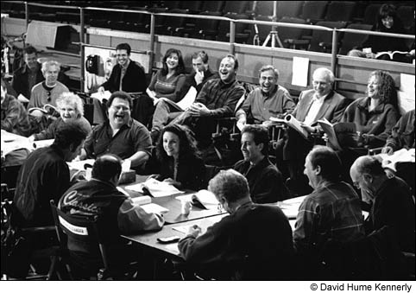

Slide 28
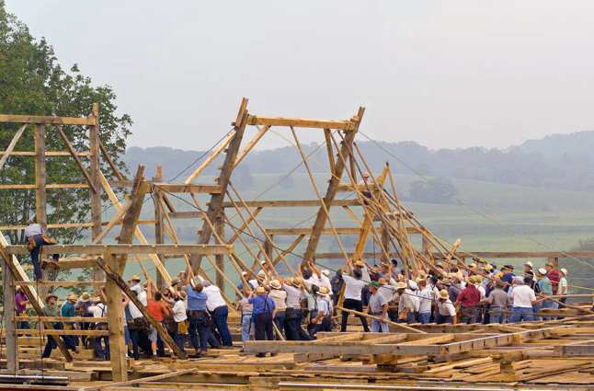
http://designthinking.ideo.com/
Tim Brown
http://designthinking.ideo.com/
http://designthinking.ideo.com/

Slide 29
Giving Up Control…
Are We Ready?

Slide 30
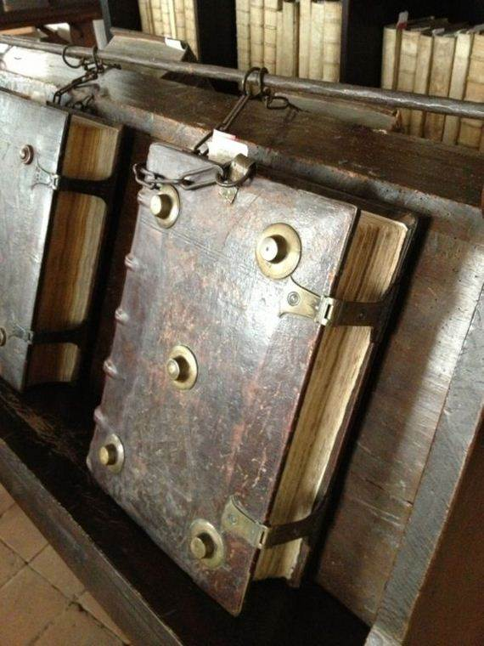

Slide 31
Revising Our Library’s Source Code
Patrons creating a policy. Patrons suggesting ways to revise a policy.
Community organization or service group helps create and set up a special collection Patrons suggesting titles for the library.
A vision statement or strategic plan document is posted to an online forum with an invitation to solicit feedback from patrons.

Slide 32
Patrons designing (and possibly delivering) a program.
Patrons voting on options for a potential program (times, themes, structure).
Patrons / organizations are marketed directly for programs.

Slide 33
“Don’t be the sage on the stage, be the guide on the side.”
From Sage on the Stage to Guide on the Side. Alison King – 1993 article on education reform in post-secondary education.
“Don’t be the sage on the stage, be the guide on the side.”
From Sage on the Stage to Guide on the Side. Alison King – 1993 article on education reform in post-secondary education.

Slide 34
Traditional Teaching Style –
One instructional method (primarily visual or auditory) taught by a person of unquestionable authority.
Contemporary Style (this is an ideal)
Several instructional methods (for many kinds of learners) taught by a facilitator that directly involves students in not only what they learn, but how they learn.

Slide 35
“Librarians are facilitators instead of the all-knowing keepers of information.”
“Libraries are not static archives of information; libraries are interactive community hubs where patrons can create and share information relevant to their lives.”

Slide 36
A public library is a shared place that is designed to connect people and information.

Slide 37
Patron/Information/Space
Share/Design/Connect
People share a space and information.
People are connected to a space and with information.
People design a space and their own information.
People share their designs for a library space.
A librarian connects patrons with information.

Slide 38
What do I think the most profound question librarians need to ask today?
How do we give our patrons more control over the library while still creating a coherent vision?

Slide 39
We need to define the relationship between a patron and their library.

Slide 40
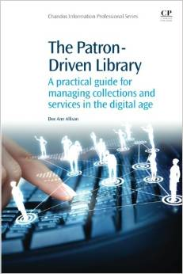

Slide 41
Libraries Need to Share Ideas with Other Libraries!
We need to put our source code into the community.

