Slide 1
How to Copyright in a Public Library
Presented by: Jesse Roberts & Lindsey Long
Thunder Bay Public Library

Slide 2
Why Now?
November 2012: Parliament finalized some major amendments to the Copyright Act of Canada (Copyright Modernization Act) http://laws-lois.justice.gc.ca/eng/annualstatutes/2012_20/FullText.html
We really should have been on top of this all along, especially after a wake-up call

Slide 3
Why Care?
Photos, Newspapers, Maps, etc
LAMs (Libraries, Archives & Museums)
Educational Institutions
Fear Factor
Digitization of Collections
Public Access & Fair Dealing
Public Demand for Support
Program Posters

Slide 4
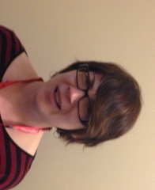
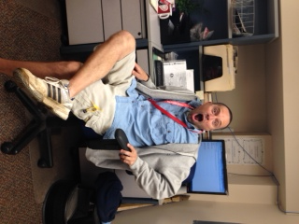
Staff Reactions?

Slide 5
What’s Worked So Far?
Getting to know the Act
Collection Development
Survey of other libraries
Staff meetings & presentation to Board

Slide 6
What’s Worked So Far?
Review existing policy, procedures, etc
Online courses, webinars, etc
Organizational comfort level re: risk
Copyright Page on website: Public FAQ, Copyright Statement

Slide 7
What’s Worked So Far?
Review of database licenses/agreements
Staff FAQ & Staff Workshops (with prizes!)
New signage
Share copyright news and media items with all staff

Slide 8
What’s Left to Do?
Future staff workshops focused on specific scenarios for practical application of copyright
Consideration of copyright clause into all contracts for reports, art, etc commissioned by TBPL

Slide 9
What’s Left to Do?
Increase staff comfort level with copyright and how to apply it to everyday work
Future digitization of local history materials and other resources
Ongoing learning as Copyright Act of Canada continues to develop and grow

Slide 10
What’s Left to Do?
Rewrite Library’s copyright policy
Implement “formal” copyright training for new staff
Share future copyright news and media items with all staff

Slide 11
Clear as Mud?
Make it a part of the day to day work
You don’t know what you don’t know
Just ask, it’s simple
Newspaper restrictions and other oddities
Public use = public responsibility
Dr. Wilkinson annual update, EI webinars, CCM courses, etc

Slide 12
Questions?
Jesse Roberts Lindsey Long jroberts@tbpl.ca llong@tbpl.ca
807-624-4203 807-684-6812
Notes:
LL

Slide 13
Pop Quiz!
What is the general rule for the length of copyright in Canada? The United States?
Can I download an image from the Internet to use for library posters?
How does copyright apply to DVDs and CDs at a public library?

