Slide 1
Serving Newcomers What do they need? How do we serve?
Sarala Uttangi
Manager, Diversity and Adult Services
Brampton Library
OLA 2015

Slide 2
Outline
Who are Newcomers
What do Newcomers need?
How do we serve?
Demographic Trends
Getting to know the Newcomer community
Building World Languages Collection
Newcomer Programs and Services
Partnerships and Collaborations
Outreach
Supporting Newcomers in Need

Slide 3
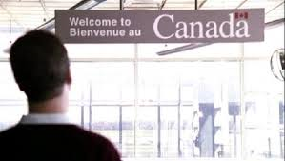
Who are Newcomers?
Imagine you, along with your family are moving abroad to settle in another country. It is not necessarily only a move to develop your career but as much
to challenge yourself in a
new cultural and social setting.
Upon settling …..

Slide 4
What are the Newcomers’ immediate needs?

Slide 5
How do we Serve?
Demographic Trends
Getting to know your community
Building World Languages Collection
Newcomer Programs and Services
Partnerships and Collaborations
Outreach

Slide 6
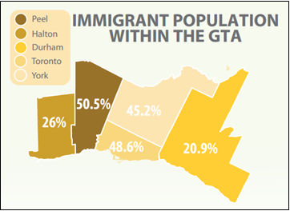
Brampton – Demographic Trends
Key destination
Highest rate of population growth
Top 5 Countries of Birth
India
Philippines
Pakistan
Jamaica
Sri Lanka
Source: Statistics Canada, National Household Survey 2011. Image from Peel Data Centre

Slide 7
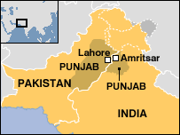
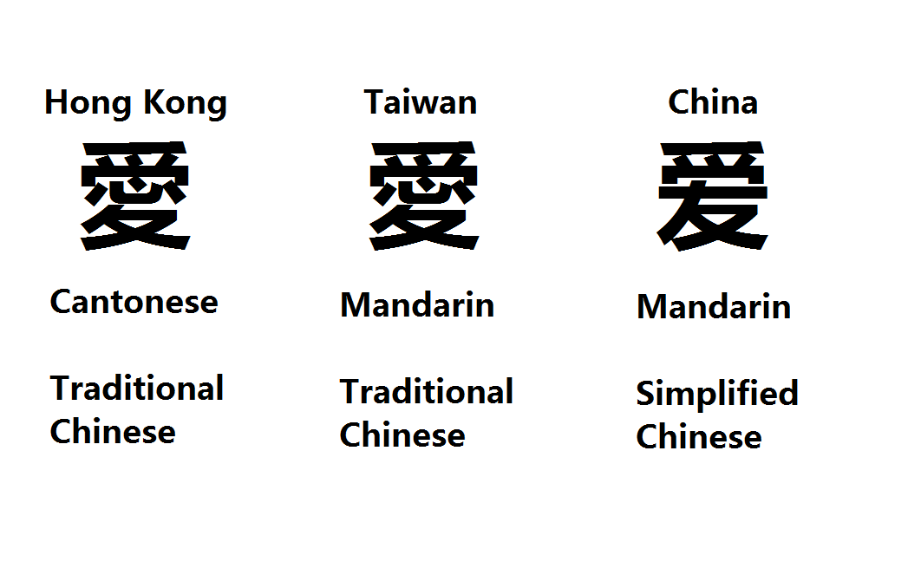
Getting to know your Community
Chinese Language
Punjabi Language

Slide 8
Newcomers Perception of Libraries
Libraries are for the educated or for those attending school
Access to the library and library services requires a fee
Libraries divulge personal information to the government
Libraries only provide materials in English
Libraries are book stores
Libraries are places to have documents notarized

Slide 9
Building World Languages Collection
Criteria for acquisition
New immigrants or new citizens
Established immigrant populations
Second or third generation immigrants
Young working families with young children
Extended families including the elderly
Fluent speakers and readers of their own language
Preferred types of material and formats
Newly arrived refugees

Slide 10
Building World Languages Collection
TIER 1 | TIER 2 | TIER 3
Punjabi | Sinhalese | Bengali
Hindi | Spanish | Marathi
Gujarati | Tagalog | Korean
Tamil | Polish | Vietnamese
Urdu | Italian | Arabic
Chinese | Malayalam | Portuguese
Eliminated Croatian, Persian and Serbian language due to low demand

Slide 11
Newcomer Programs and Services

Slide 12
Partnerships and Collaborations

Slide 13
Outreach

Slide 14
Questions? Comments?
Sarala Uttangi
Manager, Diversity and Adult Services
Brampton Library
905-793-4636 ext. 4256
suttangi@BramptonLibrary.ca

