Slide 1
Transforming Instruction with the Flipped Classroom
OLA 2015
Anne Fullerton, Jackie Stapleton, Sarah Brown, Rebecca Hutchinson

Slide 2
Outline
Flipping explained (video)
Stages of flipping (lecture)
Today’s in-class activity (hands-on)

Slide 3
Flipping the Classroom – Simply Speaking
By Penn State University (CCBY)

Slide 4
Stages of Flipped Class
Introduce Task
Out of Class Task
Assess Learning
In Class Activity
Motivation
Modified from “Flipping the Classroom” by Dr. Mark Morton and Jane Holbrook, Centre for Teaching Excellence at the University of Waterloo presentation

Slide 5
Introduce Task
Prepare students for a different learning experience
Explain the purpose of the out of class task
Set students up for success
Ensure the task and time commitment is suitable for the students’ abilities and workload
Include expectations that students complete task so they are prepared for in-class portion
Motivate students

Slide 6
Out of Class Task
Create your own support materials or pull in outside resources
Provide all information needed to complete task
Create guiding questions or prompts for students as they engage in the task
Provide a means to assess learning
My experiences:
Graduate health course
University 101: at risk students
Motivation
1st year at risk student: “I thought it was useless. I didn't see what the point of it was. The information I retained was from the PowerPoint and the activity we did …in class”
MSc student: “without the pre class activities I wouldn't have known what I did not know... I think having the pre class assignments really helped to identify areas that were unclear.”

Slide 7
Assess Learning
Find info on depletion of the ozone layer and health.
Which combination of words is best?........ Explain.
Are students prepared for in-class activity?
Evidence: Self-assessment quiz online
Automatic feedback
Check conceptual understanding
“Grade it and they do it” Your Time
Ask most difficult/confusing point about the material; JiTT online/in-class
Grade Effort – Rubric
0 – blank
1 – answer NO rationale
2 - answer AND rationale

Slide 8
In Class Activity
Activities are linked to course objectives and assessments
Motivate students to participate
Scalable application activities (discussion, problem solving, exploration)
Peer-to-peer and student-instructor dialogue is encouraged
How to deal with students who haven’t completed out of class task?

Slide 9
Today’s In Class Activity
In a group of 2-4, using the flipped class model provided, develop a plan for the following lesson:
Teaching Boolean to beginner searchers
Time limit: 10 minutes

Slide 10
Questions?

Slide 11
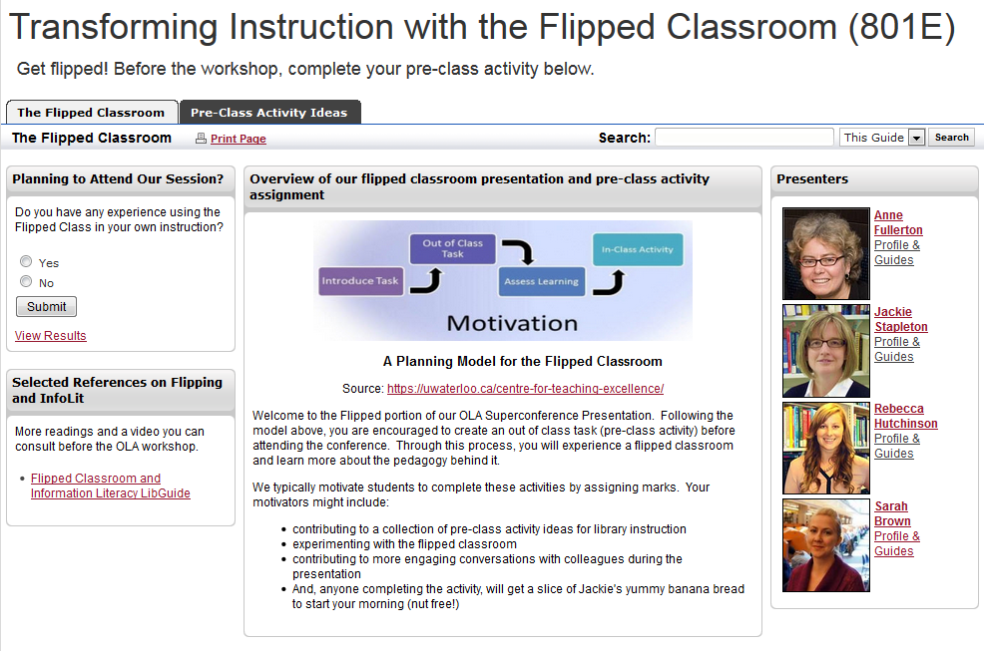
Resources and contact

