Slide 1
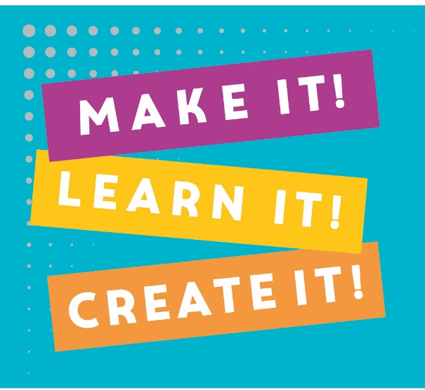
Beyond The Maker Space:
Implementing and Integrating STEAM Based Youth Programming in the Public Library
Richard Anderson Librarian II – Digital Literacies
Kasey Keeley Digital Creation Specialist - Children
January 31 2018
Notes:
Our goal today:
Promote STEAM (science, technology, engineering, arts, and math) as a foundation to youth programming. We should assume that it belongs in public libraries along with storytimes and computer tutoring

Slide 2
Our goals today:
Advocate for STEAM based youth programming
Provide tips, activities, and program ideas that have worked for VPL
Promote STEAM activities as a foundation to library programming
Notes:
Our goal today:
Promote STEAM (science, technology, engineering, arts, and math) as a foundation to youth programming. We should assume that it belongs in public libraries along with storytimes and computer tutoring

Slide 3
How we got here:
The Maker Movement
Digital Literacy Lab for Young Children
The Bio Lab - La Jolla/Riford Library, San Diego Public Library
S.T.E.A.M

Slide 4
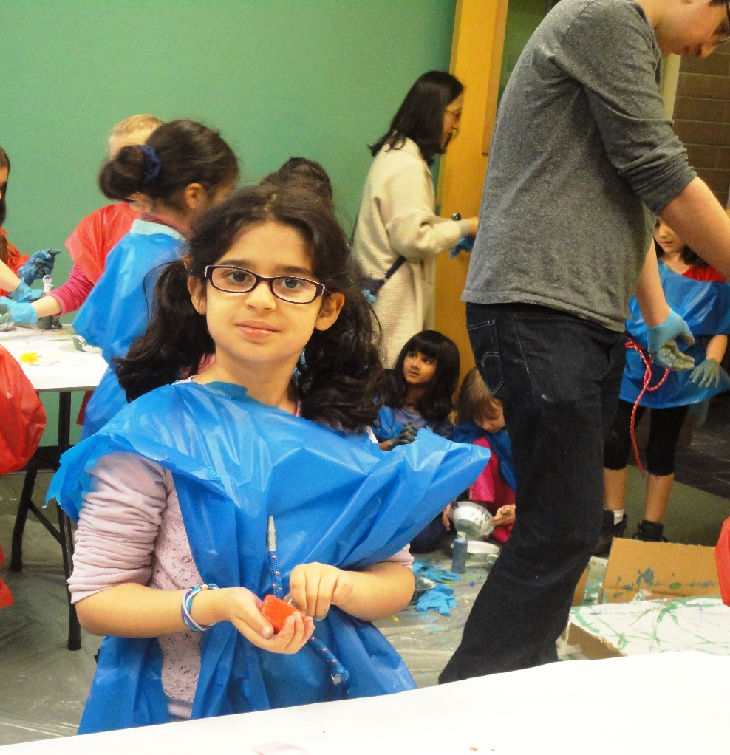
Science
Technology
Engineering
Arts
Mathematics

Slide 5
STEAM club & STEAM story time
Short Programs & PA Days
Outreach & Homeschool
Multiple Day Programs
Everything

Slide 6
STEAM CLUB &
STEAM STORY TIME
start here
lightly planned
weekly
drop-in, no registration
Notes:
Very week-to-week, not dependent on continuity/regular attendance (although many kids to do attend almost every week!)

Slide 7
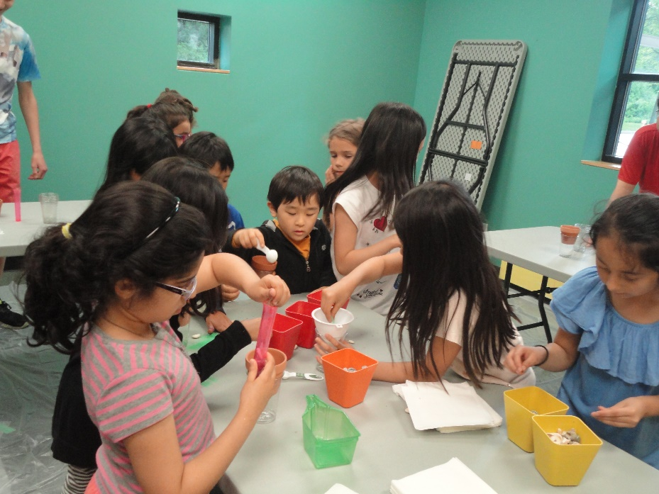
STEAM Club
1 hour program
Weekly, drop-in
Aimed at children 7-11
Each week focuses on a topic and activities falling under the STEAM umbrella
Notes:
Weekly, drop-in program for children age 7+
How many people here feel comfortable with STEAM topics? How about just with some? STEAM Club is a learning experience for the facilitator as well as the attendees!

Slide 8
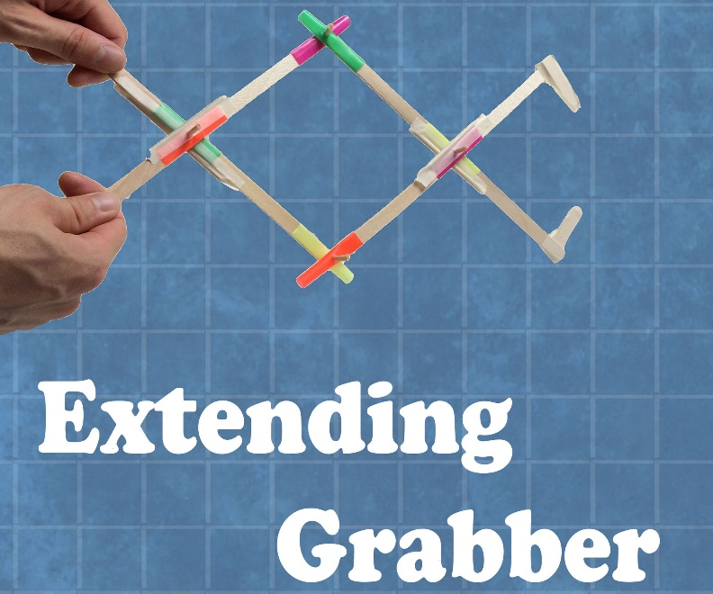
STEAM Club Example Topics
S - Extract DNA from bananas (this is surprisingly easy!) https://askabiologist.asu.edu/activities/banana-dna
T - Intro. to Twine (open-source tool for creating choose-your-own-adventure style stories) http://twinery.org/
E - Building “extending grabbers” http://www.instructables.com/id/Extending-Grabber/
Image source: http://www.instructables.com/id/Extending-Grabber/
Notes:
Materials for DNA extraction – bananas, coffee filters, rubbing alcohol, water, dish soup, salt

Slide 9
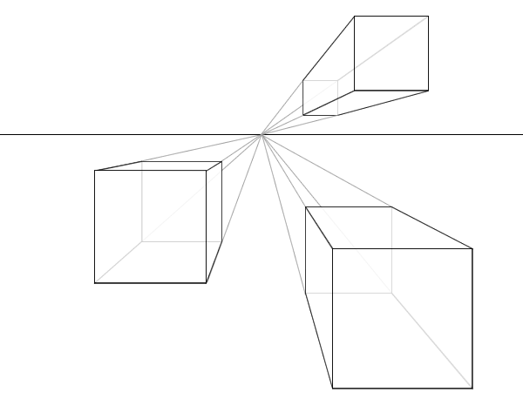
STEAM Club Example Topics (cont’d)
A - Drawing 1-point perspective (made names flying out of page)
M - Dice Olympics, based on Reiner Knizia’s Decathlon http://knizia.de/wp-content/uploads/reiner/pdfs/Knizia-Website-Decathlon.pdf
Image source: Wikimedia Commons
Notes:
Materials for DNA extraction – bananas, coffee filters, rubbing alcohol, water, dish soup, salt
Other examples: Mobius strips, testing reflexes/reaction time, two-point discrimination, colour spectrometry, paper airplanes (calculating velocity)

Slide 10
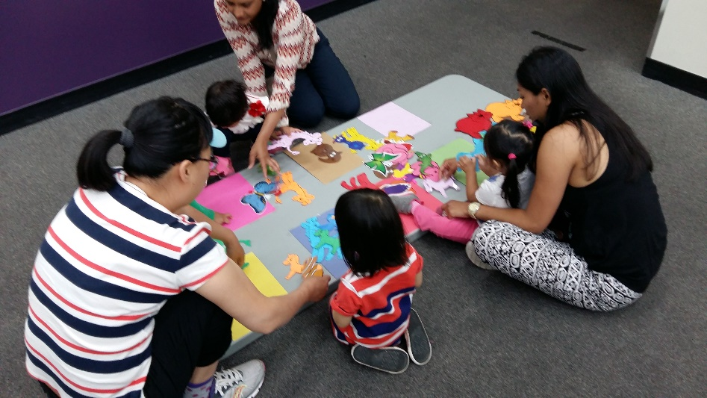
STEAM Storytime
30min-1h open-ended program
Weekly, drop-in
Children ages 2-4, with caregivers
Notes:
Weekly, drop-in program for children age 7+

Slide 11
STEAM Storytime Overview
Two components:
A short, STEAMy-themed traditional storytime
Free play time with a series of activity stations
Storytime – keep it simple
Activities! – focus on basic skills (fine and gross motor skills, sorting, counting, pattern recognition, storytelling, concepts like shapes and colours)
Notes:
Always started storytime with Ten little fingers, always ended with “If you love science and you know it…”
Briefly explain the play stations to caregivers at end of storytime (before good-bye songs)
Activity stations each have a description sheet with examples of open-ended questions caregivers can ask the children as they play, to encourage exploration and learning.

Slide 12
STEAM Storytime Example Activities – Light & Shadow
Shadow puppets (both cut-out silhouettes and hand shadows)
Prompts: point out that shadows change size when you move toward and away from light source; encourage storytelling
Flashlights!
Prompts: shine light at wall and move away; shine light through hand; shine light under face!
Materials to shine light through
Prompts: what materials does the light shine through? Do some colours block more light than others?

Slide 13
STEAM Storytime Example Activities – Toddler Chemistry!
General idea: white powder mixed with clear liquid can have lots of different results!
Corn starch and water make slime!
Baking soda and vinegar make bubbles!
Sugar and water makes the sugar disappear (but you can still taste it!)
Program pairs really well with The Mixed-up Truck

Slide 14
SHORT PROGRAMS
next steps
moderate to heavy planning
Infrequent
scheduled and marketed
(sometimes) requiring preregistration

Slide 15
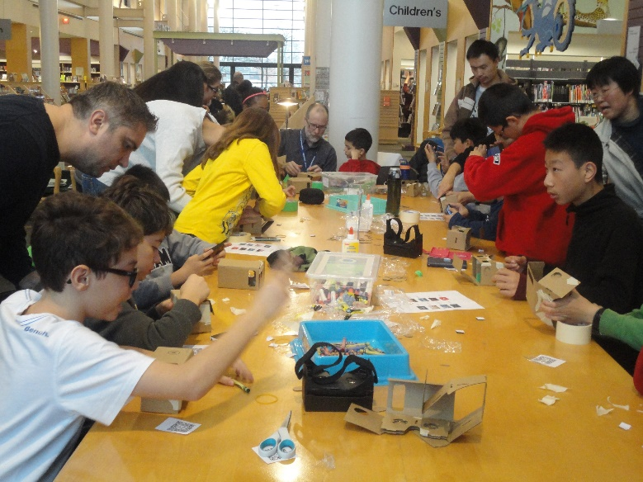
Virtual Reality at the Library
2 editions:
VR in the library 1: assemble Google cardboard-style VR glasses that you can take home!
VR in the library 2: create and test out your own VR spaces with the CoSpaces app

Slide 16
PA DAYS
go big
heavily planned
more than one staff member
multiple themed activities
Drop-in / no registration

Slide 17
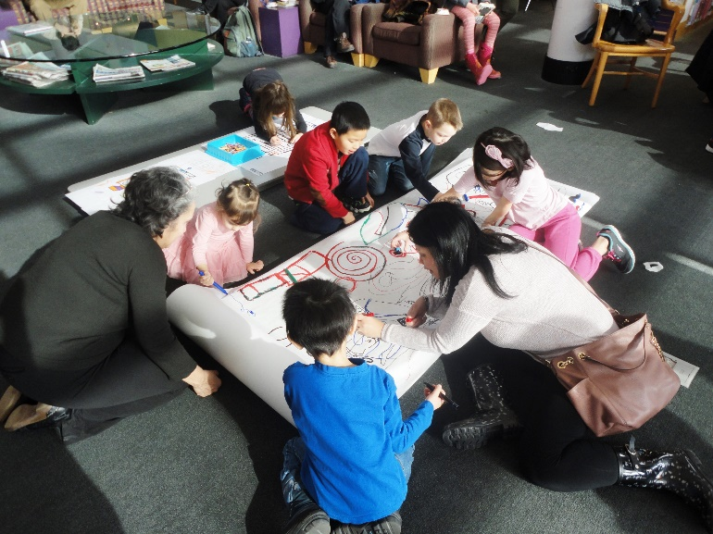
Robot Day
all robots all day
robot themed story time and activities for our youngest customers
robot costumes and colouring sheets
ozobots, sphero, cubelets, and Lego WeDo
motorized robots

Slide 18
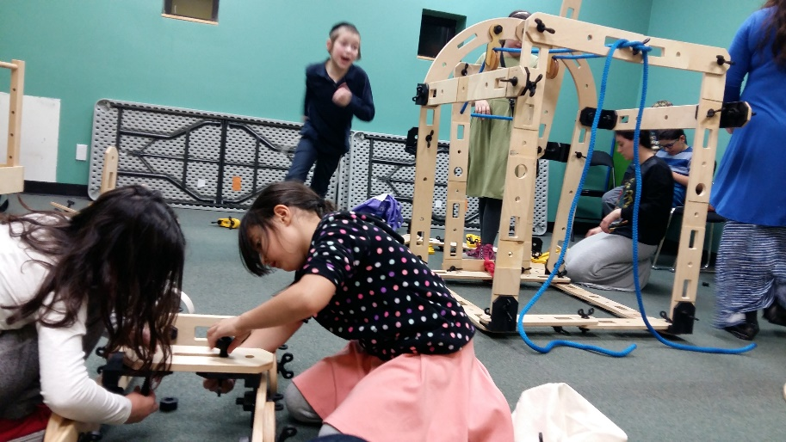
Mechanize IT!
All about simple
machine (levers,
pulleys, gears, etc.)
Rigamajig!
Basic materials provided for free building play (straws, craft sticks, yarn, tape…)

Slide 19
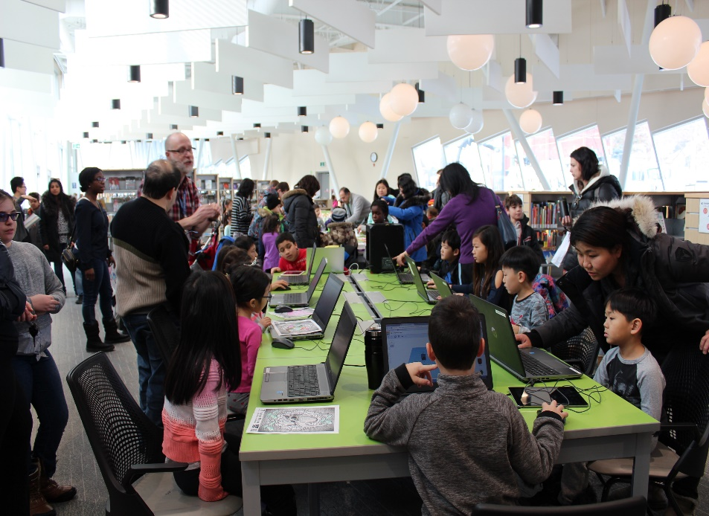
ONE TWO …3D!
3D Design via Tinkercad
Makerbot Mini
Foldify 3D paper folding
Paper fidget spinner creation
Quiver and Augmented Reality
Lego, K’Nex, and more

Slide 20
OUTREACH
get outside
‘The Maker Experience’
all day interactive event
Kindergarten to Grade 12
STEAM workshops

Slide 21
MULTI-DAY PROGRAMS
dig deeper
Heavy planning
Infrequent (perhaps*)
Preregistration

Slide 22
iCreate Camps
Registered summer day programs
1-day mini-camps run by library staff (ages 7-10)
5-half-day camps in partnership with STEM Minds (ages 8-14)
Notes:
VR it! (VR and AR), 3D it! (tinkercad, foldify), Hack it! (Kano Computers), Capture it! (Movie and photo apps for iPad)
Explore it! (digital media, 3D scanning and VR – scan yourself into a VR game!)
Code it! (make an app, using apps! – design, programming, testing and debugging)
Create it! Creating a custom Minecraft adventure map

Slide 23
Keyboarding
Registered, ages 8-11
4 weeks, 1-hour sessions
Intro. to touch typing techniques
Common keyboard shortcuts
Touchscreen keyboards

Slide 24
HOMESCHOOL
Registered
Bi-monthly
Matches public school year (March Break)
90 minute sessions
Involved, invested caregivers

Slide 25
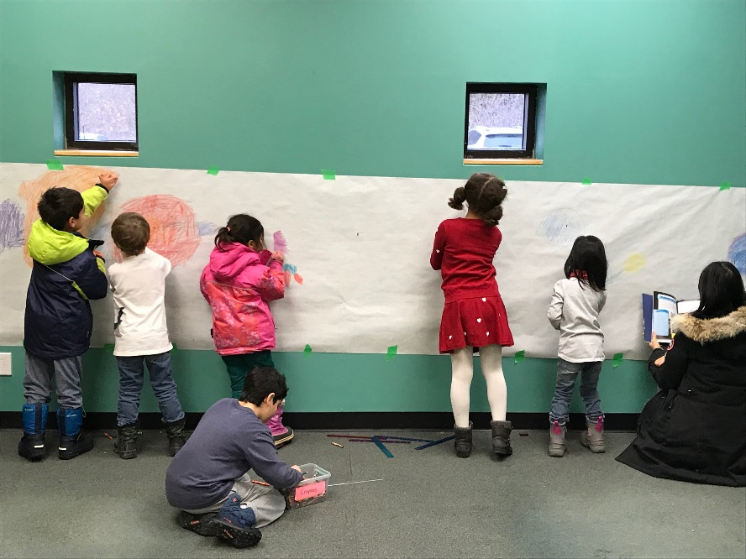
STEAM Club – the homeschool edition
S - How Big is the
Solar System?
T - Into to 3D Design
with Foldify
E - Stick Bombs!
A - Juggling
M – Velocity vs. speed with paper airplanes
Notes:
Materials for DNA extraction – bananas, coffee filters, rubbing alcohol, water, dish soup, salt

Slide 26

EVERYTHING
Everything (almost) is STEAM

Slide 27
What’s Next
Bathurst & Clark Resource Library LEARN it space
Virtual Reality and Seniors

Slide 28
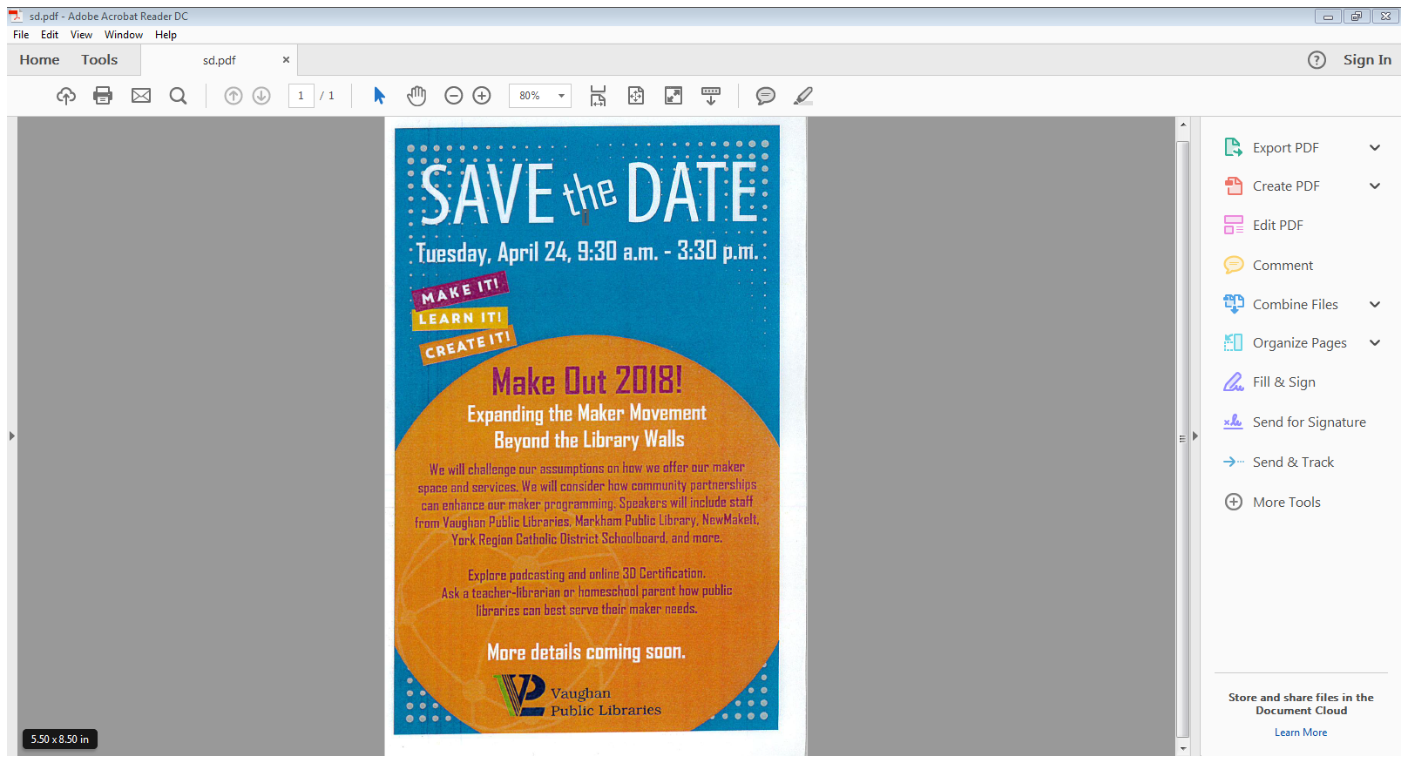
MAKE out 2018

Slide 29
CONTACT US
905.653.READ (7323) | www.vaughanpl.info
richard.anderson@vaughan.ca
kasey.keeley@vaughan.ca

