Slide 1
Designing Best and Emerging Practices in Research Management
OLA SuperConference 2018
Dr. Ann Russell, Ph.D.
Juanita Richardson, MLIS, MBA, AHIP
Kimberly Silk, MLS
Notes:
Juanita – brief intro – mention that Mikaela Gray was our practicum student from the Faculty of Information University of Toronto – cannot join us today – grateful that Kim Silk was able to step in
- We want to have more of a conversation than talking heads – feel free to ask questions at any time

Slide 2
Background
Michener Institute of Education at UHN http://michener.ca/
Research Institute of Healthcare Education http://michener.ca/research-institute/
Notes:
Ann – 10 – 15 mins
introduce the Michener Institute and the Research Institute of Healthcare Education
speak as the project sponsor – what you were hoping to achieve with this research project

Slide 3
Survey: Purpose
To identify approaches and best practices for designing Research Services in a Healthcare Education environment;
Phase 1: Environmental Scan
Phase 2: Interviews with professionals working in healthcare and research environments
Notes:
Juanita – 10 mins
starting from a position of an open question – we were aware that librarians working with researchers are well-entrenched providing systematic reviews – but we wanted to better understand the whole research life cycle process and see where emerging practices for library scientists were opening up to collaborate with researchers :
Project was broken down into two phases:
P1 - Objectives– to better understand the research life cycle – with every phase examined; identify best and emerging practices in research management and research support; identify comparable organizations and highlight their services to support research management
This research was conducted through a literature review as well as interviews with researchers from the Wilson Centre at UHN
P2 – Objectives – to build on P1 – we wanted to enrich the information collected from the P1 environmental scan and start to dig deeper into opportunities.
To this end, Mikaela conducted a series of interviews – including information professionals who provide direct research support to researchers, other information professionals who are leaders in the development of innovative services and research collaboration, as well as technology leaders.
It became clear that this was a massive project – and that, in fact, we are only getting started …

Slide 4
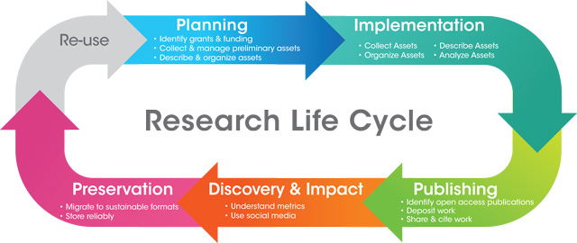
Research Life Cycle
Source: University of California Irvine Digital Scholarship Services at http://previous.lib.uci.edu/dss/
Notes:
Kim – 30 – 40 mins

Slide 5
Research Data Management Life Cycle
Source: University of California Santa Cruz Library Research Data Management at https://guides.library.ucsc.edu/datamanagement

Slide 6
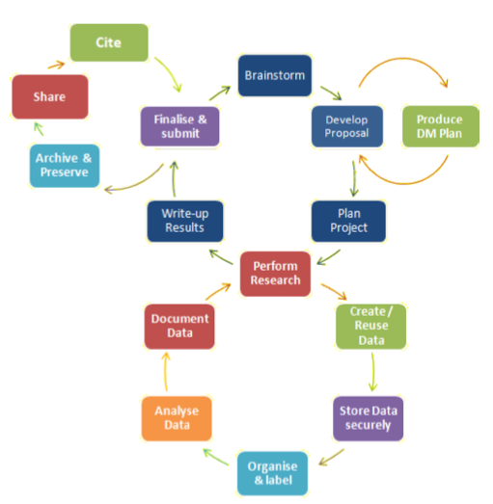
Life Cycles: The Big Picture
Source: London School of Hygiene and Tropical Medicine – Research Publications & Research Data at (https://www.lshtm.ac.uk/research/research-publications-research-data)

Slide 7
Libraries supporting the research Life Cycle
Environmental Scan:

Slide 8
Stage 1: Planning
Identify funding
Collect and organize (data) assets
Citation management
Metadata schema, file naming conventions
Producing a data management plan (DMP)
Planning to share your work and your data
Funder policies about OA
Tri-Agency Open Access Policy on Publications:
http://www.science.gc.ca/eic/site/063.nsf/eng/h_F6765465.html?OpenDocument
Notes:
Where librarians can support the research process
DMP contains:
Types of data
Who owns the data
Who can access the data during the research process
Who maintains the data during the research process?
How will the data be described?
Metadata standards, file naming conventions, taxonomy, whether proprietary software is needed to read the data
Preservation after research
Where will it be stored for long term?
Funder requirements for open data
Privacy re: human subject data
Will data be shared?
DMP Tools: In Canada, Portage Network provides the DMP Assistant ; free; bilingual; templates coming soon.
CIHR has had an open access policy since 2008; in 2015, the tri-council released an OA policy based on CIHR’s policy: all publicly funded research publications must be open within 2 months of publication.
As of 2008, recipients of CIHR funding must:
deposit bioinformatics, atomic, and molecular coordinate data into the appropriate public database immediately upon publication of research results;
Retain original data sets for a minimum of five years after the end of the grant (or longer if other policies apply)

Slide 9
Stage 2: Implementation
Organize and describe (data) assets
Analyze (data) assets
Documenting data

Slide 10
Stage 3: Publishing
Identify (OA) publications
Deposit work - publications and data
Assign permanent identifiers to work (DOI) and to authors (ORCiD)
Follow your DMP
Notes:
ORCiD – persistent, unique identifier for authors – disambiguation; free; ORCID-CA in Canada.

Slide 11
Stage 4: Discovery & Impact
Research impact metrics – traditional and altmetrics
Social media for distribution and awareness
Notes:
Research impact metrics
What’s used is specific to discipline
Traditional metrics:
Journal impact factor
Article metrics – citation count
Author level metrics – H-index
Altmetrics
Social media, blogs, twitter, reddit, etc.

Slide 12
Stage 5: Preservation
Migrate data to sustainable formats:
Text: PDF, CSV, TXT, XML, RTF
Images: TIFF, JPEG, GIF
Audio: AIF, WAV
Video: AVI, MP4
Document data
Store all outputs reliably

Slide 13
Phase 2: Interviews
Interviews with 7 information professionals in healthcare & research environments
Gerstein Science Information Centre, University of Toronto
St. Michael’s Hospital (Toronto)
University Health Network (Toronto)
Canadian Research Knowledge Network (Canada)
National Institute of Health (U.S)
Taubman Health Sciences Library, University of Michigan (U.S.)
Notes:
The Environmental scan included interviews with 7 info pros, to gather information on best practices. 9 questions.

Slide 14
Q1:
What do you feel are some of the essential services currently offered to support healthcare education research and scholarship?

Slide 15
Q2:
What sorts of changes or shifts in practice have you noticed in the past few years, and how has this influenced your services?

Slide 16
Q3:
What do you imagine the role of the librarian will be in supporting healthcare education research and scholarship in the future? What about the library as a space?

Slide 17
Q4:
In addition to the changes or shifts in practice in recent years, what shifts or changes do you anticipate going forward?

Slide 18
Q5:
What sorts of changes are you most excited about or looking forward to, in both your practice as an information professional as well as the larger landscape of library services?

Slide 19
Q6:
Which changes do you think will have the most significant impact on library services in the future?

Slide 20
Q7:
How are you preparing for change in your role as an information professional?

Slide 21
Q8:
What competencies do you think librarians need to have to keep up with these anticipated changes?

Slide 22
Q9:
What are some of the popular and emerging topics in library science more generally that you are aware of?

Slide 23
Next Steps
Notes:
Ann

Slide 24
Thank you!
Q&A
Contact:
Dr. Ann Russell ARussell@Michener.ca
Juanita Richardson Jrichardson@Michener.ca
Kimberly Silk Kimberly.Silk@Gmail.com

