Slide 1
Express eBooks: Challenging the Limitations of Your eBook Collection
Matt Abbott matt.abbott@ottawa.ca
Amy Hoffmann amy.hoffmann@ottawa.ca
Ottawa Public Library

Slide 2
Agenda

Slide 3
What are express eBooks?
We’re glad you asked!
Secondary eBook platform in addition to our Overdrive platform
Bestsellers and high demand titles already in our requestable collection
7 days loans, no holds, maximum 2 checkouts

Slide 4
eBooks: an Ottawa PL history
2009
OPL launches eBook collection
July 2010
Hachette discontinues sale of new eBooks to libraries
March 2011
HarperCollins changes licensing model to 26 circs
February 2012
Penguins terminates their contract with Overdrive
March 2012
Random House raises their prices by 300%
September 2012
Hachette raises prices on their backlist by 220%
November 2012 HarperCollins Canada adds their content
May 2013
Hachette adds their front list titles
October 2013
MacMillan adds their backlist with 52 circ/2 year license
December 2013
Penguin’s content returns with a one year license
2014
Penguin and Random House merge
November 2014
Simon and Schuster titles become available with one year or two year model
January 2016
Penguin Random House adopts Random House model of OC/OU and reduces their prices
February 2017
OPL launches express eBook collection
April 2014
OPL launches MaBiblio

Slide 5
Content Services Collection Framework
We are responsible for meeting the library service needs of the community in an efficient, effective and fiscally responsive manner.
Responsive Collections
Community Driven
Balanced Selection
Customer Driven
Responsible Investment
Evidence Driven
Continuous Improvement
Relationship Driven
Material Selection Criteria
Targets for various audiences and formats
Internal Services
External Services
Checklists
Performance
Measurements
Cost/Benefit

Slide 6
Publisher | Model | Cost | 2011 | 2012 | 2013 | 2014 | Copies | Total Cost | Cost/ Circ
Annual Circulation |  |  | 359 | 603 | 565 | 290
Hachette | OC/OU | $45.35 | 29 copies |  |  |  | 29 | $1315.15 | $0.72
 |  |  | $1315.15
Penguin | 1 year | $20.17 | 20 | 29 | 29 | 16 | 94 | $1895.98 | $1.04
 |  |  | $403.40 | $584.93 | $584.93 | $322.72
Random House | OC/OU | $85 | 29 copies |  |  |  | 29 | $2465 | $1.36
 |  |  | $2465
HarperCollins | 26 circ | $25.20 | 14 | 23 | 22 | 11 | 70 | $1764 | $0.97
 |  |  | $352.80 | $579.60 | $554.40 | $277.20
MacMillan | 52 circ | $60 | 7 | 12 | 11 | 6 | 36 | $2160 | $1.19
 |  |  | $420 | $720 | $660 | $360
 | 2 years |  | 20 | 9 | 20 | 0 | 49 | $2940 | $1.62
 |  |  | $1200 | $540 | $1200 | $2940

Slide 7
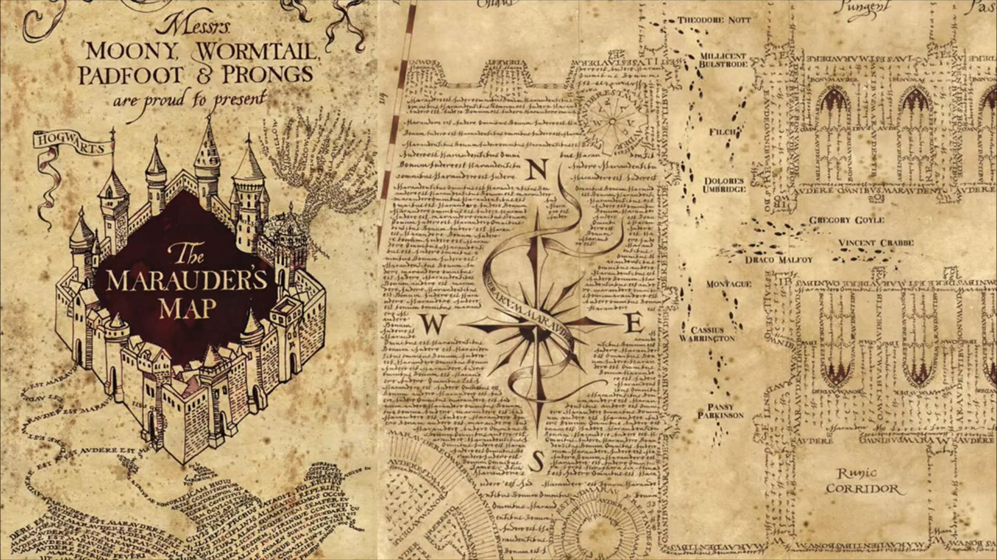
Goal 1: Enhancing access to eBooks

Slide 8
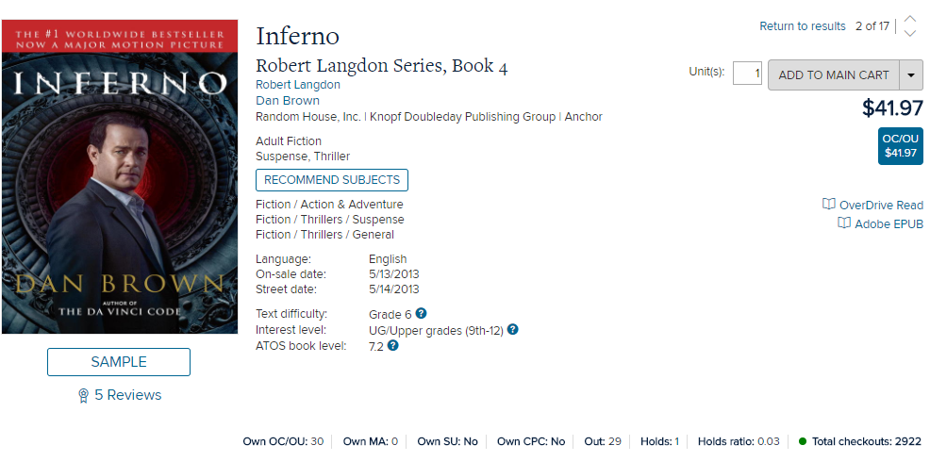
2013 – Dan Brown Inferno
2013: Purchased 30 copies x $85.00 = $2,550
445 holds (15:1 ratio or approx. 9-10 month wait)
2018: 2,922 checkouts - $0.87 per click

Slide 9
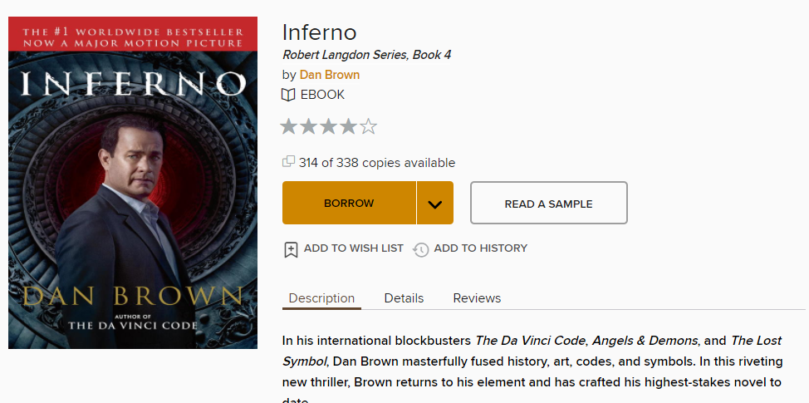
Goal 1: Offering reasonable access while adhering to budgetary constraints
This will vary by library system

Slide 10
Goal 2: Fostering Competition within the eBook marketplace

Slide 11
Fostering Competition
Single vendor monopoly
How can we help push vendors to make improvements that we want?
Have a better understanding of each platform’s advantages and disadvantages specific to our needs

Slide 12
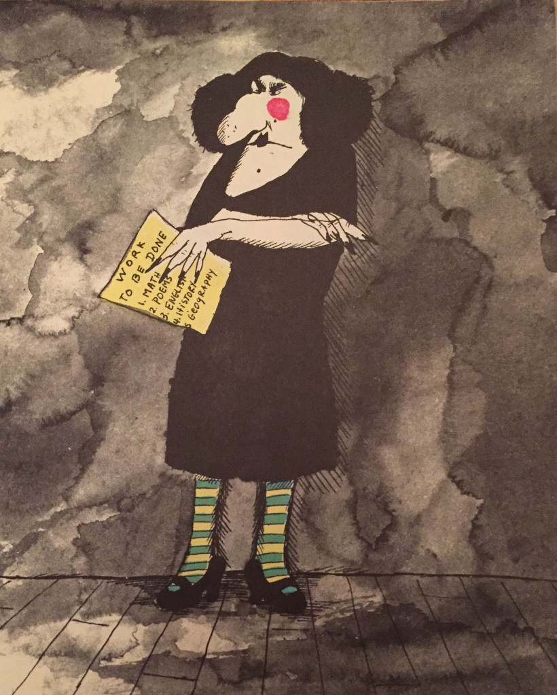

Slide 13
Express platform idea
Allow us to enhance our eBook collection with minimal effect on customers
Enables the concept of offering a complementary eBook collection with a shorter loan period
Customer familiarity with both platforms allows for a softer transition if we decide to go back to a single platform

Slide 14
Additional platform – Potential Risks
Can you justify an additional platform with the associated costs (is it going to enhance your collection)?
Is it clear to library customers as to why you have eBooks in two different places?
Are there any technical issues with operating two platforms simultaneously (cataloguing, DRM)?

Slide 15
Choosing an Express eBook platform
Mature platform and app
Platform could accommodate our loan parameters
Access to all of the big 5 publishers
Good statistical reporting options
Pricing in Canadian funds
Available API to integrate content into our catalogue
Provides both a French and English interface
Meets privacy, accessibility, and security requirements

Slide 16
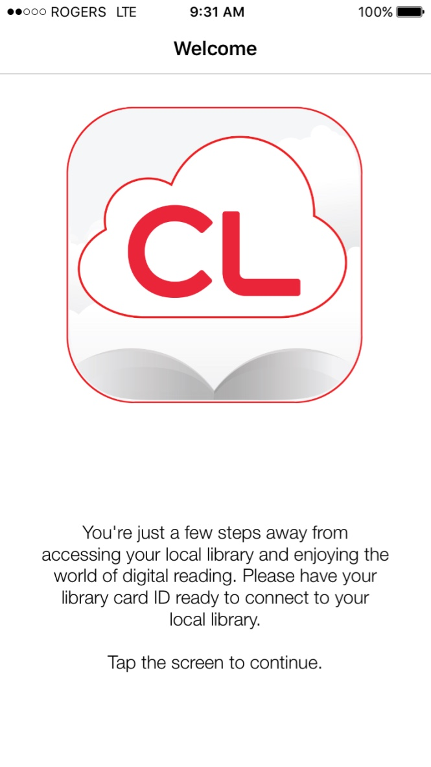
cloudLibrary

Slide 17
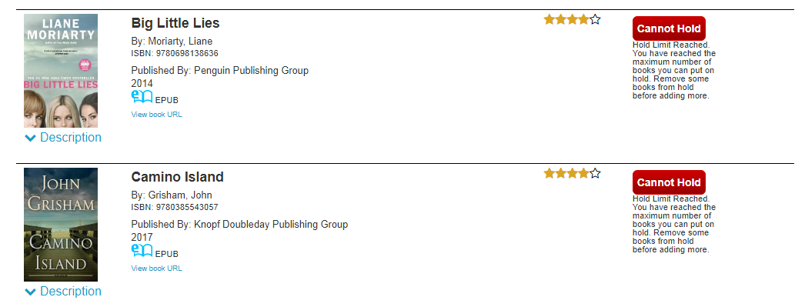
Working with cloudLibrary

Slide 18
Working with in-house partners to prepare the catalogue and website

Slide 19
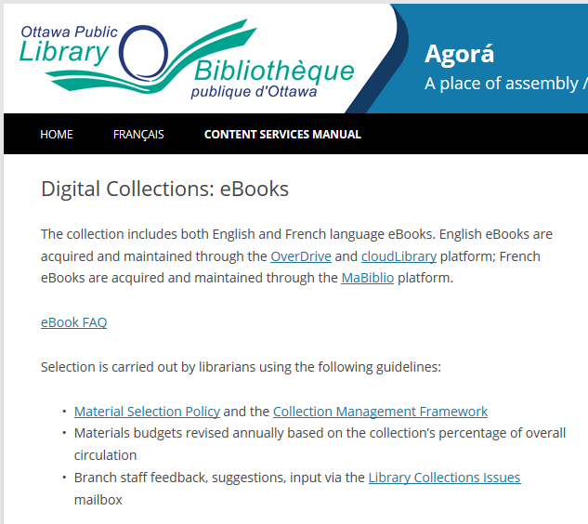
Getting the word out
Staff awareness and training
in-house blog post
email to supervisors
Content Services Manual
Information for customers
help guides
news release, in-branch and social media promotion

Slide 20
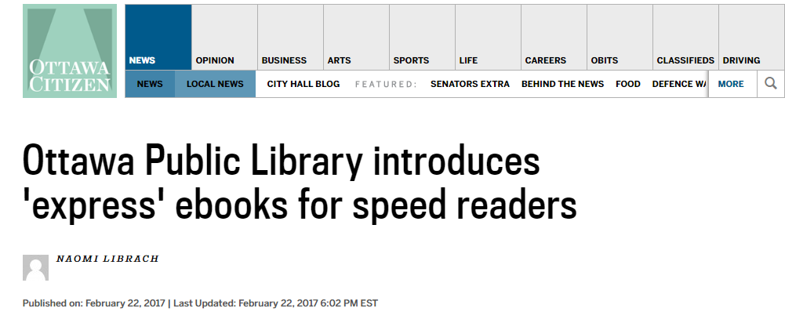
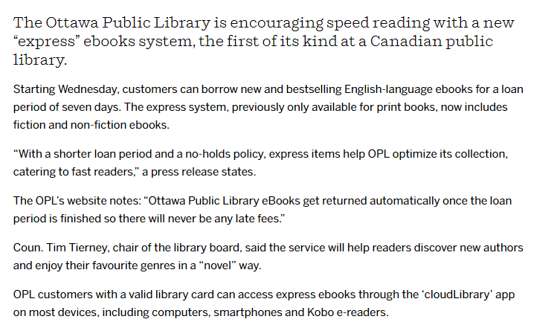
“Today I downloaded Bibliotheca's 'cloudLibrary' so that I could access e-books from the library. It took me 2 minutes exactly. Fabulous system”
A Satisfied Customer

Slide 21
Express Collection

Slide 22
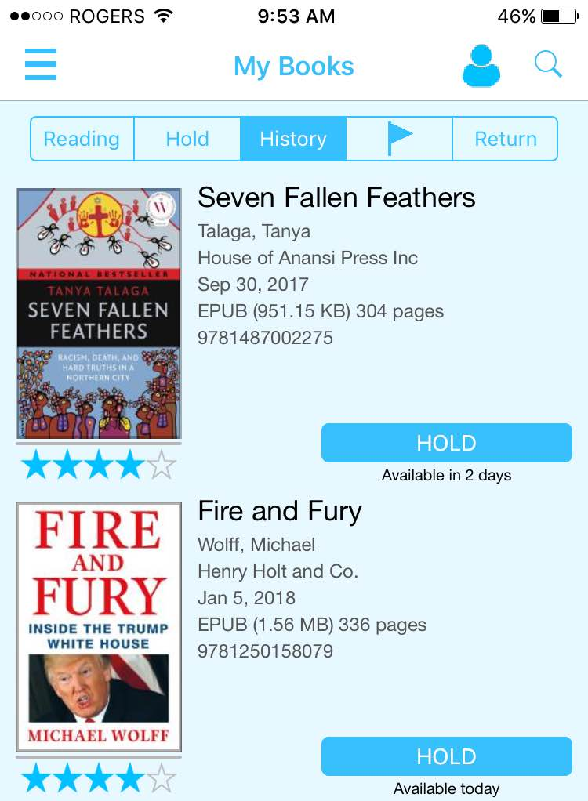
What worked

Slide 23
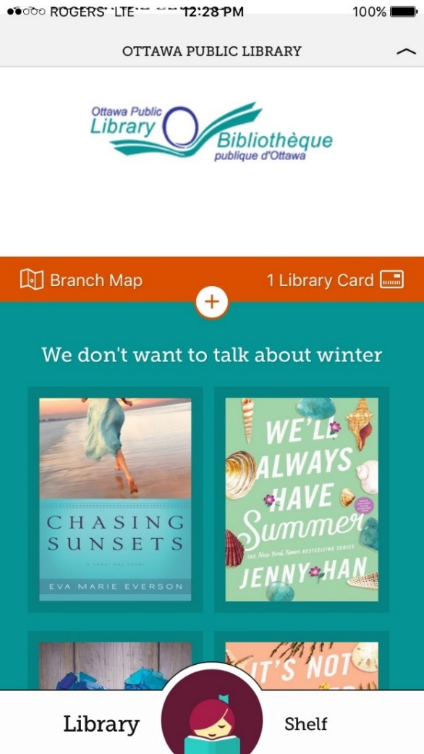
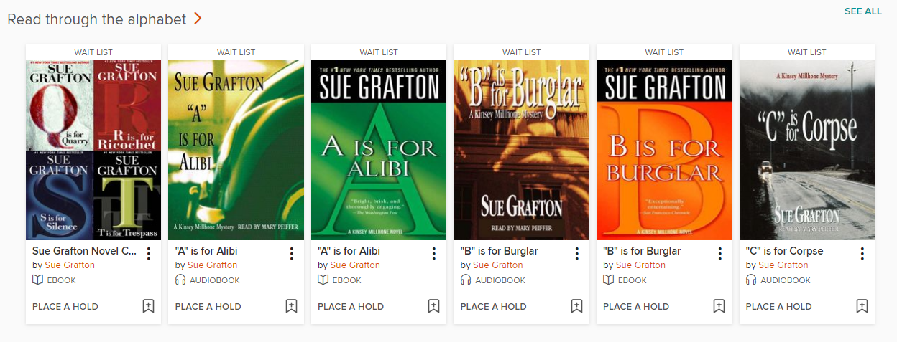
What didn’t work - content

Slide 24
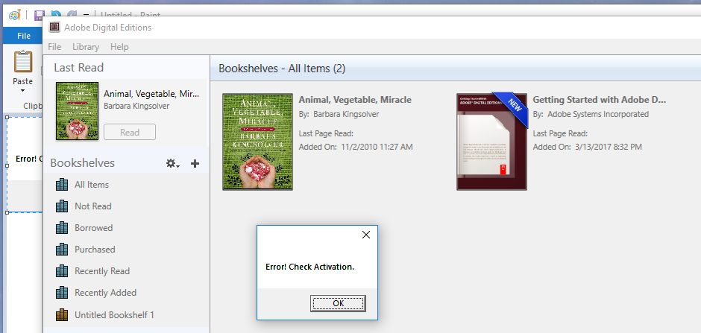
What we’re still working on
Some customers experience problems using both platforms on dedicated eReaders

Slide 25
Early data to December 31st
 | Users in 2017 | Titles | Copies | CKOs
Requestable | 40,626 | 40,772 | 78,707 | 871,885
Express | 14,276 | 414 | 2,189 | 32,849

Slide 26
Early Circulation Stats by model
Title | Author | Cost | Express copies | CKOs | Requestable copies | CKOs | Express cost/ circ | Requestable cost/ circ | Model
The Fix | Baldacci, David | $87.00 | 8 | 259 | 22 | 380 | $2.69 | $5.03 | OC/OU
The Woman in Cabin 10 | Ware, Ruth | $18.99 | 11 | 401 | 19 | 432 | $0.52 | $0.83 | 1 year
The Alice Network | Quinn, Kate | $16.99 | 10 (1 expired) | 286 | 21 (1 expired) | 148 | $0.59 | $2.41 | 26 circ
Norse Mythology | Gaiman, Neil | $60.00 | 7 | 165 | 7 | 145 | $2.55 | $2.90 | 52 circ/ 2 years

Slide 27
You knew it was coming…

Slide 28
Did we meet our goals?
Goal 1: Enhancing access to eBooks
Goal 2: Fostering Competition within the eBook marketplace

Slide 29
Questions?
Matt Abbott matt.abbott@ottawa.ca
Amy Hoffmann amy.hoffmann@ottawa.ca

Slide 30
Thank you

