Slide 1
Testing, Testing: Understanding Library Website UX at the University of Toronto Scarborough
Sarah Guay & SUE REYNOLDS University of Toronto Scarborough
Notes:
Introduce selves + title of presentation

Slide 2
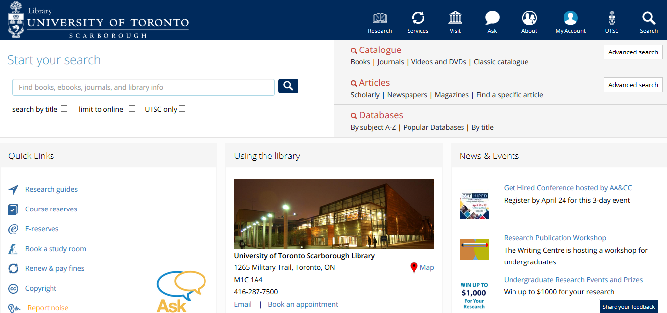
Notes:
To begin, we thought we’d provide a little background on this project – so here’s a snapshot of what our current website looks like. In late 2015, the decision was made to revamp the website to be more user-friendly, pulling key inspiration from the downtown campus to boost accessibility and incorporate a more responsive design.
So in January 2016, we launched the new website and overall we’re quite pleased with it! However one limitation is that had to be implemented very quickly (something like in the span of 3 months, due to time limitations), so we weren’t able to gather user feedback on the new design prior to launch (which is ideally something you want to do).

Slide 3
Usability Testing
What is usability?
“Usability focuses on the ways humans interact with an interface through evaluating use, identifying problems, and researching potential solutions. Results can determine if an interface is effective and if it should continue in its current state” – Emanuel, 2013
Notes:
But, better late than never! The main prompting for this project is that we decided it was still important to get that user feedback so we could make continual improvements to our revamped website. And so a couple months down the road, we decided to carry out usability testing in Summer 2016. Usability looks at the interactions between people and interfaces in order to evaluate their use, identify any problems, and investigate potential solutions to these problems. Ultimately it will provide insight into whether your interface is doing a good job of serving users or whether some changes need to be made.
In terms of a rationale for why usability testing is important, we’re definitely seeing an increase in virtual users of the library and we want to make sure they’re having their needs met. Likewise, we have to be aware of user expectations – most of these individuals are used to navigating virtual spaces and expect quick, easy access to content – and if the reality doesn’t match those expectations, there’s going to be problems! And finally, a website is the virtual representation of your institution – so if users are struggling and getting frustrated while using our website, they’re going to affiliate those negative emotions and experiences with the library, which of course is the last thing we want.

Slide 4
Purpose
Goals for usability testing:
Gain a better understanding of user behaviours
Make improvements to the library website
Notes:
And so, we went in to usability testing with two key goals in mind:
First, very broadly, we wanted to gain a better understanding of our users (in terms of how they’re using the website – if they’re using it at all – how they navigate through content, where they look to find information, etc.) – the idea here being that, if we understand how our users are interacting with the website, we can fashion content in a way that will best match those behaviours and expectations.
Second, we wanted to make improvements to the website – if there’s a way we can make it better, we want to know about it.

Slide 5
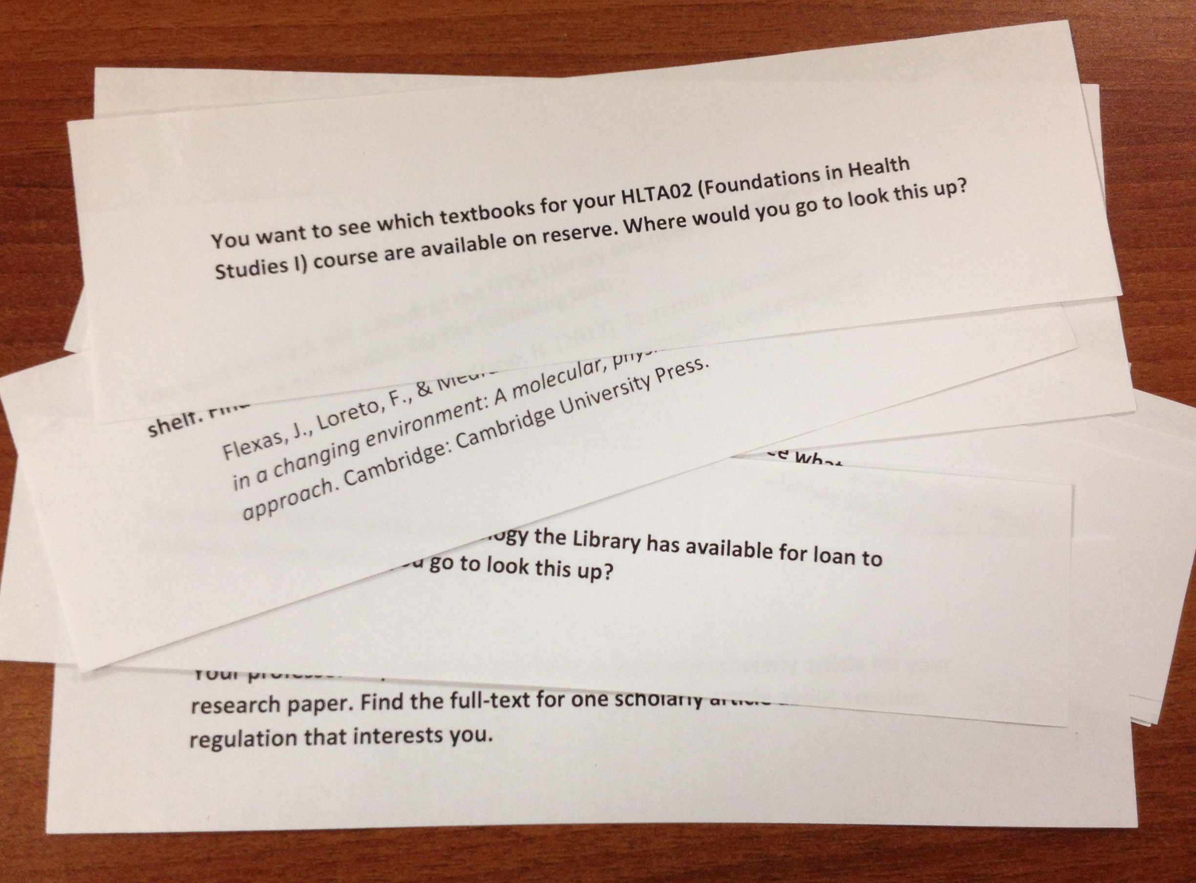
Usability Testing Methods
1. Task scenarios
2. Card sorting
Notes:
Next, we had to decide which usability testing methods would be used to reach these goals, and ended up focusing on two main methods:
The first being task scenarios, where we present users with tasks and monitor how they complete them (which allows us to reach goal 1 of understanding user behaviours)
And second using the card sorting method to see where users categorize pages on our website (which allows us to meet goal 2 by improving the information architecture of our site)
So we’ll break these down further later on, but just stow away that these are the two main methods we were focusing on.

Slide 6
Usability Lifecycle
Planning
Testing
Results & Analysis
Implemen-tation
Retesting
Notes:
So with those goals in mind, we were ready to move forward with the project – but first, we had to determine what exactly was going to be involved.
Pictured here I have a sample cycle for the usability testing process: Phase I is planning and deciding how you’re going to conduct the investigation, Phase II is conducting the testing with your users; following this you compile results and analyze findings; in Phase IV, you implement changes to make improvements to your website, and Phase V, you re-test those changes to see if they were effective. If not, you go back, re-implement, test again, and so on, until your results are satisfactory.
And ideally usability is an ongoing process, so you’ll notice the cycle doesn’t stop at retesting – it’s something that you can do in increments so that you’re constantly making your website better over time.

Slide 7
Phase I: Planning
Determine purpose and method(s) of testing
Define target audience and user tasks
Recruit participants
Prep materials (e.g. testing documentation)
Plan sessions / schedule participants
Notes:
But before we could do any actual testing, there was quite a bit of planning and prep work that needed to be done first, such as:
Figuring out who our typical users are, identifying what sort of tasks they use the library website for, recruiting those said users, and then gathering all the materials needed to carry out a usability session

Slide 8
Target Audience and User Tasks
?
User profile
What are our user needs? How are they using the website?
Library staff feedback
Participant feedback
Reference statistics
Website analytics
Notes:
So what we did was develop a target user profile, focusing on students who were full-time undergraduates between the ages of 18-24 and predominantly female (which is reflective of our current student population at UTSC)…
…and then we looked at what their information needs are and how they use the library website, pulling from a variety of sources such as staff and student feedback, reference desk statistics, and library website analytics.

Slide 9
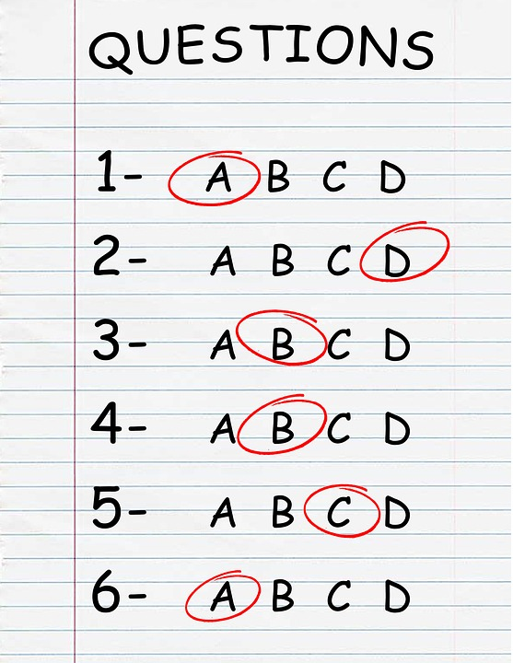
Sample User Tasks
Notes:
This resulted in a list of 12 key user tasks, so things like accessing books or course reserves, locating library hours or group study rooms, paying fines, accessing the technology library or old exams repository, and so on.

Slide 10
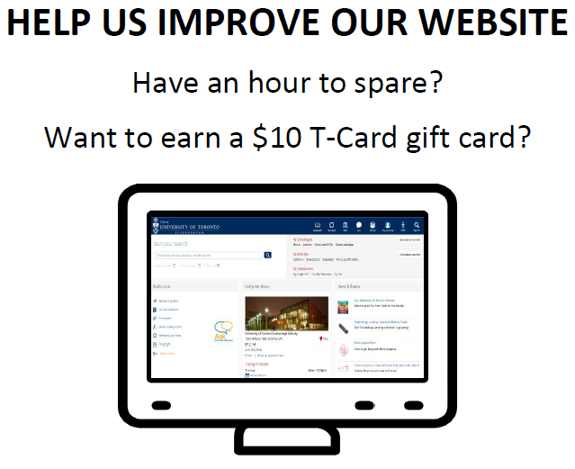
Recruitment
20 undergraduate students:
5 for Task Scenarios (Nielsen, 2012)
15 for Card Sorting (Usability.gov, n.d.)
Method: library flyers, social media, website posting
Incentive: $10 gift card
Pre-screening survey
Notes:
And once we had our user profile and list of sample tasks, we were able to start recruiting. So we ended up with a total of 20 undergraduates, 5 of whom participated in the task scenario activity and 15 of whom completed the card sorting activity, as per best practices within user experience research.
Forums for recruitment included flyers, social media, and a posting on our website, all of which included mention of the $10 gift card incentive for participation
And finally, for interested applications, we asked them to complete a quick pre-screening survey to make sure they met our user profile (so for example things like their age, enrollment status, level of experience with the website, and so on).

Slide 11
Phase II: Testing
Let the testing begin!
…Almost.
Notes:
With all our planning and prep complete, we were then ready to begin the testing!
*click* …Almost.

Slide 12
Pilot Testing
Subjects: 3 staff members with varying experience/familiarity using the website
Purpose: Test readability of usability documentation
Outcome: Minor modifications to task scenario instructions + wording in questionnaires
Notes:
First we wanted to make sure that we carried out pilot testing of the task scenario materials.
Now unfortunately we weren’t able to recruit any student users in time to pilot test the materials and instead relied on 3 staff members with varying experience using the website, ranging anywhere from very familiar to not at all familiar.
*click* Because of this limitation, the purpose of the pilot test was only focused on making sure materials were easy to read and understand, and not on subject performance for tasks.
*click* And through this, we were able to identify problematic wording within our task scenarios and also rejigged the wording and order of questionnaire content.

Slide 13
Task Scenarios
Facilitator Script
Pre-Test Questionnaire
Scenarios
Post-Task Questionnaire
Post-Test Questionnaire
Notes:
With pilot testing complete, we were then truly able to begin our usability testing!
And here’s a little snapshot of the process involved for our task scenario portion: so users were read a script to get oriented to the session and were also given a pre-test questionnaire to evaluate their existing use and familiarity with the library website.
Following this, they were asked to carry out a number of scenarios using the website and were given post-task questionnaires as well as a post-test questionnaire at the very end of the session.

Slide 14
Facilitator Script
Instructions for the activity
Time commitment for participant
Purpose of the testing
Participant cannot do anything wrong!
Be honest – we won’t be offended!
Encourage ‘Think Aloud’ as they complete tasks
Can’t guide them, but are available to answer questions
(Blakiston, 2015)
Notes:
In order to ensure consistency between sessions, a script was devised to outline key instructions for the usability activity and purpose of the testing as well as the time commitment involved for participants.
It was very important that the user realized we were testing the website and not them, so we made sure to emphasize that they can’t make any mistakes and that they be brutally honest in terms of any feedback they provide, as that’s going to be most helpful for improving the website.
Participants were also encouraged to ‘Think Aloud’ (that is, verbally describe what they’re seeing, thinking, and doing while completing tasks) and were informed that the facilitator would be present to answer questions, but could not guide participants in completing tasks.

Slide 15
Pre-Test Questionnaire
Before receiving any tasks, participants were asked to complete a user background survey with the following questions:
Please take a moment to look over the library homepage. What are your general impressions of the website?
Have you ever used the library website before, and if so, what have you used it for?
Have you ever had any positive or negative experiences with the library website?
Notes:
After hearing the script, we asked participants to complete a user background survey looking at:
*click* 1. Their general impressions of the website
*click* 2. Whether they’d used the website before, and if so, for what, and…
*click* 3. Any positive or negative experiences they’ve had with the website

Slide 16
Task Scenarios
Notes:
Next up was the main focus of the sessions, were students were presented with tasks that they must complete on the website – and these were based on user tasks identified during the planning stage (so things like paying fines or looking up library hours).
So how this worked is we created 3 columns for each of our 12 user tasks: so first we outlined the task, then we translated it into a more specific task and user scenario, and finally we outlined success criteria that would let us know whether the participant has effectively carried out the task.

Slide 17
Task Scenarios
Sample task:
Find a book
Sample scenario:
Look up the call number for the “Terrestrial photosynthesis in a changing environment”
Sample success criteria:
Find the call number QH541.15 .E26 T47 2012
Notes:
So here’s an example task: find a book.
*click* We translated that into a scenario, which was given to the user [read scenario off screen]
*click* And then our success criteria was that they found the call number within our library catalogue. Now you’ll notice we have no mention of the call number in the scenario that was presented to the participant, because we didn’t want to include any language that would ‘lead’ or direct them as they were navigating through the website – so that’s an important consideration to make when designing your task scenarios.

Slide 18
Task Scenario Activity
Take a moment to read over the following scenario:
You want to pick up a book that’s on hold for you at the UTSC Library, but can’t stop by until the weekend. What are the library hours for information and reference on Saturday?
Success Criteria: Navigate to the “Library Hours” page and find the Saturday closing time (6:00 pm)
What problem(s) do you see with the scenario wording?

Slide 19
Task Scenario Activity
Take a moment to read over the following scenario:
You want to pick up a book that’s on hold for you at the UTSC Library, but can’t stop by until the weekend. What are the library hours for information and reference on Saturday?
Leading language + doesn’t reflect our success criteria!

Slide 20
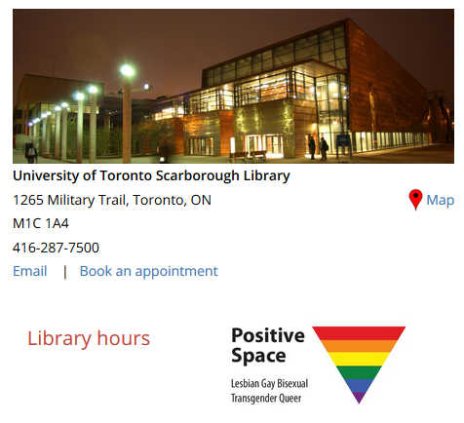
Task Scenario Activity

Slide 21
Task Scenario Activity
Revised scenario:
You want to pick up a book that’s on hold for you at the UTSC Library, but can’t stop by until the weekend. What time does the library close on Saturday?

Slide 22
Task Scenarios
3 minutes allotted for each task
Randomization of tasks
Participant used “Think Aloud” data
Observation form
Notes:
Participants had 3 minutes total to complete each of the 12 tasks and tasks were always randomized for each of the 5 participants (this was done to minimize the possibility that task order could influence results).
Again, we encouraged participants to ‘Think Aloud’ during the activities and had two people observing as they completed tasks.

Slide 23
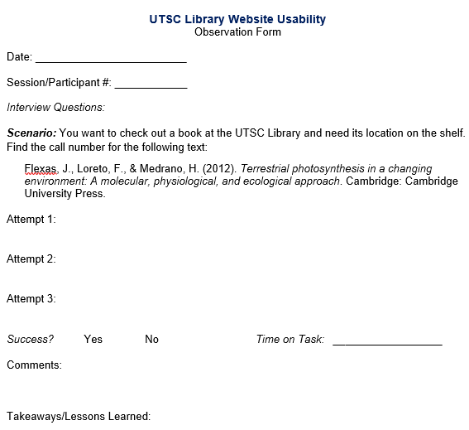
Notes:
So here’s a sample of what our observation form looked like, and we took measures of whether they successfully completed the task, how much time and how many attempts it took, and then any qualitative data such as interesting comments made by the participant.

Slide 24
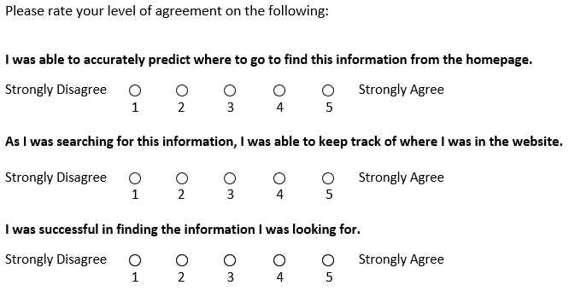
Post-Task Questionnaire
Notes:
After each task, participants received a post-task questionnaire with 3 questions looking at:
Their ability to predict where to go on the website
Their ability to keep track of where they were as they navigated through the website, and
Whether they felt they were successful in completing the task

Slide 25
Post-Test Questionnaire
Notes:
So we did that for each of the 12 tasks, and then at the very end we had a post-test user satisfaction questionnaire – looking at things like how quickly or easily they could locate information, how easy it was to read and understand website content, overall satisfaction with the website, and so on.
We also gathered some qualitative feedback such as whether the tasks matched how they would typically use the website and if they had any recommendations for improvement to website content.

Slide 26
Card Sorting
Facilitator Script
Pre-Test Questionnaire
Closed Card Sort
Post-Test Discussion
Notes:
So that was the first half of testing, and for the second part, we conducted a closed card sort using 15 undergraduate students.
The first half of this process was exactly the same as with the task scenarios, where participants were read a script and given a user background questionnaire to gauge previous experience with the website – we had the activity – and then instead of having a post-test questionnaire, we instead used interviews and focus groups to evaluate user choices made during the card sort.

Slide 27
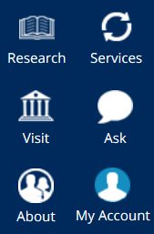
Card Sorting
Individual and group sessions
30 index cards for website pages
Randomization of cards
Notes:
For the actual activity portion, we had both individual and group sessions (based on schedule availability) and asked students to organize 30 index cards into 6 pre-defined categories based on labels used in our website’s main navigation [image on right]. As with our task scenarios, cards were always randomized between participants.

Slide 28
Card Sorting
Assignment Calculator
A tool which creates a schedule & recommended steps for completing your assignment
(front)
(back)
Notes:
So here’s a sample of what these cards looked like; on the front we’d have the name of the webpage (e.g. Assignment calculator) and on the reverse side we’d have a brief definition outlining what that page is about.

Slide 29
Card Sorting
Instructions:
Duplicate cards allowed
Can create their own categories
Can use “unsortable” category
Participants received copy of instructions
“Think Aloud” encouraged
Notes:
For instructions, students were told they could create duplicates if they felt any cards should go in more than one category and they were given the option to create their own categories or put cards into an ‘unsortable’ category if they felt than none of the 6 pre-defined ones were useful.
Participants received a copy of these instructions that they could revisit if needed, and again were encouraged to ‘Think Aloud’ as the facilitator observed their card sort.

Slide 30
Post-Test Discussion
Observation form:
Any easy cards? Hard cards?
Inclusion in more than one category? Any added categories?
How would you “label” cards or categories?
Notes:
Once they’d finished sorting all 30 cards into categories, the facilitator and participants held a post-test discussion, looking at things like:
Whether there were any particularly easy or difficult cards that they felt conflicted on
Whether they sorted cards into more than one category or created any categories, and
How they would label content, both for any of the 30 webpages or for the 6 pre-defined categories
And we gathered some useful feedback from these questions, but as the testing went on, we found it was more beneficial to target discussions around re-occurring ‘problematic’ cards that had been identified from previous card sorting sessions.

Slide 31
Card Sort Activity
A) Starting by yourself, place the following pages into one or more categories listed to the right (1 min):
Makerspace
Report Noise
Technology Lending
B) Discuss your choices with the group. Were there similarities or differences at your table? (2 min)
Notes:
*Hand out cards + definitions to each of the tables/participants

Slide 32
Card Sort Activity
How’d it go?
Makerspace:
Services (33%), Visit (27%), Unsortable (13%)
Report Noise:
Services (33%), Ask (33%), Unsortable (7%)
Technology Lending:
Services (87%)
Notes:
Coloured text = where we ended up putting it on our website

Slide 33
Phase III: Results & Analysis
http://blog.capterra.com/wp-content/uploads/2013/05/7-benefits-grant-management.jpg
Notes:
With the testing phase complete, we then moved into the data entry and analysis stage – which, as the picture implies, was a bit daunting!

Slide 34
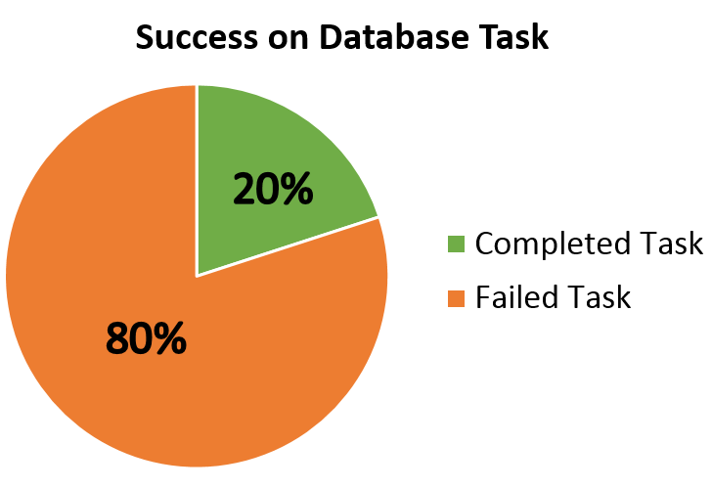
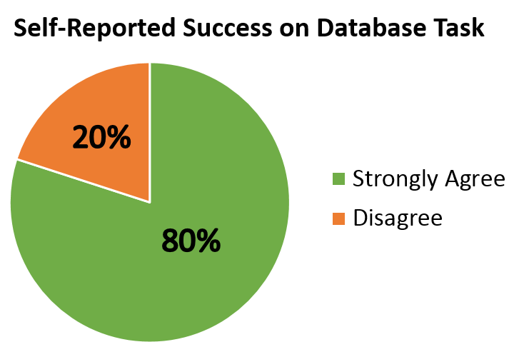
Task Scenarios
Notes:
So, starting with the task scenarios: overall we found that participants performed well and were usually successful in completing the tasks presented to them.
However, there were some interesting exceptions that we encountered. For example, when asked to locate an Anthropology database to help them find research articles, 4 out of 5 of the students failed the task (this was definitely the task that participants struggled most with).
*click* But then, when we looked at results from our post-task questionnaire, we found that 4 out of 5 students felt they had successfully completed the task – so when rating themselves on a scale of 1-5, 80% of them “Strongly Agreed” that they had been successful. But what’s even more fascinating is that this was a direct inverse relationship – so the 4 students who failed the task were the same 4 students who rated their performance highly. And then we had the 5th participant who rated themselves low, at a 2, even though they had successfully completed the task.
So this gave us some interesting insights into student perceptions of success vs. actual rates of success.

Slide 35
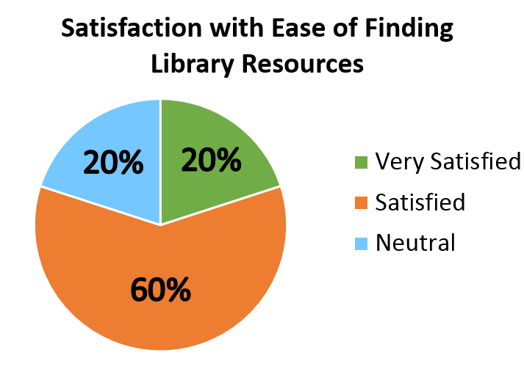
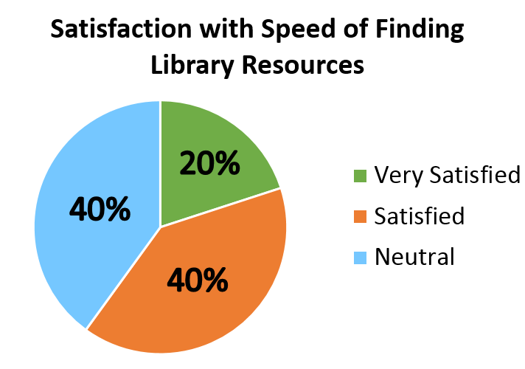
Task Scenarios
Notes:
The biggest discrepancies in scores were found for these next two results:
So when rating how easy it was to locate information on the library website, 60% reported they were satisfied, 20% were very satisfied, and 20% were somewhat satisfied or neutral – and this came out in the qualitative date we gathered, as people noted that information could sometimes be hidden or not readily apparent to them when scanning the library homepage.
*click* Here’s where we saw the greatest variation, regarding how quickly participants felt they could track down information. So we had a 40/40 split with somewhat satisfied and satisfied, and then 1 person at 20% for very satisfied. So again this is likely tied to the ease of findability and also parallels what we know from our user profile – that students expect to find information quickly and seamlessly and will get discouraged if excessive ‘digging’ is required.

Slide 36
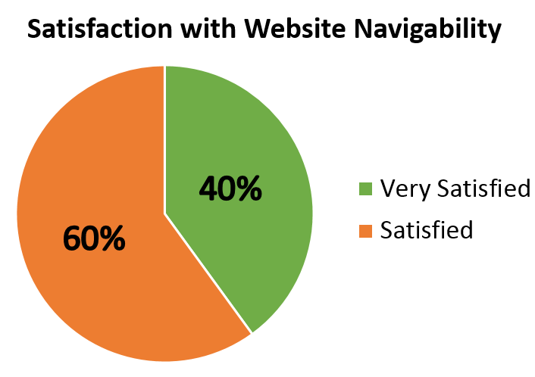
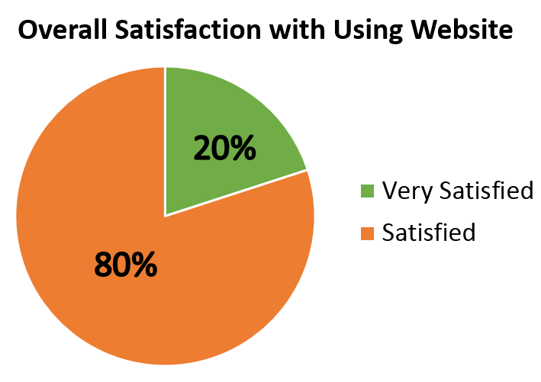
Task Scenarios
Notes:
And finally we have satisfaction with the website navigation, so the ability to move easily from page to page within the website, which was rated well, and
*click* overall satisfaction with using the website, again in the 100% positive categories. So that was encouraging to us! Even though there were some small areas where students felt confused or frustrated, overall it functioned well and students were very happy with the website redesign.

Slide 37
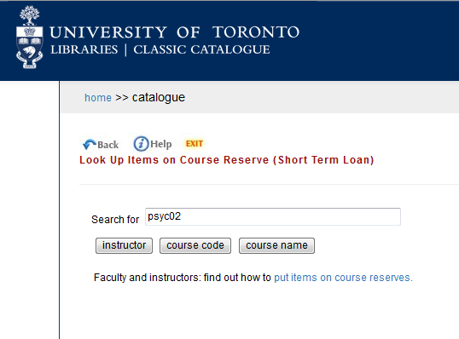
Task Scenarios
Notes:
Another interesting result we found related to participant expectations vs. actual website functions.
So for example, this is our search screen for finding course reserves. Students would type in their course code, hit enter, and then… *click*

Slide 38
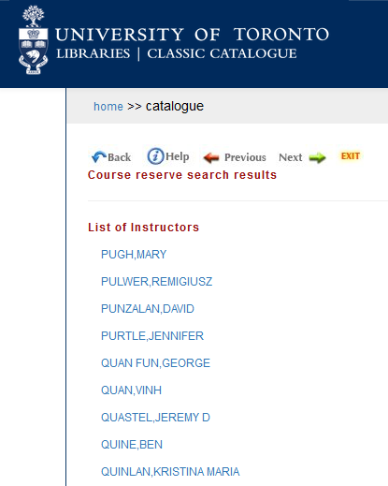
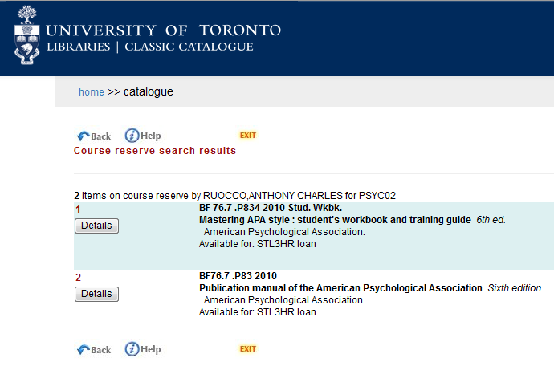
Task Scenarios
Notes:
End up with this! (list of instructors) When what they were actually expecting *click* was this.

Slide 39
Task Scenarios
Notes:
The problem here was that hitting ‘Enter’ defaulted to the first search button under the search bar, which so happens to be instructors.

Slide 40
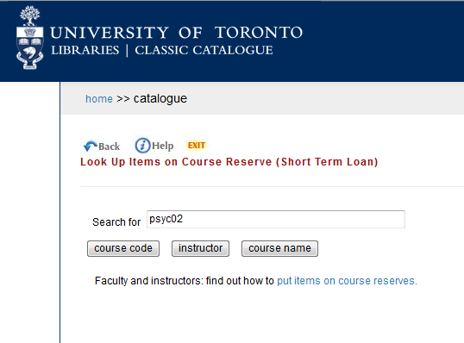
Task Scenarios
Notes:
So we were able to switch the button order so that course code is now the default option when users hit enter. (bonus: this change has been implemented across the whole UTL system! Findings thus benefit the whole library community)

Slide 41
Task Scenarios - Major Takeaways
Overall, users performed well
Certain tasks (e.g. journals, databases) proved challenging
Library jargon may contribute to difficulties
Failed tasks vs. users’ perceptions of success
Disconnect between user expectations and website
Notes:
So those are some highlights for what we found from our task scenarios data; in terms of major takeaways: Again, students performed well overall, but there were certain tasks that proved challenging and it’s possible that the use of library jargon on the website and in the task scenarios may contribute to this.
We found some interesting contrasts in terms of user perceptions of success and actual rates of success, and also noticed a disconnect between user expectations and some areas of the website (such as the course reserves tool).

Slide 42
Card Sorting
Notes:
Moving on to our card sorting results:
So what we did here was make a spreadsheet of all 30 pages that we tested, listed where they were currently located in the website navigation, followed by where students thought they should be located as indicated by their card sort.
And what we found was pretty shocking! Of the 30 cards given to students, 18 of them were problematic – meaning that students overall did not place them in the categories currently being used on the website. So our task was to re-examine these cards and prioritize how best to address these problems.

Slide 43
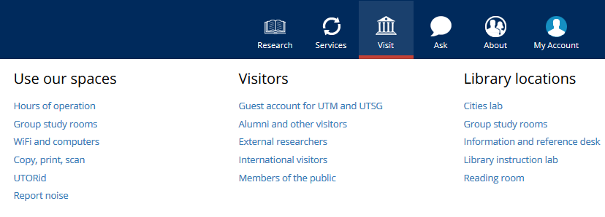
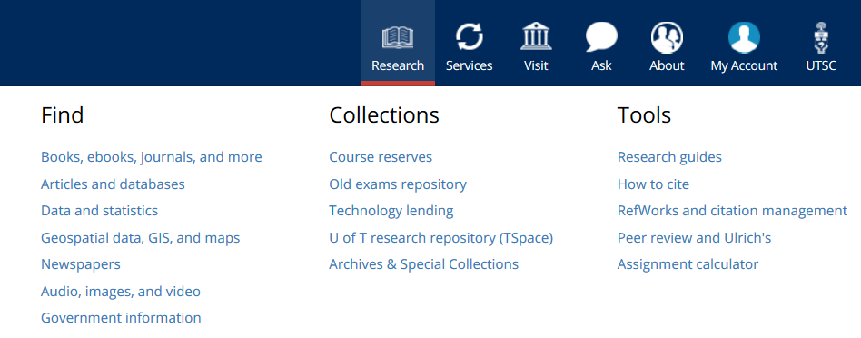
Card Sorting
Notes:
In terms of some highlights, we discovered that the ‘Collections’ sub-menu within our Research category was quite problematic. Two of the pages (course reserves and TSpace) were duplicated elsewhere in the other navigation menus, and the old exams repository and tech lending library were universally rated as a Service rather than a Research item.

Slide 44
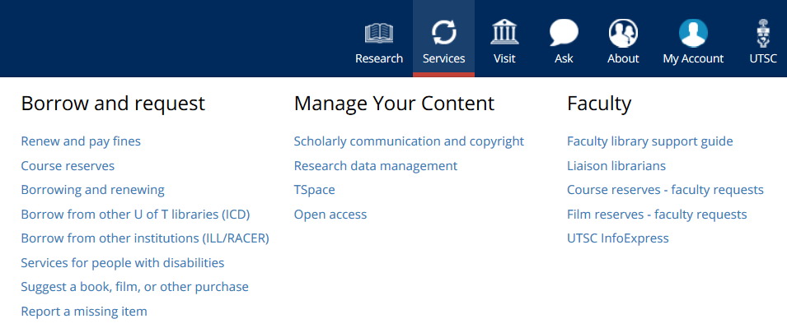
Card Sorting
Notes:
In our Services menu, we decided that the ‘Manage Your Content’ menu could be completely reworked into the faculty support sub-menu, under a ‘Researcher Support’ page…

Slide 45
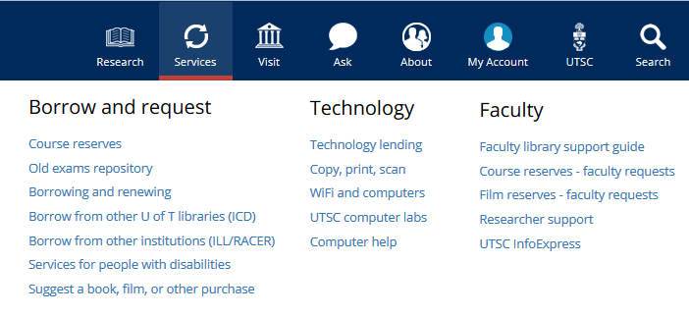
Card Sorting
Notes:
…Which has now gone live! So this was a really efficient way to condense 4 menu items into a single page. We also replaced the “Manage your content” sub-menu with a “Technology” sub-menu, which you can see brought in items from other menus such as the technology lending and computer pages.

Slide 46
Card Sorting
Notes:
Our Visit menu ended up generating the most discussion among participants. Prior to the testing, we had recently added a ‘Library locations’ sub-menu as a place to highlight things like study rooms, instructional spaces, our new Makerspace, and so on.
However, feedback from the testing noted that this label made it sound like there were multiple UTSC Libraries, not just the one, and so we decided to change it to ‘Library spaces.” However, *click* this then created some problems with the existing ‘Use our spaces’ menu, and you’ll notice there’s also some redundancies between the two (e.g. Group study rooms).
When we looked at the card sorting results, it turned out that everything in the ‘Use our spaces’ menu was identified as problematic for participants, *click* so we actually decided to nix this section altogether to reduce duplication and rejigg content into other more appropriate menus.

Slide 47
Card Sorting - Major Takeaways
Substantial disconnect between library categorization and user categorization
Labels were a source of confusion + differentiating the categories
Prioritize! Focus on what changes are most important
Set goals for these changes (short- and long-term)
Figure out what needs collaboration (e.g. local vs. shared resources)
Notes:
So in terms of overall findings, we noticed a substantial disconnect between library and user categorization of pages and users also reported difficulties in understanding certain labels and differentiating between categories in the website navigation.
Upon identifying these problematic areas, we had to prioritize what the most important changes were and create a timeline for implementing these changes, while also being mindful of any areas that required collaboration with other UofT libraries (for example, pages maintained by our downtown campus, such as a the course reserves page).

Slide 48
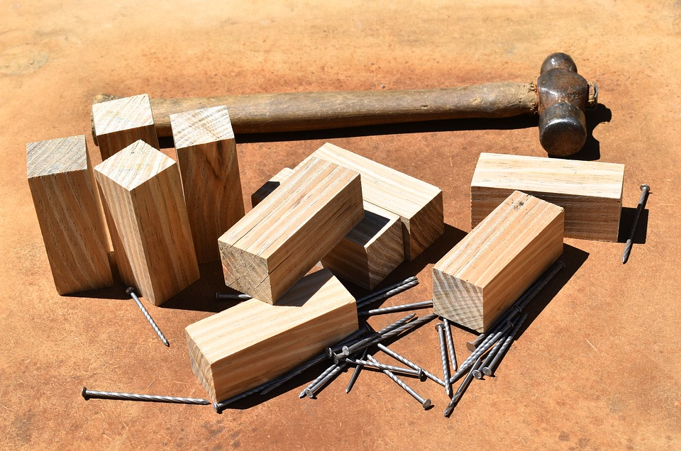
Phase IV: Implementation
Notes:
So those are the key things that we found! All of these changes went live on our website over the summer, and we’re now focusing on reducing some of the redundancies between actual pages on the website, but overall we’re really happy with how our navigation menus are shaping up.

Slide 49
Phase V: Retesting & Future Directions
Next steps: re-test to see if major changes were effective
Target additional problem areas we couldn’t address during the first round of testing
Future testing: mobile website
Notes:
Next is Phase V of our usability study, which will be to re-test that changes we made and see if they were effective, as well as to target any additional problem areas that we couldn’t address the first time around. And then from there, in the future we’d also like to conduct testing for mobile device users, as their experiences can be quite unique compared desktop or laptop users.

Slide 50
Takeaways & Lessons Learned
Know your audience!
Aim for less experienced users if possible
Consider timing of testing – exams!!
Assemble a usability team
Set clear success criteria (task scenarios)
Pilot test card definitions (card sorting)
Data volume + manageability
Prioritize what to test and what to change
Notes:
And now, as our parting gift to you, we have some takeaways and lessons learned. [read off slide]

Slide 51
Questions?
Drop us a line!
Sarah Guay, sarah.guay@utoronto.ca
Sue Reynolds, sreynolds@utsc.utoronto.ca
THANK YOU! ☺

Slide 52
References
Blakiston, R. (2015). Usability testing: A practical guide for librarians. London: UK: Rowman & Littlefield.
Emanuel, J. (2013). Usability testing in libraries: Methods, limitations, and implications. OCLC Systems & Services, 29(4), 204-217.
Nielsen, J. (2012). How many test users in a usability study? Retrieved from https://www.nngroup.com/articles/how-many-test-users/
Usability.gov. (n.d.). Card sorting. Retrieved from https://www.usability.gov/how-to-and-tools/methods/card-sorting.html

