Slide 1
A Dance With the Unknown:
The gamification of staff digital literacy training
Kim Bates – Learning and Development Specialist
@bedtime4budgies
Notes:
Three main goals:
Identify their feelings,
Understand the expectations of their jobs
Feel an increased comfort in dealing with digital literacy questions.

Slide 2
What we did…
ID’d psychological barriers
Examined use of multi-staged training
Enhanced learning with games
Evaluated
Notes:
Id’d psychological barriers - staff have with troubleshooting as well as biases they hold about these types of CS interactions.
Different staff require different access to training (more immediate, as a refresher, etc.)
How can we make it accessible and not intimidating to get more staff to buy into it as something they can do.

Slide 3
Can you help me with my…
“--- isn’t here right now can you come back?”
“I don’t use Androids.”
“I don’t know anything about this”
Notes:
At EPL we have a CS approach to serve the customer at their point of need, and promote digital literacy as being a core service.
The following responses were in opposition to our CS philosophy providing inconsistent service to customers but not uncommon…

Slide 4
The Ghost

Slide 5
Past training included…
Branch visits
Hands on practice
One on one coaching
Digital literacy branch champions
Notes:
In the past we had done some more traditional style training
Visited branches: specific device and OS training
One on One coaching: staff could call or email DLI for help.
Staff just passing questions off so 2 or 3 people were answering questions from all over the system.
We’d often not get the name of the LA so couldn’t follow up with them so they could learn from the interaction.
Branch Champions: ideally hoped they would act as a in branch trainer but most of the questions just ended up being answered by the champion who may or may not be working when customers showed up.
Limited improvement was noted – generally by small number of staff who took an interest.
Technology constantly being updated, and with new staff starting all the time, not having a more effective approach was leading to customers having inconsistent service depending not only on who they approached but also what branch they visited.
Some branches put stronger emphasis on providing digital literacy services to customers than others and the gap in service was widening and adding unnecessarily to the work load of Digital Literacy Librarians
A common complaint consisted of staff telling us it wasn’t possible to help customers with all their devices and it wasn’t a realistic expectation of their jobs.

Slide 6
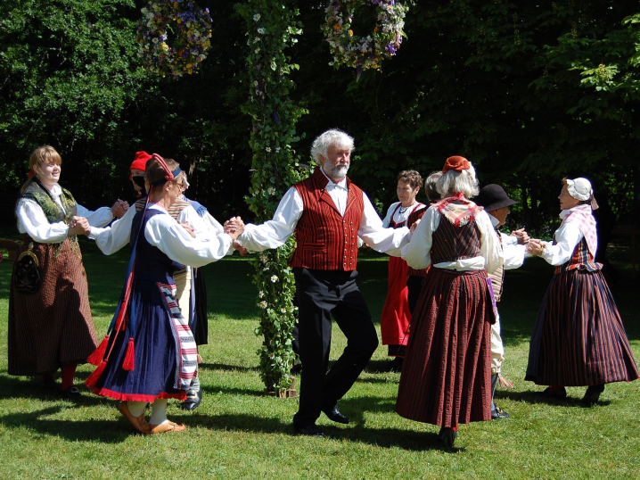
The Dance Began
Notes:
Researched other public library training
We didn’t find anything revolutionary among other public libraries that we hadn’t already attempted in one form or another.
Feedback from branch managers
Managers added that they found it difficult to get new staff up to speed as there wasn’t training offered regularly enough nor did they have a clear idea of what benchmark competencies staff should be expected to know.
Audited digital literacy questions
We’d received complaints from customers about the service they’d received, heard firsthand what staff were telling customers,
Customer facing staff told us about the expectations they believed we were imposing upon them. Unfair was bandied about regularly.
Next Steps
We didn’t have the capacity to increase in person training.
But seeing everything together helped us focus our ideas, additionally EPL purchased a learning management system and a new intranet that gave us more options for training that had been previously unavailable.

Slide 7
Three things were revealed…
Define Digital literacy competencies
Address training new staff
Design an approach to get existing staff comfortable troubleshooting with customers
Notes:
Needed to clearly define our DL competencies for helping customers troubleshoot their devices.
Traditionally we had said if customers have a device they need help with we will help them. It’s just like any other reference question. We stood by that service requirement and wanted to come up with some training that addressed this in a more specific way – i.e. how can you help someone with an unfamiliar device use our online resources?
Training New Staff
New staff were starting all the time. Two new branches had recently opened and it meant dozens of new front line staff starting at different times. In general we have new staff starting pretty much weekly at any given branch. Managers were at a bit of a loss when it came to ensuring they had the digital literacy training they required to feel confident on the desk.
Existing staff were still resistant
Change is not easy for anyone and with the pace of technology changing so quickly we had to come up with a way of presenting the information in a manner that even the most reluctant front line staff could at least see some value in and take something from it to enhance their customer service.
Because of the resistance to change it was also important to approach the training in an accessible way. Tone and presentation were key to getting broader buy-in.
As an aside if staff felt more confident in helping customers Digital Literacy Librarians could move away from spending significant time helping individual customers and use their skills to address other system needs.
The following slides will show you how we address each of these 3 main issues…

Slide 8
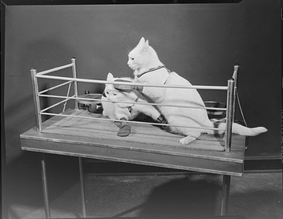
Feats of Strength
Notes:
Presented using a boxing metaphor staff were challenged to fight their way through a series of “rounds”
Read, Listen, Watch, Learn, Research
Rounds available on our Intranet and LMS
Each category consisted of a list of actionable tasks. Download a book, set up an Adobe account, stream a song, sign up for a course – ALL THINGS STAFF WERE EXPECTED TO KNOW AND TROUBLESHOOT
They are meant as self paced, to be completed as needed. Staff have limited time off desk and in order to give them some focus when it came to digital literacy skills they would now have a reference point.
This format addressed the need for competencies, filling in the gap as new staff started and updating skills for staff who needed it.
We evaluated after a couple months and found that some Managers hadn’t talked to their staff to find out who was doing these, as such reminders/promotional posts were sent out every couple of months to remind staff and encourage them to use the feats to sharpen their skills:
“Did a customer stump you with a tricky tech question? Has a fellow staff member impressed you with their digital savvy? Has this left you wondering “How I can avoid that customer situation and become that savvy staff member in the future?” Look no further than Feats of Strength!
Need a reason? Add it to your performance appraisal, it’s an easy way to fill that goal you are struggling to think of.
Need time? Ask you scheduler, they’ll fit it in for you so you can practice, the feats let you target your learning and not waste any precious task time.
Need a cheerleader? Ask a Digital Literacy Librarian, we’ll send you a motivational message along with visuals.”
Definitely a training tool that needs to be accompanied with consistent reminders but when staff know about it they like it/ are appreciative and will use it. At least one branch has built upon it to engage staff further.

Slide 9
Preparing for Play
Notes:
With a basis for expectations set via Feats of Strength we now wanted to address skills and processes staff could use for troubleshooting live.
One of the biggest drains on training was covering theory. With our new LMS we were able to offer online training
Objectives of the online training are to
Define Troubleshooting
Evaluated personal and customer expectations – how are both parties approaching the interaction, be realistic, set expectations –> we expand on this in another course.
Describe the EPL troubleshooting framework.
Established a common vocabulary in which everyone could speak knowledgeably about what they were doing and where they were experiencing difficulty. Quizzes and reviews were sprinkled throughout the training and worksheets were available to help staff practice either live with a customer or on their own. It is presented in a very friendly approachable manner and has been described by different staff as helpful, funny, and calming - it captures my desired effect to be unintimidating and non-anxiety producing.
Important that we were all talking from a common basis of knowledge. Without that we couldn’t realistically expect all staff to be able to perform to meet expectations. Feats of Strength listed what they needed to be able to do, online module showed them how to do it, now they needed the opportunity to actually put their skills into action.
By breaking it all down to it’s simplest components we were able to build up common understanding.

Slide 10
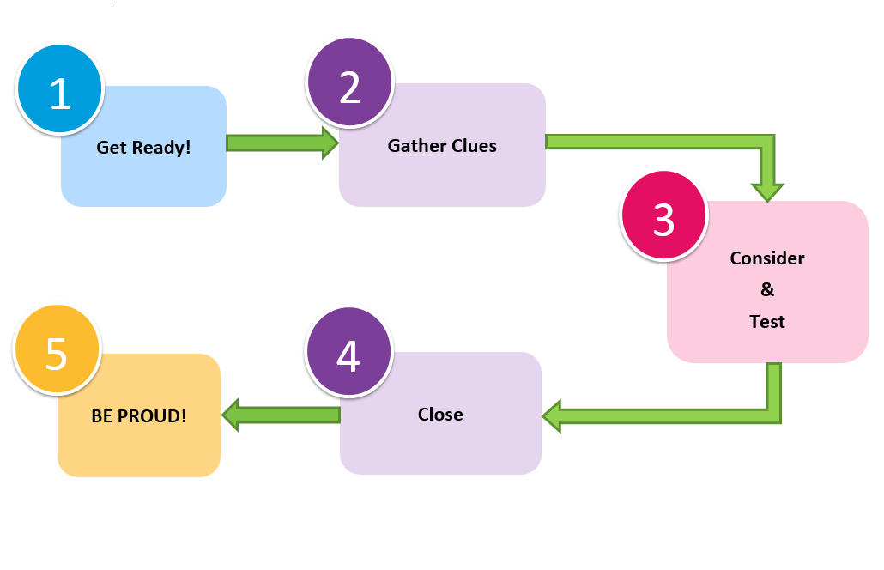
Troubleshooting Framework
Notes:
We refined a framework by streamlining the steps one takes when performing troubleshooting. How can we simplify the process to its core so that people can see what’s happening and it can give them some guidance and link it back to our customer service framework. It also helps people focus their service if/when things get mixed up or confused.

Slide 11
In-person training
3 games
Troubleshooting Jeopardy
Framework Family Feud
Troubleshooting Hotshots
Notes:
This is where it all comes together and where the gaming begins.
The class is split into 2 teams and go head to head in each of these 3 games.
They pick team names, I keep score (more or less) and immediately we move from a training session to a game.
Range of skill level and confidence intro/extro
Start off with a very easy game we all know and slowly build in complexity.
The games and the order they appear was purposeful.

Slide 12
Troubleshooting Jeopardy
It’s not magic | Help? | I got this!
100 | 100 | 100
200 | 200 | 200
End game
Notes:
Nothing revolutionary to start with and this was purposeful.
We’ve established a fun unintimidating tone in online learning to keep psychological anxieties to a minimum and when we finally meet in person we start off with a game of Jeopardy that reviews what they’ve learned in the online training. This game is almost universally known and understood. It requires very little explaining.
I picked categories that reflect vocab I used in the online training, none of the answers are new, the questions reflect some of the most common ones we were receiving as DLI librarians. VERY basic and simple things people know when they take the time to think it through.
Participants often think the questions are meant to trick them and I’m often reassuring them “This is not a trick question, tell me what you think the answer is and you’re probably going to be right.”
Some may have taken online a few weeks prior so this is meant as a refresher. Categories were selected to reflect what we talk about online and questions are structured to address the specific, often simplest questions staff would tell us they’d be challenged by. For example:

Slide 13
It’s a normal part of working with technology
ANSWER

Slide 14
What is “Troubleshooting?”
Notes:
What is Troubleshooting - responded to “I just don’t understand why this keeps happening to me.” It doesn’t. It happens to everyone you aren’t special.

Slide 15
A search engine that can help you locate troubleshooting information
Answer
Notes:
This customer is getting “xxx” error code can you help them, I don’t know what it means?

Slide 16
What is Google?
Notes:
Did you Google it? Because that’s what I’m going to do. Why not cut out the middle man and just do this with the customer when they ask for help. It’ll save everyone time.

Slide 17
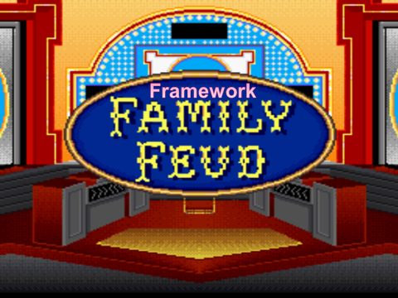
Notes:
This game is meant to sharpen their skills for using the framework. We do a quick review of the framework prior to playing then the split up into our teams.
Right away we see the body language change. The first game was an easy win, they all felt they could handle the questions we up the anti slightly depending on who you are.
Generally there is a bit more participation from the shy participants here. Many of the younger staff don’t know this game so I will ask the older staff to help explain the game, this helps bridge a gap as well. Older staff who aren’t as confident with their skills are now teaching the younger staff about something they know about. There is some nostalgia that comes out for the game “Oh, I haven’t seen this is years etc.” You see a subtle increase in confidence among some older staff.
We’re using this game to reinforce the online learning again. The framework is a key component to the process of troubleshooting and helps staff focus their response to a DL question. We want to be sure they can work their way through it and responding to these questions helps trigger their memory.
We keep it very light, use catch phrases and sound effects whenever we can.

Slide 19
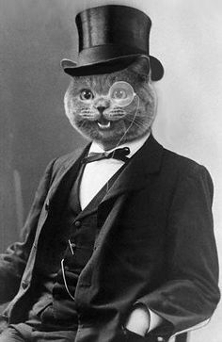
Troubleshooting Hotshots: a game of intelligence and accuracy
Notes:
3rd final and the game that really puts your skills to the test!
We wanted to simulate the experience staff have when a real customer comes to them with a question, 3 key elements:
There is limited time to help the customer – to simulate the pressure staff feel when they are in troubleshooting situation
The customer has very limited information – staff have to rely on their ability to ask questions and listen to the customer responses.
All the questions needed to be realistic – each question is real, from a real customer to a real staff person.
The teams will either play the role of the customer or the staff member. The team who plays the customer is given a DL issue and a list of questions the staff member may possibly ask along with answers. If the Staff team asks them a question they don’t have the answer to they reply with a shrug.
There is enough information provided to solve the problem and it’s up to the staff to figure out how to target the issue. They learn as the game unfolds how to do that:
They use the framework and approach we’ve outlined
They listen to the customer
They ask targeted questions that lead them to new information
Staff have 2 minutes to ask the customer questions and 2 minutes to come up with a hypothesis of what the issue is and how to fix it. Teams are awarded tokens as when they ask certain questions and they can trade these tokens in for clues if necessary.
After each round we debrief – what questions worked, why, what was the breakthrough that helped you figure it out, what tools did you use to work out the answer etc…
By doing this members from both teams will think of questions and situations they’ve been in and ask for clarification. It helps demystify the process for staff that are scared when they see exactly how the process unfolds in real life.
As the rounds progress you see even the most reluctant, fearful staff members start to come out of their shells and offer suggestions of questions to ask the customer. You’ll also see members of the customer team have realizations about how to solve the problem too.
Score keeping becomes fairly secondary to learning at this point and staff curiosity is the prime motivator. This is EXACTLY what we want to happen when they are on the floor.

Slide 20
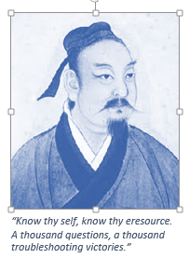
Hotshots round
Customer Question:
“I forgot my Hoopla password.”
Notes:
To make it fun my co-worker gave each customer a historic persona. They have a quotation and a quippy exit line when they leave the interaction. This encourages staff to keep playing, they get a laugh out of each customer and ask for more even if they don’t get the question right they want to know who the customer was and try to help them.

Slide 21
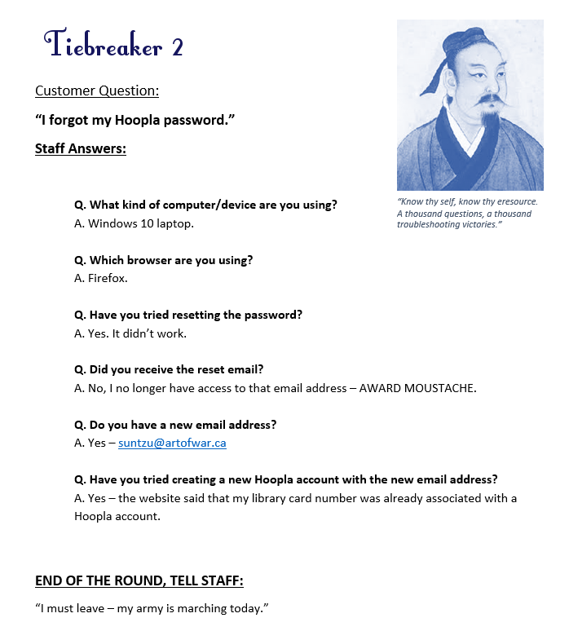

Slide 22
Evaluations
“Troubleshooting is really hard! But it's also really simple. That it's more about getting the right information than it is about knowing everything about computers and devices.”
Notes:
For each session we finished by asking for feedback:
Was that helpful? Do you feel more capable? Are there any parts you think we can adjust to make it better?
From that we were able to tweak the game questions.
Most respondents agreed or strongly agreed that they felt better equipped to help a customer troubleshoot.
We also sent out a formal survey with specific questions to gauge staff’s capabilities and confidence, the following reflects the overwhelming feedback that the course was successful.

Slide 23
Evaluations
“That it is okay not to know the answer, and that we should ignore the instinct to run but to instead try anyway.”

Slide 24
Evaluations
“It is fun to troubleshoot! I liked the troubleshooting game.”
“…I learned how easy it can be to systematically work through a problem to figure out a solution.”

Slide 25
Questions
Kim Bates
Learning & Development Specialist
kim.bates@epl.ca
:@bedtime4budgies

