Slide 1
Tell Your Story How to Write a Winning Grant Proposal Dr. Cory Laverty Queen’s Centre for Teaching & Learning lavertyc@queensu.ca

Slide 2
Outcomes
Identify elements that lead to success
Describe writing techniques to improve readability
Review assessment criteria for research grants
Identify potential funding sources

Slide 3
Grant Writing Process
Team
Discuss
Funding Options
Review Guidelines
Alignment
Read
Outline
Organize & Plan
Connect
Feedback
Revise
Story

Slide 4
Preparing to Write
Review granting agency goals. What is important to them?
Review guidelines and process
Use their headings as outline for your proposal
Structure your project around funding deadlines
Review successful grants
Discuss ideas with colleagues
Seek reviewers unfamiliar with your project

Slide 5
Clarify Your Goals
State goals clearly; don’t let them get lost in narrative
Demonstrate that goals are achievable within timeline, budget, and resources
Describe how goals relate to your organization
Align goals with granting agency goals/mission

Slide 6
Tell Your Story
Grants are pitches, not descriptions
Describing steps is not sufficient
Make a case using a scenario and/or stakeholder voices
Include quotations and examples to tell your story
Consider what makes your project unique & significant
Novel datasets, archives, or documentary sources
Innovative approach
Outreach to marginalized populations
Timely information needs

Slide 7
Write for the Reviewers
Grants are about reading, not writing
Use language appropriate to your reviewers (researcher vs. public; specialist vs. non-specialist)
Never assume that reviewers know about the topic
Reviewers should be able to summarize your project within 1-2 minutes of reading
Use their headings to outline your proposal (e.g. Purpose, Statement of Need, Project Plan, Timelines, Budget)

Slide 8
Tips for Writing
Organization
Use headings derived from guidelines or questions
Language
Match guideline language and terminology
No jargon; spell out acronyms
Define your terms or concepts
Substantiate facts with evidence
Active voice: It has been demonstrated by research that …. Research shows that
Direct language: NOT in addition to, it would thus appear, in the event of, etc.

Slide 9
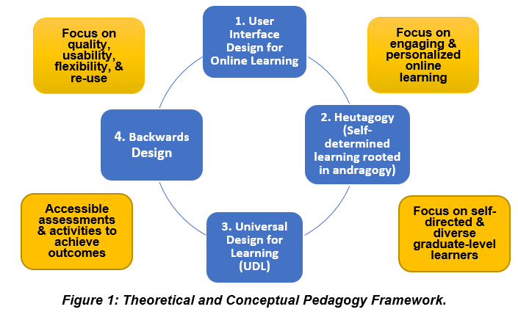
Tips for Writing
Style
Check required font and page limit
Use data visualization techniques
(e.g. diagrams, graphs)
Example from eCampus
Ontario grant

Slide 10
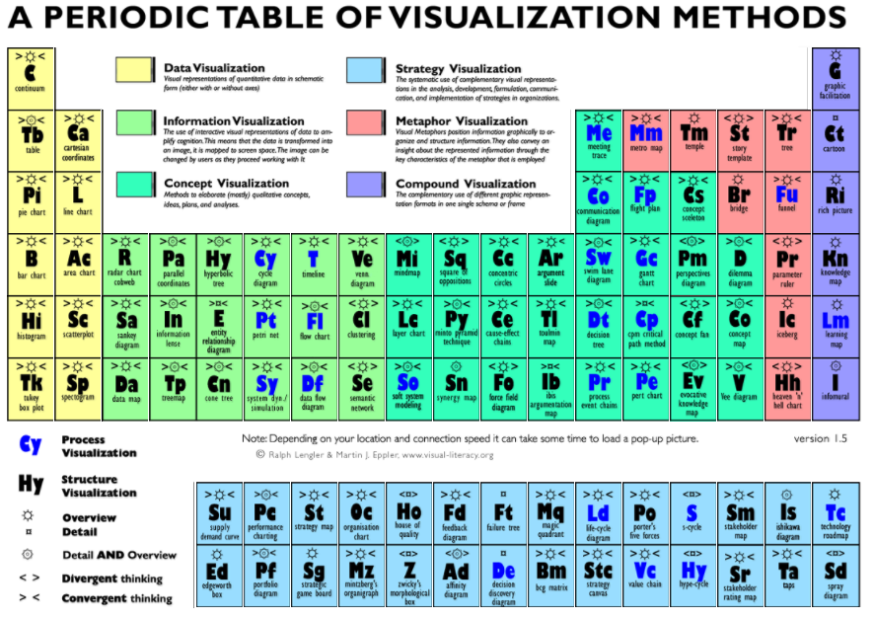
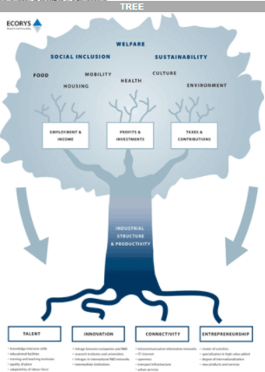

Slide 11
Tips for Writing
Documentation
Have your CV professionally reviewed; align to project
Examples of budget categories:
Personnel (salaries, employee benefits, external consultants)
Incentives (gift cards such as bookstore or coffee)
Supplies (software, equipment, consumables)
Dissemination and Publication (translation, editing, open access fees, producing training materials)
In-Kind Contributions (space, equipment, people)
Travel: check on travel for dissemination purposes

Slide 12
Library
workshop
evaluations
Personal experience
Exit
surveys
Story
Sources
Course Syllabus
Current
news
Staff meetings
Student
Testimonials
Library suggestions

Slide 13
What to include
A few sentences to a few paragraphs in the introduction or statement of need
Quotations from testimonials
Paraphrase of someone’s experience
Describe real people and situations
Description of impact on specific people. Who are they?
Goals of your organization. What are they building towards?
Colleagues behind your work. What have they achieved? What are their challenges?

Slide 14
Components | Description
Project title | Capture interest with a compelling title. First impression!
Introduction | Summarize the project. Use a story to create interest. Situate within sponsor’s priorities. State who will benefit and how. Establish who you and your team are.
Goals & Outcomes | State specific outcomes or research questions.
Statement of need | Literature review from general to specific. Establish importance and significance of the project. Identify gap/issue and how it is addressed by the project. Include preliminary data to demonstrate your knowledge. Align your organization’s and sponsor’s goals.

Slide 15
Components | Description
Evaluation criteria | How will you know you’re achieving your goals? What will you measure to gauge progress? What information will be documented? How and by whom? How will the project be sustained?
Methods & Timeline | Research methods (sample, data collection, analysis, ethics) or process Who is responsible for what?
Team Credentials | Establish credibility of partners.

Slide 16
Components | Description
Dissemination & Mobilization | How will you share your findings? Consider diverse audiences (within institution, local community, national and international interest groups) Include range of mediums (conference, article, website, brochure, policy)
Budget | Detail is good. Include narrative to provide context. Include all sources of in-kind support.
References & Appendices | Ethics forms Letters of support if allowed Data collection instruments

Slide 17
Sample Rubric for Research Grant
Articulates research question or project need in plain language.
Outlines how the project will address the research or need.
Situates the project within existing scholarship.
States appropriate methods for achieving project goals.
Demonstrates the ability of the applicant to complete the project.
Provides realistic and appropriate timelines.
Includes detailed and justifiable budget.
Offers specific plans for assessing the impact of the project.
Describes how the project will be sustained beyond the grant.
Provides a plan for disseminating the results of the project.
Offers potential for application by other librarians/libraries.

Slide 18
Funding Opportunities
Within your institution:
SEED money from department or library
Centres for teaching: teaching enhancement and educational research grants
Alumni association grants (conferences, networking)
Library Associations:
OLA Grant and Sponsorship ideas
Canadian Association of Research Libraries: Research Grants
ALA Impact Grants (must be ACRL member)

Slide 19
Funding Opportunities
Other Organizations:
Southeastern Ontario Academic Medical Organization
Libraries and Autism: We're Connected: Autism Welcome Here: Library Programs, Services, and More Grant (any library U.S. or Canada)

Slide 20
Funding Opportunities
Corporations: Canada Post Community Foundation
Provincial:
eCampus Ontario (building tutorials, courses)
Ontario Libraries Capacities Fund (public libraries)
Improving Library Digital Services (public/First Nation)
Ontario Trillium Foundation

Slide 21
Funding Opportunities
Federal:
Library and Archive Canada (documentary heritage)
Canada Council for the Arts (ebooks, digitization, use)
Canadian Culture Funding: Canada History Fund
Canadian Heritage
Funding Databases
Canadian Funding Portal: aggregates 7,000 sources within free database (government and private).
Canada Grant Watch

Slide 22
Funding Opportunities
SSHRC: view competition results
Connection Grants (international network for research; stories of race and sports; data visualization; personal narratives; conferences)
Insight Development Grants (emerging researchers)
Knowledge Synthesis Grants (digital literacy skills; digital textbook; data literacy education)
Partnership Grants (financial literacy; makerspace training; online reviews; open non-profit data; memoirs of migration; impact of community archives; scientific communication; research dissemination strategies)

Slide 23
Funding Opportunities
NSERC/CIHR/SSHRC: (library as partner)
Community and College Innovation Fund (literacy; open data; learning materials for Aboriginal children; storytelling exchange; evidence-based practice in science; community guide to cancer nutrition)
Keeping Current:
Contact your research services unit for grant digest and grant database

Slide 24
References
Blanco, M. A., & Lee, M. Y. (2012). Twelve tips for writing educational research grant proposals. Medical teacher, 34(6), 450-453.
Gerding, S. K., & MacKellar, P. H. (2016). Winning grants: A how-to-do-it manual for librarians. Chicago: ALA Neal-Schuman.
University of Kansas. Writing a grant application for funding.
Sample grant proposal for Kurzweil Education: https://www.kurzweiledu.com/files/proof_resources_grant1.pdf

