Slide 1
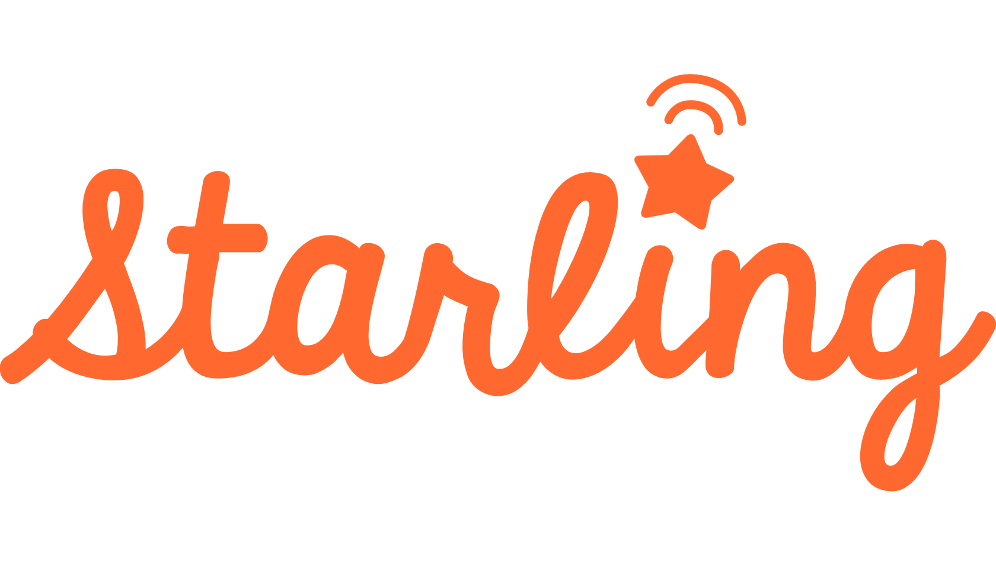
Baby Language Monitor
Nicole Charles
Assistant Director

Slide 2
What is Starling?
Notes:
Starling is a wearable tech device for babies that measure the number of words spoken daily between baby and caregiver. Using a free downloadable app, Starling will set a baseline for the number of words normally spoken with baby. From there, it will create goals for the amount of words you could use daily with your baby. Starling will create graphs so you can see when peak times for language activity occur.
**Show Starling

Slide 3
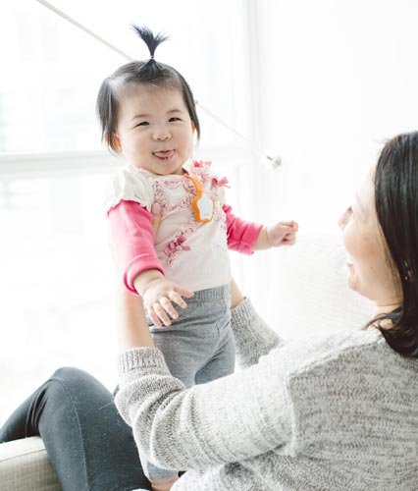
Why use Starling?
“What matters most is speech directed to babies and toddlers, not what they overhear.”
- Dr. Anne Fernald, Stanford University.
Notes:
One of the biggest predictors of school success is the amount of vocabulary a child has by the time they enter kindergarten. Starlings encourage and remind parents and caregivers that even though babies don’t “talk”, using language with them is still important.

Slide 4
How does Starling work?
Pin device to baby
Download free app (iOS or Android)
Create an account
Start talking!
Notes:
Pin device to baby
Download free app (iOS or Android)
Create an account
Talk with baby to start tracking!
Monitor registers language usage and will graph results.
App offers daily tips and topics to talk about with your baby.

Slide 5
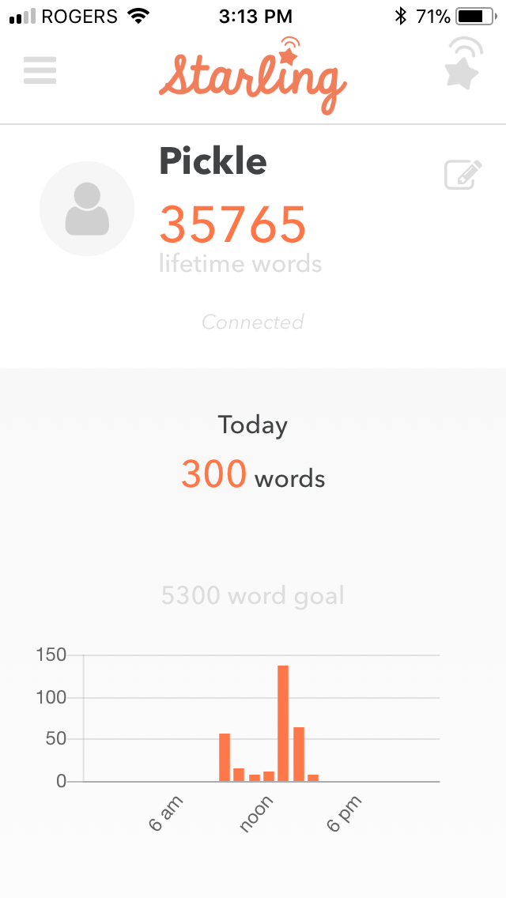
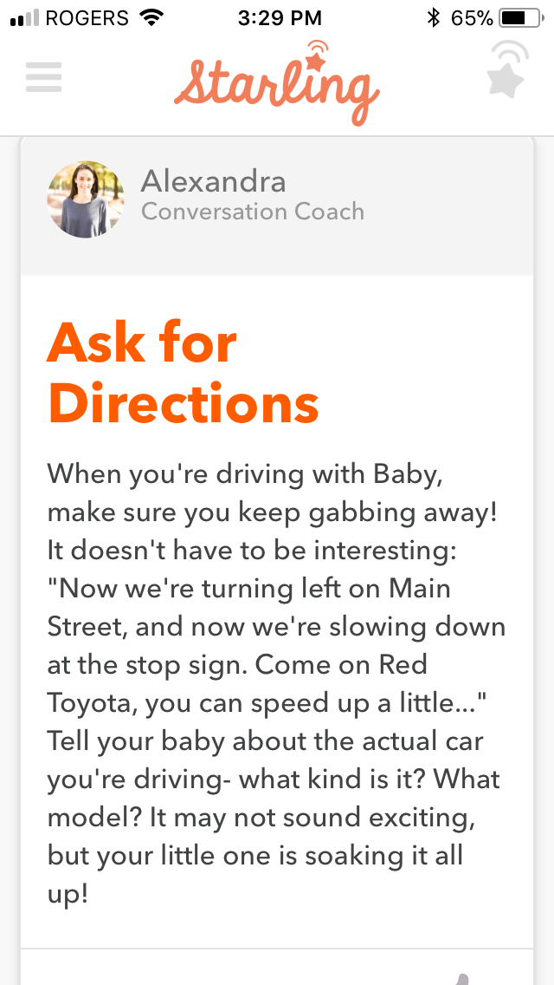
The App
Daily Activity Suggestions and
Word Count
Notes:
App is available on iOS and Android
Customers do need to register their child (but can give them a nickname). All info entered is confidential.
As each Starling has its own identification number, people may have to “Pair New Starling” when they take a Starling out more than once. This is found in the Menu under “My Starling”.
Full instructions included under “Help and Settings” or on Starling website.

Slide 6
Why at BCPL?
“The Starling heard between 3000-3600 words per two sessions of 1/2 hour storytime. When I explained what the Starling was, parents and caregivers were very interested in it (Like, eyes lit up and paying attention to every word I said, interested). I mentioned that if there was enough interest in the Starling the library might start circulating them, many nodded their heads vigorously, or flat out said “That’s wonderful! When?”
– Vernon Area Public Library, in Lake County, Illinois, USA
Notes:
One of the outcomes of offering the MYBT early literacy bags is to affect an increase in literacy in Bruce County. Starlings are a measurable way of determining if there is an increase in literacy engagement with those who receive the bags.
Starlings align with our BCPL Strategic Goal of balancing new innovations and technology with existing services, and the Bruce County Corporate Strategies of leveraging technology and finding creative new ways to engage our public.

Slide 7
Getting Starlings to the Public
1. Redeem coupon from Me, You, and a Book Too (MYBT) bags - With MYBT coupon, provides a way for us to track usage and data to see if the baby bags are affecting literacy engagement. – October 2017
2. Starling kits lendable to any library member – Offering the lending item allows all our library users to try Starling and doesn’t exclude those who have already received a MYBT bag or are visitors/border community users. – November 2017
3. Starling kit for staff program use (babytime/storytime) – Offers a way for staff to promote literacy during programming and encourage parents/caregivers to try Starling by borrowing one from the Library. Can be used with other program partners (like EarlyON) – End of 2017
Notes:
1. Redeem coupon from MYBT bags - With MYBT coupon, provides a way for us to track usage and data to see if the baby bags are affecting literacy engagement.
2. Starling kits lendable to any library member – offering the lending item allows all our library users to try Starling and doesn’t exclude those who have already received a MYBT bag or are visitors/border community users.
3. Starling kit for staff program use (babytime/storytime) – offers a way for staff to promote literacy during programming and encourage parents/caregivers to try Starling by borrowing one from the Library. Can be used with other program partners (like EarlyON)

Slide 8
Questions?

