Slide 1
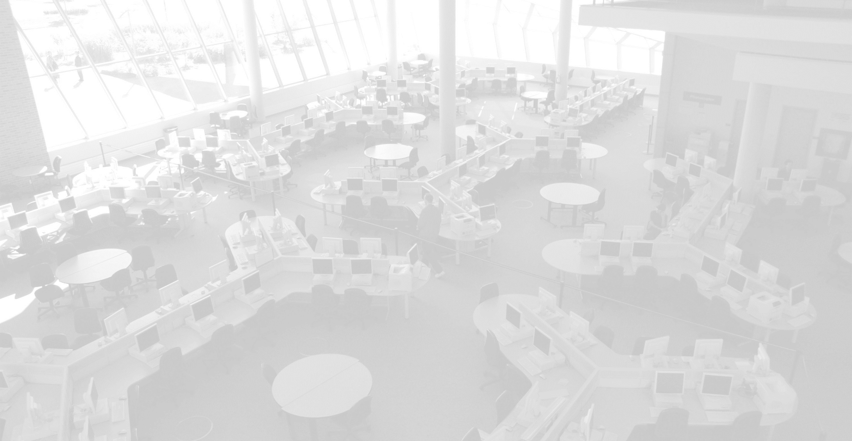
QA, eh?
Developing and Implementing a Quality Assurance Initiative at Seneca Libraries
Pamela Bolan
February 1, 2018

Slide 2
& Seneca Libraries
About
30,000 full-time students
70,000 continuing education registrations
190 programs, including 16 degrees
10 campuses
64 library employees (FT & PT) across 4 campus libraries
5 functional library teams:
User Services, Information Literacy, Information Resources, Systems & Technical Services
Notes:
16 staff are librarians (11 FT, 5 PT)

Slide 3
About Your Library
Academic, public or special?

Slide 4
About Your Library
Academic, public or special?
Is there a quality assurance program in place?

Slide 5
About Your Library
Academic, public or special?
Is there a quality assurance program in place?
Does your library have an assessment or Quality Assurance librarian?

Slide 6
About Your Library
Academic, public or special?
Is there a quality assurance program in place?
Does your library have an assessment or Quality Assurance librarian?
Are you collecting lots of data but not really using it for any purpose?

Slide 7
A Framework is Born
October, 2013 – January, 2015
committee began working on a quality assurance strategy for the library
members included 1 associate director and 6 library staff members, including at least one team member from each functional team
committee met regularly and completed thorough review of available standards and frameworks
framework was developed using ACRL’s Standards for Libraries in Higher Education as our model
Notes:
college had developed a new quality assurance policy in 2013

Slide 8
Our Philosophy for Measuring Quality
QA measures overall quality, never the quality of work done by individual staff members
framework should be built and modified with staff input
elements of the framework should be owned by staff
track the truth – what’s working and what isn’t – and take action accordingly
data is most meaningful when viewed longitudinally
Notes:
Point 5 – data should help libraries to improve, not just to make themselves look good

Slide 9
Customizing ACRL's Standards
Our modifications included:
renaming elements we did not find intuitive (e.g., ‘tracking tools’)
removing one principle (External Relations) and renaming several others (Professional Values → Academic Honesty)
devising QA statements that reflected our library’s definition of quality
adapting practices and timelines to ensure sustainable processes for our library

Slide 10
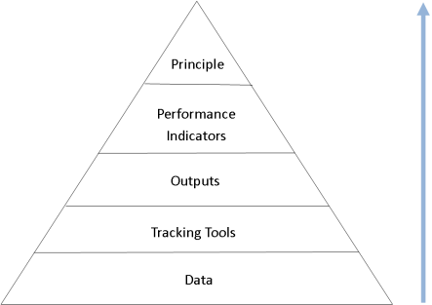
Framework Elements
8 Principles (broad statements) Example: Seneca Libraries supports Seneca's high standard of academic honesty, including copyright, citation and fair dealing.
22 Performance Indicators (fairly broad statements) Example: The library supports the college's copyright policy.
44 Outputs (specific statements) Example: The library has a trained copyright team that answers and addresses copyright questions and issues.
113 Tracking Tools (metrics that collect and review data) Example: number of copyright questions answered

Slide 11
Our 8 Principles
INSTITUTIONAL EFFECTIVENESS
COLLECTIONS
ACADEMIC HONESTY
SPACE
EDUCATIONAL ROLE
PLANNING & ADMINISTRATION
DISCOVERY
PERSONNEL

Slide 12
Principle Statements (# 1 - 4)
INSTITUTIONAL EFFECTIVENESS Seneca Libraries contributes to institutional effectiveness and applies findings for purposes of continuous improvement.
ACADEMIC HONESTY Seneca Libraries supports Seneca's high standard of academic honesty, including copyright, citation and fair dealing.
EDUCATIONAL ROLE Seneca Libraries provides information and digital literacy instruction and tools to support academic success, research, professional development and lifelong learning.
DISCOVERY Seneca Libraries enables learners to discover and retrieve information in all formats through effective use of online technology and organization of knowledge.

Slide 13
Principle Statements (# 5 - 8)
COLLECTIONS Seneca Libraries provides collections sufficient in quality, depth, diversity, format and currency to support the research and teaching missions of the institution.
SPACE Seneca Libraries provides physical spaces that support and encourage learning and facilitate the creation of knowledge.
PLANNING & ADMINISTRATION Seneca Libraries engages in continuous planning and review to inform resource allocation and to meet our mission.
PERSONNEL Seneca Libraries provides an appropriate number of high quality personnel to ensure excellent service, support student success, and function in an environment of continuous change.

Slide 14
How would you define quality?
With regard to a specific service, resource type or space offered at your library ...
Notes:
Doesn’t have to be in a full sentence; can just be key words

Slide 15
Initial Implementation
February, 2015 – May, 2017
assessment librarian was appointed to implement the framework devised by the original committee
quality assurance SharePoint site created
staff received initial Tracking Tool (TT) training, during which metrics were fleshed out
staff completed Year 1 data tracking and TT summarization

Slide 16
QA SharePoint Site
Staff Training
Tools & Project
Timelines & Deadlines
Framework Hierarchy & Repository of Data & Completed Reports
created with assistance from the college’s SharePoint support specialist and the library’s systems librarian
can be viewed / edited only by library staff working on the QA initiative
Notes:
User-friendly; my goal was to make it as easy to navigate as a libguide

Slide 17
Tracking Tool Staff Training
TT Creation Camp:
1:1 sessions provided by the assessment librarian
acquaints staff with use of the SharePoint site
Tracking Tool owner and assessment librarian establish specific parameters for each TT (what, how & when)
Tracking Tool specifics are recorded in a TTD form within each Tracking Tool Summaries & Data page

Slide 18
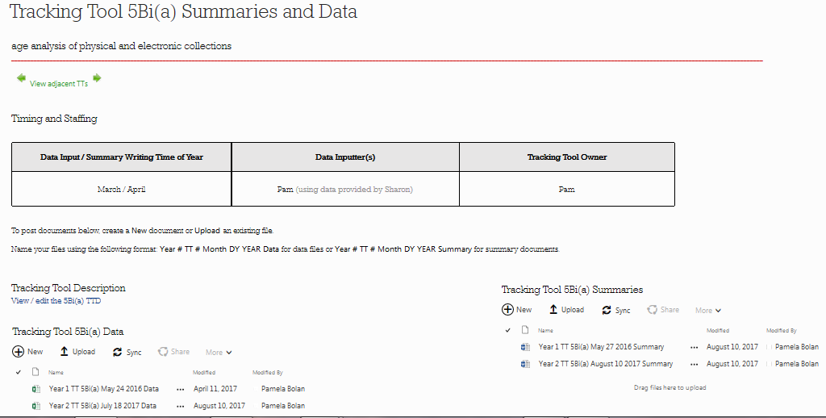
Sample
TT Page

Slide 19
Tracking Tool Data Collection Periods
some TTs track data by fiscal year (April 1 – March 31)
other TTs track data by academic year (September 1 – August 31)
Fiscal Year TTs:
Academic Honesty
Collections
Planning & Administration
Personnel
Year 1: April 1, 2015 – March 31, 2016
Academic Year TTs:
Institutional Effectiveness
Educational Role
Discovery
Space
Year 1: September 1, 2015 – August 31, 2016

Slide 20
Tracking Tool Variation
some of our TTs track qualitative data (e.g., KPI results)
some track quantitative data (e.g., gate counts)
some track a whole year’s worth of data (e.g., subject guide use)
some track whether something is true each year (e.g., is there a link from the library’s site to the college’s copyright policy?)
some collect a large data set (e.g., collection age analysis)
some track a small data set (e.g., staff conference attendance)

Slide 21
How could that be measured?
With regard to the quality definition you devised ...

Slide 22
Phase 2 Implementation
June, 2017 – present
staff received Output training and completed all Year 1 Output reports
staff participated in Output meetings
assessment librarian completed all Performance Indicator reports
assessment librarian completed all Principle reports
library director reviewed / finalized Principle reports and action items
staff have completed most Year 2 Tracking Tools

Slide 23
Output Reports & Meetings
Output Reports:
summarize Tracking Tool report findings and highlight concerns / issues
written by appropriate member of the management team and one librarian with expertise in the area
Output Meetings:
attended by relevant staff who review Output reports prior to meeting
staff discuss opportunities for improvement and possible action items for the upcoming year (finalized via anonymous vote after the meeting)
Notes:
e.g., Manager of Library Literacy, Instruction & Outreach writes Educational Role report

Slide 24
PI & Principle Reports
Performance Indicator Reports:
describe strengths and opportunities for improvement
written by assessment librarian
Principle Reports:
list finalized action items (as determined via vote)
written by assessment librarian and reviewed / finalized by library director

Slide 25
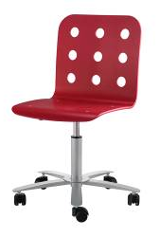
Sample Action Items: Space
Opportunities for Improvement | Action Items
There are no consistent guidelines regarding how to handle noise and space complaints. | Develop a set of guidelines for staff regarding how to handle noise and space complaints, and use these guidelines to train staff.
Some student complaint information is not being captured / recorded. | Create and implement a library complaint form that students can fill out directly.
Not all available power outlets within library spaces are functional. | Develop and implement a plan to test all power outlets in all library spaces to determine if they actually work; this testing will be undertaken on a regular basis.
Library furniture is often dirty, broken or in disrepair. | Develop and implement an addendum to the library furniture inventory that identifies furniture in need of cleaning or repair.

Slide 26
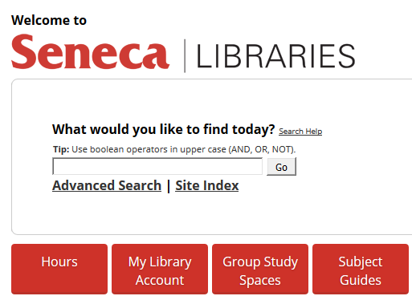
Sample Action Items: Discovery
Opportunities for Improvement | Action Items
Students aren’t clear on what is and is not included when they conduct searches via the main library search box. | Work with the IL team to develop a learning object that covers possible dead ends in the library system and what is and is not discoverable via Primo.
Technical issue requests submitted to ITS, vendors and Ex Libris are not tracked systematically. | Build LibAnswers for centralized long-term tracking of technical issues submitted to ITS, vendors and Ex Libris.
Seneca Libraries content is not as discoverable as it could be in Google – e.g., Seneca Archives. | Determine and implement strategies to increase the discoverability of Seneca Libraries content via Google.
Notes:
There are usually 4-8 action items per principle

Slide 27
Action Item Implementation
Once finalized, action items are:
assigned to team member(s) or a sub-committee
added to the library’s annual business plan (with brief project charters for each)
scheduled for completion within one year
discussed via brief updates at relevant team meetings
reviewed by the assessment librarian to determine degree of completion at the end of the year

Slide 28
QA Timelines
February 2017 Year 1 TTs, Outputs, PIs & Principles were completed
February 2018 Year 2 TTs are being completed (delayed by strike)
February 2019 Year 3 TTs, Outputs, PIs & Principles will be completed
February 2020 Year 4 TTs will be completed
and so on ...
tracking tools are completed annually
upper-level reports are completed every second year

Slide 29
QA & Business Planning
Year 1:
fiscal action items were incorporated into 2017-18 business plan
academic year action items will be incorporated into the 2018-19 business plan
Year 3:
fiscal year action items will be incorporated into 2019-20 business plan
academic year action items will be incorporated into 2020-21 business plan

Slide 30
Best Practices
✓ Build into the framework what you are already measuring well
don’t overlook existing metrics that can answer your key quality questions
✓ Make the most of your multi-faceted metrics
don’t forget that one metric can often help to answer more than one question
✓ Provide supportive training and ongoing guidance
don’t assume all staff are comfortable tracking data & writing summaries
✓ Carefully review all submitted content
don’t forget to ensure alignment of data with summary documents

Slide 31
More Best Practices
✓ Distribute TTs across a broad range of staff members
don’t burden any staff member with too many QA tasks on top of their usual workload
✓ Build framework editing into QA process (e.g., part of our Output meetings)
don’t assume necessary modifications will happen organically
✓ Engage in all levels of QA work in order to identify and fix process issues
don’t assign work to staff that you (the assessment librarian) aren’t also doing
✓ Stagger deadlines where possible
don’t forget that tracking data by fiscal or academic year, as applicable, varies due dates

Slide 32
And a Few More Best Practices
✓ Remember that much can be learned without controlled statistical tests
don’t think that you must have a data librarian on staff to track data and learn from it
✓ Review data with an open mind
don’t assume causation (unless that type of statistical test has been conducted)
✓ Create a sustainable process for your library
don’t bite off more than can be chewed (if you do, modify accordingly)
✓ Only track what can be measured easily and well
don’t include arduous metrics or those that give you incomplete / inaccurate data

Slide 33
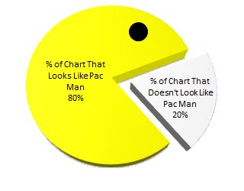
Questions?
pamela.bolan@senecacollege.ca
Notes:
Image source: http://www.quietlikehorses.com/

Slide 34
Benefits of a QA Initiative
Quality Assurance programs allow libraries to:
identify strengths and weaknesses
track trends
make informed decisions
foster a culture of continuous improvement
access data any time, regardless of staff absences
fulfill the province’s PQAPA requirements (for colleges)
effectively communicate contributions and needs to parent institution
Notes:
Program Quality Process Audit is the province’s review of each college’s quality assurance processes.

Slide 35
Thank You
pamela.bolan@senecacollege.ca
Notes:
Image source: http://www.quietlikehorses.com/

