Slide 1
Services for Socially Vulnerable Populations
OLA Super Conference 2018
Linda Garvin and Kyle Marshall
Notes:
Survey findings, including: (5 mins)
o Notable customer demographics(housing/housed, ethnicity, employment, age)
o Notable use patterns (time spent, frequency visited, activities, computer use, outreach participation)
§ Diversity of library use
4. Themes from staff focus groups, including: (5 mins)
o Slides with quotes from staff, focusing on the major themes
§ Behaviour Management
§ Safety
§ Wellness
§ Training
§ Community Services
§ Access
o Differences between managers and staff

Slide 2
A collaborative project
Conducted research March – June 2015
Image credit University of Alberta (https://www.ualberta.ca/risk-management)
Notes:
Why did we embark on this project?
Don’t capture data on socially vulnerable populations very well – we observe them in the space but don’t know much about how they are using it. They don’t typically answer our online customer satisfaction survey. We think/hope that we are having an impact on their lives but don’t really know what our how much. Idea sparked by a similar survey that Multnomah County library conducted with the Multnomah County department of Human Services.
Also had a business plan goal to help staff better serve socially vulnerable populations, so needed data on what staff needed and who these populations were.
Big project that we wanted to get right, so approached some external researchers to collaborate with.
The research design had 2 components a survey administered by volunteers at select branches and a series of focus groups with staff and customers.

Slide 3
Initial observations and questions…
Staff are first to recognize user needs
Increased usage rates
Preparation for addressing needs
Understanding of use patterns
Improvement of services and changing roles
Notes:
Library staff are often the first to recognize the needs of the users.
Increased usage by socially vulnerable users.
Are library staff feeling prepared to address the needs of socially vulnerable users?
Are library staff understanding how socially vulnerable users utilize library space and resources?
How can services be improved?
How can the “non-traditional” role of the library be explained to staff and the general public?

Slide 4
Mixed Methods
Notes:
Briefly explain what we asked and how we did the surveys and their results and then will discuss the focus groups. Margot, as was mentioned was unable to be here today and that was to be her section as she conducted them.
By the way we actually did make use of clipboards!
Before we dig into the methods for a few minutes…
SHOW OF HANDS - Who in here has conducted research in their professional lives?

Slide 5
SURVEYS
Notes:
KYLE

Slide 6
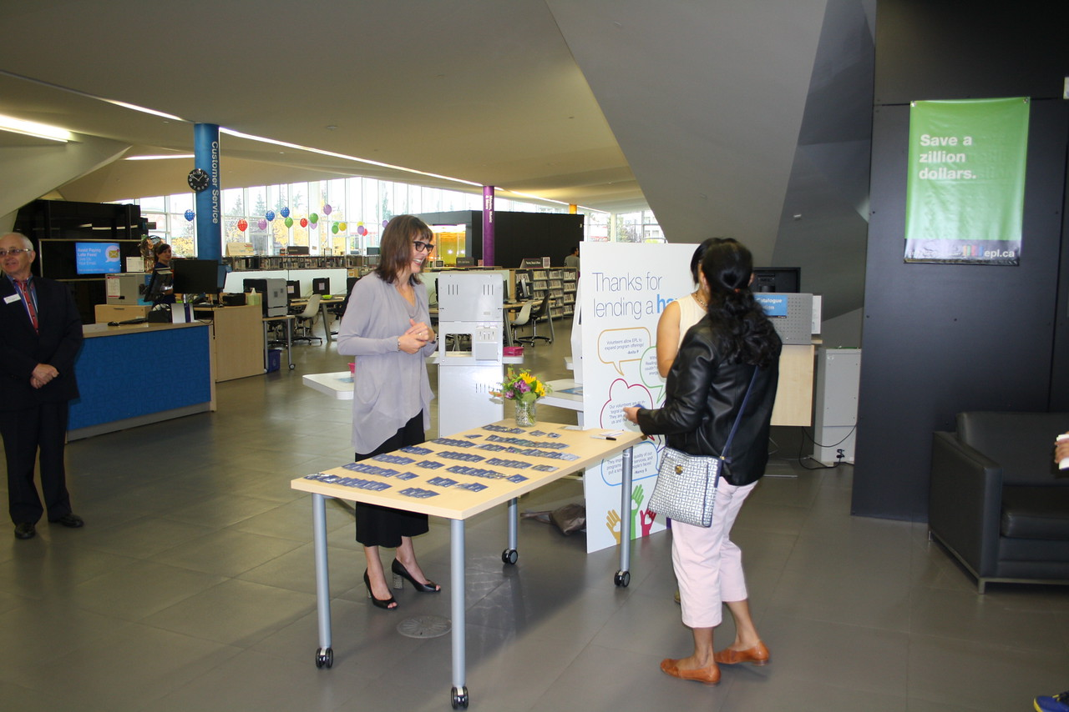
Undertaking of Surveys
6 locations
Volunteers
4,110 responses received
Notes:
These locations mostly have low socioeconomic indicators relative to the rest of Edmonton. Downtown and Strathcona are the exceptions as they have large post-secondary student populations, some very well to do areas, and significant homeless populations.
-48 Volunteers logged 550 hours in helping the completion of this project
-The way the surveying worked is that they asked every 10th customer if it was busy, 5th if it was not busy, and every customer if it was slow, this was to ensure that they didn’t self-select respondents.
This results in surveying 4,110 customers at the six branches
The survey was scheduled for about 4 weeks, but we began to reach saturation in week 3, where volunteers reported that quite a few customers were telling them they had already been approached.

Slide 7
…Surveys
Demographic questions
Employment status
Housing status
Frequency of library visits
Activities at the library
Access to computers outside of the library
Use of Outreach Worker Program
Notes:
For demographics, we asked the participants’ Age, gender, broad ethnic identification
We asked for the frequency and length of visits
needed to keep it short because survey was being administered by someone on the spot.
Had to fit 1 page double sided.

Slide 8
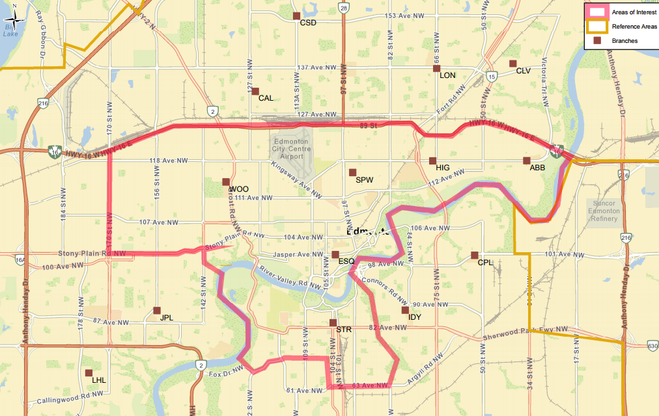
Notes:
-This shows the study area, which incorporates the catchment areas of the six branches in question
-all EPL branches are indicated by the brown squares on the map, and the city’s boundaries are in yellow. This is zoomed in, as the area only takes up one fifth of Edmonton’s population, with large suburban populations to the west, south and north of the study area

Slide 9
Survey – Demographics
Fairly even age distribution
25-34 years old, 21% of participants
Ethnic background
61% Caucasian
19% Visible Minority
12% Indigenous
Gender
52% Male, 47% Female
Notes:
-demographics were all self-identified through the survey using Stats Canada distinctions. We did not dial down into Visible Minority, as the census does. Many in the room likely share the issues with Stats Canada’s ethnicity data, as well, but we won’t get into that
a majority of participants identified as Caucasian, but a sizable number of visible minority and Indigenous participants responded to the survey.
A quick note here, 34% of Edmontonians identifying as a visible minority and nearly 6% identifying as indigenous.
As with many major Canadian cities, however, our more ethnically diverse populations are in the suburbs.
In the areas of study, those figures are 24% and 8% respectively, so these branches are underrepresented by folks who are visible minorities and overrepresented by indigenous folks, relative to the population
-gender was slightly skewed towards males, which confirms previous seating sweeps inner city branches, and our downtown branch skews quite heavily (2/3) male;
-gender skew is slightly female at other EPL branches, and for EPL cardholders in general

Slide 10
Survey – Demographics
Employment Status
54% employed full-time, permanently
Unemployment rate 16%
Housing
50% renting, 36% own
Notes:
-unemployment rate was higher than with the general population, and there were also significant numbers of people (6%) who were unemployed but not looking for work
-Housing tenures were not necessarily surprising. According to the census in these areas 55% rent and 45% own –so our numbers are fairly close and reinforce the validity of our data. In addition to the renters and owners, 3% were students living with friends or family, and 11% were experiencing homelessness, as I will explain in greater detail on the next slide.

Slide 11
Survey – Homelessness
Notes:
-There are a range of circumstances that can indicate that one is experiencing homelessness
-The provisionally accommodated are those living in temporary housing
such as a hotel/motel, vehicle, friends or family, or a treatment centre – this made up 64% of participants experiencing homelessness
-The other two are more self explanatory, so those living in shelters were 28% of those in this graph, whereas unsheltered were 8%.
-One factor to keep in mind is that this survey was taking part in a shoulder season – mostly April and May. It’s likely that the unsheltered figures go up/down depending on season.

Slide 12
Survey – Visitation
Notes:
-semi-frequent visits to the library were most common, with 38% coming weekly to monthly, and 36% coming more than once weekly.
-in terms of time spent, fairly equal parts spent less than one hour and between 1 and 4 hours, with only 3% spending more than 4 hours.
-we used these factors to cross-tabulate the data and see trends between different groups.

Slide 13
Survey Findings
Notes:
Here we look at those customers who do not have access to a computer outside of EPL. At the bottom are internal branch codes for different EPL locations; MNA is our downtown central library (as can be seen in the n values, there were 340 participants from Milner)
-Of course in 2018, most of us are aware that the digital divide is pronounced in these communities. Still, I think that the numbers are fairly staggering, given job expectations and requirements, let alone social expectations in the contemporary world
-the average across these branches was 21%, so 1 in 5 customers in these branches don’t have a computer other than at EPL.
-also remains a vital advocacy point when speaking with funding partners, to be able to speak about these issues with specificity and credibility.

Slide 14
Survey – Ethnicity by Age
Notes:
-now these graphs mimic, in a way, the populations in our communities
-the average age of indigenous and visible minority populations are younger across the nation than for Caucasian Canadians
-but these differences are represented in library activity
-whereas only 42% of Caucasian participants were younger than 45 years old, nearly ¾ of Indigenous and visible minority participants were under 45
-we can see from this graph that we are doing a far better job at reaching Indigenous and visible minority youth, in these areas, yet are far less successful at maintaining those patrons as they age
-a quick note on library use by ethnicity – while indigenous participants were twice as likely to be daily library users, they were also as likely to be infrequent (monthly or less) visitors
-finally…I know that this isn’t the best chart type for the dataset, but the others didn’t present well, so please forgive me this indiscretion.

Slide 15
Survey – Activities
Notes:
Here we can look at use patterns; where we look at library activity between participants who are housed vs. participants who were experiencing homelessness
-I’ll give you a moment to review this visual
We know that our customers engage in a wide variety of activities at the library, but the findings of this survey give us hard data to boost the credibility of those observances.
-As you can see here, participants experiencing homelessness engage in quite a wide variety of activities when they come to the library, which we believe counters some stereotypes.
read
to research
to study or work.
-Notable here are the lower rate of program attendance by participants experiencing homelessness. Despite the fact that these participants tended to spend longer in the library, and visit more frequently, they rarely came to programs. Upon looking at our program offerings, we think that part of the reason for this is that our adult programs are mainly offered in the evenings, when members of this population may be seeking food and shelter for the evening.
-it’s possible that the larger breadth of activities here is due to the longer average length of time spent in the library, but the research did not confirm a causational relationship.
-this also confirms other research libraries have done with vulnerable populations, and this diverse spectrum of use indicates how important we are in the lives of our customers who are experiencing homelessness

Slide 16
Survey – Vulnerable Customers
Homelessness rate higher
10% of all participants; 18% at Downtown Branch
0.3% for city (Homeward Trust, 2014; City of Edmonton, 2015)
Unemployment rates higher
16% at library
6% for city (Statistics Canada, 2016)
Notes:
-again, this confirmed what was believed by staff, but it’s of great benefit to see hard data.
-it is undeniable that vulnerable populations frequently visit these branches, and make up a greater proportion of in-branch customers than they do of the general Edmonton population
-our indigenous customers were more likely to both be experiencing homelessness and using our outreach worker program.
-remember that these are figures specifically at branches with lower socioeconomic indicators, so they will be lower if the library’s 12 other branches were included in the study

Slide 17
Survey – Marginalized Youth
Youth under 18 more likely to
Visit the library more frequently
For longer periods than other age groups
Be indigenous or a visible minority
Have the library as only computer access
Notes:
-Over 20% of youth respondents (under 24) were experiencing homelessness; tragically, nearly double average rate for other age groups
Homeless or socially vulnerable youth “confront many challenges due to their age and development stage that their homeless adult counterparts may not
-60% of youth participants spend more than an hour when they come to the library; that’s compared to 43% of all respondents
Despite stereotypes that youth are more connected than adults, youth respondents were the least likely to have access to a computer outside of the library.
Early intervention can help reduce the portion of society in the future that are living in socially vulnerable circumstances.
-there is a gap in service for these communities, and the library seems to be a haven of sorts for youth in these situations

Slide 18
FOCUS GROUPS

Slide 19
Purpose of focus groups
Introduce staff perspective
Gather deeper attitudes, feelings, beliefs experiences and reactions
Notes:
Gather data and stories to help staff, customers and EPL better understand and engage with marginalized populations using the library.
To gain a better understanding of the issues surrounding individuals living in vulnerable situations which will assist in providing the building blocks leading to an improved skill set for engaging with these individuals.
To indicate areas where additional staff training and/or support could be of assistance.
Help craft a new dialogue with other customers and the general public around library use and the importance and power of free and open public space.
To decrease stigma.
Also, both quantitative and qualitative research have their strengths, but this is intensely emotional work
As I went through the quantitative data, you’ll notice that observable “facts” have a trickier time at stirring up an emotional response. It’s heartbreaking to see the gaps in access in our society, or to see how many our customers don’t have a reliable shelter in the evening. But just knowing that as a quantitative stat is not nearly as beneficial
We work in professions that value storytelling. Qualitative data (such as that coming from focus groups) gathers much of its power and effectiveness through its stories

Slide 20
Focus groups
9 groups in total
Socially vulnerable customers (2)
Socially vulnerable youth (1)
Library staff of various levels (4)
Branch managers (1)
Outreach workers (1)

Slide 21
“This is the one place I come and they know that I’m in this [addictions program] and they don’t really care. They’re just…treating me like a person.”
Notes:
Now that I’m getting into some brief feedback from our staff focus groups, I want to lead with a positive customer comment here that was passed on by a staff member
[read quote]
-the focus groups had many positive comments about our staff, and pride they took in the work they were doing
-many thought we fulfilled a service that couldn’t be found elsewhere, and we were also the first point of contact to help vulnerable populations
-I’m stating this to provide balance – as there are many challenges and gaps in services, which I will be focusing on – but there is also pride in the work the library does and great appreciation for it.

Slide 22
Notable Findings (Staff groups)
Regular suspensions as barrier to rehabilitation
Unclear procedures in contacting for help
Notes:
-Staff considered it difficult when customers are repeatedly suspended due to their behaviour
-by suspending a customer, it is removing a vital space in their lives – these are often the people who spend hours there, daily
-yet in these cases the customer is having trouble navigating the library’s social expectations, and staff expressed how difficult it is to have a meaningful conversation with the customer when a suspension is on the table
-an example is that, if you’re caught intoxicated in our spaces, you get an automatic 3 month suspension from the library
-at this point, we can no longer help connect that person to addictions help; moreover, for someone with an addiction, they may never be allowed to remain within our space for any length of time.
-staff also spoke of the difficulty they face in not being able to offer options to the customer if the behaviour has improved
-for both emergency situations, or when staff need to contact a health organization or non-profit for help, the procedures aren’t always clear
-changes occur quickly to contact information, and the process needs to be simplified for staff; they have to act fast to assure customers
-staff spoke about the need for standardized, system-wide contact procedures for specific incidents

Slide 23
Notable Findings (Staff groups)
Staff stress levels are high in some branches
Support structures need greater flexibility
Notes:
-high staff stress levels and the concept of burnout came up in multiple focus groups
-good staff can have trouble sleeping or they might relive difficult scenarios in their minds
-individual situations often don’t cause alarm in isolation, but the concept of a “last straw” was raised
-EPL uses an external contractor for the Employee & Family assistance program, and specific feedback was raised on mental health and trauma supports available to staff
-there is interest among managers in how staff are using the services
-moreover, the counselling services are only open for weekdays; how are they supported when crisis occurs on evenings or weekends?
-there is not quiet space for staff to have a telephone appointment while at work
-another question was raised: how are we relieving staff from certain duties while keeping their situation confidential?

Slide 24
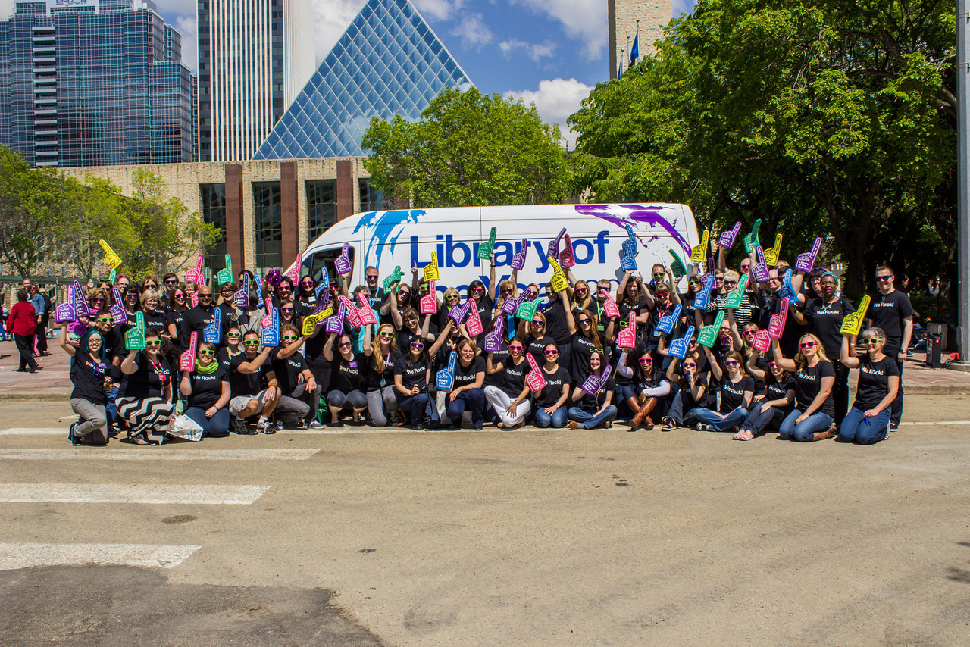
Notable Findings (Staff groups)
Mental health first aid
Mutual compassion
Interview questions
Notes:
-training for mental health first aid was considered helpful; and in some ways is the most vital
-unlike other job functions, this deals with situations that really add to staff stress
-mental health first aid was said to be offered fairly infrequently, and there might be limits on how many staff can attend from each branch
-at some branches, every staff member should have this training
-staff also felt that they needed regular refreshers for this training
-mental health first aid was also considered in the sense that a full understanding of underlying issues such as cognitive functions, effects of trauma and social development is needed by staff in order to help them to compassionately assist customers.
-it was interesting to see that our library assistants expressed compassion for the difficult situations Outreach Workers must be put into, and the significance of situations that they deal with, on a daily basis. On the flipside, Outreach Workers were concerned for the lack of peer support structures available to Library Assistants – as they saw it, they worked in a tight, close-knit team, whereas Library Assistants often have shifts/breaks that have them working with different people all the time.
-they also showed interest in collaborating more, and gaining greater understanding of the scope of each other’s work
-Managers questioned whether our current hiring practices were appropriate to determine the right staff for 21st century urban library work
-job descriptions might not reflect the new reality of working in our buildings
-need to give them a realistic job preview, be clear on potential challenges, as the cost of an unsuccessful hire is significant to the organization
-at this point it should be eminently obvious that most of our roles are service jobs, and require far more than a passion for literature; but it isn’t always something applicants truly understand

Slide 25
What have you or your staff noticed, experienced or observed in working with socially vulnerable populations?

Slide 26
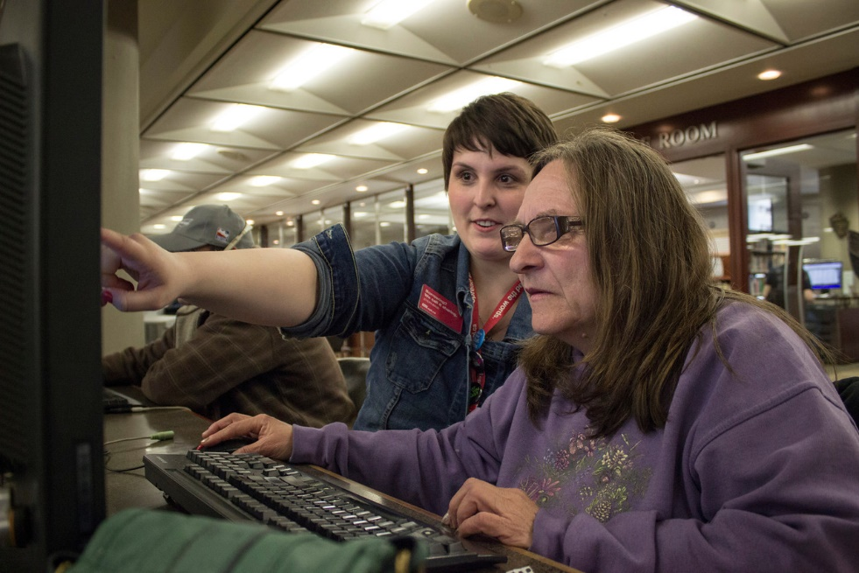
Customer Focus Groups - Logistics
Location and timing
Central
In the evening or afternoon
Provide food
Notes:
-Recruited through outreach workers – challenging to get people to show up
-Timing critical – for shelter users can’t be too late as they need to line up by later afternoon.
-But for youth, around supper was the right timing.
-incentive is always important for focus groups but being a public institution, there are limitations to what we can offer
-again, I would say that all research participants should be respected and thanked for devoting their time and thoughts
-but for these groups, I would argue it’s more important.
-many of them have reasons to distrust authority or anything structured in this sense
-asking them to be vulnerable and exposed in this type of setting is asking a lot. It’s important to thank them adequately and appropriately for their time

Slide 27
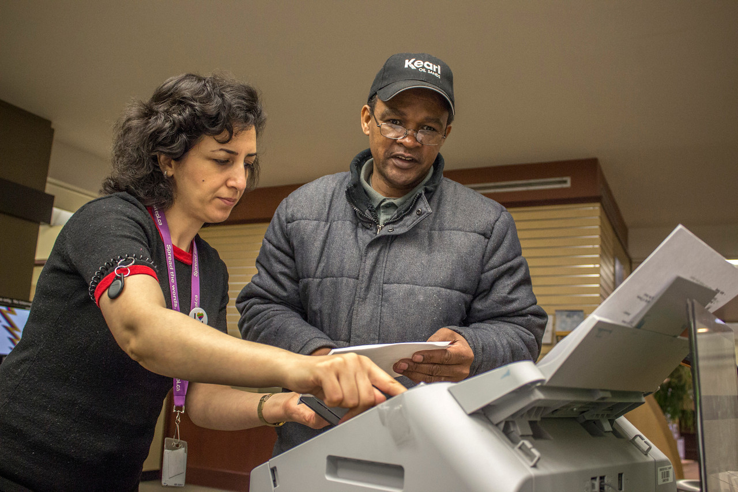
Notable Findings (customer group)
Free and safe space
No sleeping policy/safety
Computer use
Staff
Notes:
Need for a quiet space to read or “just chill”
Availability of public washrooms; They need to understand just how many people they are servicing here”
Computer use
Keeping in touch with family and friends via social media
Job searching
Conflict about video game usage and monopolizing computer space.
No sleeping policy
Overall agreement with this new policy;
Perception of physical safety within the library; “It’s a safer place. I’m not saying it’s the safest place but it’s safer” “When they were allowing sleeping in there, the seats were all taken up and you could see, it was a rough crowd”.
Staff:
In general, feedback was positive in nature; “almost everyone is pleasant, courteous and solicitous”.
Some underlying suggesting that not every staff member was helpful and friendly; “there’s other floor staff there that I avoid, if I can go to somebody else, I do”
Some High Expectations though.
Observation of medical emergencies in library and staff preparedness; “I’m not asking them to be paramedics. But just an understanding that some of the types of diseases they many come across.. and incidences like that in medical nature need to be taught to them”

Slide 28
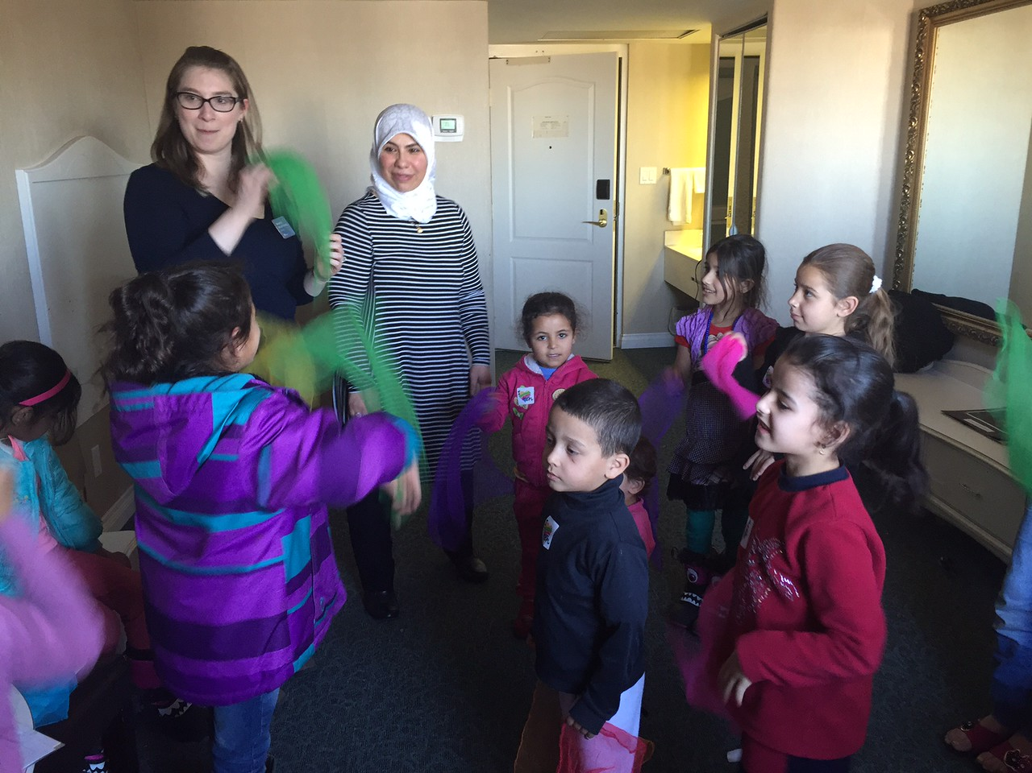
Notable Findings (customer groups)
Programming
Volunteer opportunities at the library
“I think a volunteer thing would be good…people like us who know resources and stuff…teens helping teens, you know”
Notes:
-they spoke to the variety of children’s programming that they see offered, and yet want things at the library that can enrich their lives
-more free movie nights, creative writing classes and programs for seniors were raised
-our customers spoke about improving their skills through volunteering
-particularly, they spoke to using their strengths for good – they know resources, how to source things like hot meals, and would be able to apply that knowledge

Slide 29
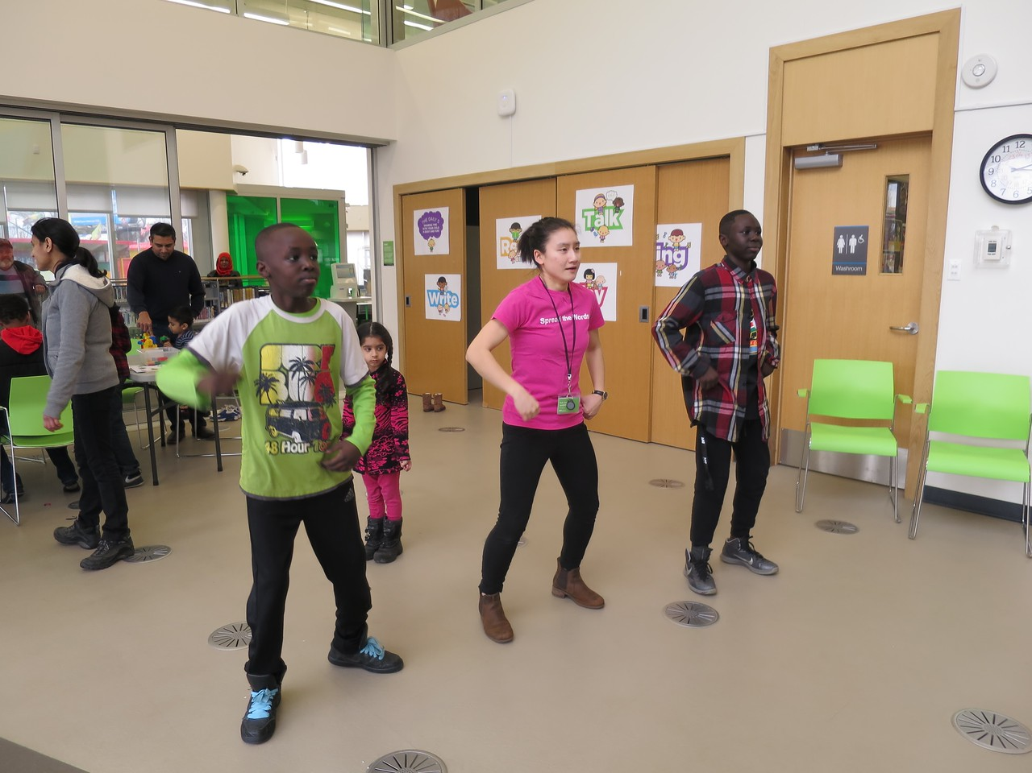
Notable Findings (youth group)
Computer usage
Free and safe space
Outreach workers
Notes:
Aged 15-24, which is a bit older than the youth in this photo…but I liked it. You can see one of our staff showing off her moves in the middle there.
Free and safe public space:
“the spot to meet people”
“a place to seek shelter when it’s cold outside [because] its warm in here”
Outreach workers
Assistance with housing, employment, obtaining ID, income support, recreational activities, nutritional support (snacks and food donations), health care advocacy and referral, subsidy programs & mental health programs.
“without (outreach worker’s name) and the workers here we’d probably still be on the street…”
“They will assist you…they will take you there [service] and help you if you have bad anxieties like I do”

Slide 30
“When you’re dealing with some staff of who’s ‘How are you doing today? You’re looking a bit blue. How are you feeling?’
…And it’s just two sentences but it makes a difference.”
Notes:
[read quote]
-our Outreach Workers received tons of praise from the respondents, and they would mention making special trips to see a specific outreach worker
-even commented on how difficult it must be for customer service staff to respond to the needs of diverse user groups. Kudos!

Slide 31
Recommendations

Slide 32
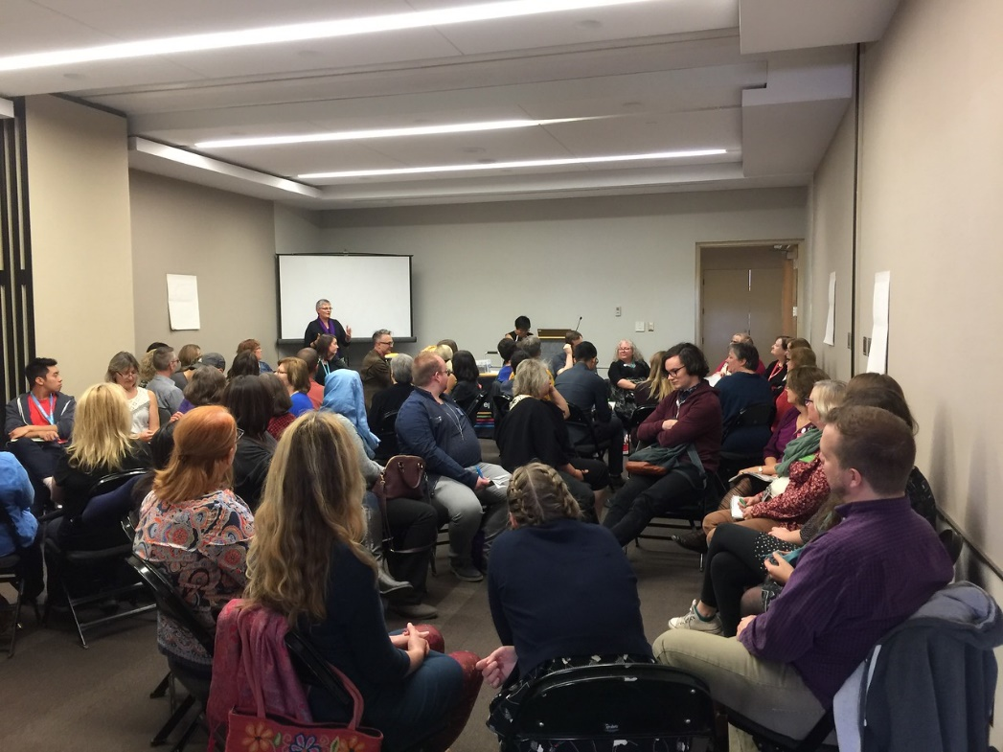
Staff support
Trauma informed service
Informal training sessions
Desensitization
Notes:
Staff Support
Staff focus groups indicated that EPL needs to consider new models to support staff who have witnessed or experienced trauma. New approaches should improve staff wellness and avoid problematic responses brought on by desensitization. Recommendations include:
Continue to explore how branch staff can be more integrated into the Service Framework for Outreach Workers. ESQ Manager 2017 action. (new)
Explore what other “caring” professions do to address potential high stress levels. Discovery Services 2017 action. (new)
Understand and develop a strategy to address staff stress.
Investigate peer support models for library assistants. Outreach workers commented on how vital it is to work with supportive team members with whom they can debrief and suggested this models for LAs. Discovery Services 2017 action. (new)
Investigate frequency of managers staying after hours to assist socially vulnerable customers or address other issues. Executive Director, Customer Experience 2017 action . (new)
Investigate City of Edmonton and Edmonton Police Services response to staff stress. Our close partners at the CoE and EPS may have developed positive solutions for dealing with staff trauma that can be adapted for EPL staff. Learning & Development 2017 action. (new)
Explore need for using City Chaplain or trauma teams for EPL staff. Learning & Development 2017 action. (new)
Provide feedback to Homewood Health regarding the Employee and Family Assistance Program. Concerns were raised regarding the flexibility of Homewood Health’s services, including for evening and weekend support, and offering diverse (e.g. both group and one-on-one) counselling options. HRS Workplace Health Consultant 2017 action. (new)
Explore lack of EPL Outreach Worker support for socially vulnerable populations on weekends. ESQ Manager and ESQ Director 2017 action. (new)
Provide a list of tools/links that help staff support socially vulnerable populations. Discovery Services to communicate 211 services and resources. (new)
Who is responsible for looking at the data?
HR?
Who's responsible for looking at the data? HR?
This was in the printed copy from Linda, but not edited in the electronic copy I was sent. Not sure which edit you wanted.
Use printed copy edits.

Slide 33
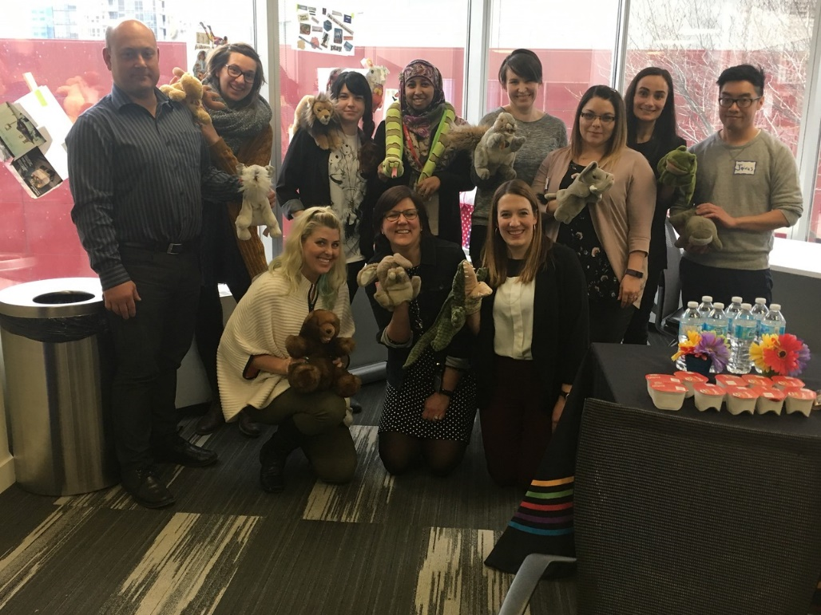
Staff support
Mental Health First Aid
Other organizations
Tactical Communication
Access to Experts
Peer to Peer support and debrief structure
Notes:
Mental Health First Aid
Investigate other organizations
Tactical communication
Access to experts
Peer to Peer support and debrief structure
Staff Support
Staff focus groups indicated that EPL needs to consider new models to support staff who have witnessed or experienced trauma. New approaches should improve staff wellness and avoid problematic responses brought on by desensitization. Recommendations include:
Continue to explore how branch staff can be more integrated into the Service Framework for Outreach Workers. ESQ Manager 2017 action. (new)
Explore what other “caring” professions do to address potential high stress levels. Discovery Services 2017 action. (new)
Understand and develop a strategy to address staff stress.
Investigate peer support models for library assistants. Outreach workers commented on how vital it is to work with supportive team members with whom they can debrief and suggested this models for LAs. Discovery Services 2017 action. (new)
Investigate frequency of managers staying after hours to assist socially vulnerable customers or address other issues. Executive Director, Customer Experience 2017 action . (new)
Investigate City of Edmonton and Edmonton Police Services response to staff stress. Our close partners at the CoE and EPS may have developed positive solutions for dealing with staff trauma that can be adapted for EPL staff. Learning & Development 2017 action. (new)
Explore need for using City Chaplain or trauma teams for EPL staff. Learning & Development 2017 action. (new)
Provide feedback to Homewood Health regarding the Employee and Family Assistance Program. Concerns were raised regarding the flexibility of Homewood Health’s services, including for evening and weekend support, and offering diverse (e.g. both group and one-on-one) counselling options. HRS Workplace Health Consultant 2017 action. (new)
Explore lack of EPL Outreach Worker support for socially vulnerable populations on weekends. ESQ Manager and ESQ Director 2017 action. (new)
Provide a list of tools/links that help staff support socially vulnerable populations. Discovery Services to communicate 211 services and resources. (new)
Who is responsible for looking at the data?
HR?
Who's responsible for looking at the data? HR?
This was in the printed copy from Linda, but not edited in the electronic copy I was sent. Not sure which edit you wanted.
Use printed copy edits.

Slide 34
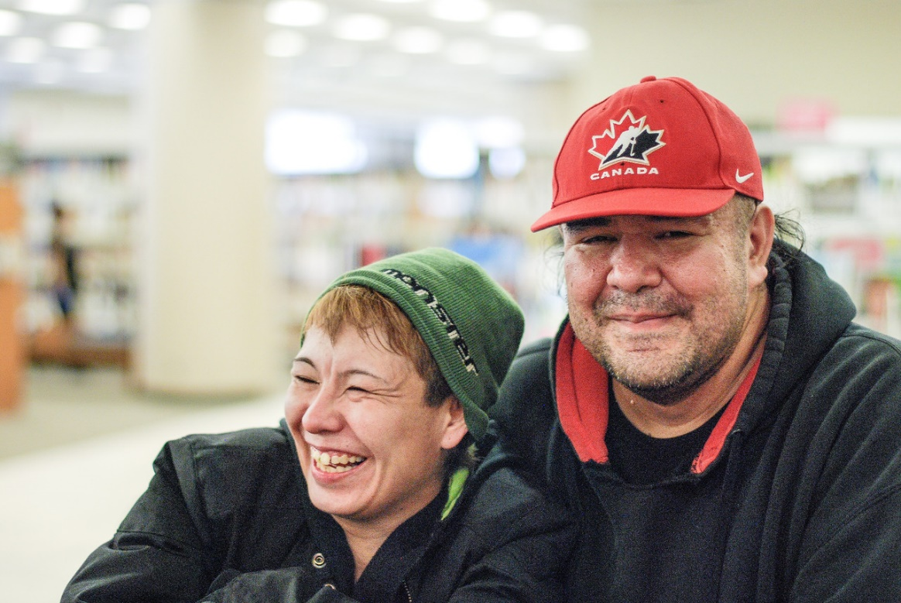
Recruitment and Onboarding
The right people for the right job
Interview questions
Recruiting for soft skills
Notes:
Recruitment and Onboarding
Making positive, sustainable additions to our staff is a vital piece of maintaining a strong EPL team. Managers mentioned that changes to the recruitment and selection will help to bolster these processes. Recommendations include:
Review current interview questions to ensure we are effectively able to assess applicants’ ability and judgement in responding to situations typical of an urban library setting. HRS and managers from branches serving neighbourhoods with low socioeconomic indicators 2017 action. (new)

Slide 35
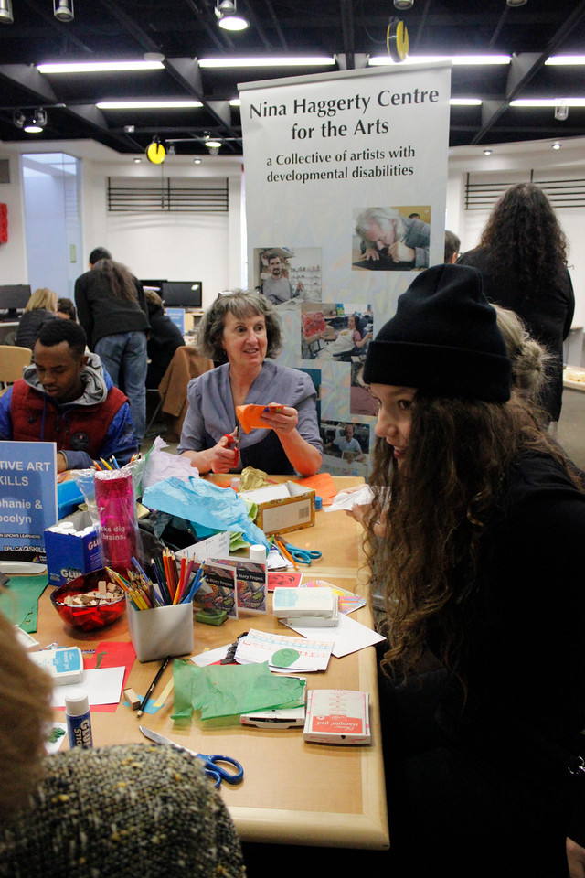
Services
Collaborations
Day time service offerings
Volunteer opportunities
Alternative model - suspensions
Notes:
Services
As a large and vulnerable population that the library serves, focus group participants and the literature review indicated new services that EPL should consider for and with socially vulnerable populations. Recommendations include:
Continue to explore potential collaborations with health agencies. EPL has already engaged in collaborations with health agencies (see Changes at EPL since data collection, pp. 42-43). Staff focus groups illuminated an interest in having nurse practitioners and/or community mental health counsellors available at the library. The literature review identified library systems where these personnel are available to customers. Executive Director, Customer Experience 2017-2019 action. (new)
Improve day time service offerings for adults. Survey responses indicate that socially vulnerable populations visit programs less frequently than the general population, despite visiting the library more frequently and for longer periods of time, possibly because there is little programming for adults during the day. Adult Services 2017 action. (new)
Identify volunteer opportunities for socially vulnerable populations. Participants in community focus groups expressed an interest in volunteering at the library, perhaps as peer counselors, to share their expertise and increase employability. Assess San Francisco Public Library’s model as an option. Community-Led Team and Volunteer Coordinator 2017 action. (new)
Consider an alternative, restorative justice model to customer suspensions. Customer suspensions result in a high rate of recidivism and don’t necessarily permit for positive conversations with customers on behavioural expectations or treatment options. By removing customers from a vital community in their daily lives, suspensions can have humiliating and isolating effects on customers. Executive Director, Customer Experience. (in progress)
I don’t think this sentence should be here. It doesn’t make sense in the context of recommendations section. If it needs to be here than whole point needs to be reworded to something like: While EPL engages in a variety of collaborations with health agencies, ongoing explorations for new partnerships are recommended.
See notes from Pilar – e.g. what we are already doing

Slide 36
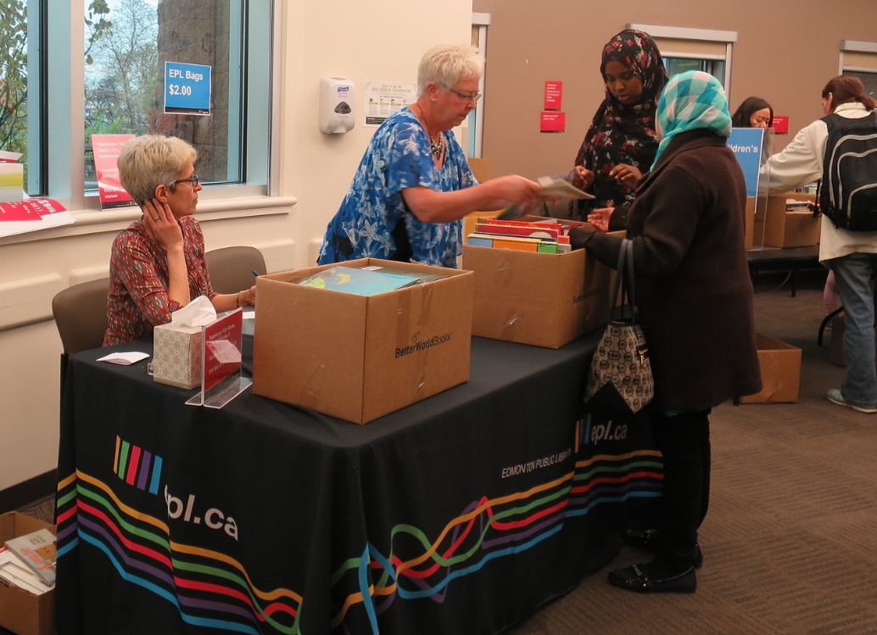
Services – Tricky bits
Volunteer opportunities
Alternative model - suspensions

Slide 37
Where we are at now

Slide 38
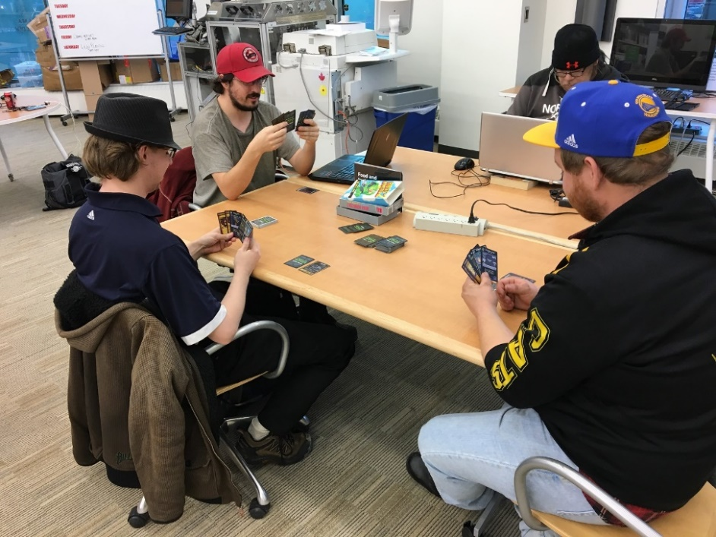
Where we’re at now
Personal resiliency
Circle Way training
Tactical Communication
Indigenous Awareness Training
Stories of Survival
Space Animation

Slide 39
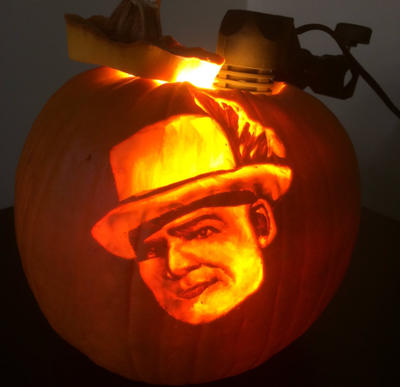

Slide 40
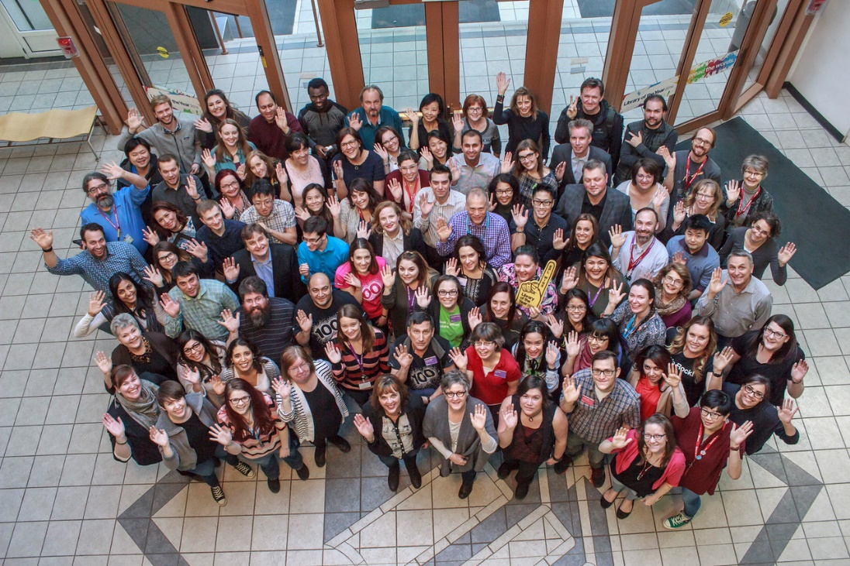
Next Steps
Status of recommendations
Assess training and support for staff
Publish report

Slide 41
Reflections…
Notes:
Important to collaborate with external researchers so that staff felt comfortable opening up in the focus groups
Experienced researchers also helped refine the survey and focus group questions
Volunteers worked surprisingly well, and without them would not have been able to deploy a survey like we did. Though the recruitment and training took up significant time, still less than it would have otherwise.
Focus groups mostly solidified thoughts that had already been occurring, but it did also highlight some important considerations, such as training needs to be ongoing with refreshers, it’s not a once and done thing.

Slide 42
“It’s the staff, it’s the people. The programs, they’re good ideas, but it’s the people who make the difference.”
Notes:
In one customer focus group, a participant summed this up quite nicely:

Slide 43
Audience Reflections
What might you do to engage your staff in these conversations?
Your customers?
Address what you’ve heard from these groups?
Notes:
Select from group depending on time

Slide 44
Questions?
kmarshall@epl.ca
lgarvin@epl.ca

