Slide 1
Keep it or Lose it
Using Google Keep to save, sort, & share ideas
Twitter: @glarcina
Email: glarcina@gmail.com

Slide 2
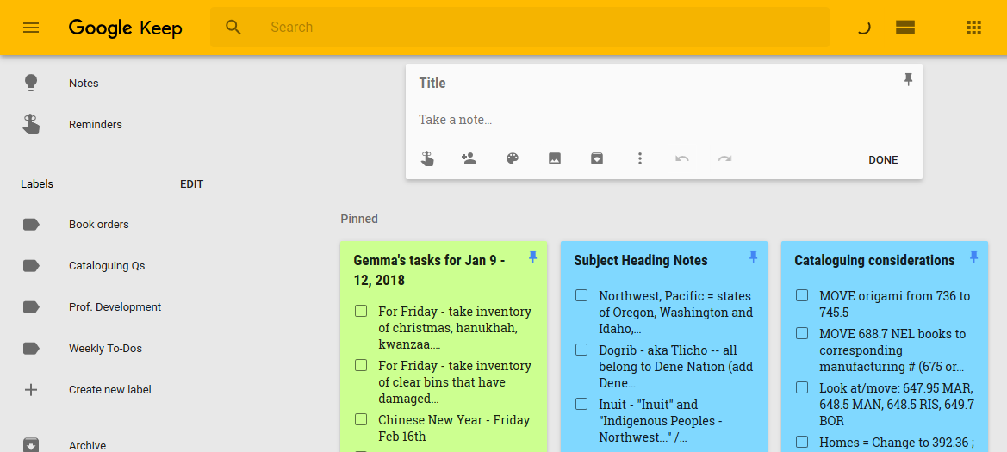
Accessibility
Reminders
Share with

Slide 3
Organization

Slide 4
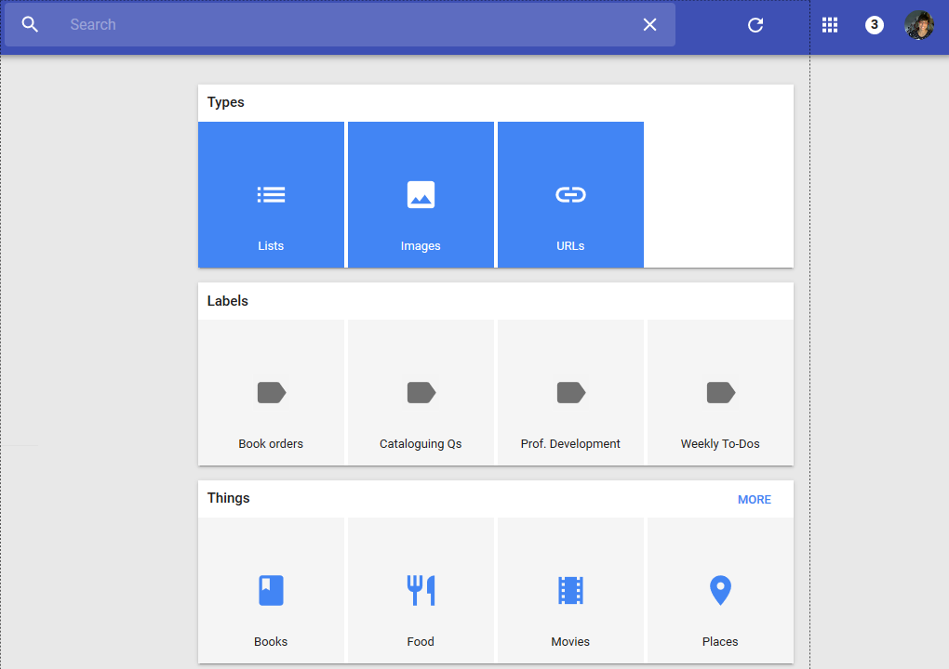
Searching
Also:
By collaborator
By color
By keyword

Slide 5
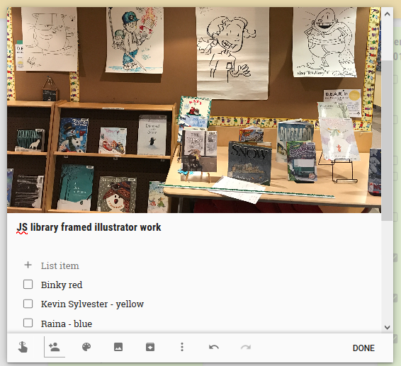
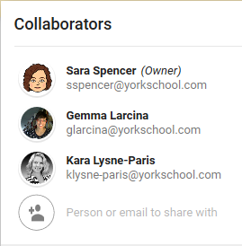
Collaboration

Slide 6
Why Keep?
Accessibility
Web app & mobile app, offline & cross-platform
Organization
Labels, colors, searching
Collaboration
Twitter: @glarcina
Email: glarcina@gmail.com

