Slide 1
Mindful
3D Printing

Slide 3
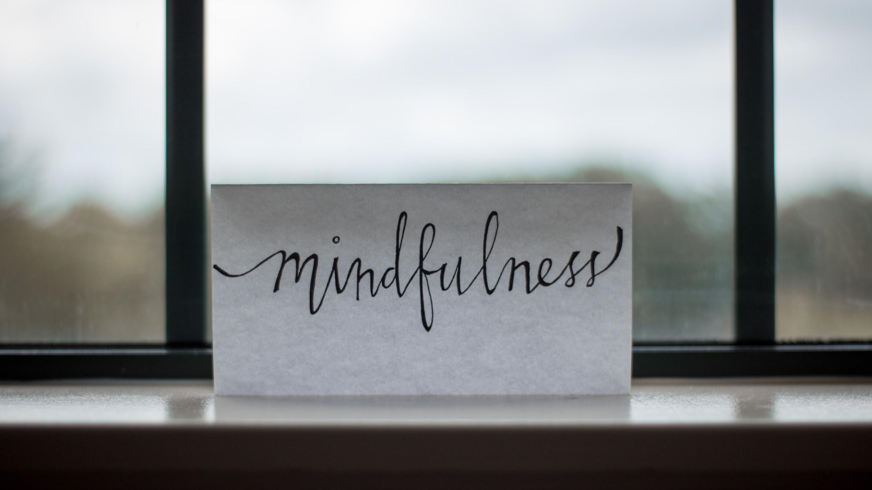

Slide 4
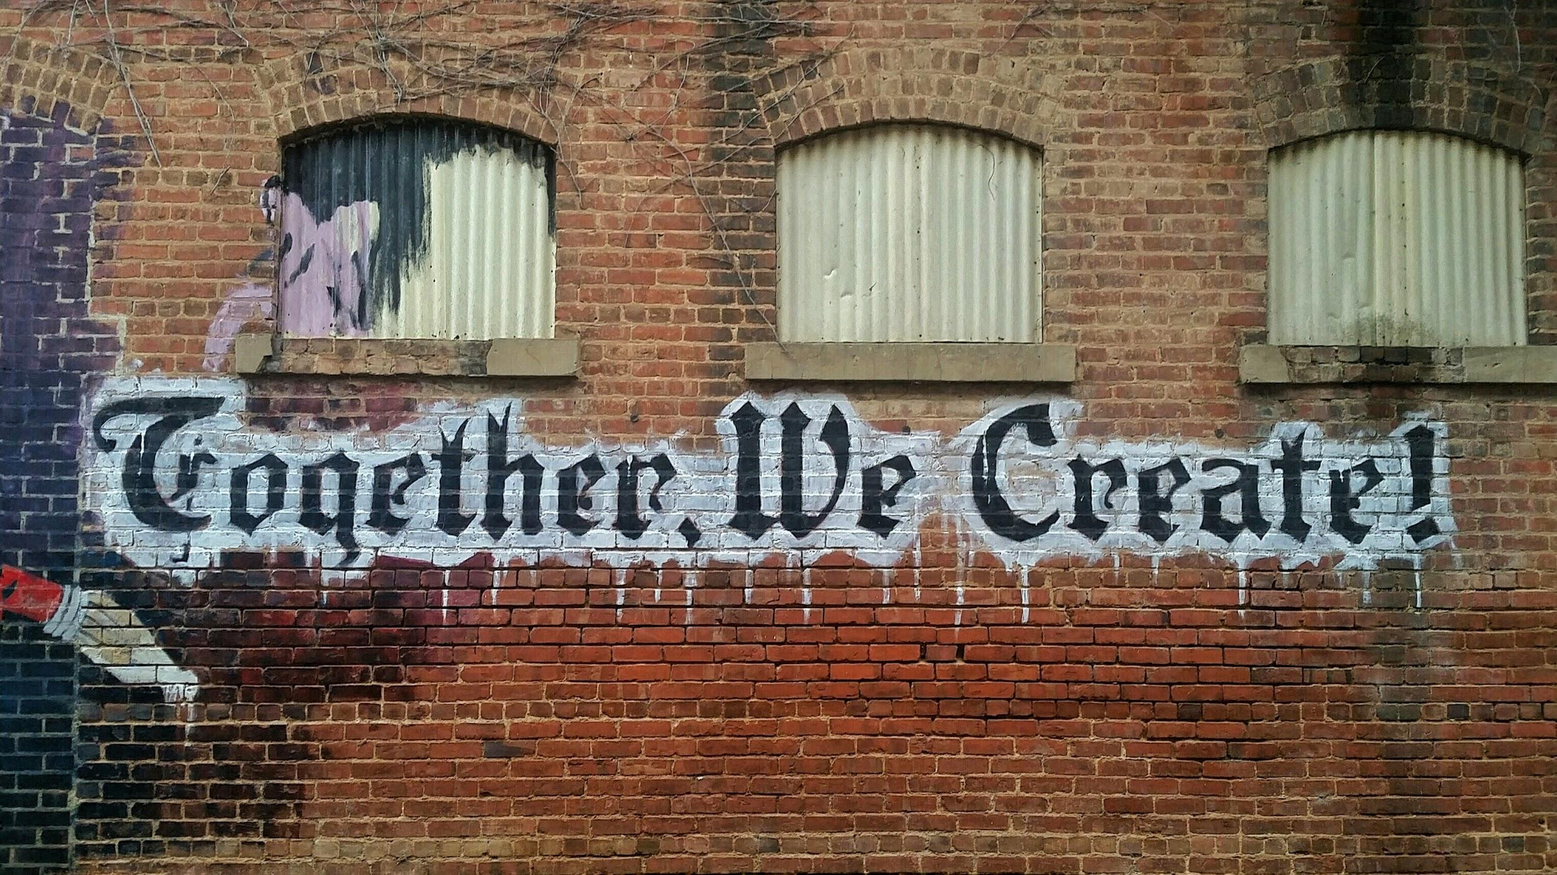

Slide 5
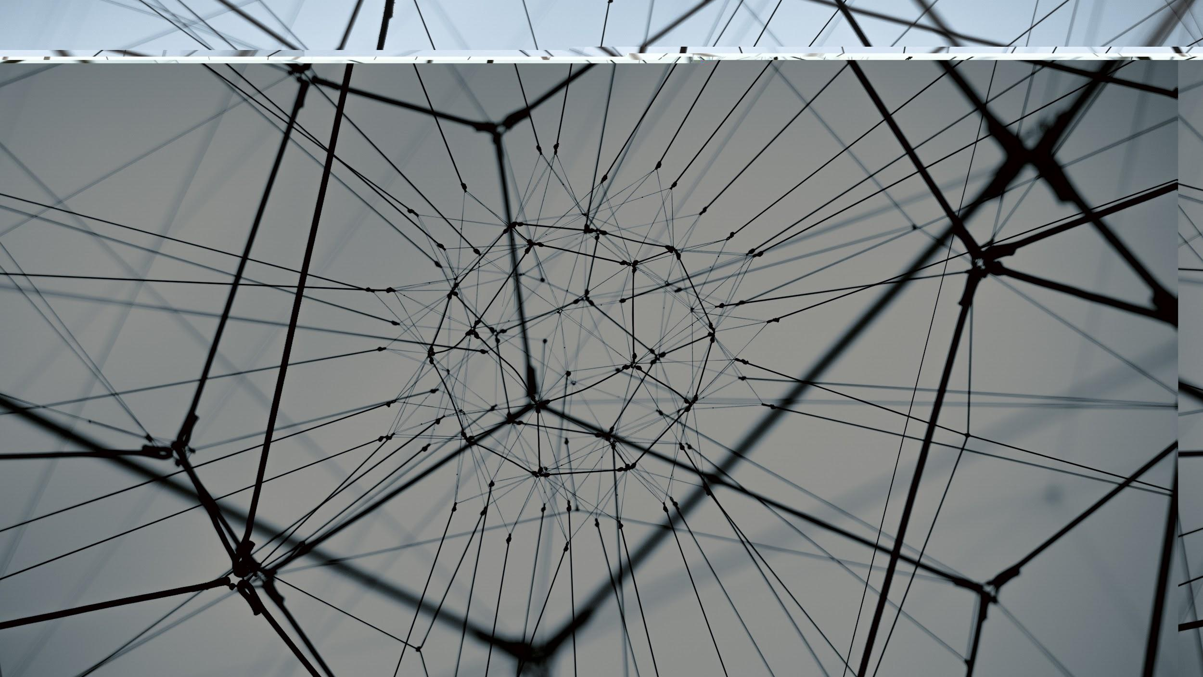
Stacey Lapp
slapp2@uwo.ca
FIMS Graduate Library
University of Western Ontario

