Slide 1
Beat the Winter Blues
Wearable Light Therapy at the Library
OLITA Tech Talks Chris Stephenson @ALibraryAtNight

Slide 2
Bancroft PL
OLITA Tech Talks Chris Stephenson @ALibraryAtNight

Slide 3
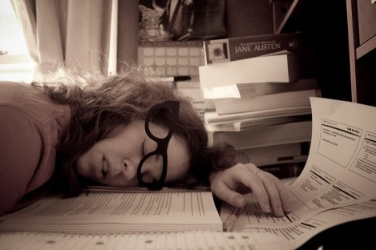
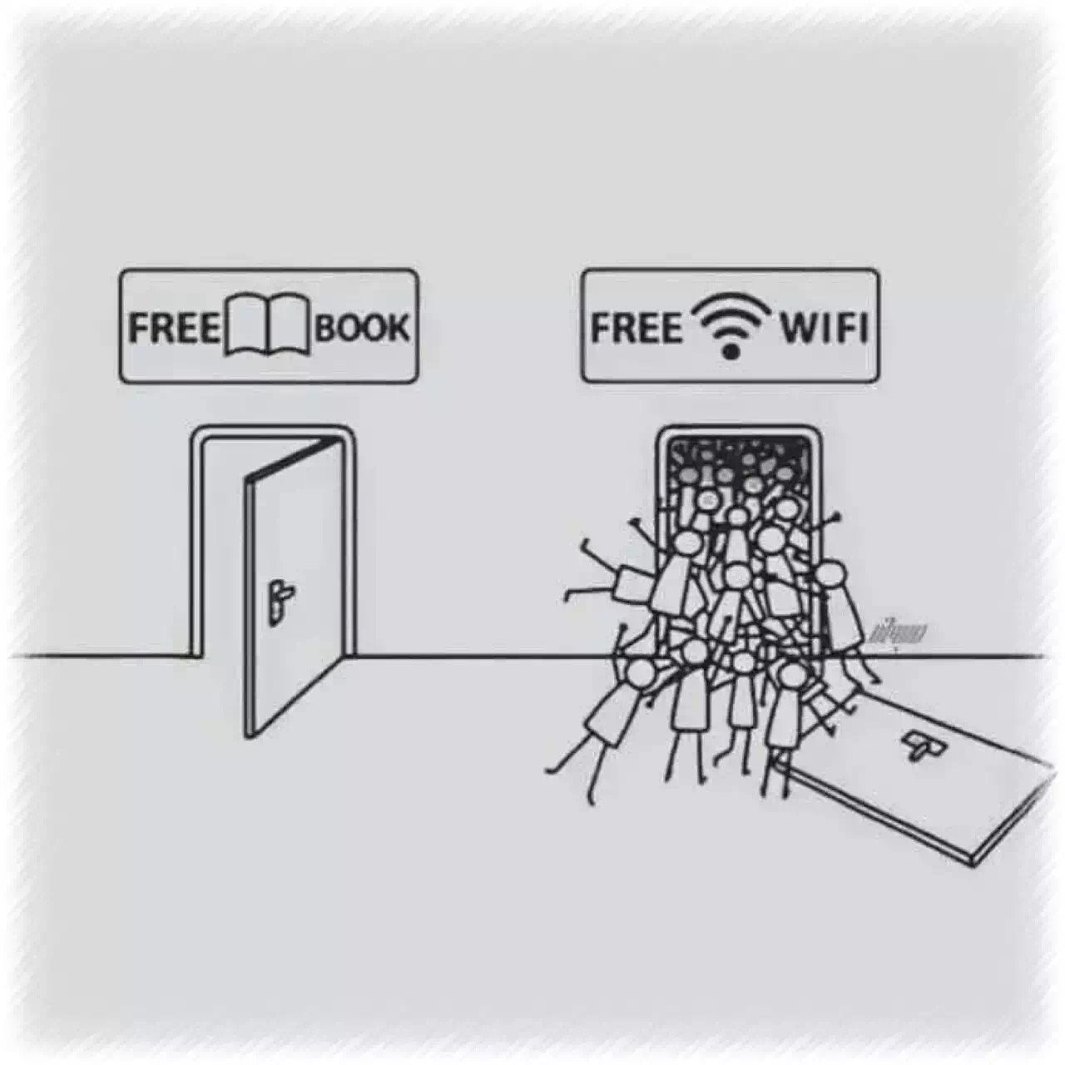
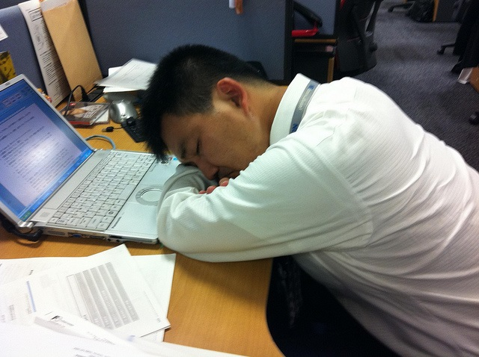
Needs Assessment
OLITA Tech Talks Chris Stephenson @ALibraryAtNight

Slide 4
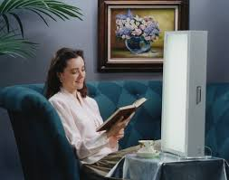
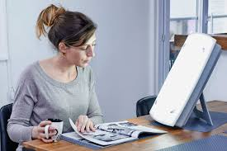
Traditional Models
OLITA Tech Talks Chris Stephenson @ALibraryAtNight

Slide 5
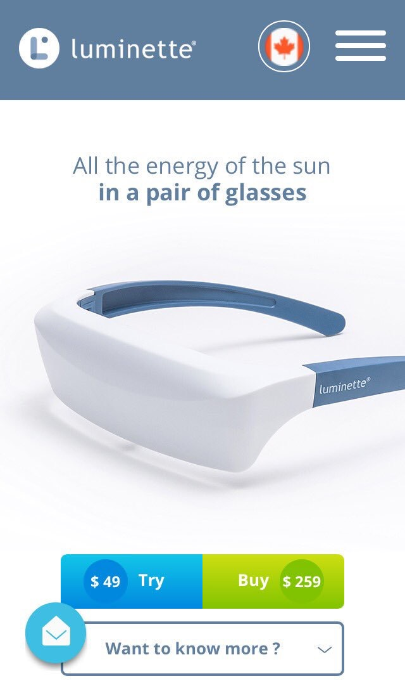
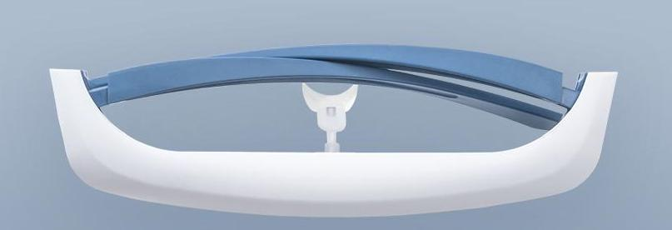

Slide 6
BEFORE AFTER

Slide 7
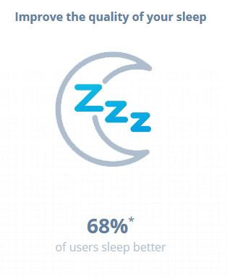
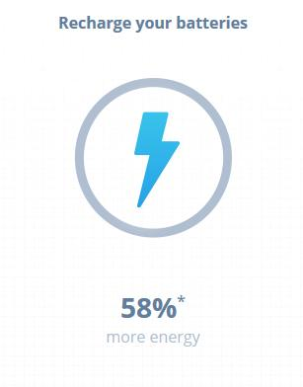
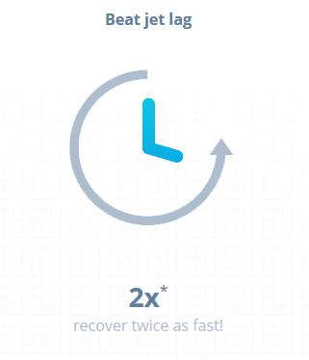
Benefits?
OLITA Tech Talks Chris Stephenson @ALibraryAtNight

Slide 8
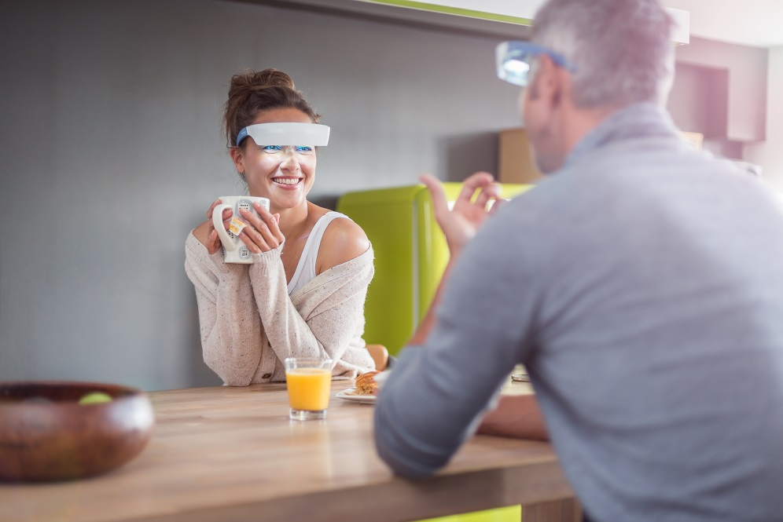
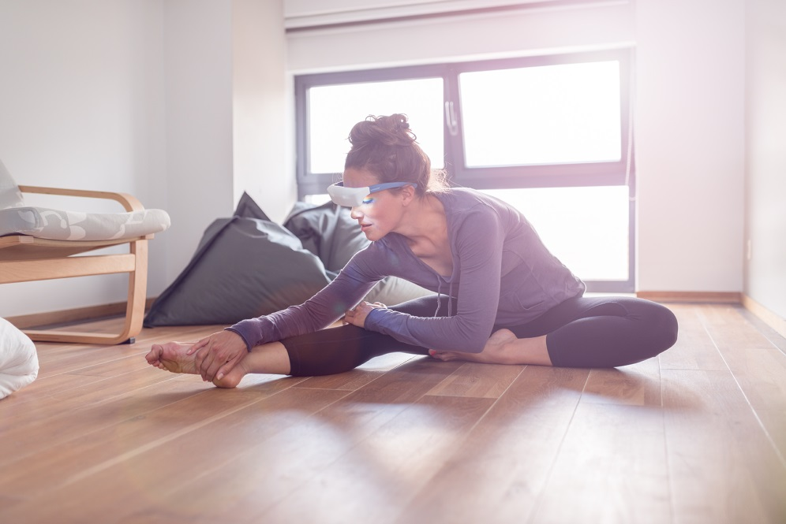
Applications
• cook
• work
• read
• light exercise
• TV

Slide 9
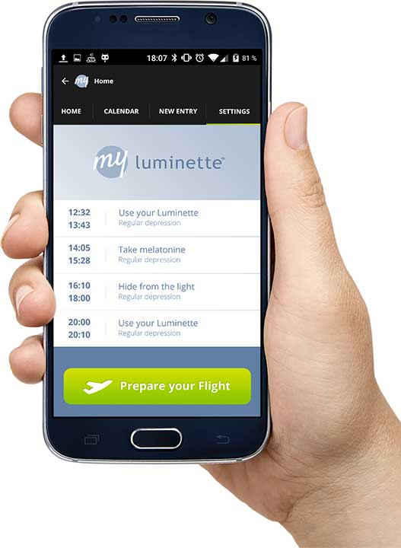
My Luminette
OLITA Tech Talks Chris Stephenson @ALibraryAtNight

Slide 10
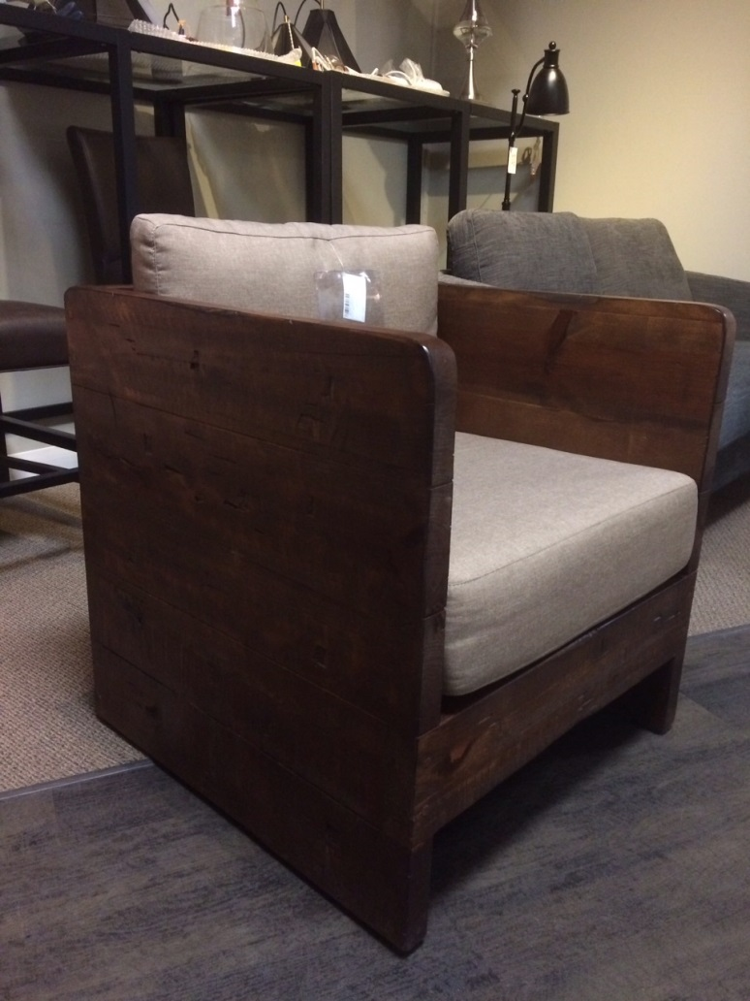
Creating a Station
OLITA Tech Talks Chris Stephenson @ALibraryAtNight

Slide 11
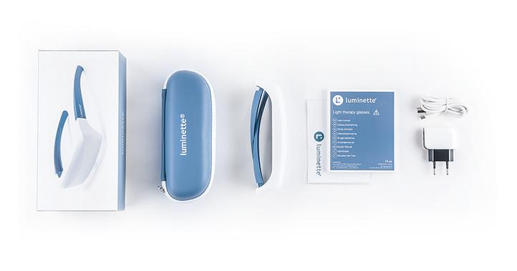
How much, Chris?
OLITA Tech Talks Chris Stephenson @ALibraryAtNight

Slide 12
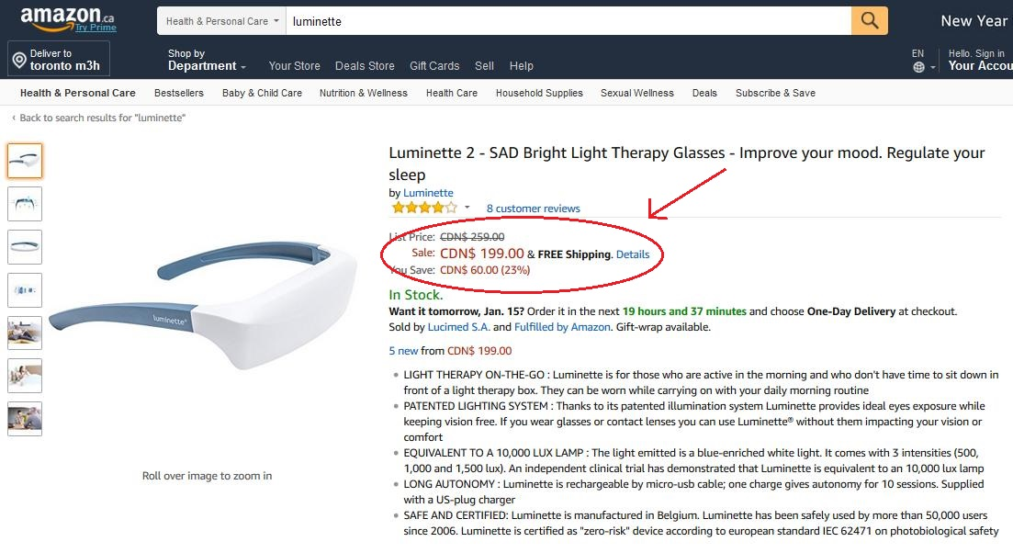
Amazing!

Slide 13
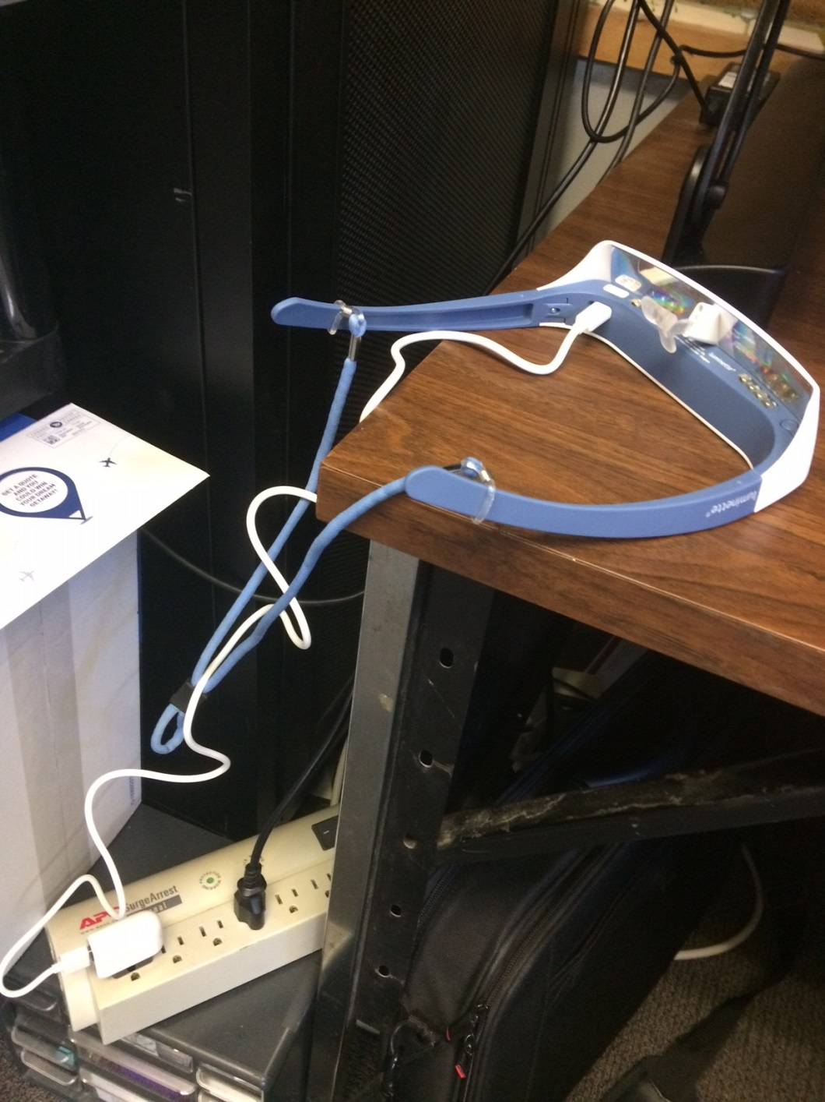
PROS & CONS
• micro-USB
• basic training
• hygiene !
• loss ?
OLITA Tech Talks Chris Stephenson @ALibraryAtNight

Slide 14
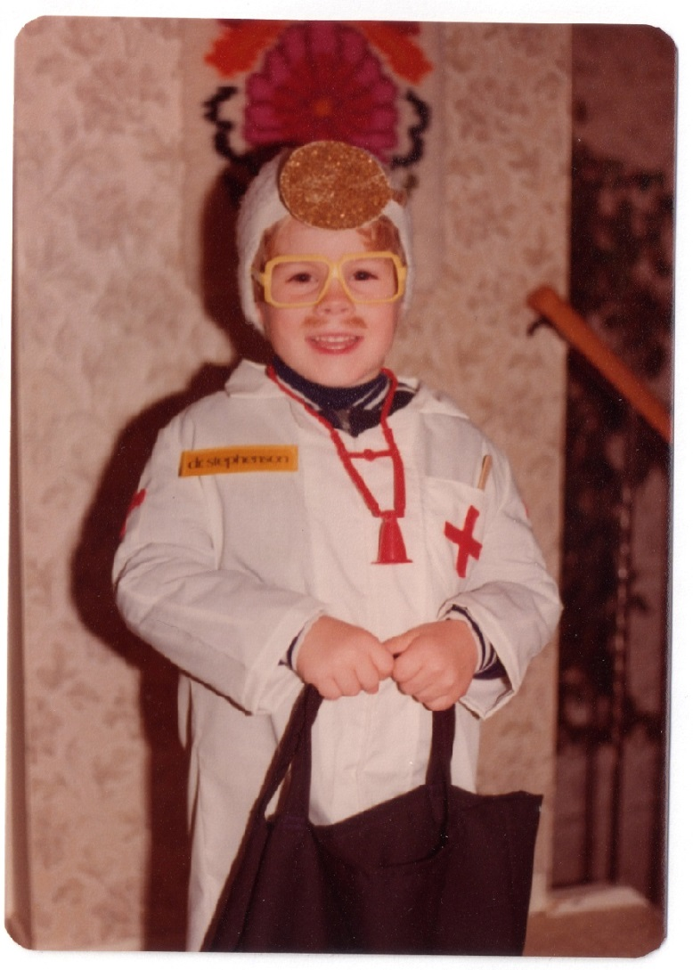
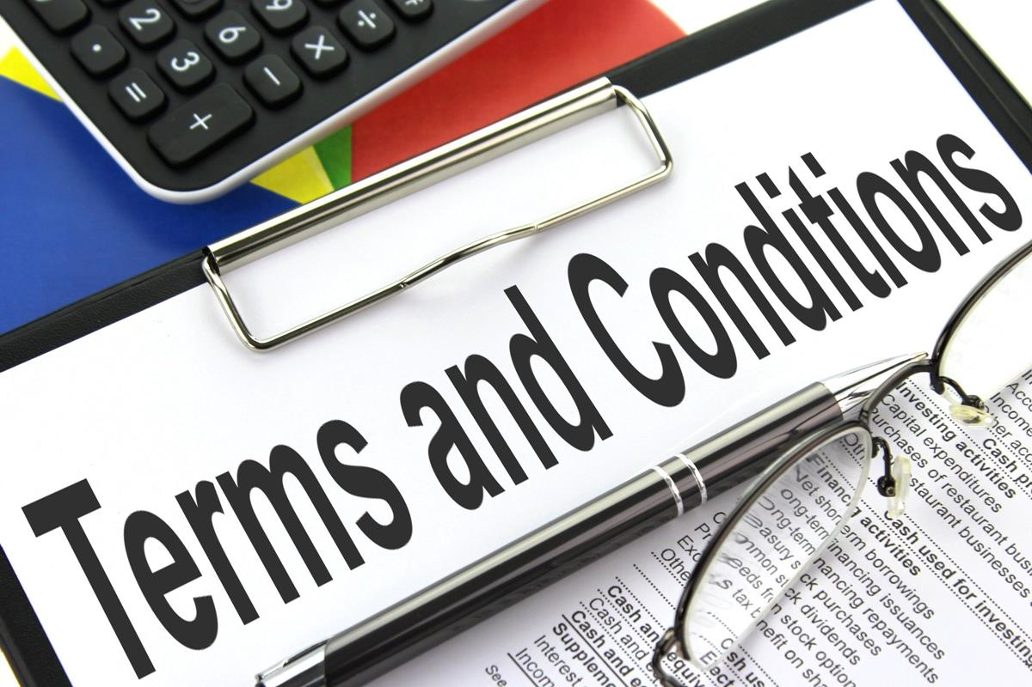
Lending Terms
OLITA Tech Talks Chris Stephenson @ALibraryAtNight

Slide 15
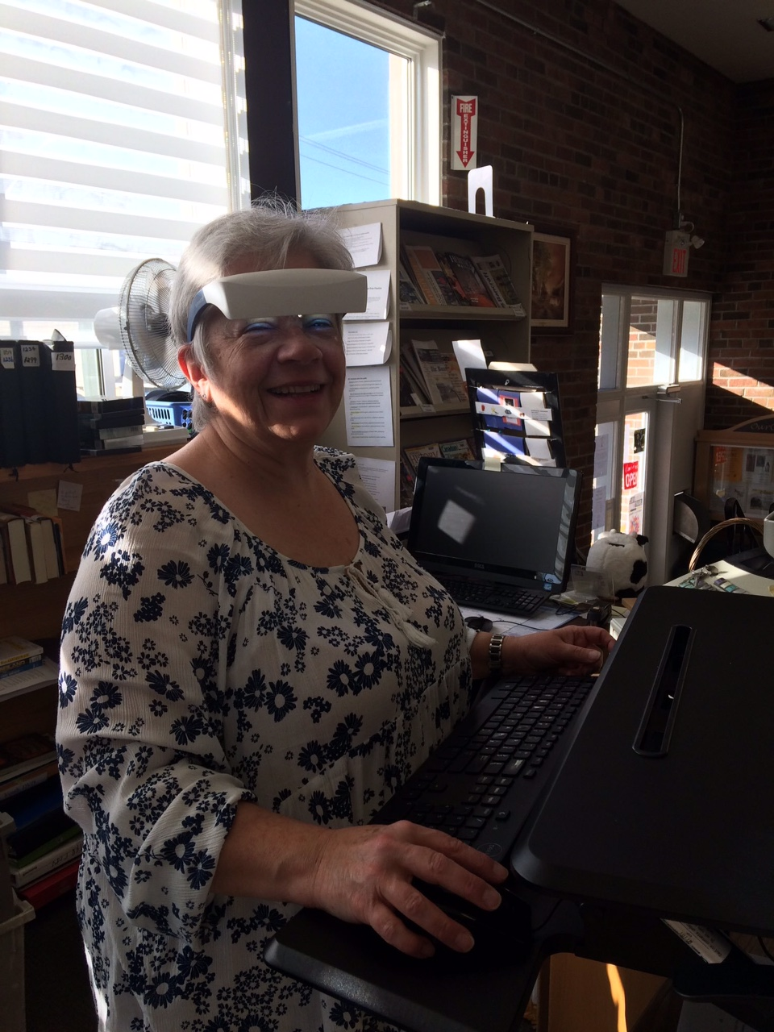
Conclusion
OLITA Tech Talks Chris Stephenson @ALibraryAtNight

Slide 16
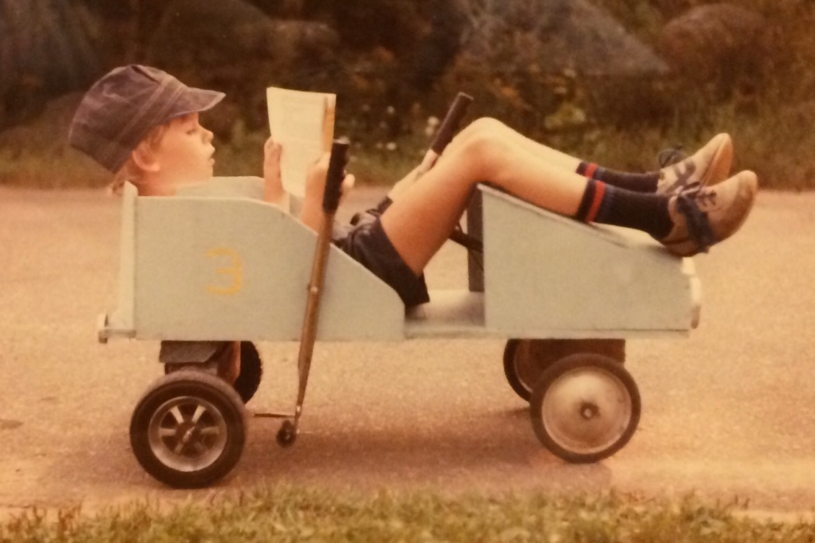
Thank you. Any questions?
Chris Stephenson,
MLIS
OLITA Tech Talks @ALibraryAtNight

Slide 17
Creative Commons & Other Credits
Exhaustion. Jessica Cross (2009) flickr
My Colleague is Very Overworked. Hiroo Yamagata (2011) flickr
Steve Bannon. The Last American Vagabond.com (2017) online blog
Terms and Conditions. Alpha Stock Images, Nick Youngson CC Images BY-SA 3.0
All Luminette icons & images from https://www.myluminette.com/en-ca
Personal photos supplied (and taken) by Chris’s mom, Anita Stephenson.

Slide 18
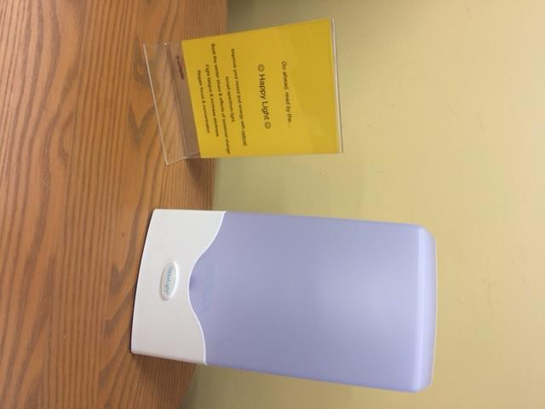
Gravenhurst PL
OLITA Tech Talks Chris Stephenson @ALibraryAtNight

