Slide 1
Pop-Up Library:
A New Approach of Community Outreach
Dijia Qin, Kat Drennan-Scace & Shelagh Irving

Slide 2
Today’s Agenda
Background information
What makes a Pop-Up better than a regular
outreach?
Components of a Pop-Up Event
Success of the Pop-Up program management
Pop-up event examples and tips

Slide 3
Background Information
Hamilton Population (2016 Census data):537,000
22 Branches + 2 Bookmobiles
2017 HPL Circulation: 6.6 Millions
Active HPL Card Holders: 159,345
New Cards in 2017: 21,981

Slide 4
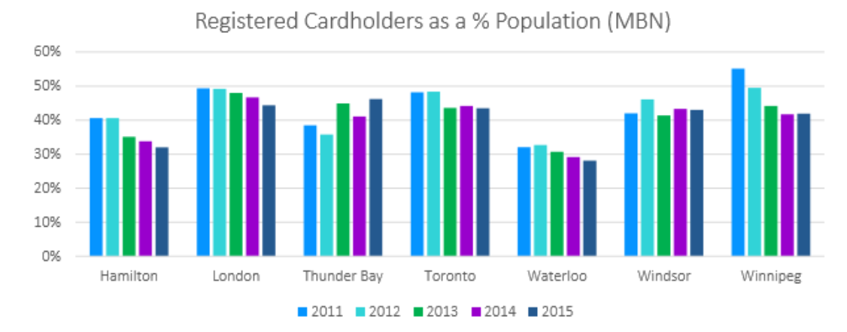
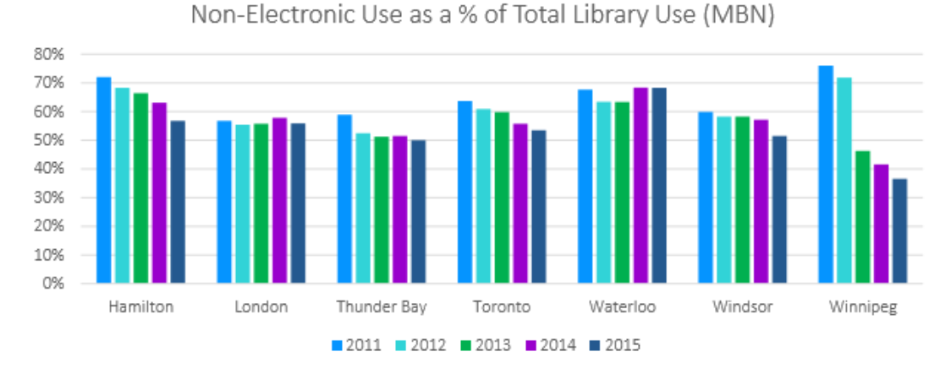

Slide 5
Library is Transforming
HPL offered 8650 programs in 2016
16 branches equipped with Maker Space
High speed internet, WiFi, and lots of public computers
75 items check out, 75 holds, 5 renewals
Expanded e-collections (Overdrive, RB digital, Hoopla,
Lynda.com…)

Slide 6
Expected Outcomes for Outreach
Increase usage & awareness of the Library’s collections,
programs and services
Increase awareness of the Library’s Maker Space
Increase the library user base
Engage and interact with others in the community
Enhance brand awareness
Proactively respond to seasonal promotional demands

Slide 7
What is a Pop-Up Library
It is when the library temporarily activates places and spaces for promotion, trials, or the sharing of resources. The characters of a Pop-Up event are expected to be spontaneous, vibrant, innovative and unexpected.

Slide 8
How to Run a Better Outreach Event?
Staff asked:
Grab & go lightweight package
Library swag
Make library cards
On the spot check out
We offered more:
Branded signage
System coordination
Devices to support the Pop-Up

Slide 9


What’s New
Branded Event

Slide 10
What’s New
Theme-based Pop-Up Events
Core package
Innovative library
Summer fun
Reading on the go
March break at your library
Welcome, Student!

Slide 11
What’s New
System Wide Coordination
City of Hamilton
Suggested Branch
Size of event
City Division
Event Location
Occurrence
Demographic
Notes:
When researching possible locations for the Pop-Up to go we looked into community events & locations and compiled an excel document.
We categorized the list by the City Division (ie. Hamilton East, West, Downtown, Ancaster, Dundas, Stoney Creek, Flamorough, Hamilton Mountain East & West)
From there compiled a list of:
Event locations with the address
Suggested Branch to be involved or to conduct the pop-up
Size of event (this would help determine what to bring with you as well as staffing)
Occurrence (If talking about an event– ArtCrawl – occurs the 2nd Friday of the month, could this be a repeat event?)
This list helped us get started on places to go and events to attend but the Pop-Up can really go anywhere!

Slide 12
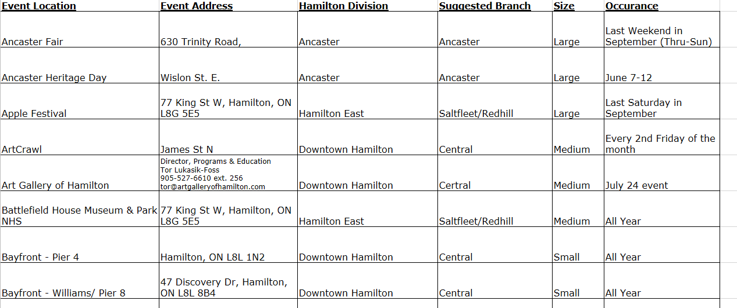
System Wide Coordination

Slide 13
System Wide Coordination
Pop-Up Liaison - Like a booking agent
How are they getting the kit?
Which components do they need?
Do they need to book a button maker or tent?
How did it go?
Did they enter stats?

Slide 14
Event Information
Name of event
Location
Pop-Up Material
Event Theme
Follow-Up
Check List Details
Setting– indoor/outdoor
Date and Time
Number of Swags
MiFi
Team Liaison
Pick-up Date
Head Count
Event Stats
Pop-Up Package Reservation

Slide 15
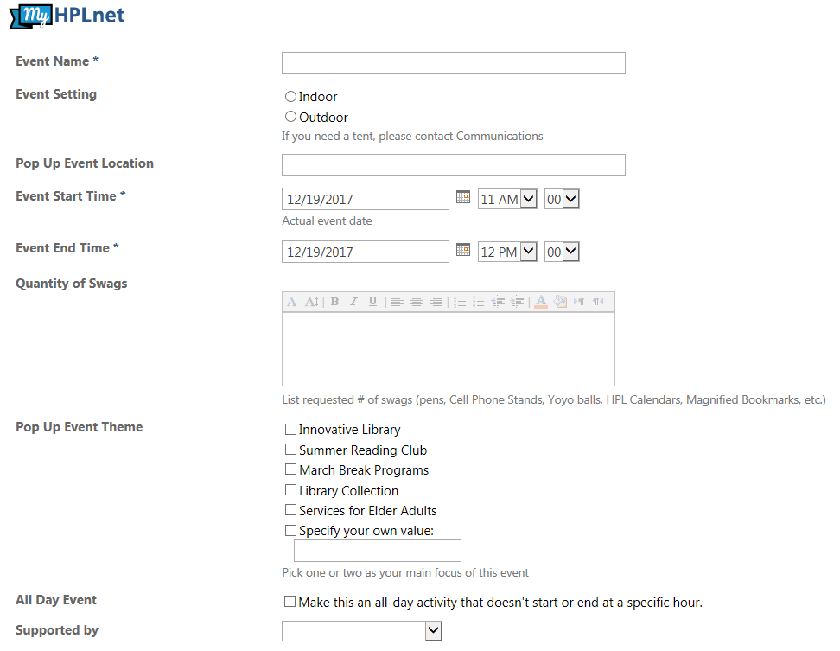
Online Reservation

Slide 16
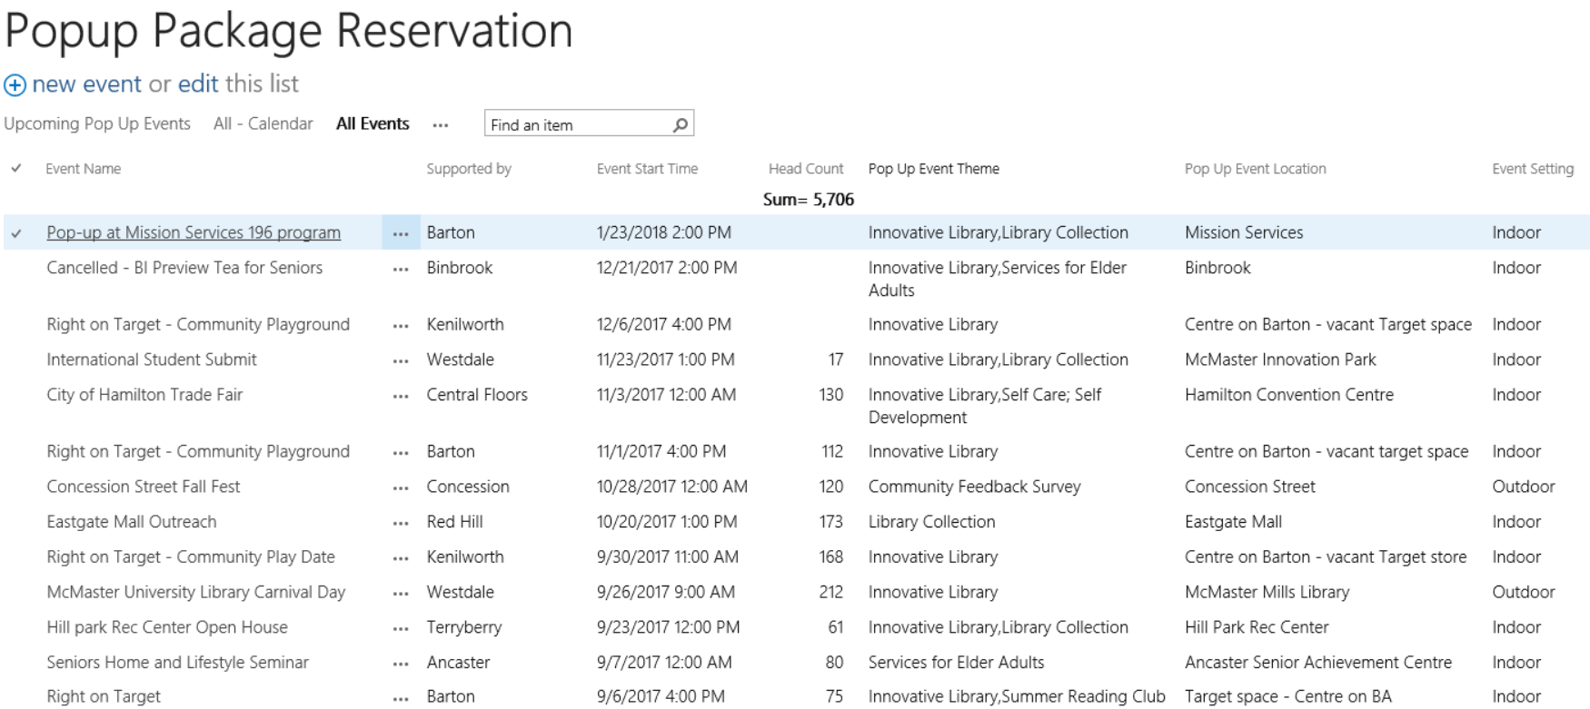
Online Reservation

Slide 17
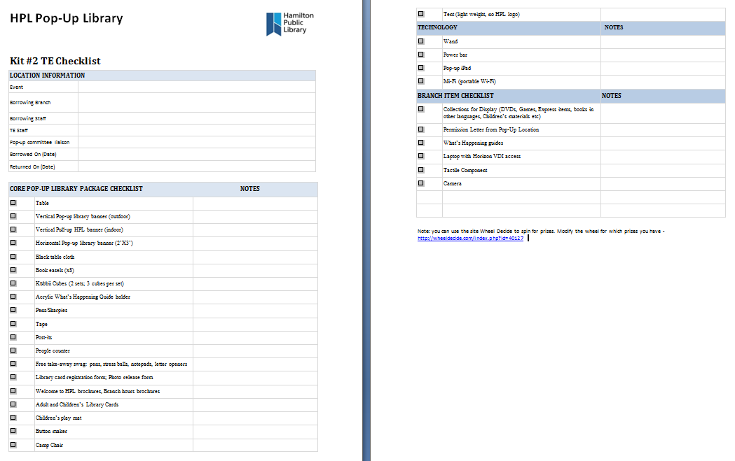
Event Checklist
Notes:
Change to new list

Slide 18
Pop-Up Booking Process
Think of the Pop-Up Event
Arrange staffing
Get insurance
Book Pop-Up Online
Fill out details
Fill out check-list together
Arrange for pick-up
Pick Up Pop-Up
Connect with Liaison
Make sure all components are ready
Add branch components if needed
Do Pop-Up
Keep track of stats to enter later
Have fun!
Return Pop-Up
Return kit to hub or pass it on to next branch
Enter in stats from outreach

Slide 19
Components of a Pop-Up
Think…
lightweight
portable
practical
flexible
branding
fun!
Notes:
When thinking of the pop-up components, here are some things to keep in mind.
We didn’t want the pop-up kit to be too cumbersome to carry around and needed to make sure it could fit in a vehicle easily.

Slide 20
Budget
2016 – $3600
1st Pop Up kit
Outdoor banners (3)
Kubbii cubes (3 sets)
Swag
2017 - $4000
2nd Pop Up Kit
2 iPads
Button maker
A Tent
Mifi
Swag
Notes:
When thinking of the pop-up components, here are some things to keep in mind.
We didn’t want the pop-up kit to be too cumbersome to carry around and needed to make sure it could fit in a vehicle easily.

Slide 21
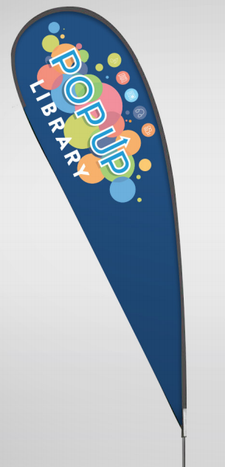
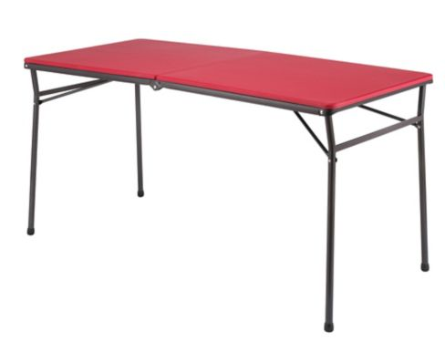
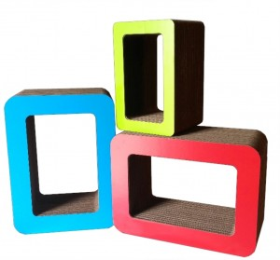
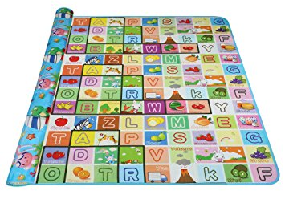

Components of a Pop-Up!

Slide 22
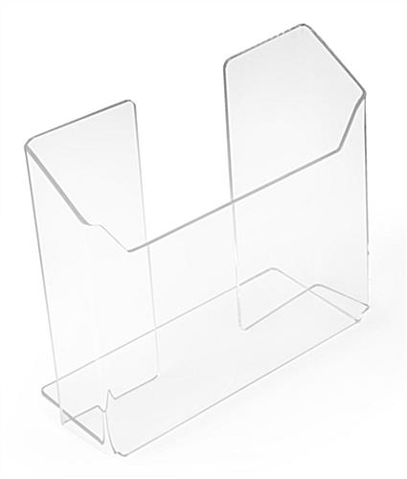

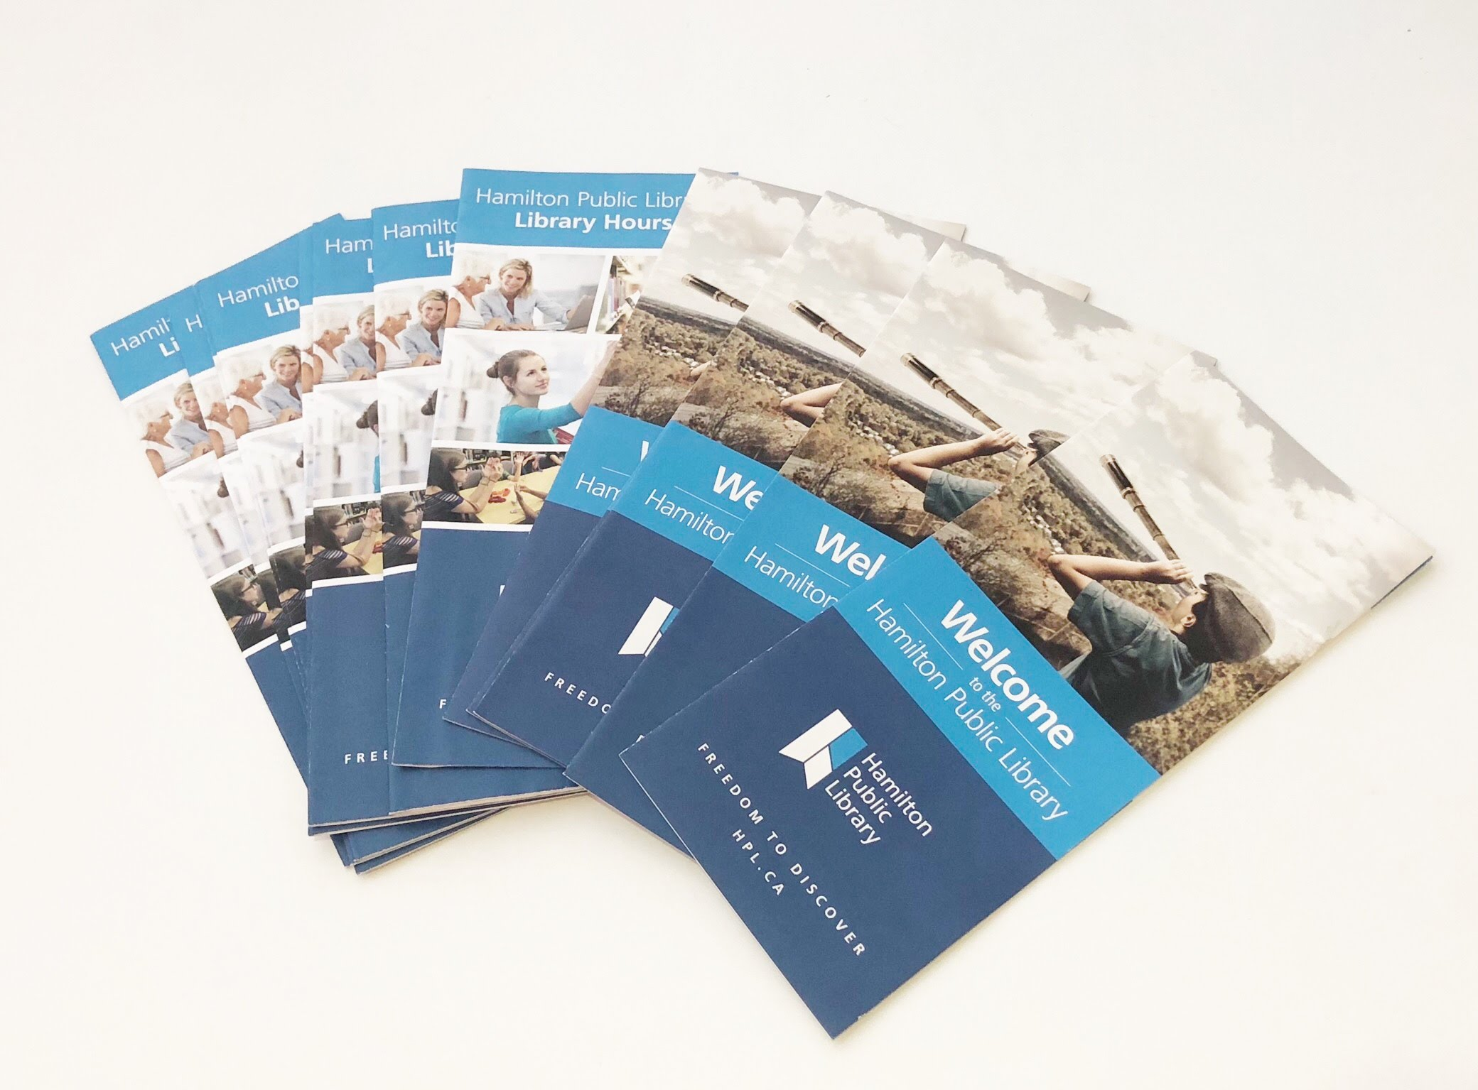
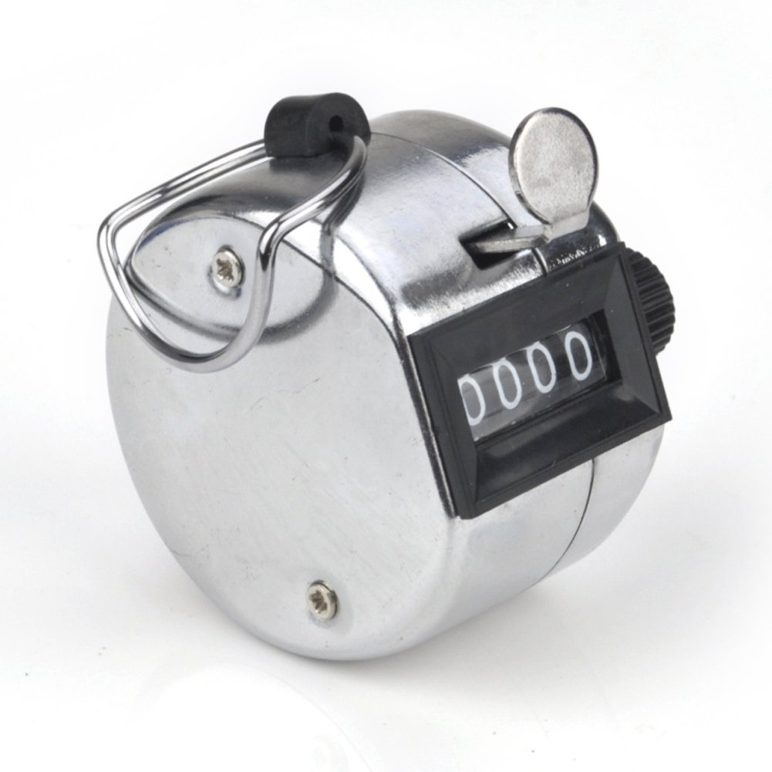
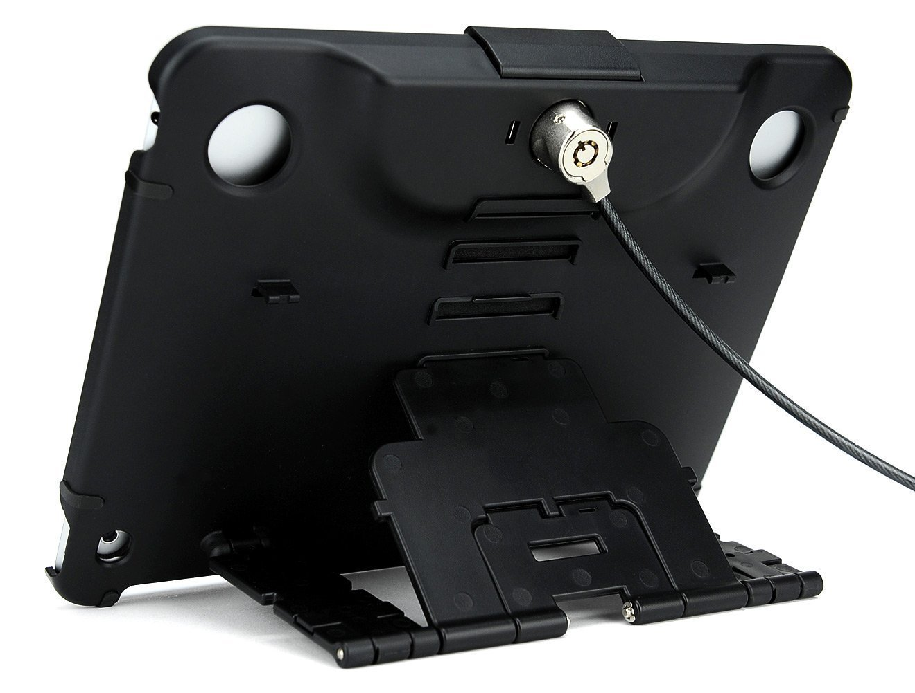
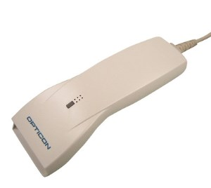
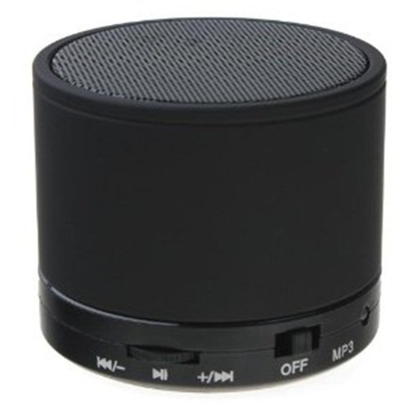
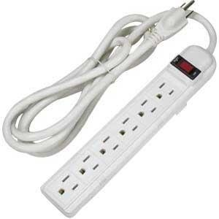
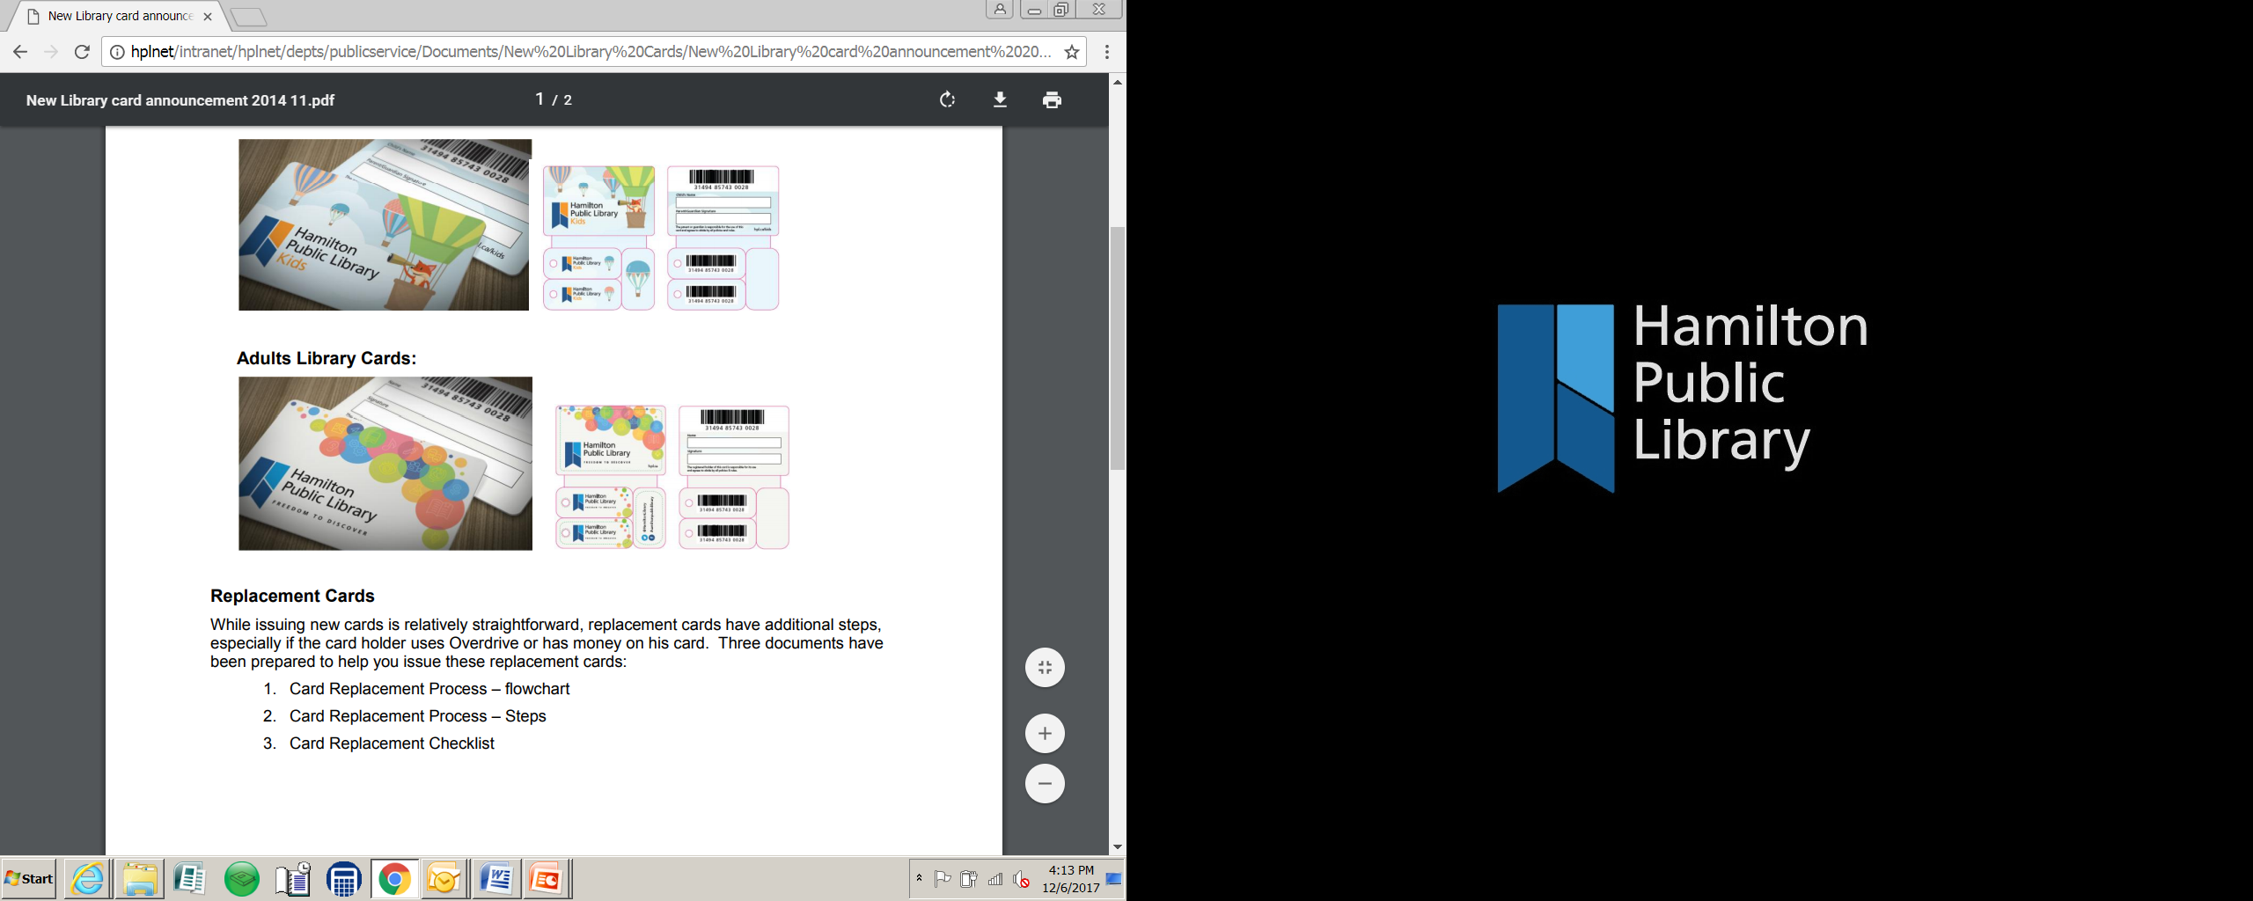
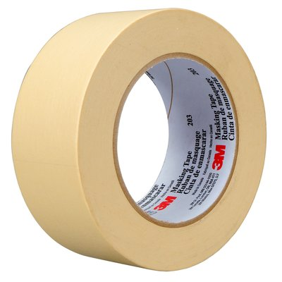

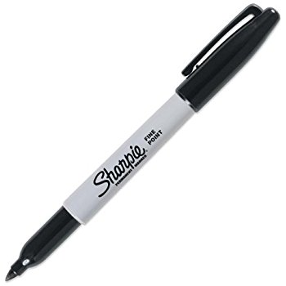
Components of a Pop-Up!

Slide 23
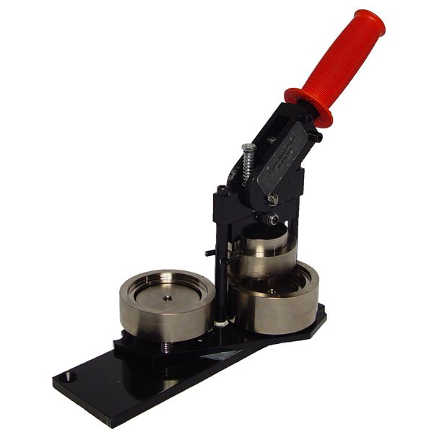

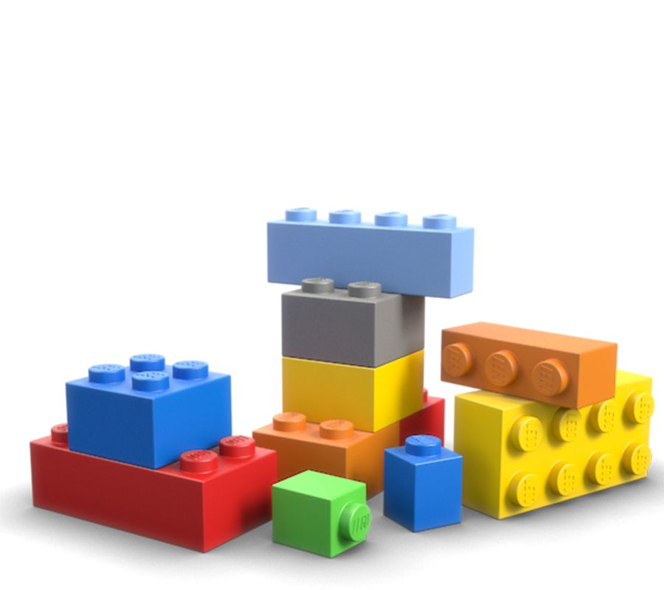
An Element of Fun!

Slide 24
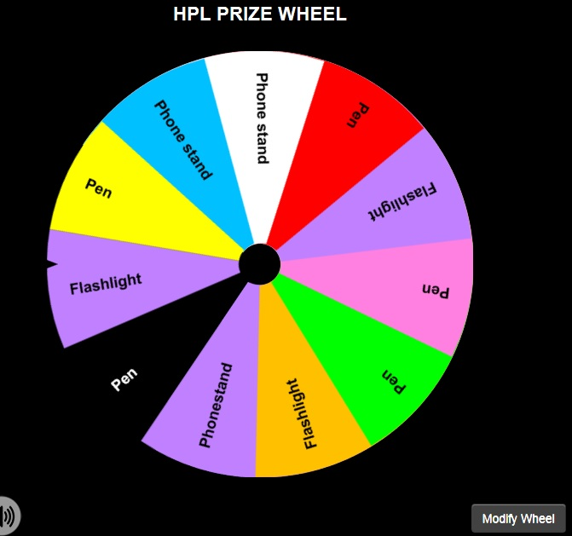
An Element of Fun!
Notes:
Prize Wheel Picture

Slide 25
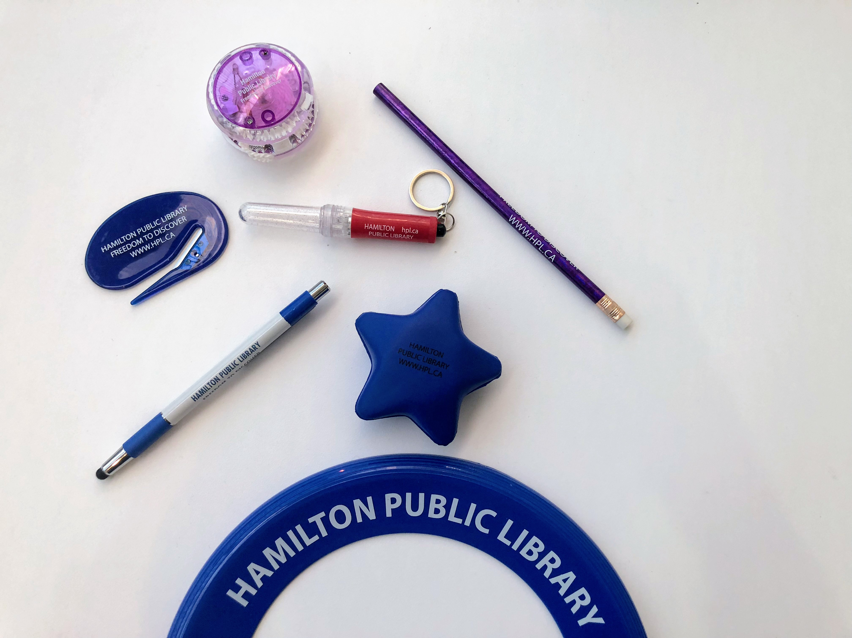
Swag

Slide 26

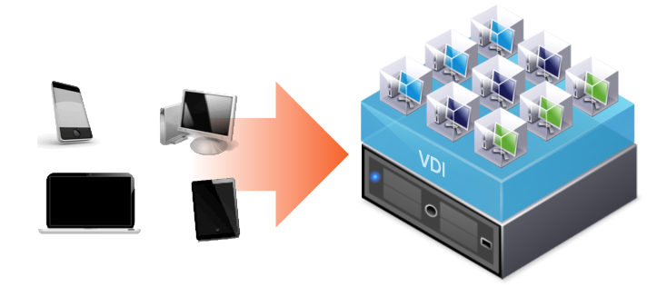
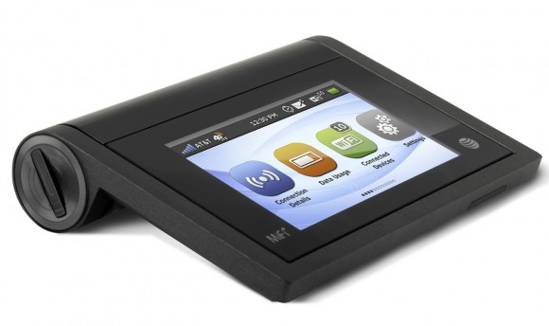
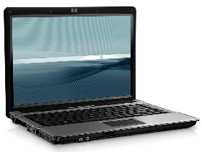
Technical Components
Notes:
Desktop (operating system, applications etc.) is
a virtual machine that lives on a server in the datacenter – accessed from any end point.
An up-to-date platform – Windows 7, Internet Explorer, Firefox
Timely software updates
Addition of Office for all computers (Word, Excel, PowerPoint)
Improved security and user privacy
Better response times for application loading
Improve media / video experience

Slide 27
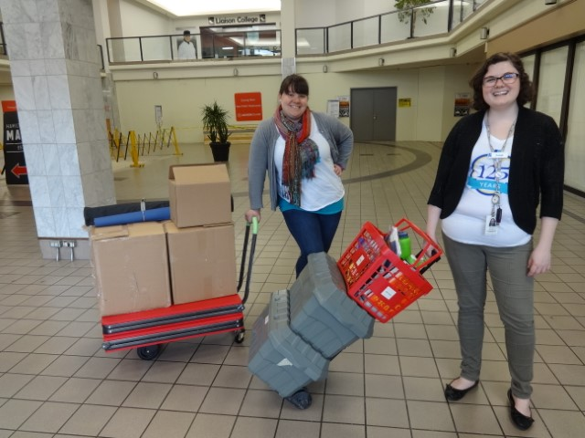
Pop-Up in Action

Slide 28
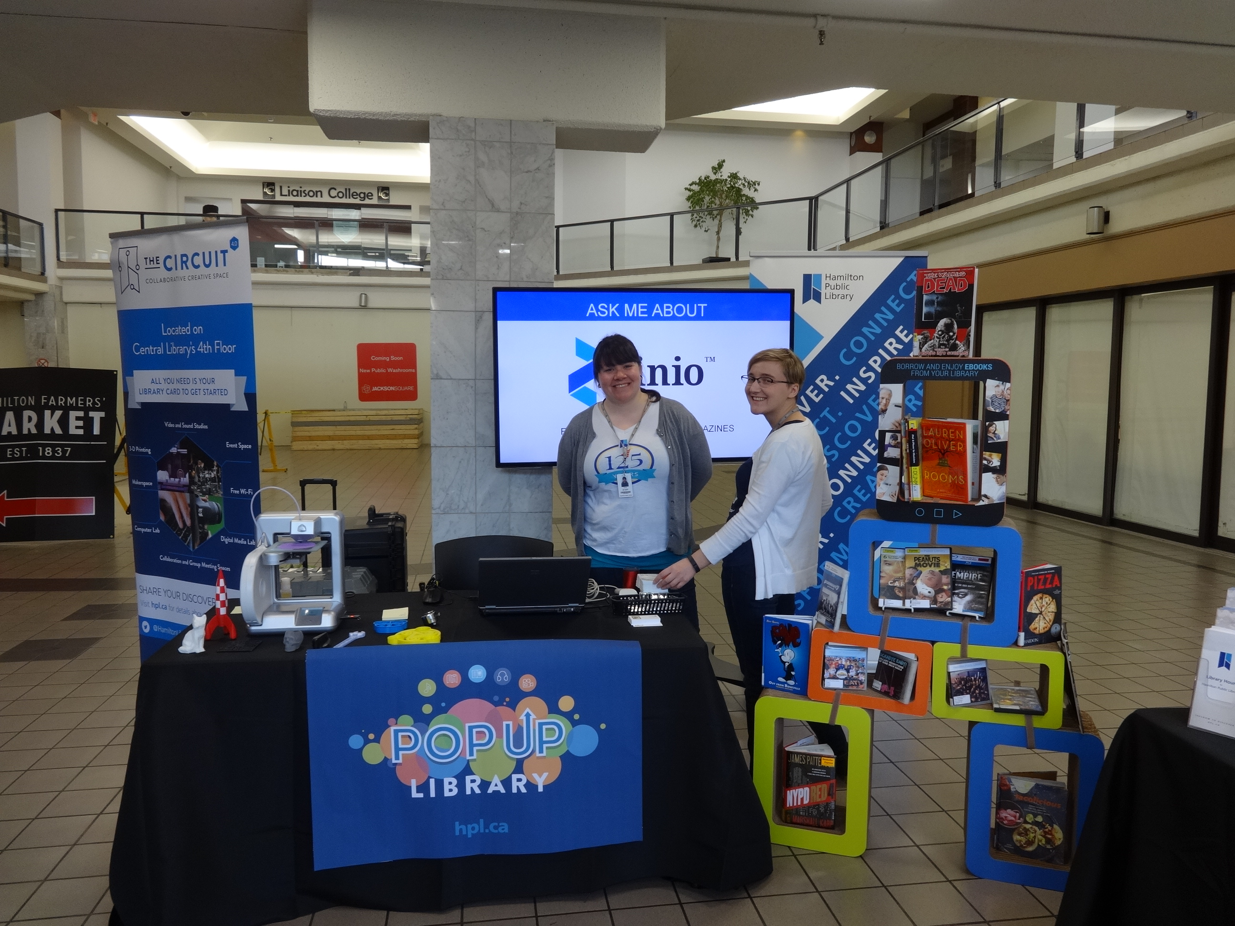
Pop-Up in Action

Slide 29
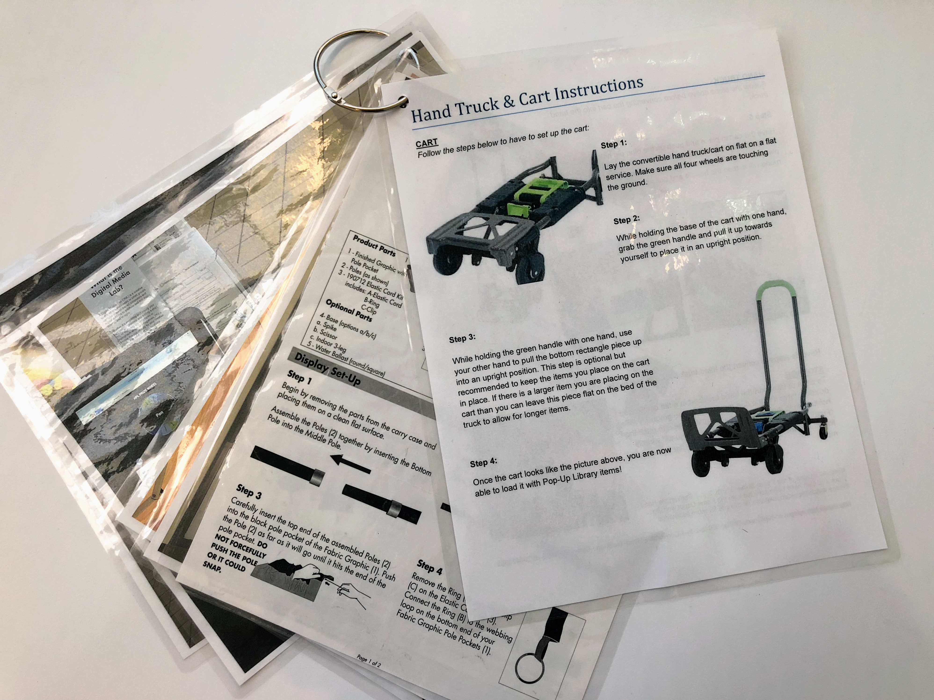
Help Putting it All Together

Slide 30
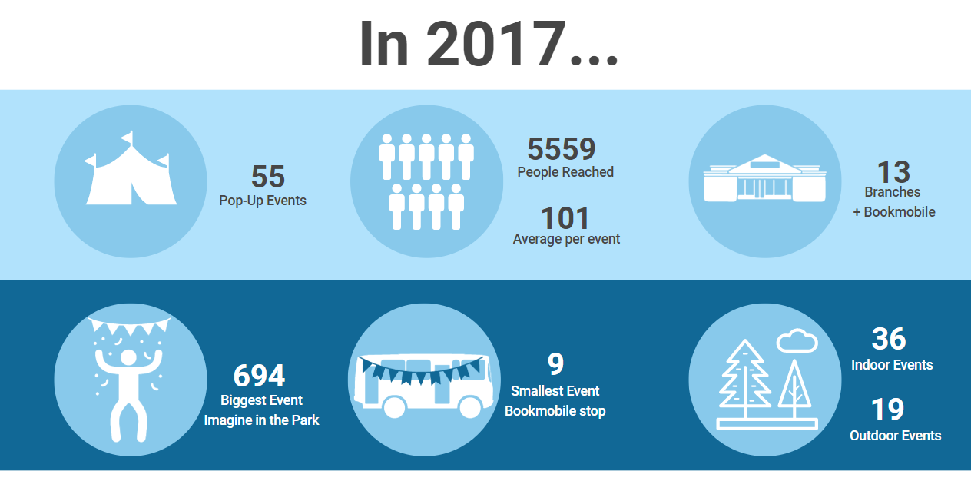

Slide 31
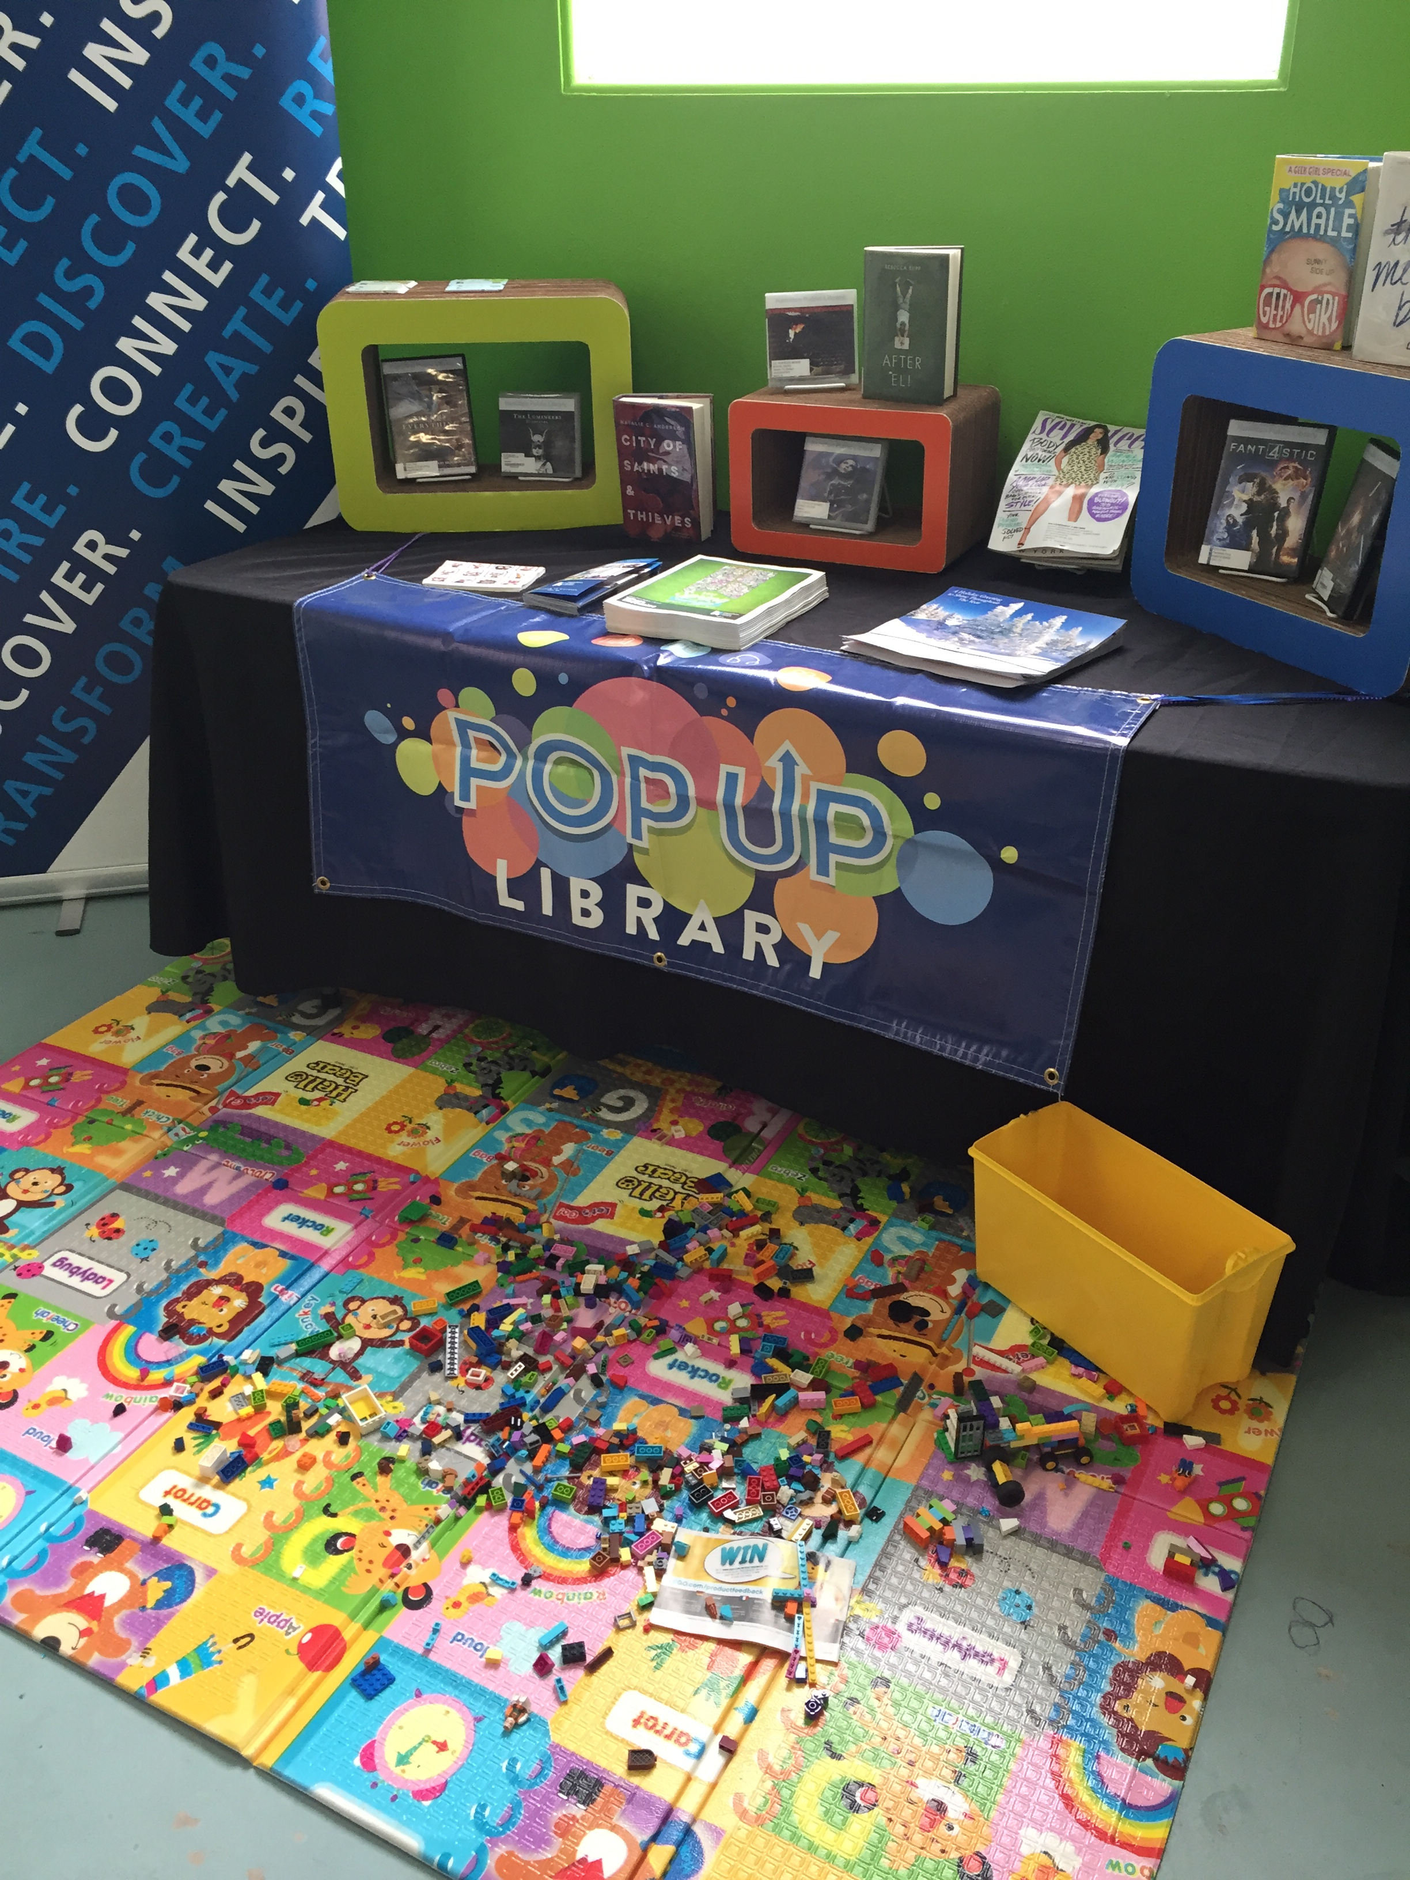
Other Successes
Different locations
Developing partnerships
Staff engagement &
empowerment
Professional kit and material

Slide 32
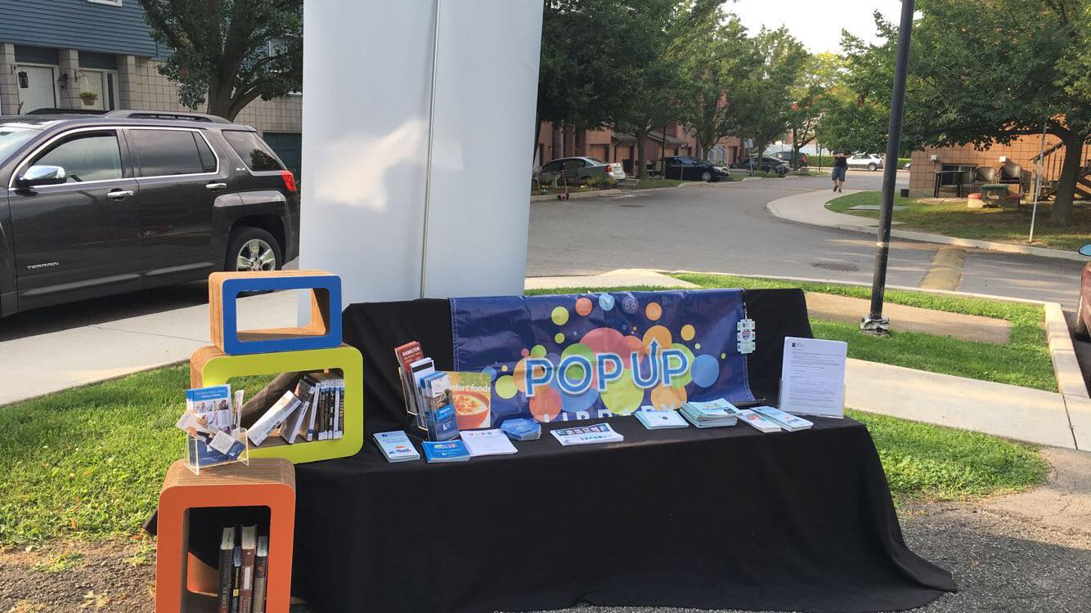
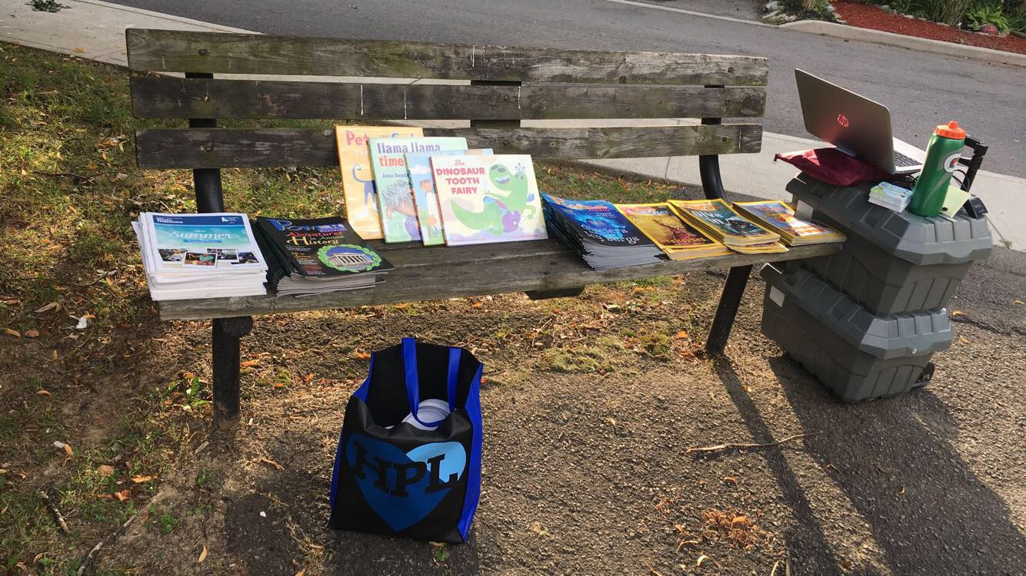
Pop-Up Example
Lessons Learned
Be flexible and adaptable
Check the kit before event
Bring a variety of library material
Staffing
Label everything
Be ready for anything!
Notes:
Weather – windy / tent
Staffing – 1 person vs 2 (cover breaks/ assist with the # of people)
Highlight the theme or special collection

Slide 33
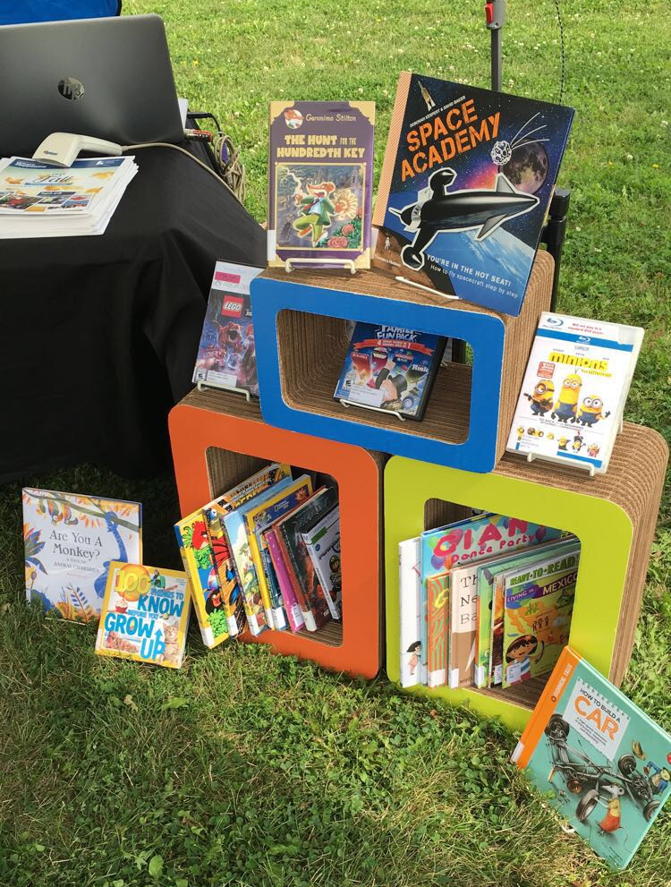
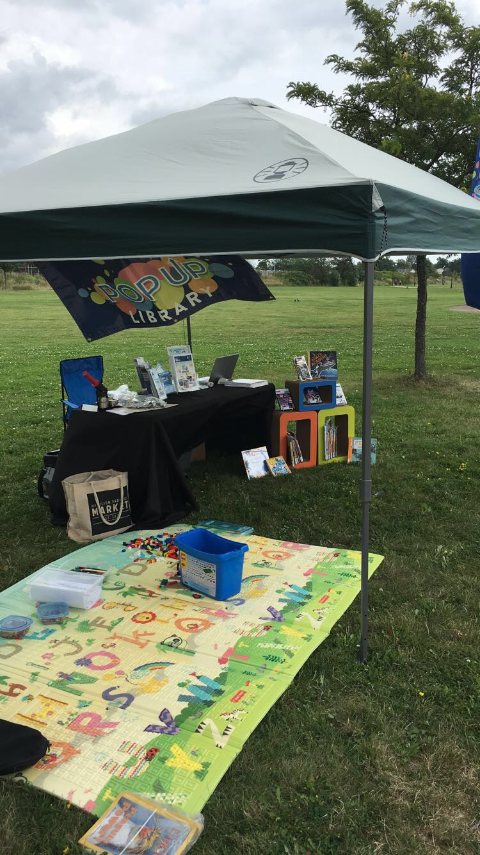
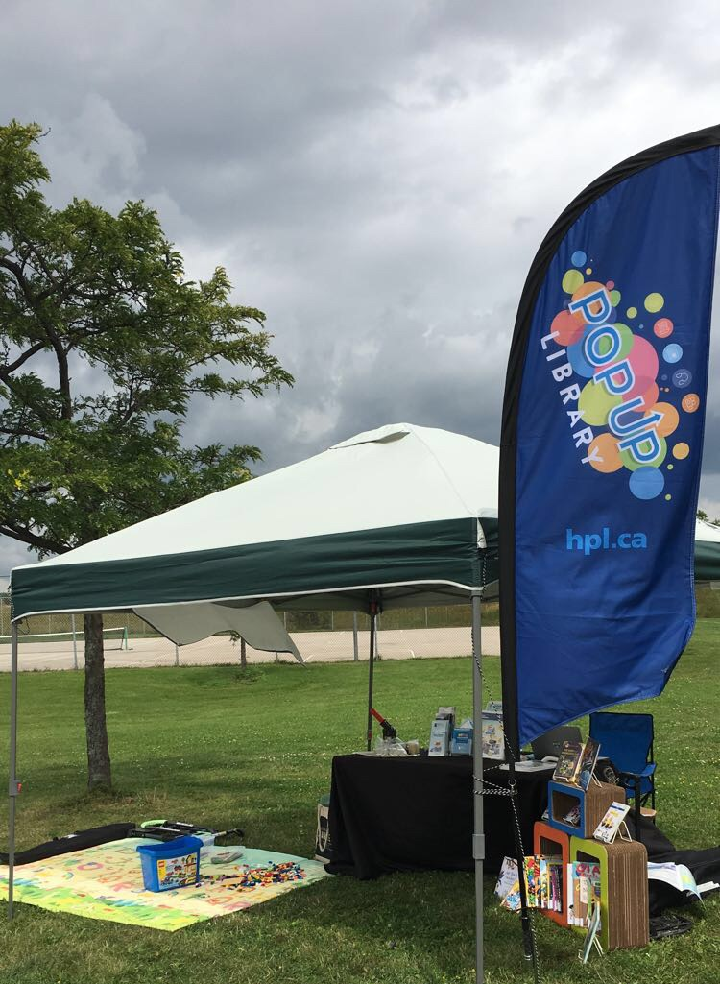
Pop-Up Example

Slide 34
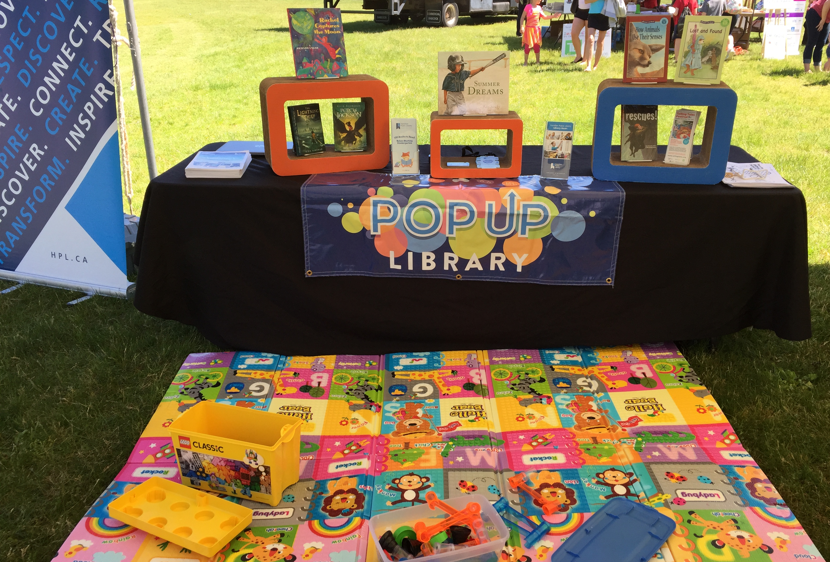
Pop-Up Example

Slide 35
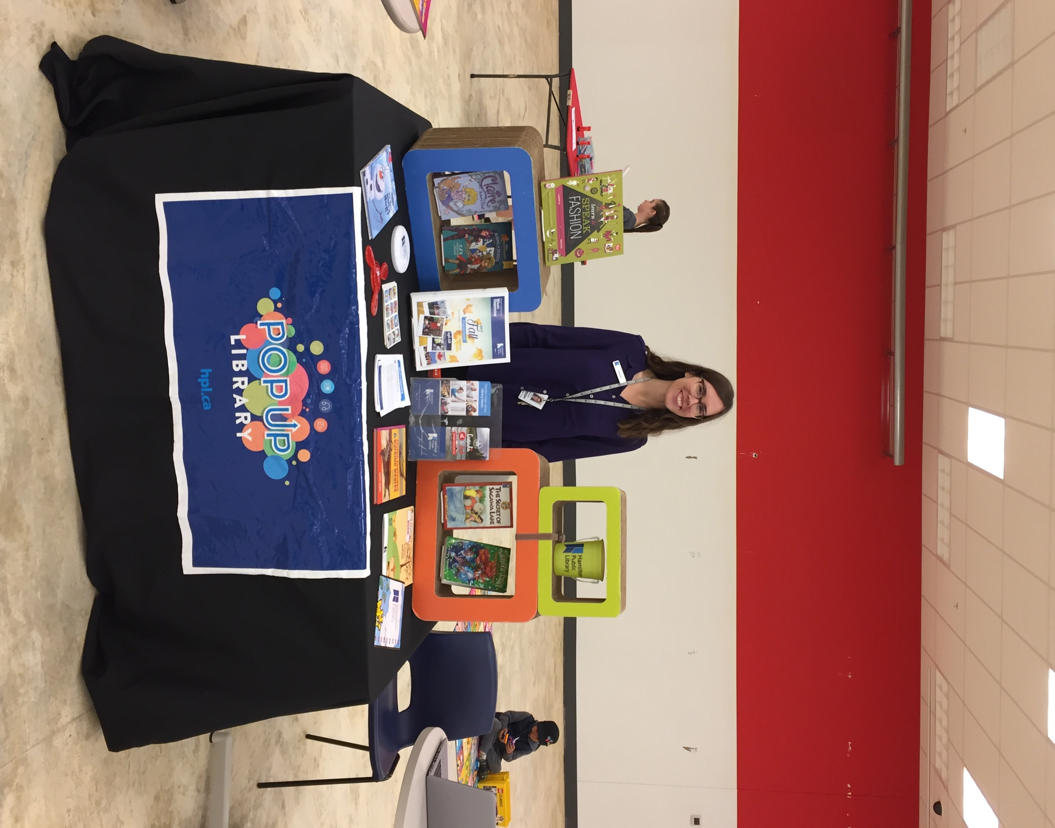
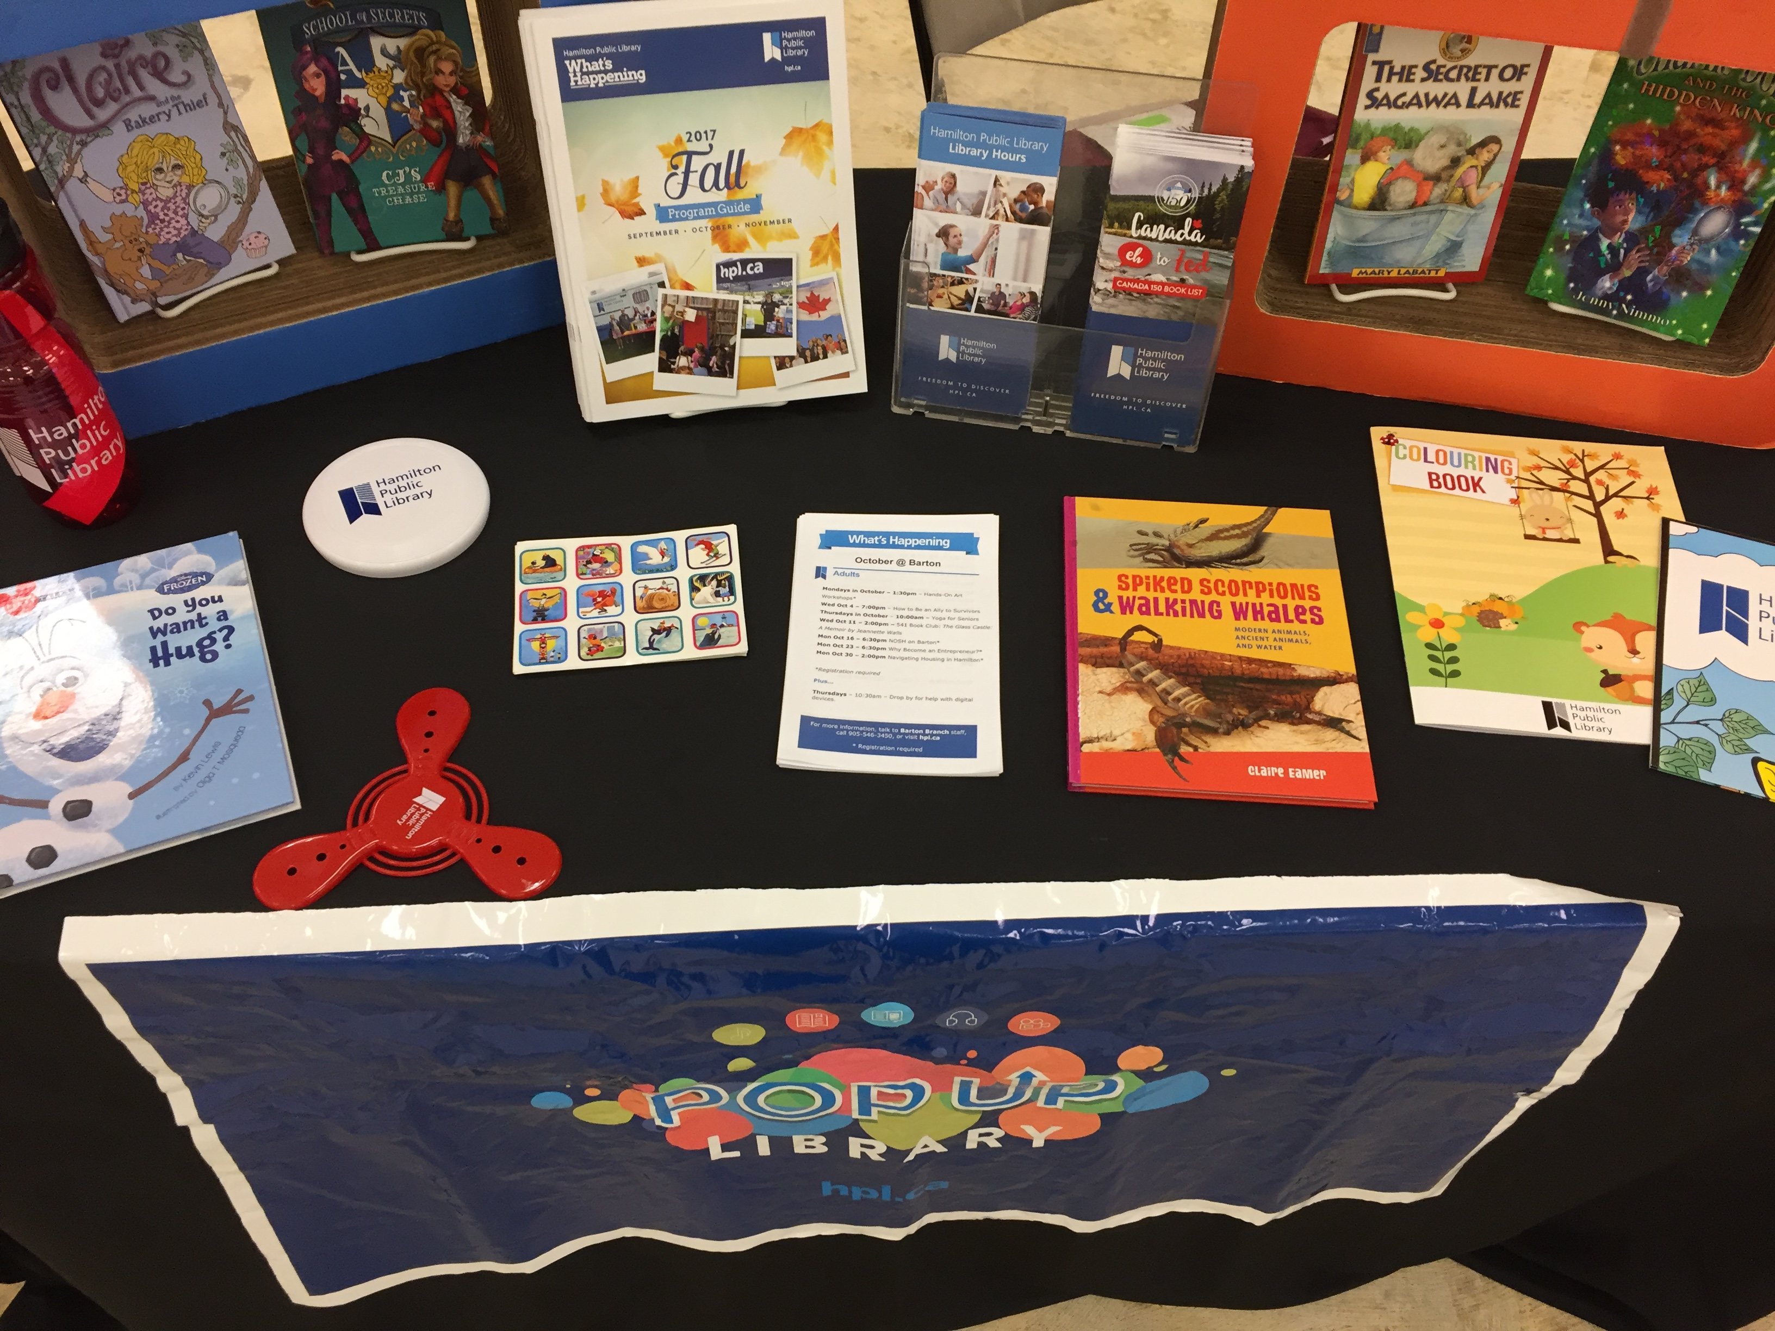
Pop-Up Example

Slide 36
Oh the Places You’ll Go!
Business Expo
City Management Meeting
Farmers Market
Art Gallery
Community BBQ
Police in the Park (and other festivals)
Universities
Maker Fair
Missions Services (shelters, community housing)

Slide 37

Thank You!

