Slide 1
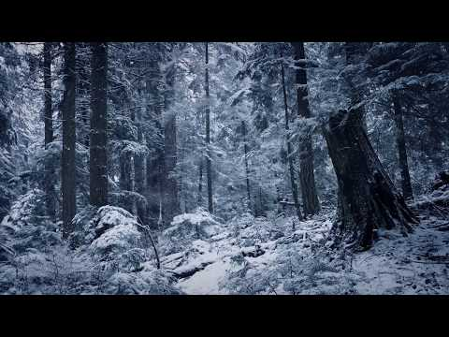

Slide 2
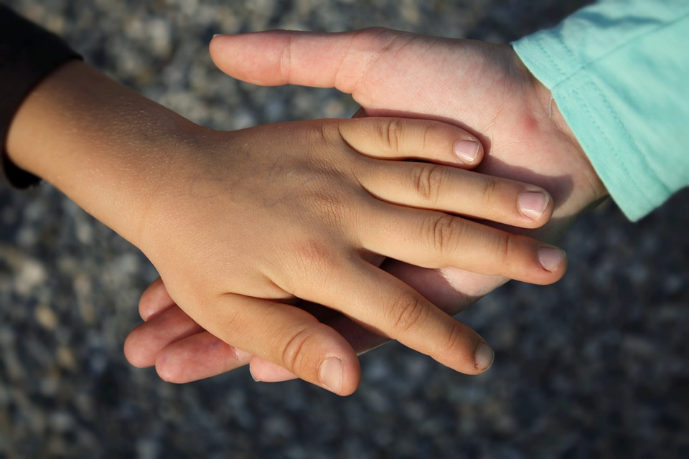
TRANSFORMATIVE PERSPECTIVES
Connecting Students to Current Indigenous Issues Through Literacy

Slide 3
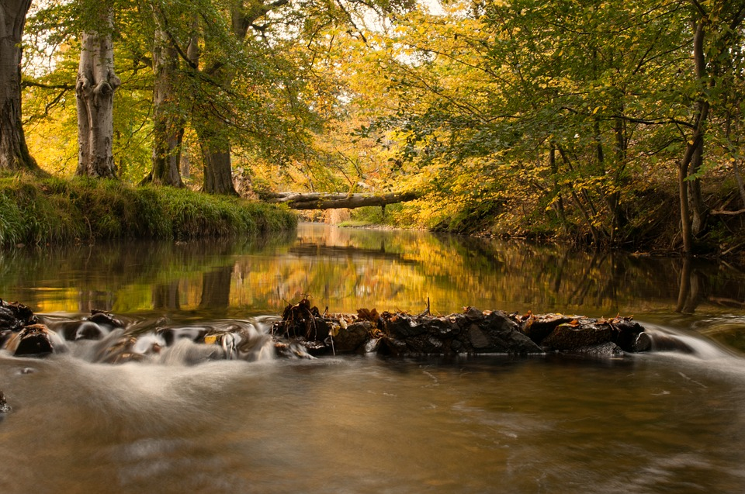
Land Acknowledgement
Notes:
Importance of acknowledgement and placing oneself, talk about our place in the creation.

Slide 4


Troy Maracle @TroyMaracle
Indigenous Education Lead
HPEDSB
Andrea Kerr @andCreative
Learning Support Coordinator, Teacher-Librarian
HPEDSB

Slide 5
Who’s in the room?
Notes:
Librarians Elementary Teachers Secondary Teachers Community Partners
People introduce themselves to their neighbour - it’s a part of being in relation with one another.

Slide 6
Terminology
Indian?
Native?
Aboriginal?
First Nation? Metis? Inuit?
Indigenous
Notes:
Even though most may know this piece, I always start with a brief conversation around terminology.
It’s NOT about being politically correct - it’s about being accurate. It’s the truth and the reasoning behind each one. Let’s not forget who placed these labels.

Slide 7
Reconciliation Is
A dictionary definition:
“The reestablishment of a broken relationship, or forging positive accord where there was discord.”
According to Reconciliation Canada:
“Based on the idea of restoring friendship and harmony – about resolving differences, accepting the past and working together to build a better future.”
“Reconciliation is not an Aboriginal problem. It is a Canadian problem. It involves all of us.”
Justice Murray Sinclair

Slide 8

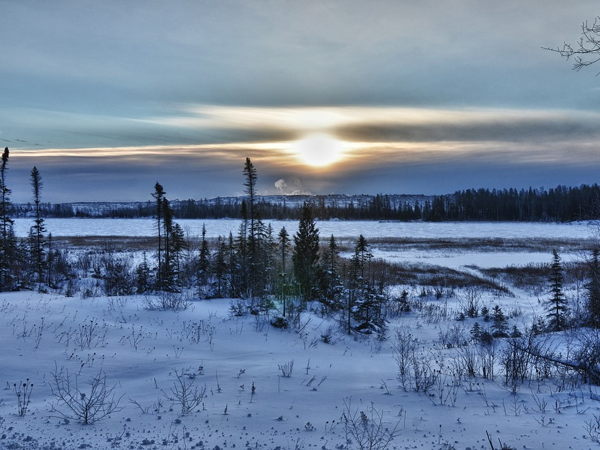
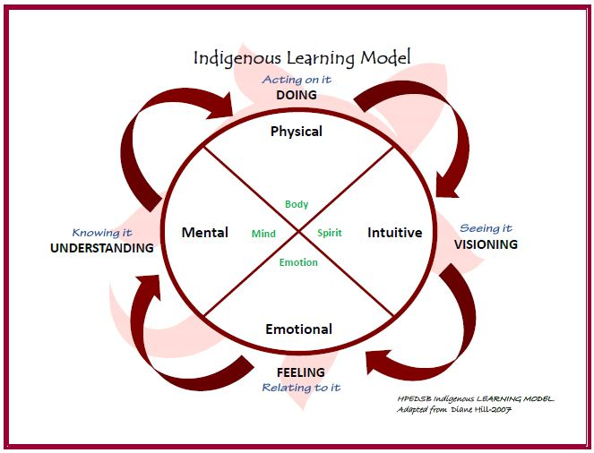
Notes:
A Framework, a process, a holistic approach
Learning model for our professional learning

Slide 9
Building student capacity for intercultural understanding, empathy, and mutual respect.
Notes:
Call to action #63 part 4
Moral imperative - people learning the truth before moving forward in reconciliation
Not one and done - things, activities, events, projects, guests, crafts in the “doing”
Reconciliation is changing your thinking, your way of being, your perception - it’s changing your mind
The difference between a one and done and truly developing an understanding
Take a moment to clear your mind and open yourself to the Learning process

Slide 10
Visioning
Seeing it.
Notes:
11:00

Slide 11
Notes:
It’s about activating the students curiosity to want to learn more,
Compelled to learn - creating an urgency to ask questions and know more
When we engage students with authentic and meaningful inquiry questions and thinking - we use current events, paradoxes, issues, and big ideas

Slide 12
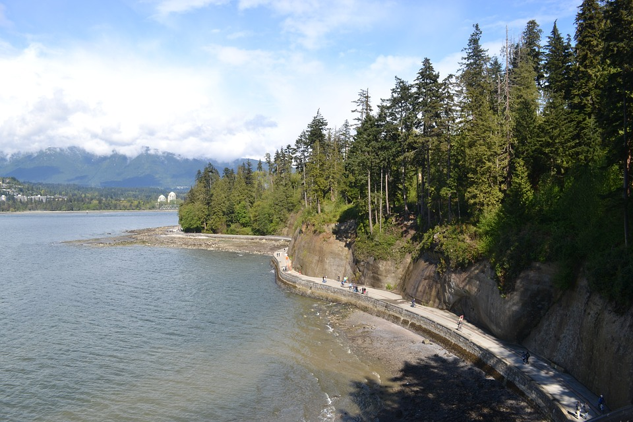
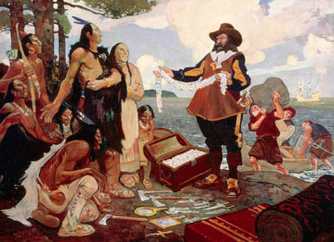
Perspectives?
See, Think, Wonder…?
Notes:
This is the visioning (exploring, questioning) C.W. Jefferies 1911
Write what you SEE, THINK and WONDER about this picture. Building on the thinking talking in pairs in a turn and talk - share with your first partner, listen to their thoughts, share two more times - Adding on or changing what you originally thought.

Slide 13
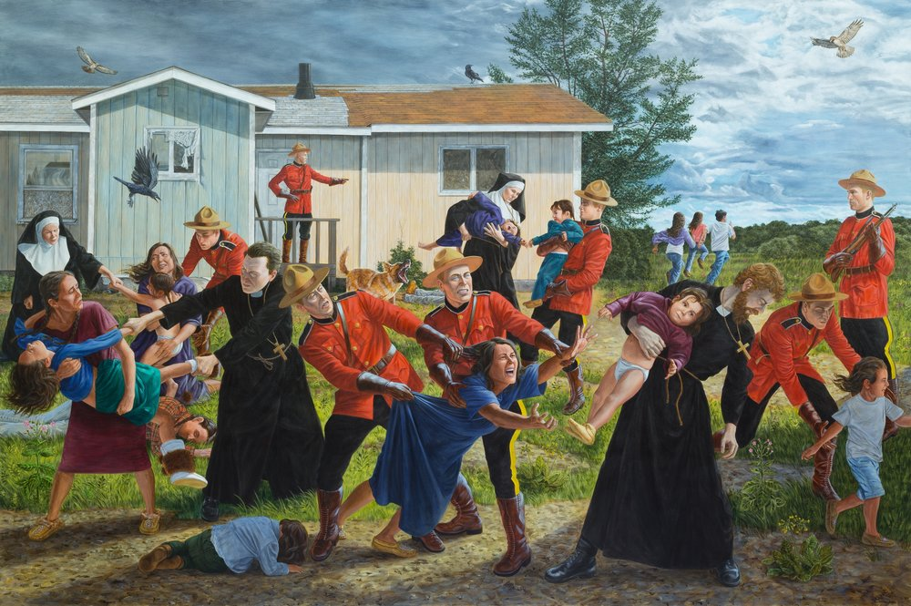
Perspectives?
See, Think, Wonder…?
Notes:
Kent Monkman 2017
Do same exercise with this image.

Slide 14
Checking our Assumptions
How did your perspective change after hearing from three people?
How did your perspective change when you were introduced to the new painting?
Notes:
Look back at your note - Think about your own thinking.
Taking on new perspectives and challenging our assumptions are at the heart of critical literacy.

Slide 15
Visual Literacy
Notes:
Andrea:.
https://vtshome.org/
We aren’t looking at pictures we are reading them, like we would read words on a page. Students need to develop these skills in this ever changing world of graphic information…
We need to unpack the images with students, listen to their questions, thoughts ...

Slide 16
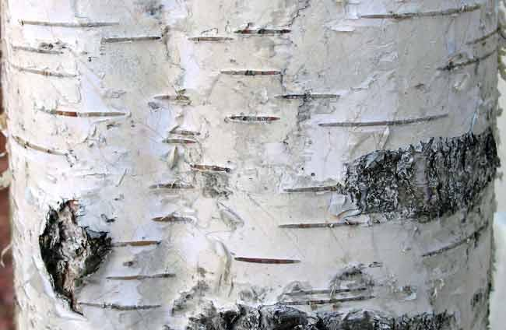
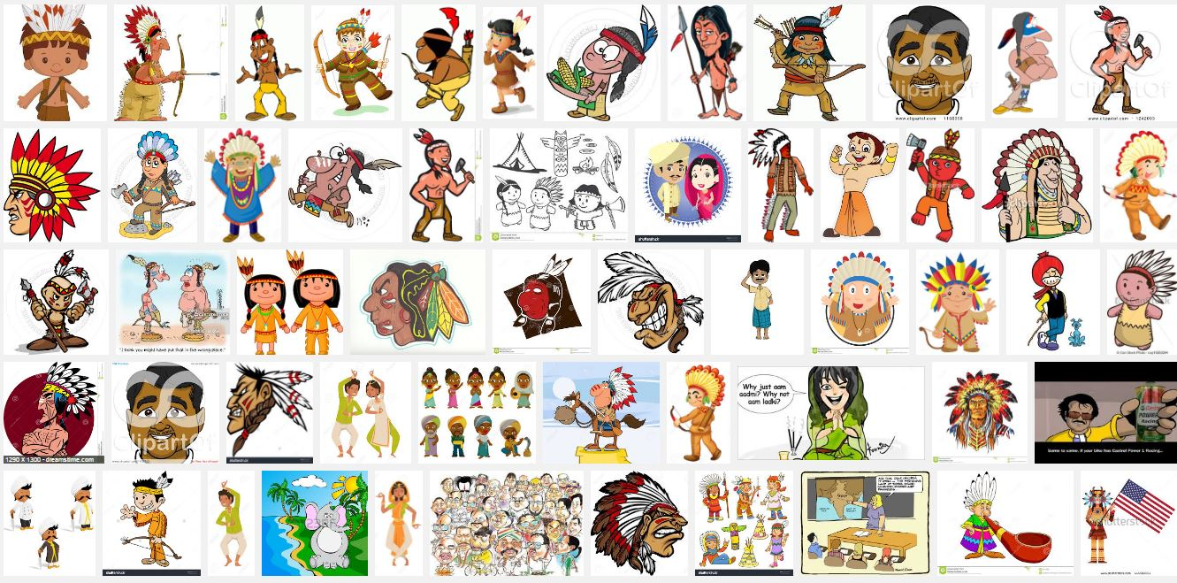
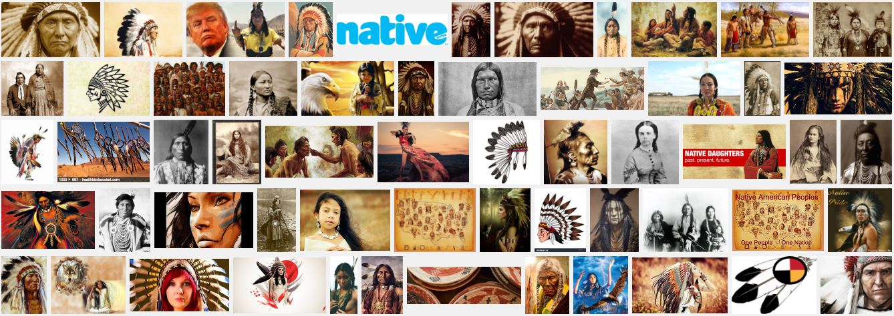
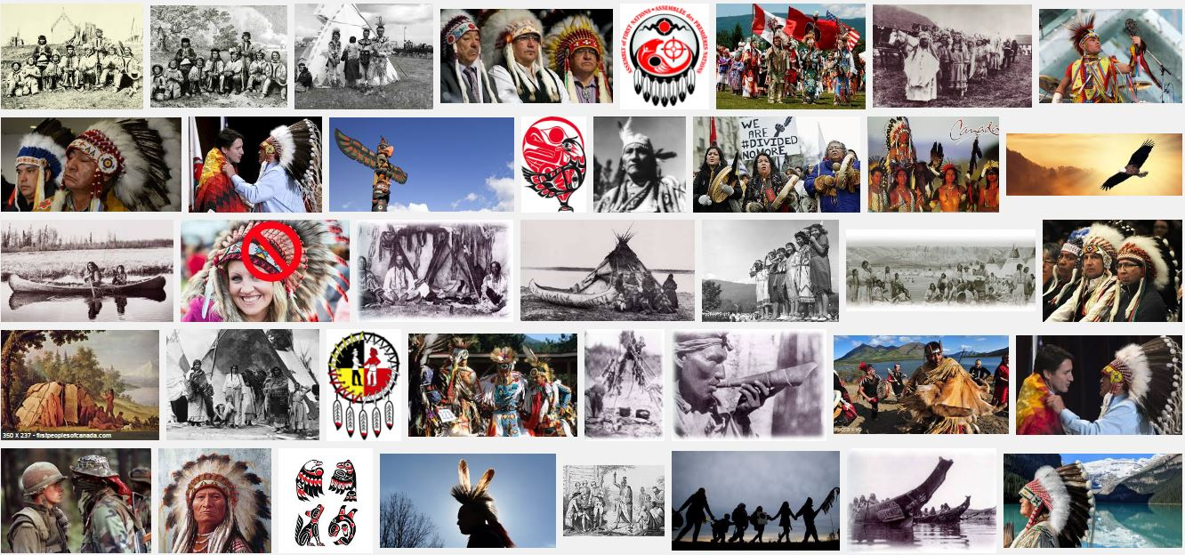
Images are powerful tools but...
Notes:
Googled Indian, Native and First Nations
Consider the images in the resources and materials in your libraries
Weeding in our libraries - considering images, terminology, perspective and bias - kept some for critical literacy and historical thinking
As for the selection of resources - we trust the already vetted resources and expertise of Goodminds
Reach out to the Indigenous branch of the OLA

Slide 17
Feeling
Relating to it.
Notes:
11:15

Slide 18
Notes:
FEELING - Relating to it - Determining importance, investing
Teaching of the difference between the heart and head. From the Heart to the Heart. Shifting from planning lessons to Creating Experiences.
The importance of. Why we stay in the feeling
Students are connected to the ideas and are moved to take action - they are passionate

Slide 19
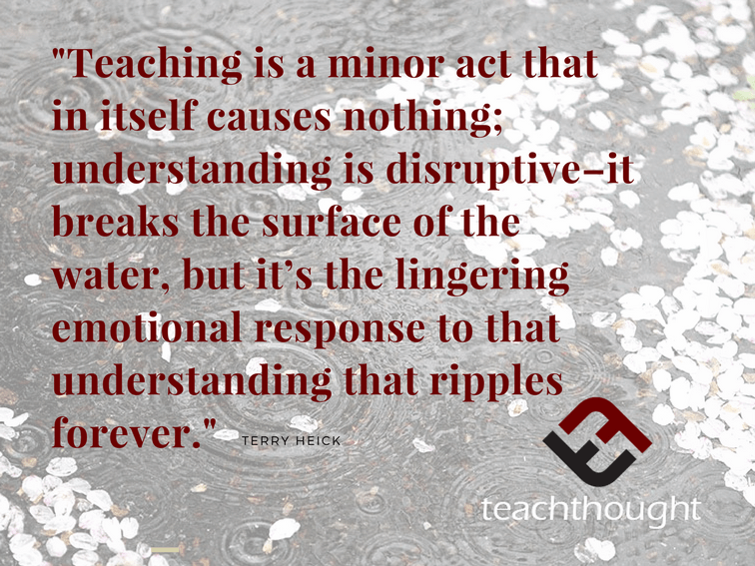
Notes:
“Students may never remember what you taught them, but will never forget how you made them feel.”
Think of social justice issues -
it’s their emotion–their affections and hopes and concerns–that make them human and carry them when “being rational” isn’t enough. Begin the learning with emotion, use it throughout the process, and end there.
https://www.teachthought.com/learning/emotion-learning-edutopia/

Slide 20
Who decides which Canadians get clean water?
Notes:
Single, pair, cluster of four
I can slow down and clear my mind to intentionally avoid reacting with personal bias, assumptions, and emotional impulses
I can pose deep questions to monitor and extend my thinking, to linger on ideas, and to remain open
I can actively value the advantages of both sides of the argument/paradox/issue simultaneously
I can continually connect to other people and to the real world in order to consider the many ways these ideas can be understood
I can clearly relate ideas to myself and my prior knowledge so that I can identify new learning and changes in my own thinking
I can intentionally reference and collect more research and evidence that will clarify my thinking

Slide 21
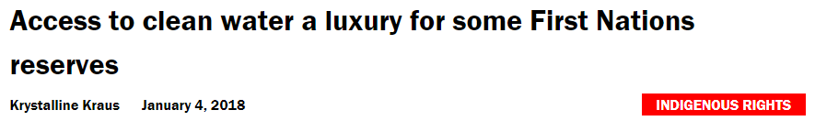
Notes:
"Between 2004 and 2014, 93 per cent of all First Nations in Saskatchewan and New Brunswick reported at least one water advisory in their communities," notes the CBC investigation. "Alberta is close behind at 87 per cent."
http://rabble.ca/blogs/bloggers/activist-communiqu%C3%A9/2018/01/access-clean-water-luxury-some-first-nations-reserves
I can slow down and clear my mind to intentionally avoid reacting with personal bias, assumptions, and emotional impulses
I can pose deep questions to monitor and extend my thinking, to linger on ideas, and to remain open
I can actively value the advantages of both sides of the argument/paradox/issue simultaneously
I can continually connect to other people and to the real world in order to consider the many ways these ideas can be understood
I can clearly relate ideas to myself and my prior knowledge so that I can identify new learning and changes in my own thinking
I can intentionally reference and collect more research and evidence that will clarify my thinking

Slide 22
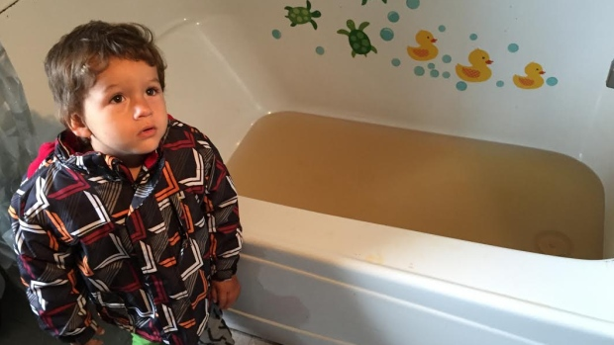
Notes:
The knee - Changed forever. Our colleague told us about the wound on her knee that festered and wouldn’t heal until she sealed it off from the tap water on the reserve where she lived.
I can slow down and clear my mind to intentionally avoid reacting with personal bias, assumptions, and emotional impulses
I can pose deep questions to monitor and extend my thinking, to linger on ideas, and to remain open
I can actively value the advantages of both sides of the argument/paradox/issue simultaneously
I can continually connect to other people and to the real world in order to consider the many ways these ideas can be understood
I can clearly relate ideas to myself and my prior knowledge so that I can identify new learning and changes in my own thinking
I can intentionally reference and collect more research and evidence that will clarify my thinking

Slide 23
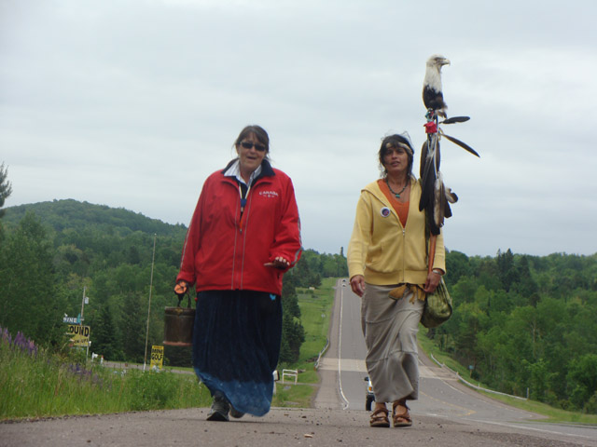
Notes:
Josephine Mandamin
With a copper pail of water in one hand and a staff in the other, Josephine Mandamin, an Anishabaabewe grandmother took on a sacred walk, traversing over 10,900 miles around each of the Great Lakes. She is known as the “Water Walker.”
http://www.motherearthwaterwalk.com/
I can slow down and clear my mind to intentionally avoid reacting with personal bias, assumptions, and emotional impulses
I can pose deep questions to monitor and extend my thinking, to linger on ideas, and to remain open
I can actively value the advantages of both sides of the argument/paradox/issue simultaneously
I can continually connect to other people and to the real world in order to consider the many ways these ideas can be understood
I can clearly relate ideas to myself and my prior knowledge so that I can identify new learning and changes in my own thinking
I can intentionally reference and collect more research and evidence that will clarify my thinking

Slide 24
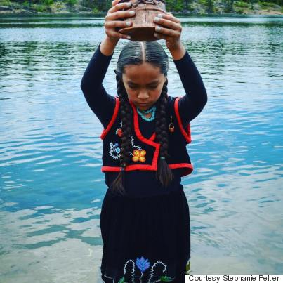
Notes:
Autumn Peltier
Autumn was also the only child from Canada to be nominated for the 2017 International Children's Peace Prize. She will also receive the Sovereign's Medal for Volunteers, a national award in recognition for her contributions to her community, in January at the Office of the Lieutenant Governor of Ontario.
http://www.huffingtonpost.ca/2016/12/08/autumn-peltier-trudeau-assembly-first-nations-letter_n_13518870.html
http://www.cbc.ca/news/indigenous/autumn-peltier-anishinaabe-water-advocate-un-1.4448454
I can slow down and clear my mind to intentionally avoid reacting with personal bias, assumptions, and emotional impulses
I can pose deep questions to monitor and extend my thinking, to linger on ideas, and to remain open
I can actively value the advantages of both sides of the argument/paradox/issue simultaneously
I can continually connect to other people and to the real world in order to consider the many ways these ideas can be understood
I can clearly relate ideas to myself and my prior knowledge so that I can identify new learning and changes in my own thinking
I can intentionally reference and collect more research and evidence that will clarify my thinking

Slide 25
Critical Literacy
Notes:
I can slow down and clear my mind to intentionally avoid reacting with personal bias, assumptions, and emotional impulses
I can pose deep questions to monitor and extend my thinking, to linger on ideas, and to remain open
I can actively value the advantages of both sides of the argument/paradox/issue simultaneously
I can continually connect to other people and to the real world in order to consider the many ways these ideas can be understood
I can clearly relate ideas to myself and my prior knowledge so that I can identify new learning and changes in my own thinking
I can intentionally reference and collect more research and evidence that will clarify my thinking

Slide 26
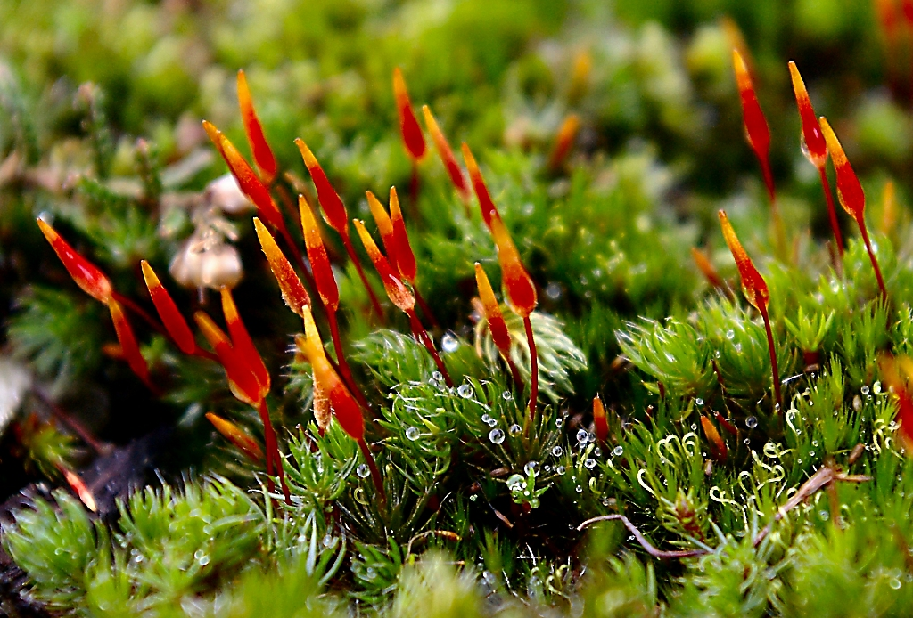
Critically literate students understand that meaning is not found in texts in isolation. People make sense of a text or determine what a text means in a variety of ways.
~ p.51 Ontario Social Studies Curriculum, 2013
Notes:
Critically literate students understand that meaning is not found in texts in isolation. People make sense of a text, or determine what a text means, in a variety of ways. Students therefore need to be aware of
points of view (e.g., those of people from various cultures),
the context (e.g., the beliefs and practices of the time and place in which a text was created and those in which it is being read or viewed),
the background of the person interacting with the text (e.g., upbringing, friends, school and other communities, education, experiences),
intertextuality (e.g., information that a reader or viewer brings to a text from other texts read previously),
gaps in the text (e.g., information that is left out and that the reader or viewer must fill in), and
silences in the text (e.g., voices of a person or group not heard).
Pg 51 of the Social Studies Curriculum

Slide 27
Understanding
Knowing it.
Notes:
11:35

Slide 28
Notes:
Understanding:
Knowing, Learning, Synthesizing, Evaluating, Determining Impact - Going deeper
Building a shared understanding

Slide 29
“The capacities for creative knowledge work also include social and collaborative skills that are built from a strong sense of empathy, open-mindedness and healthy communication habits; this in turn helps students develop themselves socially and emotionally as well as academically.” KB Gallery
Notes:
Thinking about problems of Practice - Giving ourselves the space and time to learn, to listen, to act as researchers, to build on each other’s ideas.

Slide 30
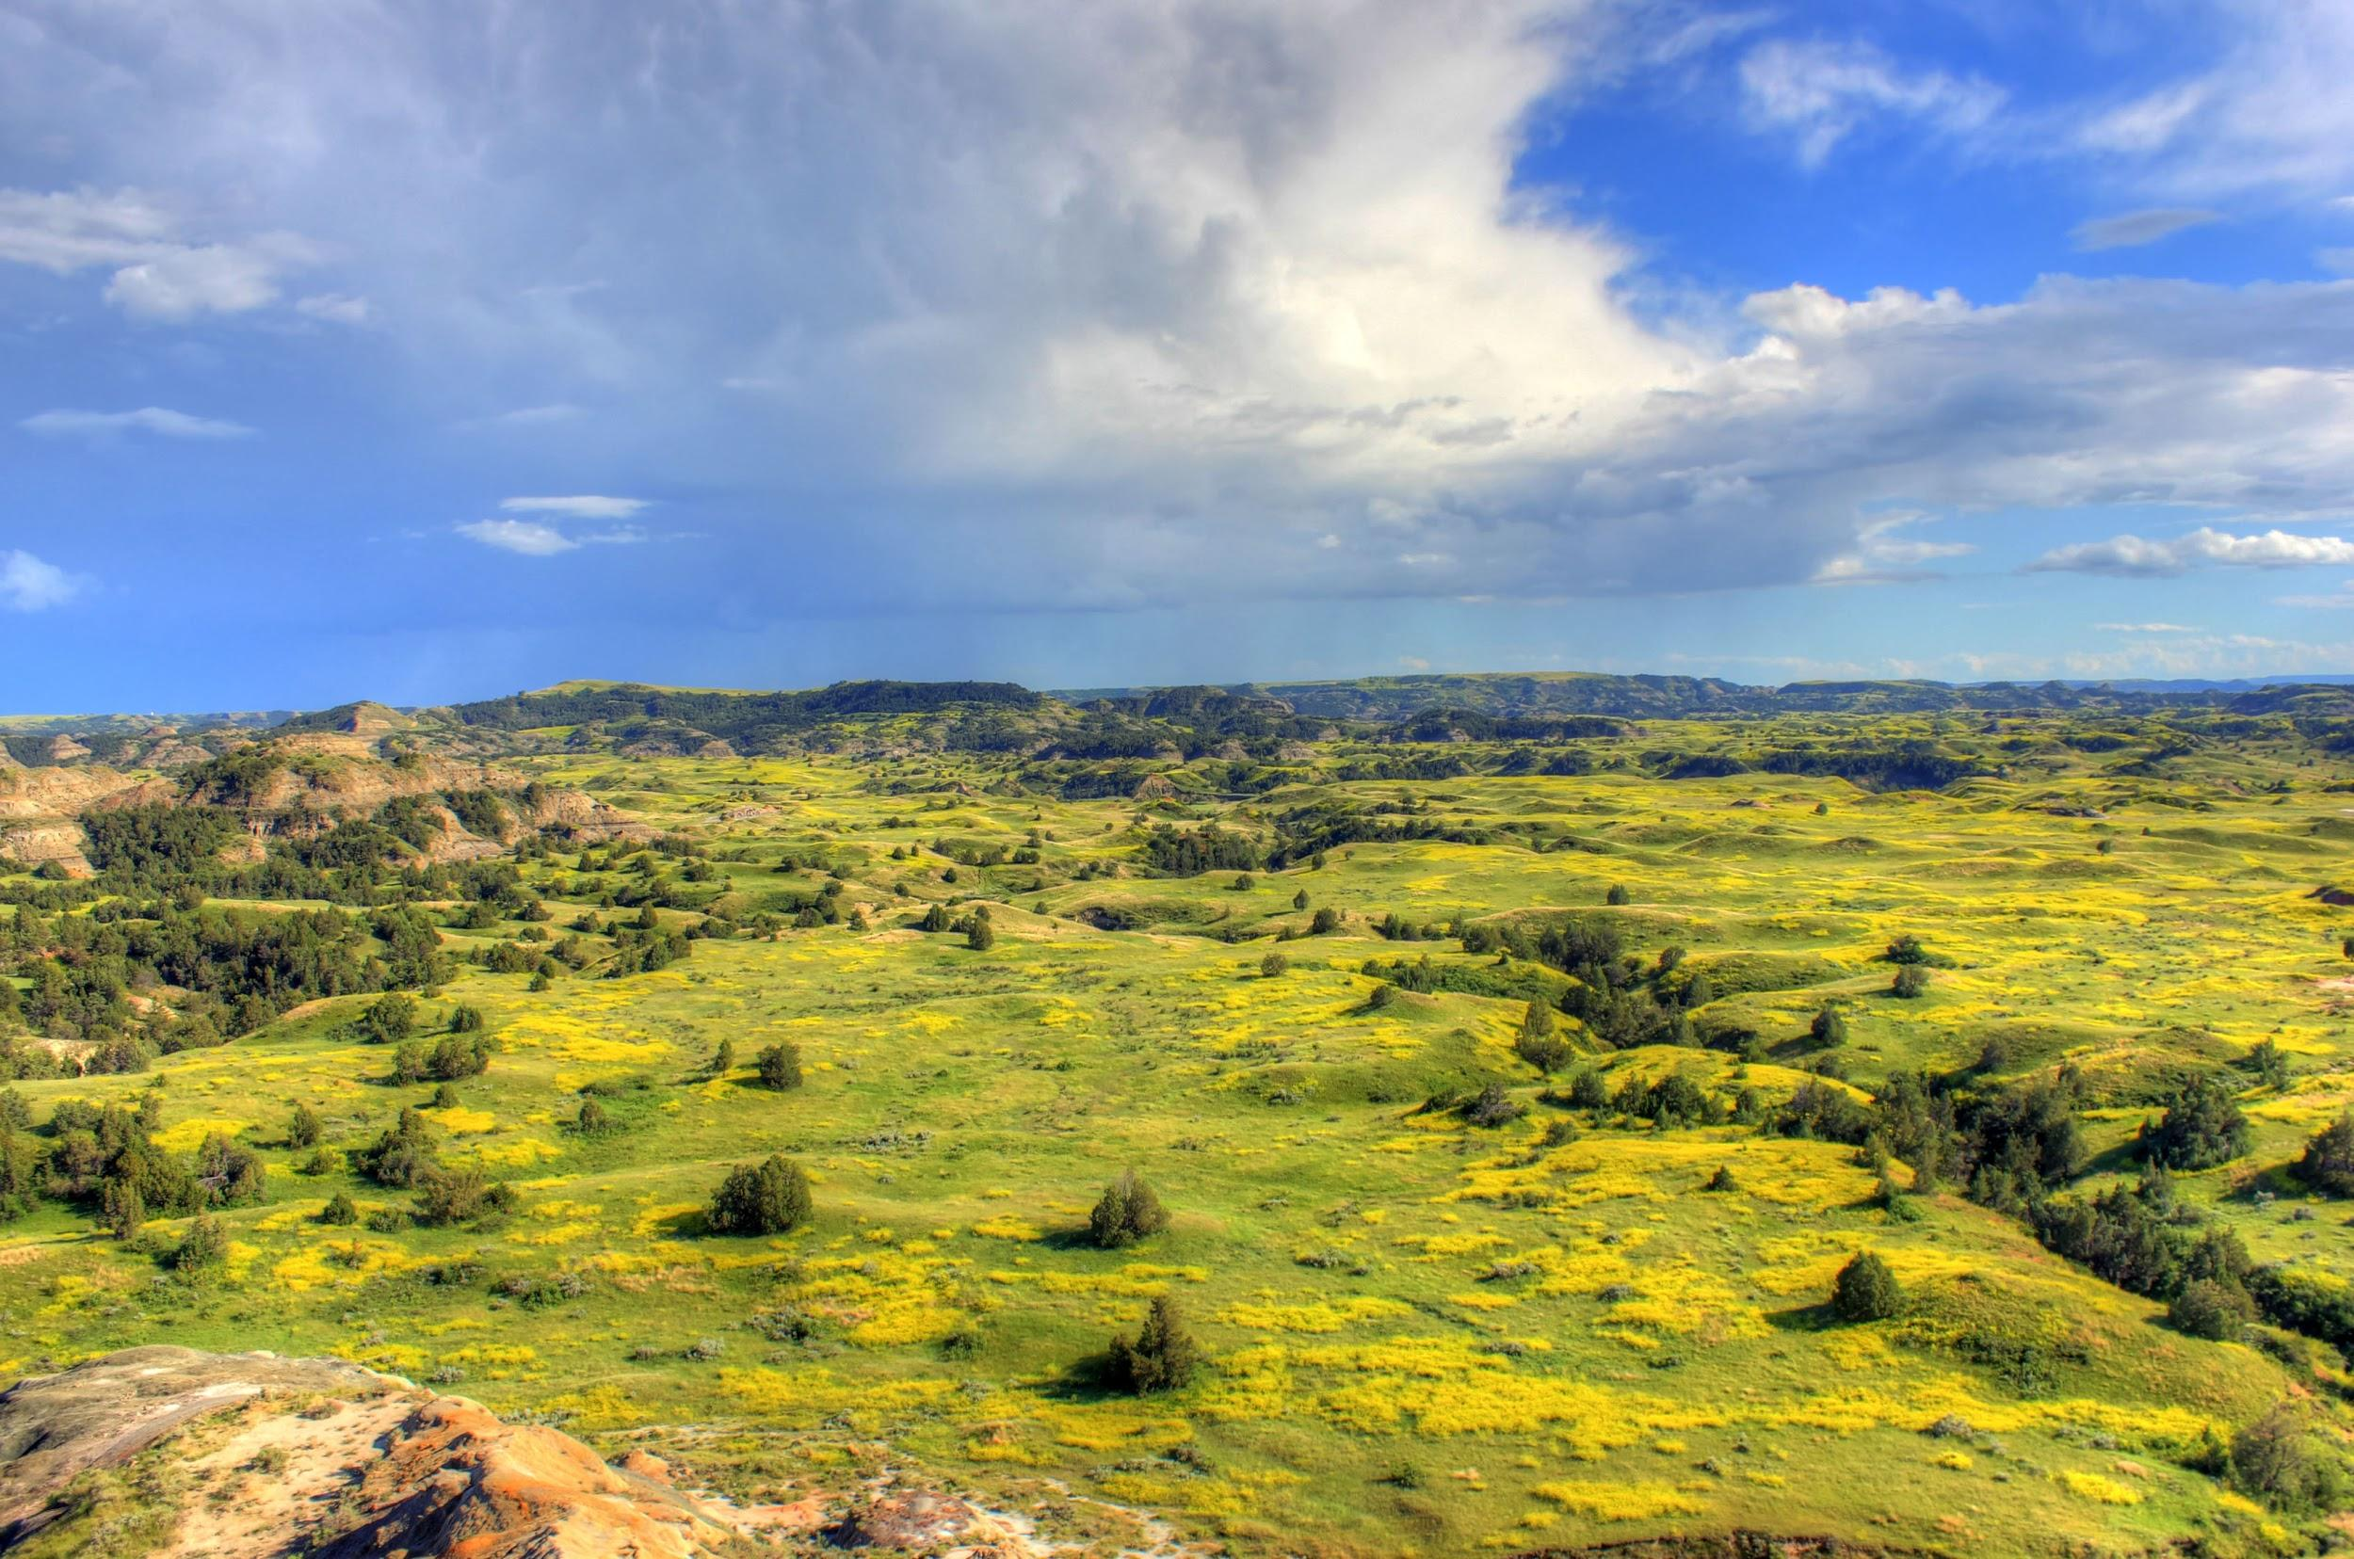
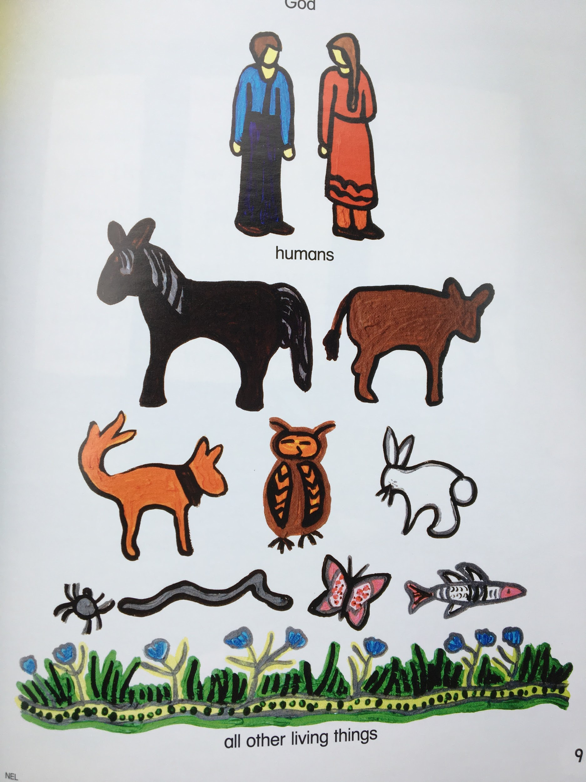
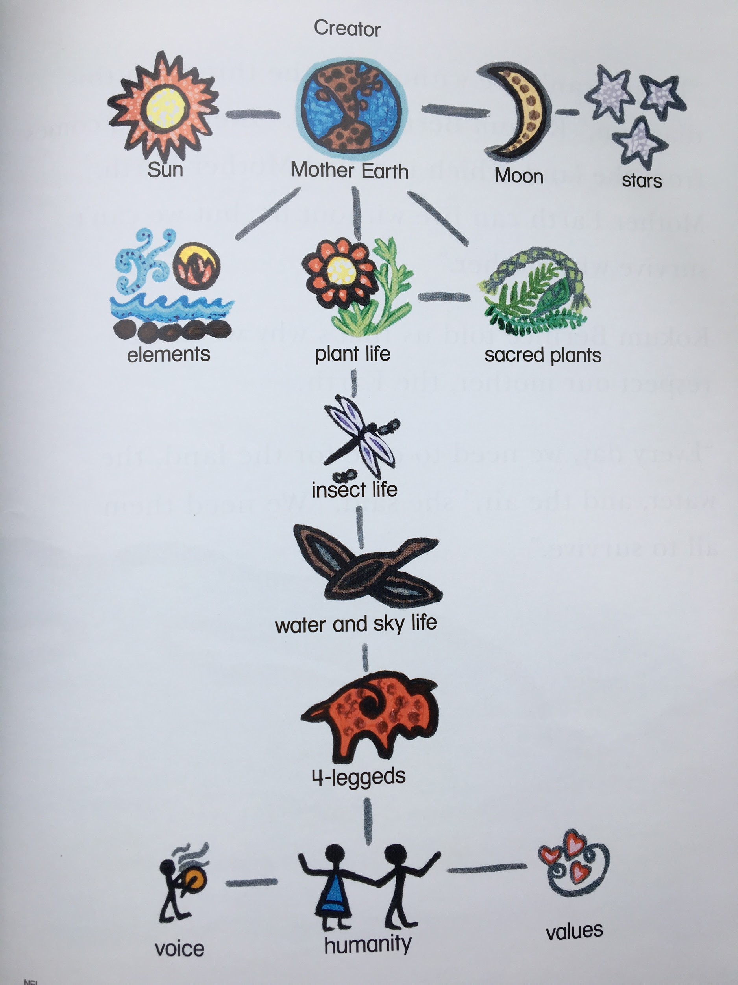
Notes:
Grade Two with Terri - Nelson Under One Sun - Gr 3 guided reading book - Two Views
Intercultural Understanding
Basic concept of Indigenous worldview - a way of being, knowing
What are the implications of the difference?

Slide 31
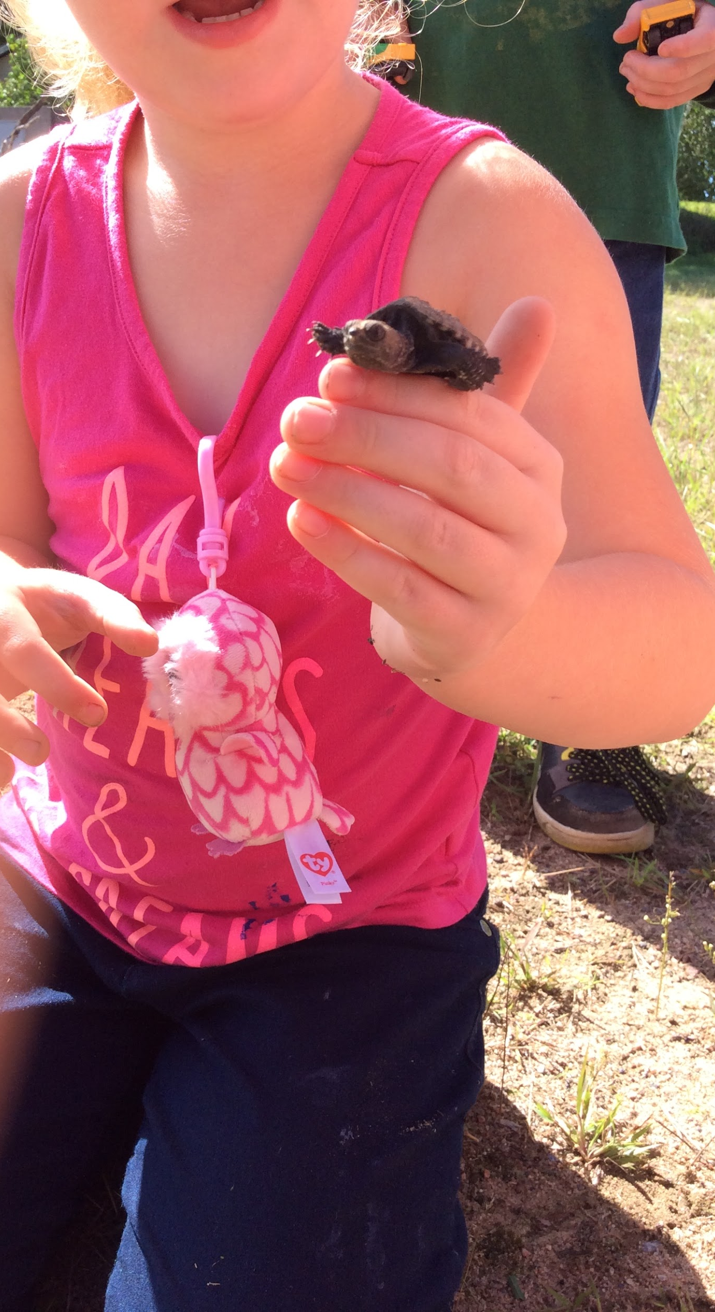
Notes:
Land-based
Natural Curiosity
Same process in outdoor settings - instead of images or text as provocation, it’s natural objects, events or interactions

Slide 32
Doing
Acting on it.
Notes:
11:45

Slide 33
Notes:
Doing:
Acting on it - Communicating, Sharing, Creating, Extending, Contributing

Slide 34
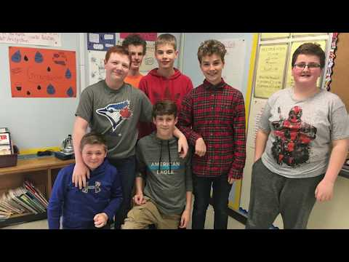
Notes:
The Pledge Set up the context.
This is an example of community partnerships
Refer to OAC protocol video

Slide 35
Nya:wen
Thank You
Questions
tmaracle@hpedsb.on.ca akerr@hpedsb.on.ca

